Slide 1
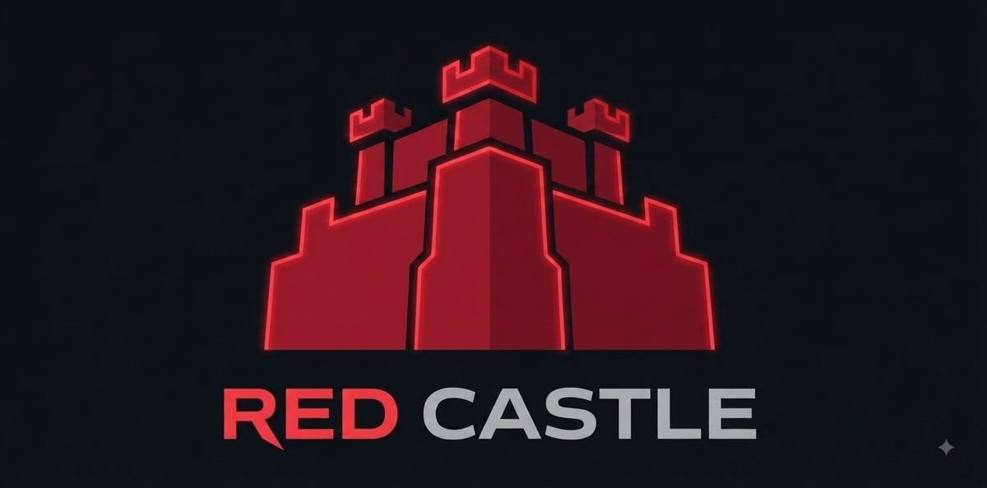
Engineering Journal
WRO 2026 Future Engineers — Self-Driving Cars
Team The Red Castle | HMK AI and Robotics Club
Coach: Ahmad Kalthom | Jolian Wassof · Omar Shammout · Louay Rashwan

Slide 2
Table of Contents
• 1. Introduction
• 2. Solution
- 2.1 Open Challenge
- 2.2 Obstacle Challenge
• 3. Mobility Management
- 3.1 The Steering Assembly
- 3.2 The Driving Assembly
- 3.3 The Robot's Body / 3D Design
- 3.4 Mobility Measurement
• 4. Power and Sense Management
- 4.1 The Robot's Power Source
- 4.2 Main Components
- 4.3 Wiring Diagram
- 4.4 Sensing
• 5. The Robot's Evolution
- 5.1 Past 5.2 Present 5.3 Future
• 6. The Vehicle's Photos
• 7. Team
• 8. Links and Credits

Slide 3
1. Introduction
Self-driving cars are one of the clearest places where robotics, computer vision and control theory meet in a single physical object that either works or doesn't. For WRO 2026 Future Engineers, our goal was to build a vehicle that finds its own way around a track it has never measured, using only what a camera can see.
We built our car around a Raspberry Pi 4 and a single wide-angle camera. No LiDAR, no ultrasonic rangefinders, no wheel encoders, no IMU. Everything the rules require the car to know — where the walls are, which way to lap, where the traffic signs are, where to park — is visible to a camera, so we put our engineering time into making that one sensor trustworthy instead of into fusing several imperfect ones.
That decision shaped most of what follows. A camera-only car lives or dies on image quality and threshold tuning, and a large part of this document is the story of getting those right: a sensor swap that fixed a depth-of-field problem we didn't expect, a wall detector that turned out to be reading corner lines as walls, and a control law that we rebuilt once we had a correct measurement to calibrate it against.
The vehicle drives the Open Challenge — three laps around a track whose inner wall positions are randomised each round — and the Obstacle Challenge, which adds red and green traffic signs that must be passed on the correct side and a parking manoeuvre at the end.
1

Slide 4
2. Solution
2.1 Open Challenge
The Open Challenge is three laps of a track whose inner wall positions are randomised each round, so nothing about the corridor width can be hard-coded in advance — the car has to read it from the camera as it drives.
• Direction is decided once, from the first corner line the camera sees, and locked for the rest of the run — whichever colour reads bigger in that frame sets clockwise or counter-clockwise, and the reading is cross-checked against which side of the image has more open wall as a second opinion.
• Between corners, a proportional-derivative controller holds a fixed distance to the outer wall only. We deliberately do not centre between both walls: the inner wall moves every round, so the outer wall is the one reference that stays put.
• At a corner, crossing the driving-direction's line fires a scripted turn — full steering lock held for a bounded time, ending as soon as the way ahead reads clear rather than after a fixed duration.
• A wall emergency always wins, in any state: if either wall gets too close the car escapes proportionally to how close it is, and if both walls are close at once (jammed facing a corner) it commits to a single escape direction instead of wavering between two.
• The car stops once 11 quadrants are counted and the lap timer has run out, so it finishes driving through the last straight instead of halting on the line itself.
2

Slide 5
2. Solution
2.2 Obstacle Challenge
The Obstacle Challenge adds red and green traffic signs that must be passed on the correct side, then a parking manoeuvre once the laps are done.
• If a sign is visible, the car steers to place it correctly — red on the car's right, green on its left — with the target position sliding further toward the frame edge as the sign gets closer, so the manoeuvre curves rather than swerving late.
• If a sign was visible a moment ago but drops out of view for a frame, the last steering command is held rather than reacted to — sign detection can flicker sharply between consecutive frames, and reacting to every drop-out broke passes mid-way.
• Between signs, the car falls back to the same outer-wall lane-keeping law used in the Open Challenge, instead of driving straight and hoping a wall override corrects it in time.
• A wall override sits above all of this and also does the job of turning the car through each corner, since there is no separate scripted-turn sequencer here.
• Parking is not yet wired into the main loop — the magenta gate is currently treated purely as a wall to avoid. This is called out honestly in the Evolution section.
3

Slide 6
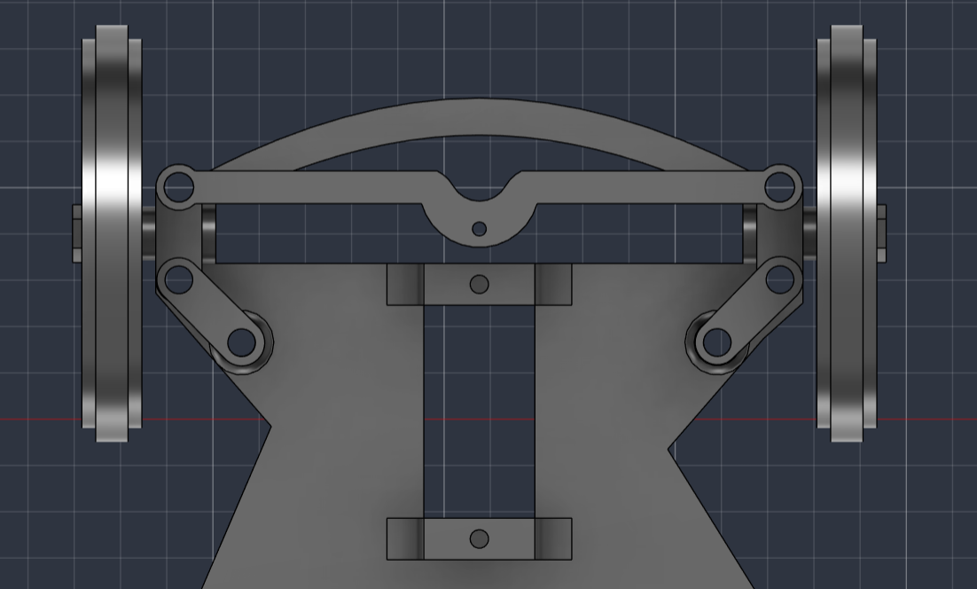
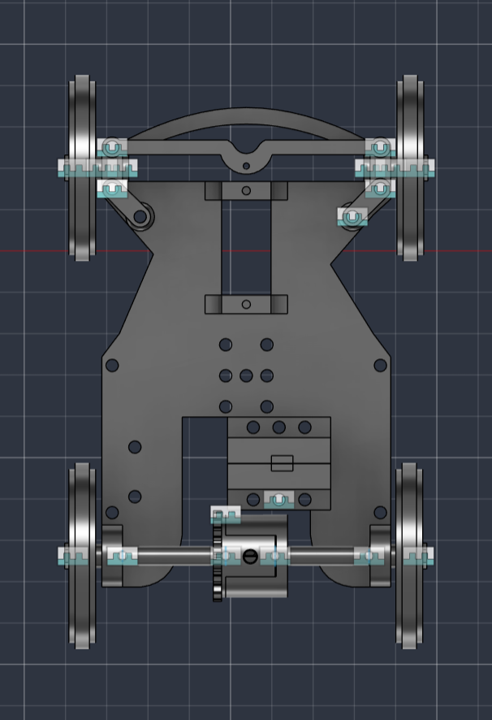
3. Mobility Management
3.1 The Steering Assembly
Steering is Ackermann-style, driven by a single SG90 micro servo (GPIO13, which is a hardware-PWM pin — a smoother, lower-jitter signal than a software-timed one).
The servo turns a central bell-crank, which pushes a tie-rod out to both front steering knuckles. Because the linkage geometry is Ackermann and not a simple parallel arm, the inner wheel turns through a sharper angle than the outer one in a corner — each wheel follows its own turning radius instead of fighting the other and scrubbing.
The linkage's mechanical limit is ±35°. In software we run it at ±20° (STEER_MAX in config.py) for stability at full driving speed — the wider mechanical range is there if a future tuning pass wants it.
Every steering command in the codebase passes through this one constant and one servo() function, so there is exactly one place that ever needs to know the true centre position — the field-calibrated trim is stored in servo_center.txt (currently -9°) and applied automatically.
Front steering linkage, top view
Steering turned, showing the linkage sweep
4

Slide 7
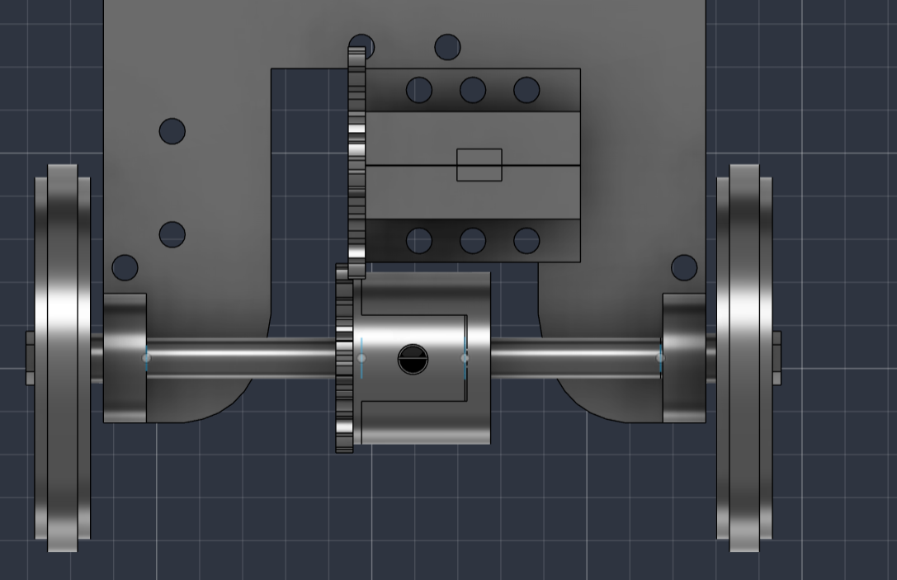
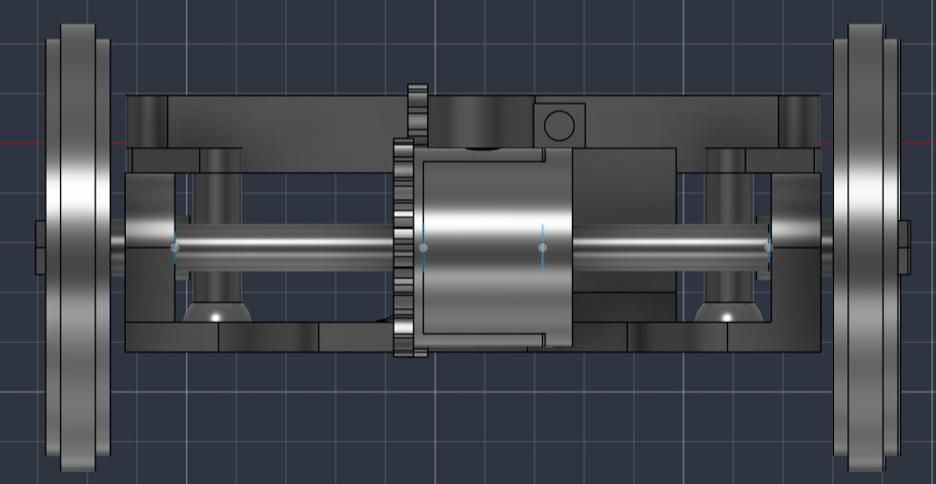
3. Mobility Management
3.2 The Driving Assembly
Drive comes from an N20 geared DC motor rated 12 V, 200 rpm, chosen for its compact size and enough torque to pull the car away from rest repeatedly without stalling.
The motor is controlled by an L9110S dual H-bridge, wired so one input is held low while the other carries the PWM speed signal (GPIO24 = forward, GPIO23 = reverse). In software, motor() never switches directly from forward to reverse — it coasts to a stop and waits first, because slamming the direction while the motor is still spinning drives its back-EMF onto the supply rail and can destroy the Pi's regulator. We found this out by losing a regulator early in the build.
From the motor, a 25-tooth pinion drives a 20-tooth gear (a 1.25:1 reduction) into a 3D-printed differential we designed ourselves — outer shell, outer ring gear, and two inner bevel gears on long and short shafts. The differential is the single change that let us raise the steering limit: with a solid axle, the outer wheel scrubbing against the inner one through a corner cost so much traction we had to cap steering near 8° just to keep the car from stalling mid-turn.
N20 motor driving the differential gear mesh
Rear axle, front view
5

Slide 8
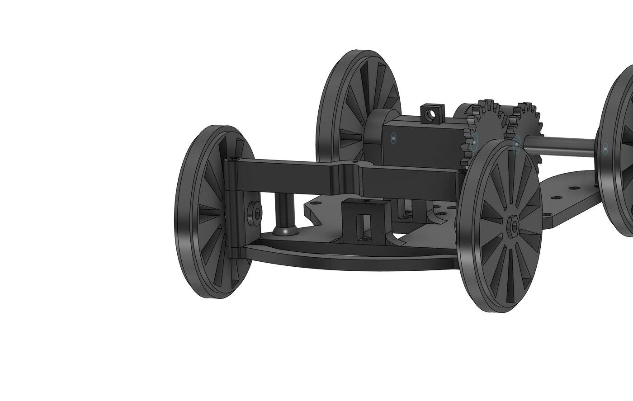
3. Mobility Management
3.3 The Robot's Body / 3D Design
The chassis was designed in Fusion 360 and printed in PLA+ Silk Silver on a Bambu Lab A1: a base plate, a middle plate and a top plate carrying the Pi, battery, driver, buck converter and the camera mast, sized to keep mass low and central over the wheelbase.
Full car assembly
Mass 407 g, overall footprint 14.2 x 9.3 x 15 cm, wheelbase 9.4 cm, rear track 8.5 cm — a wheelbase-to-track ratio close to 1:1, a stable proportion for cornering without tipping risk at this size.
6

Slide 9
3. Mobility Management
3.4 Mobility Measurement
To reason about how fast the car can safely go, we worked through the drivetrain's speed chain from the motor to the ground:
Wheel radius (rw):
rw = 4.7 cm / 2 = 2.35 cm = 0.0235 m
Wheel perimeter (Pw):
Pw = 2π·rw = 2 × 3.1416 × 0.0235 ≈ 0.1477 m
Motor speed and the gear reduction:
ωmotor = 200 rpm (rated, no load)
ωaxle = ωmotor / 1.25 (25:20 reduction) = 160 rpm
Ground speed (theoretical, no load):
v = Pw · ωaxle = 0.1477 × 160 ≈ 23.6 m·min⁻¹
v ≈ 0.394 m·s⁻¹ (≈ 39 cm/s)
This is a ceiling, not a running speed: tyre friction, the differential, and the car's own 407 g mass all take a share of it. What actually governs how fast the car drives in competition is the 100% cruise setting in software, which cruise_speed() then eases back automatically whenever the steering is working hard — fast on the straights, deliberately slower through a turn.
7

Slide 10
4. Power and Sense Management
4.1 The Robot's Power Source
Power comes from three 18650 Li-ion cells in series — about 11.1 V nominal, up to 12.6 V fully charged — feeding two separate rails rather than one shared one:
The motor is wired straight from the battery to the L9110S driver's supply pin, with nothing in between. A separate DC-DC step-down converter, rated at 5 V and at least 3 A, powers the Raspberry Pi and the servo on its own rail.
This split exists because of a real failure: early on, the motor and the Pi shared one supply, and the Pi rebooted every time the motor drew current under load — a classic brownout, made worse by the driver's ground not being tied back to the Pi's ground at all, so the only electrical link between them was the GPIO signal wire itself. Separating the rails and tying every ground together (battery, driver, Pi) fixed it completely, and is now a fixed rule on the car rather than a tuning choice.
A rocker switch sits in the battery line as the master on/off. We also note, as a live watch item rather than a solved problem: a freshly charged pack at 12.6 V sits marginally above the L9110S's 12 V rating, so driver temperature is worth checking after a run.
8

Slide 11
4. Power and Sense Management
4.2 Main Components
• OV5647 wide-angle camera — a small-sensor, fixed-focus module with roughly a 120° field of view. It is the vehicle's only sensor: every wall, corner line, traffic sign and the parking gate is read from its image. Fixed focus means a large depth of field, so the near mat and a far wall stay sharp at the same time with nothing to hunt or mis-lock mid-run — a deliberate choice explained in the Evolution section.
• Raspberry Pi 4 Model B, 2 GB RAM, running Raspberry Pi OS Bookworm — the single board that captures every frame, runs the vision pipeline, decides the steering and speed, and drives the servo and motor through its GPIO header.
• L9110S dual H-bridge motor driver — a compact two-pin-per-motor interface, chosen for its small size and simple PWM control, sitting on its own supply rail straight from the battery.
• SG90 micro servo — 9 g, powered from the Pi's 5 V rail, driving the Ackermann steering linkage.
9

Slide 12
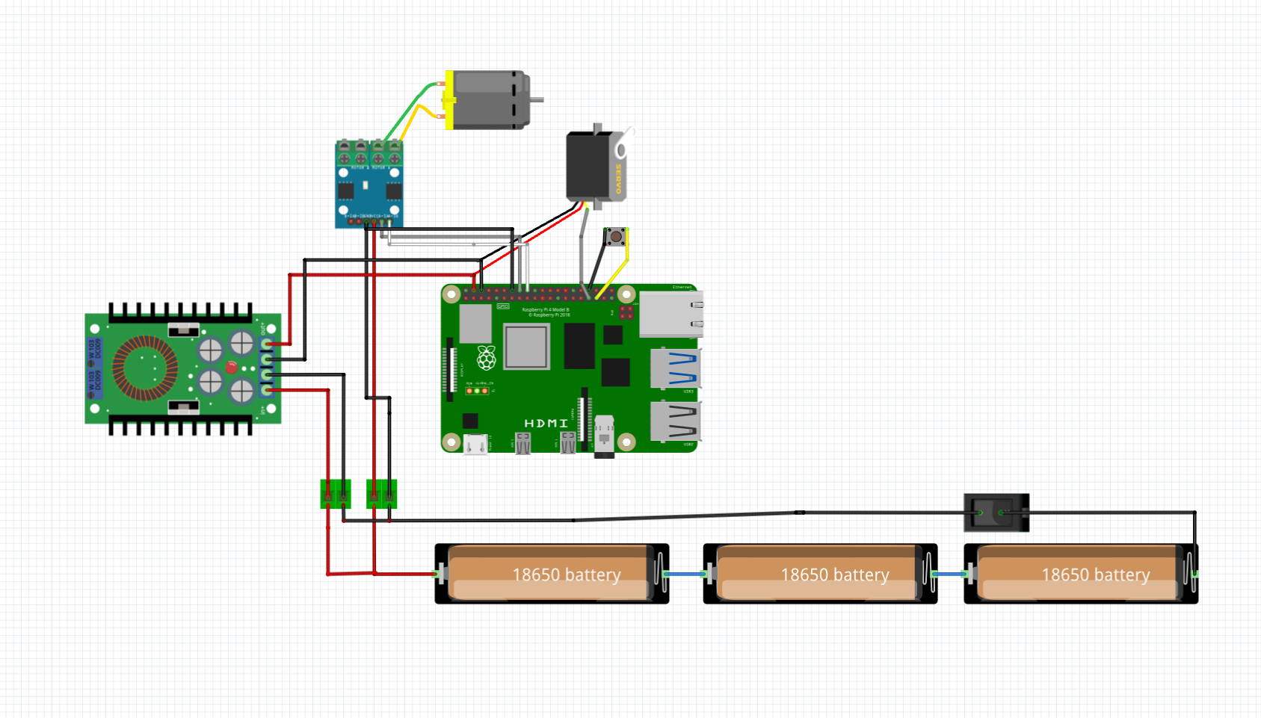
4. Power and Sense Management
4.3 Wiring Diagram
10

Slide 13
4. Power and Sense Management
4.4 Sensing — Vision Pipeline
• Capture: the camera is read at 640x480 in RGB888, then the frame is rotated 180° in software, since the camera is physically mounted upside-down on its mast.
• Crop and resize: only the lower portion of the frame — the mat — is kept and resized down to 320x160 before any colour work happens, which both discards background clutter above the walls and keeps every frame cheap to process.
• Median blur, then HSV: a light blur is applied first because the camera runs a short exposure and elevated gain to freeze motion, which makes the raw image noisy enough to break both the colour masks and the wall scan if left untreated. The frame is then converted to HSV, which is far more stable than RGB under the mat's own lighting variation.
• Wall detection is a two-tier test, not one brightness threshold: a pixel is a wall if it is very dark regardless of colour, OR dark and low-saturation. A single brightness cut also lit up the blue and orange corner lines and the mat's printed markings, since they are dark too — and unevenly between the two frame halves, which injected a steering bias that looked like a control problem for a long time before we traced it to the measurement itself.
• Colour lines are searched only in the bottom of the region of interest, because a line painted on the mat physically cannot appear higher in the frame than the mat itself — searching the whole frame let bluish background pixels near the top trigger false line readings.
11

Slide 14
4. Power and Sense Management
4.4 Sensing — Camera Position
CAMERA POSITION IS CRUCIAL FOR THE ROBOT'S PERFORMANCE.
• Height 12.5 cm above the mat. The walls are 10 cm tall, so the lens must sit above the wall line to look down onto the mat and see the wall's base — the white-mat/black-wall edge, the highest-contrast feature in the frame.
• Tilt roughly 15° downward, enough to keep the mat and both wall bases in the lower frame while still seeing far enough ahead to catch a corner line or a traffic sign before reaching it.
• Centred laterally and facing dead ahead, zero yaw. Wall-following compares the left half of the frame against the right half, so any sideways offset or twist becomes a permanent steering bias that no amount of threshold tuning removes.
• Mounted on a rigid mast, not a flexible arm. A vibrating camera blurs the wall edge and injects noise straight into the steering loop, so mast stiffness is a control requirement, not a cosmetic one.
• The connection itself uses the Pi's dedicated CSI ribbon port, not a GPIO pin, so it needs no separate power and does not appear on the wiring diagram.
12

Slide 15
5. The Robot's Evolution
5.1 Past
Two decisions from earlier in the build turned out to be wrong in ways that only showed up once we started driving, not while designing.
The first camera was a Raspberry Pi Camera Module 3 — a larger sensor with autofocus. Focused on the mat it saw the near track sharply, but distant traffic signs blurred, and blur desaturates colour badly enough that the HSV masks lost far-away signs entirely; the car only 'saw' an obstacle once it was already close. A focus sweep confirmed we genuinely could not have both near and far sharp on that sensor at once. We replaced it with the OV5647, a smaller, fixed-focus sensor with a much larger depth of field — losing autofocus cost nothing, since a ground robot never needs to refocus.
The second was the drivetrain. Our first rear axle was solid, so both driven wheels were forced to the same speed. In a corner the outer wheel has to cover more distance than the inner one, and with no way to do that it scrubbed, losing traction and sometimes stalling the car mid-turn. Our first fix was purely in software — cutting the steering limit down step by step until the scrubbing stopped, which landed near 8°. That kept the wheels turning but left the car unable to corner tightly enough to follow the track. It was a workaround for a mechanical problem, not a fix for it.
13

Slide 16
5. The Robot's Evolution
5.2 Present
The current car fixes both of those at the source rather than around them.
A 3D-printed differential now sits on the rear axle, driven from the N20 motor through a 25:20 gear reduction. With the wheels free to turn at different speeds through a corner, the scrub is gone, and the steering limit came back up from 8° toward the linkage's mechanical ceiling.
The bigger present-day story, though, was perception rather than mechanics. Even after the camera swap, the car kept crashing near corners in both driving directions, in a way that no amount of gain or setpoint tuning changed. We eventually stripped the controller down to nothing and started saving an annotated frame every time the steering swung hard, colouring in every pixel the code was calling 'wall'. The answer was immediate: the wall detector was any dark pixel, and the blue line, the orange line, and the mat's own printed markings are all dark. They were being counted as wall — unevenly between the left and right halves of the frame — which is exactly why the fault only showed up near corners and resisted every attempt to tune it away. The controller had never been the problem; its input was lying to it.
Once the wall test was corrected to require genuine darkness or darkness plus low saturation, every distance constant in the project was re-measured from real centimetres, and the Open Challenge now completes in both directions with stable control.
14

Slide 17
5. The Robot's Evolution
5.3 Future
• Wire the parking manoeuvre into the Obstacle Challenge's main loop. The magenta gate is detected and currently treated purely as a wall to steer around; the reserved constants for the approach and stop condition already exist in config.py, but the behaviour itself is not yet connected.
• Close out a shadow-misreading issue seen at two of the four corners in field testing, where shadow on the mat is occasionally read as part of the wall. The existing two-tier wall test already rejects most shadow; a dedicated diagnostic tool (shadow_check.py) was built to separate a genuine wall from shadow in the field, and tightening the test against this case is active work.
• Move wall-following from a pure proportional-derivative law on wall distance to a heading-plus-offset controller, so the car corrects its angle to the wall rather than only its distance from it — this should make the straights noticeably straighter.
• Track a sign's position across several frames instead of frame by frame, to smooth the approach further than the current short-memory hold already does.
15

Slide 18
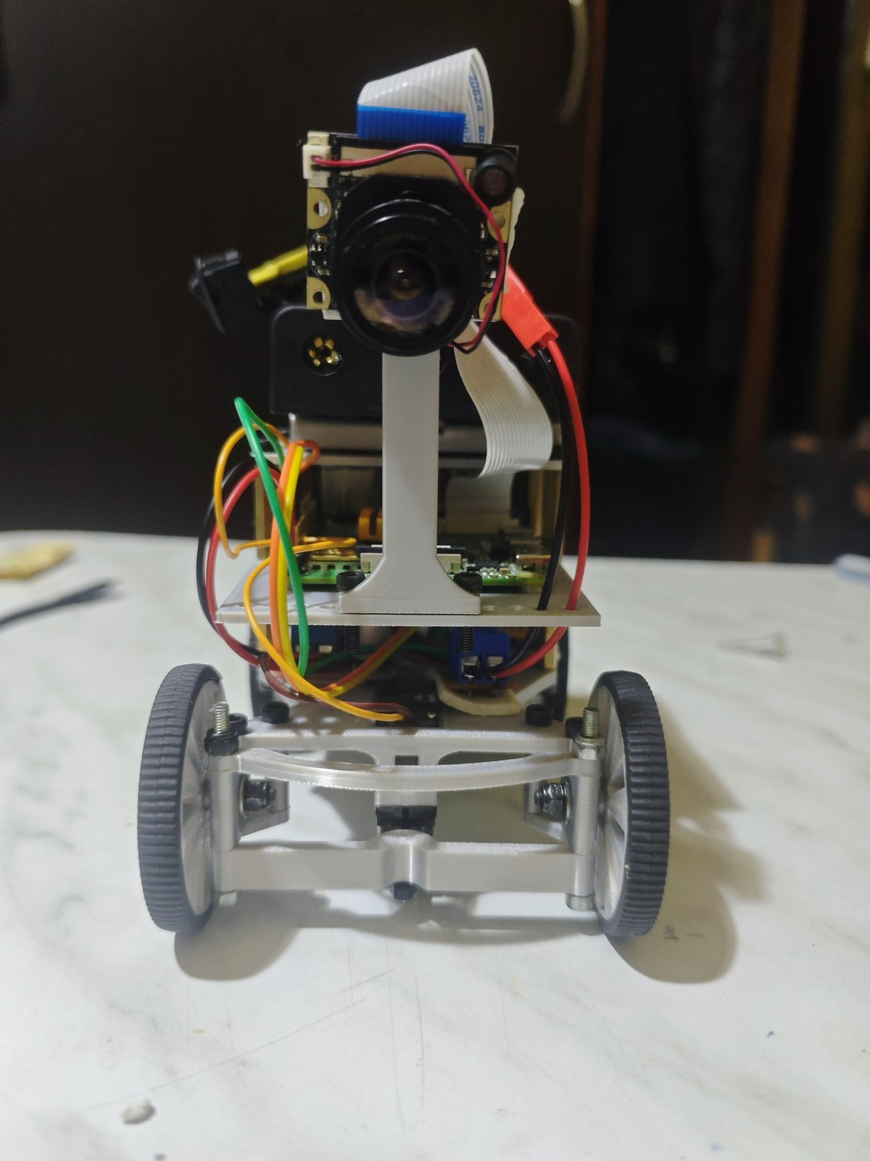
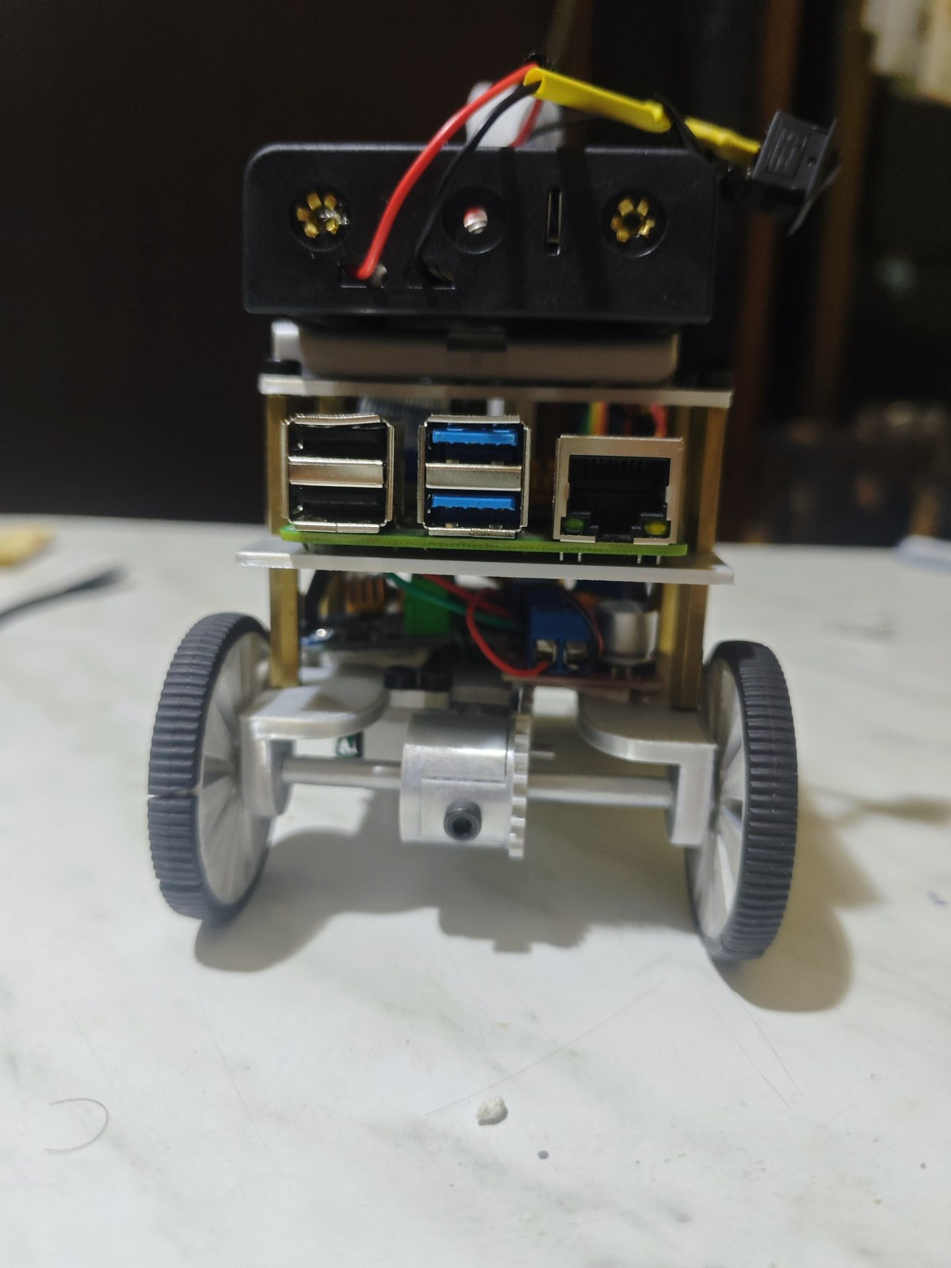
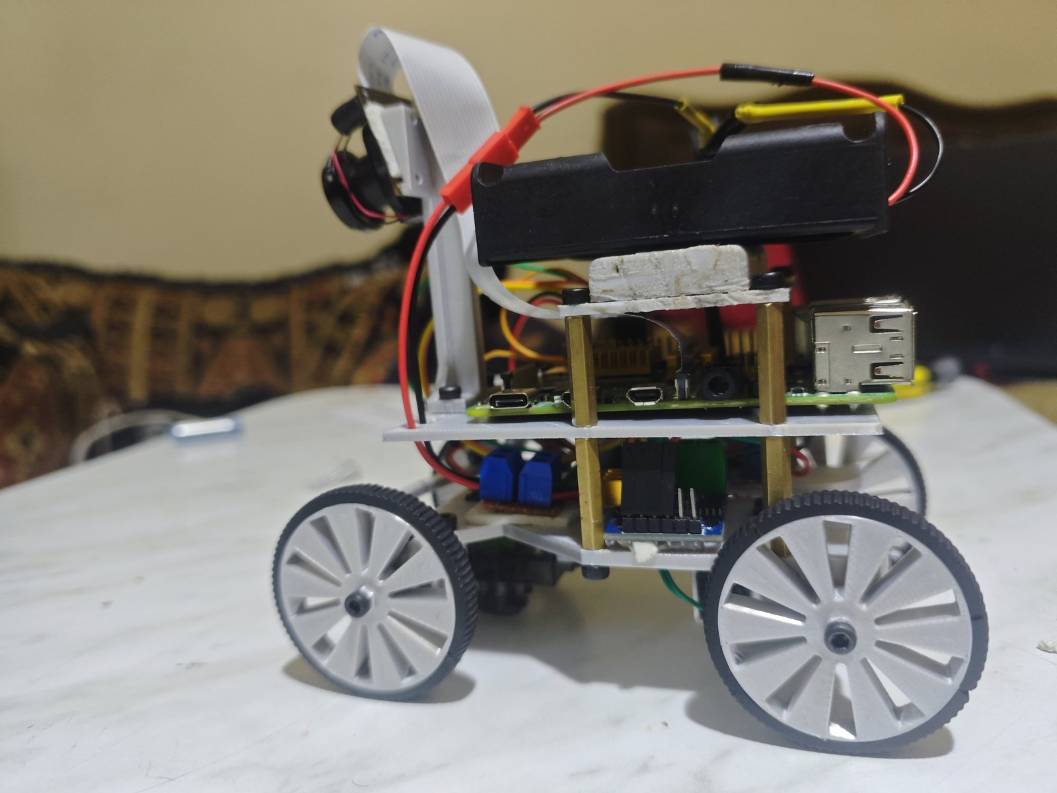
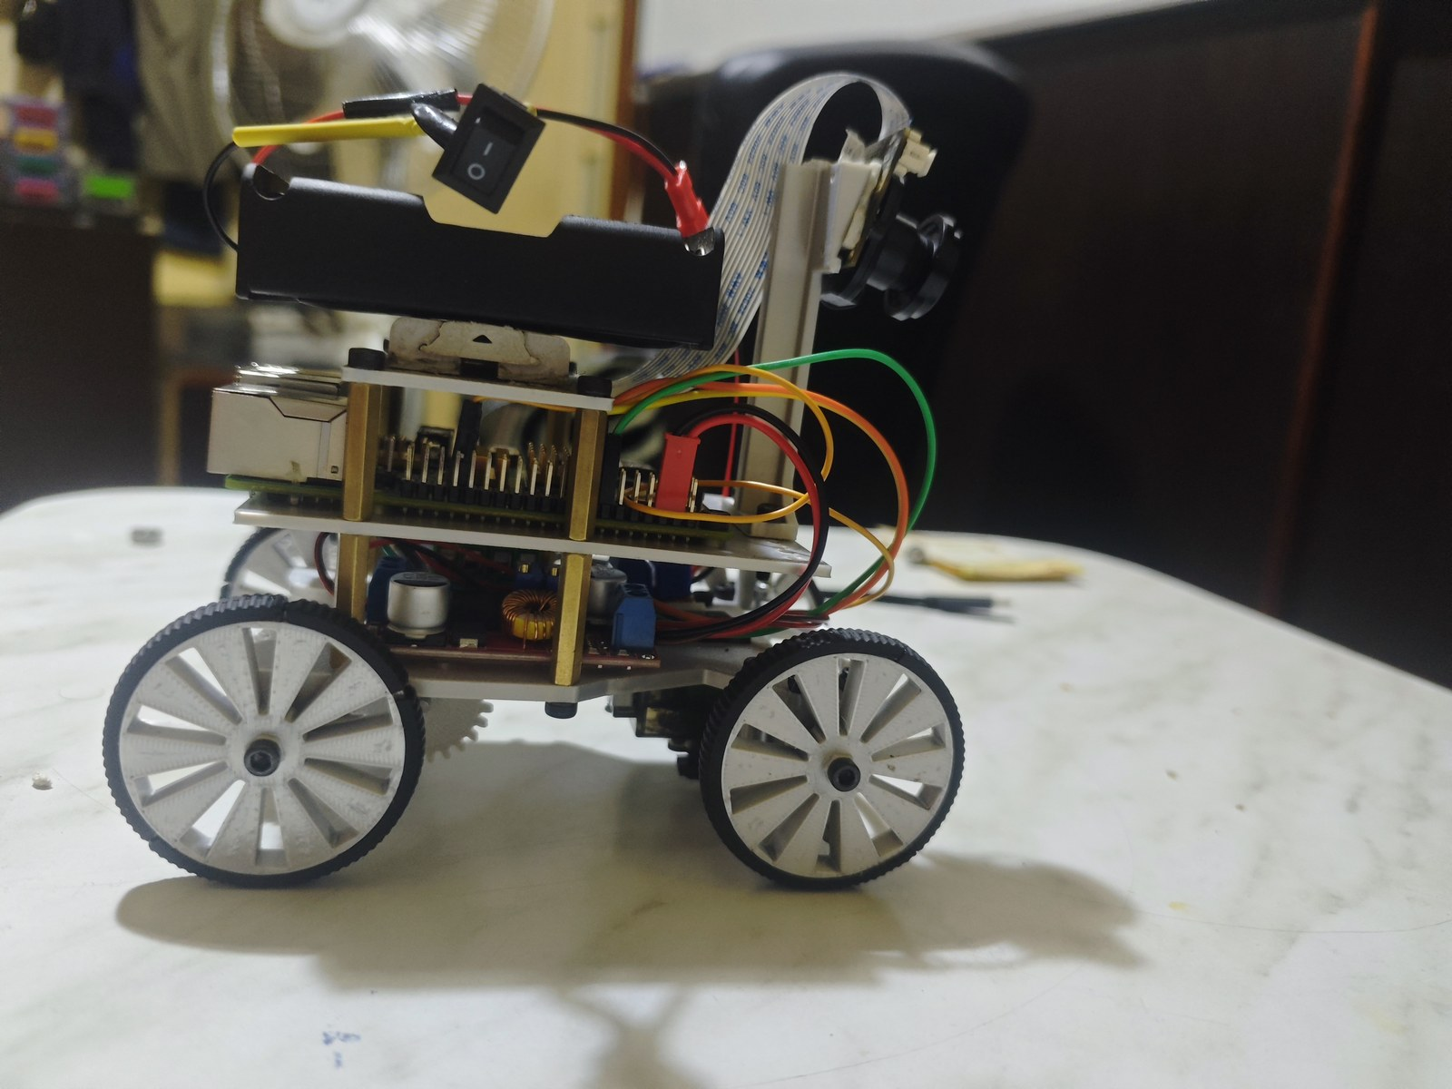
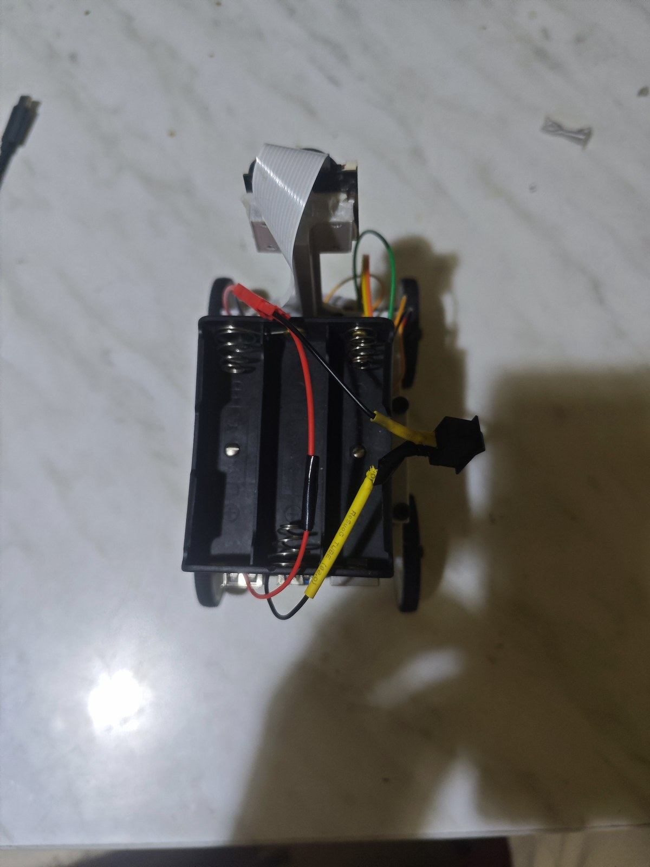
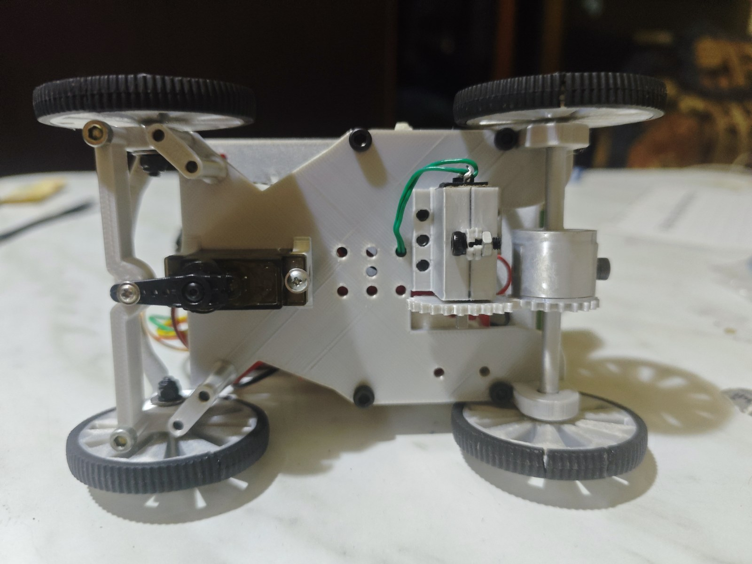
6. The Vehicle's Photos
Front
Back
Left
Right
Top
Bottom
16

Slide 19
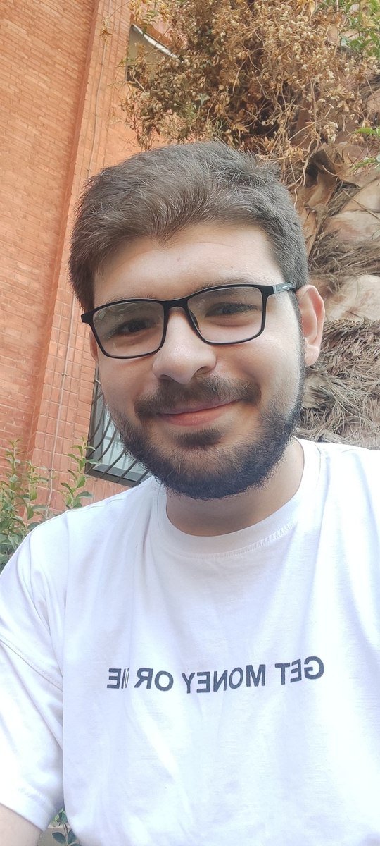
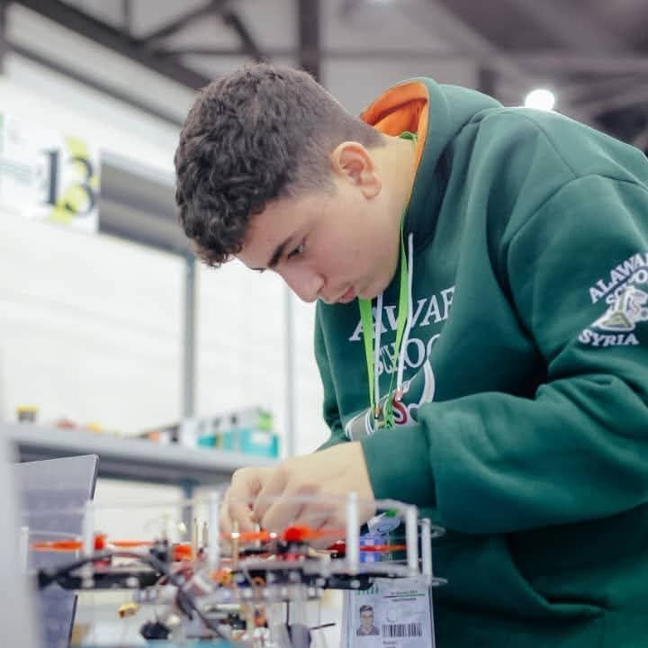
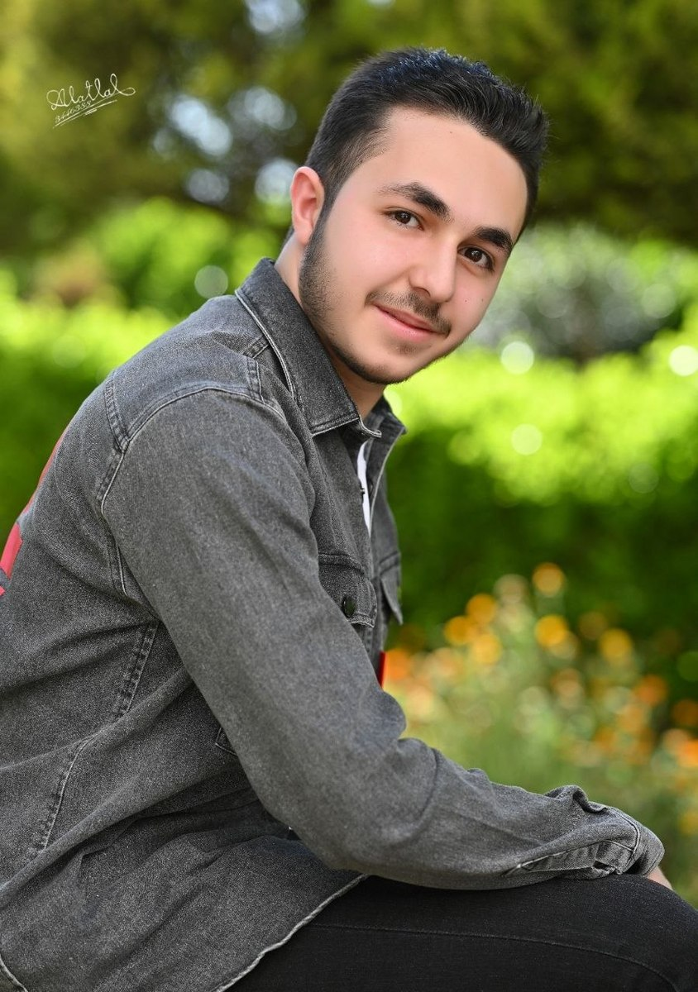
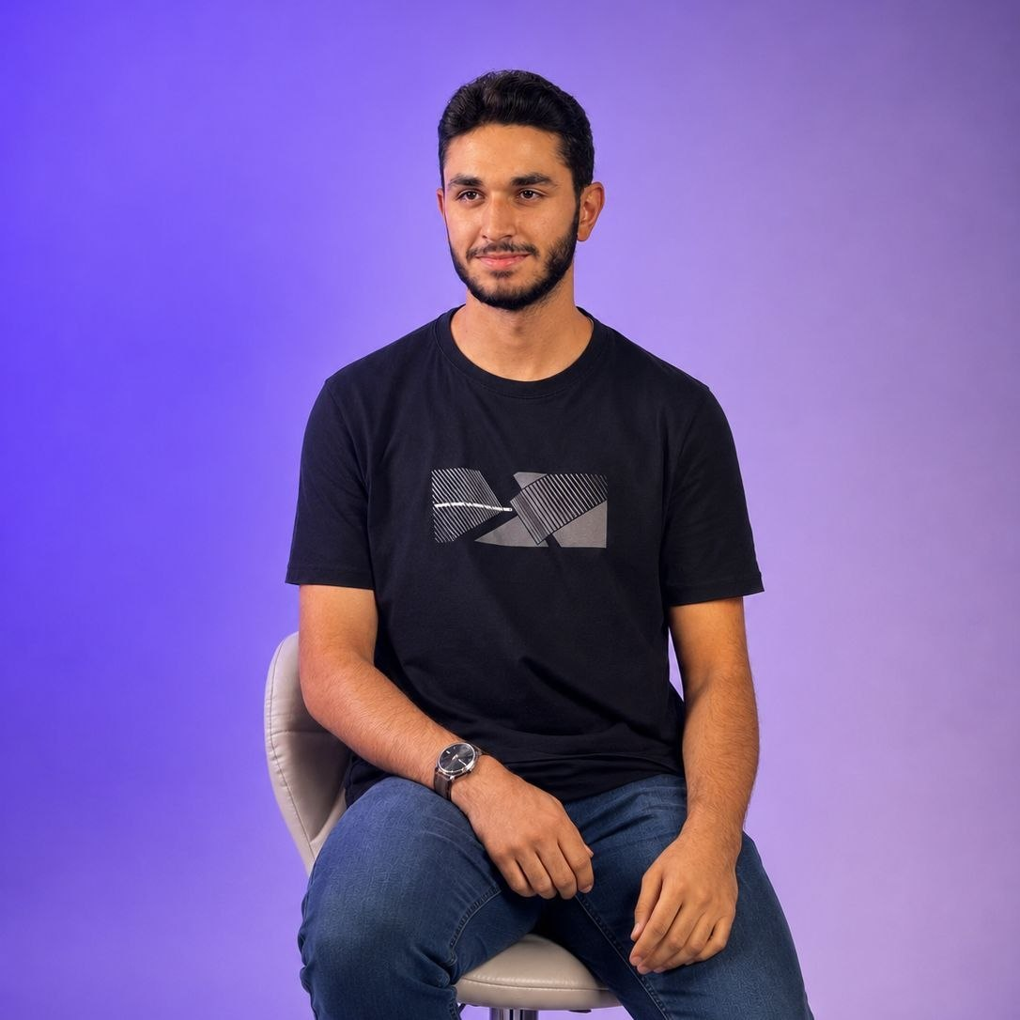
7. Team
Ahmad Kalthom
Jolian Wassof
Omar Shammout
Louay Rashwan
Coach
Team member
Team member
Team member
Computer and Automation Engineering student, Damascus University.
Al-Awael School. AI, robotics and drones; WRO, Pacific and Syrian AI Olympiads.
IT Engineering student, Damascus University. Robotics, AI, electronics.
Computer and Automation Engineering student, Damascus University.
Team The Red Castle — HMK AI and Robotics Club
17

Slide 20
8. Links and Credits
• GitHub repository (full source, CAD, documentation):
- https://github.com/jolianjij/Red-Castle-WRO-Future-Engineers-2026
• Open Challenge driving video:
- https://youtu.be/GmrX7NhcAxE
• Obstacle Challenge driving video:
- https://youtu.be/ujbImlpQH6g
Thanks
As a team, we thank HMK AI and Robotics Club for hosting and supporting us throughout this build, and our coach, Ahmad Kalthom, for the guidance that kept the project moving through every dead end along the way.
18

