Slide 1

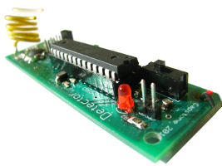



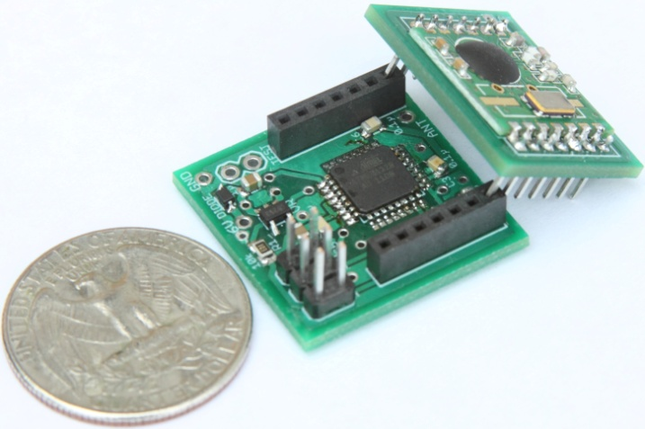

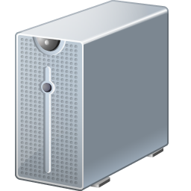





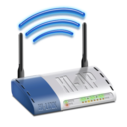
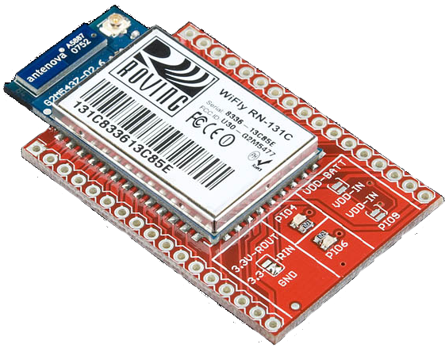
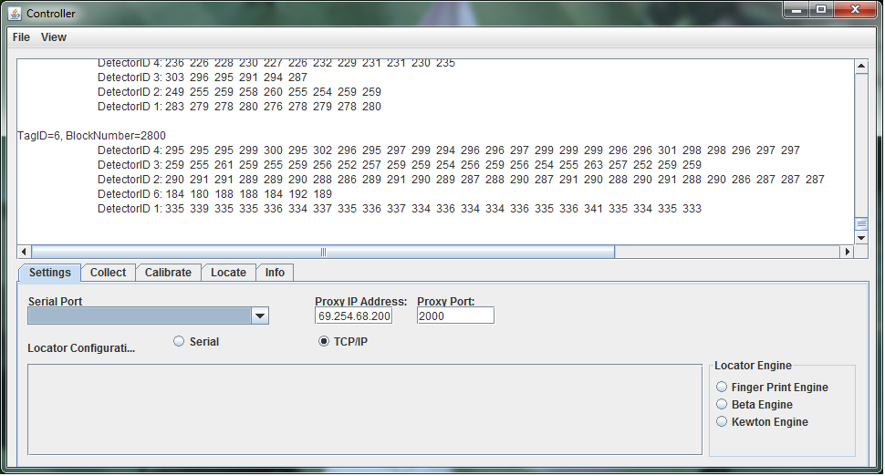
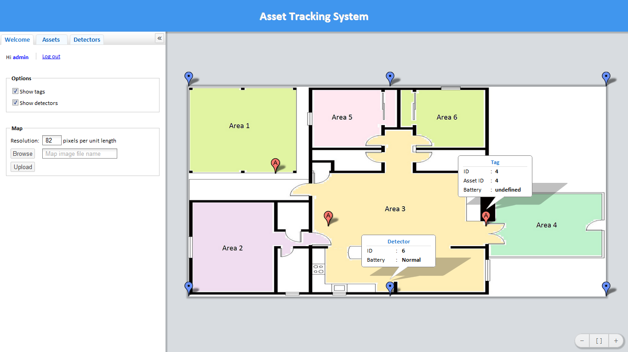
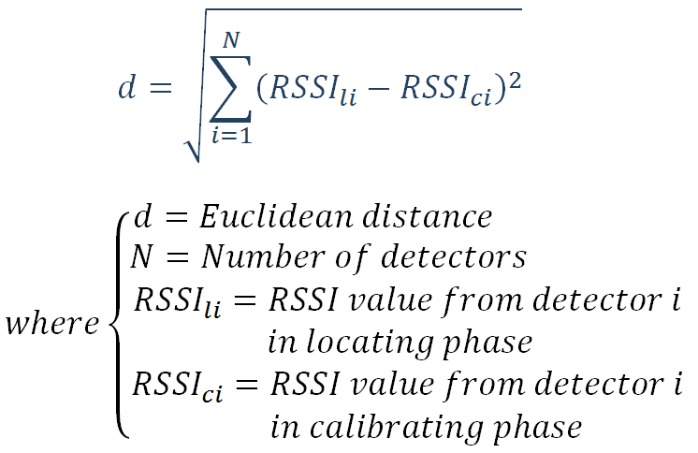
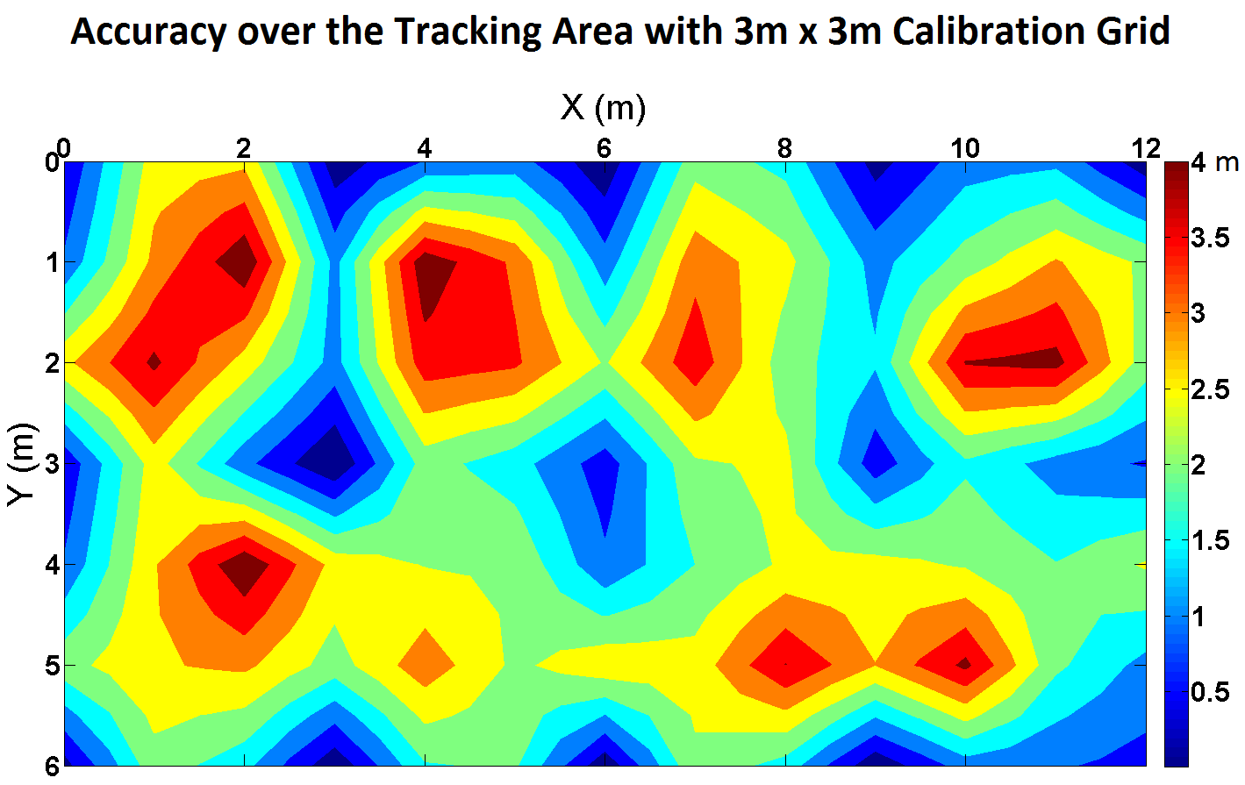

TIU Tracking System
Capstone 2011
Sponsored by Intel
Advisor: Prof. Robert Daasch
Team Members:
Daniel Ferguson – Dung Le
Lynh Pham – Man Hoang – Tri Truong
Introduction
Design
Products
Intel's large and complex validation labs contain many Test Interface Units (TIUs) used in validating hardware. A TIU is a custom PCB that provides test points that a testing machine can probe. Since the hardware to be tested is varied, there exists a variety of different TIU's, and as such, finding a particular TIU is useful because, previously, the testing machine had to be broken down to identify the TIU it was using.
Back-end
Front-end
Users
Web App
Database
Asset Tag
Size: 1”x1”x1”
ATMega328p MCU
RF12B transceiver at 434MHz
20mm coin cell battery
Battery life: at least 1 months
Cost : $25
Detector
Size: 3.5”x1”
ATMega328p MCU
RF12B transceiver at 434MHz
9V battery/adapter
Cost: $30
Admin
Tag
Approach
Wi-Fi
Proxy
Detector
Controller
The system uses an RF transceiver mesh network to track mobile tags indoors. The system determines a tag’s current location by matching the RF signal strength pattern of a tag’s periodic broadcasts with pre-collected patterns stored in a database.
Radio Received Signal Strength Indication (RSSI) is a measurement of the power received by an antenna. Signal strength based location method has several advantages over other methods such as GPS, IR, and Acoustics as it is easy to implement and does not require line of sight. Also, low cost RF transceivers are readily available.
For scalability, a mesh network of detectors relay all data to a centralized controller where locations of the tags are calculated and saved in a database. An easy to use web application provides visualization of tag locations, as well as other configuration details.
Controller
Receives RSSI and battery data from the mesh network
Executes the locating algorithm
Communicates with the Database
Fingerprint Algorithm
A pattern matching algorithm based on Euclidean distance
Employs heuristics and input output filters to further enhance the accuracy and reliability of the locating process
Web Application
Primary user interface with an interactive 2D map
Search TIUs and detectors via ID
Display locations and battery levels of all tags and detectors
Configure tags and detectors
Configure the tracking area
Tags
Attached to TIUs
Periodically broadcast
When not broadcasting, in a low power state
Detectors
Listen to messages from tags and determine the RSSI values
Forward the messages to the proxy via a controlled flooding mechanism
Implements collision avoidance using time division
Wi-Fi Proxy
Relays data from the mesh network to the controller
SQL Database
Stores locations and battery levels of all tags and detectors
Stores user accounts
Proxy
ATMega328p MCU
RF12B transceiver at 434MHz
WiFly 802.11b/g transceiver
9V battery/adapter
Cost: $80
Experiments
Conclusions
We have a complete system that achieves small size, low cost, and battery life that exceeds 1 month. As for accuracy, when a tag is placed on exactly a location that was calibrated, success rates are at least 90%.
Further work to be done includes
Refine the testability of the system
Analyze antenna radiation pattern
Improve the robustness of the location algorithm
Department of Electrical and Computer Engineering

