Slide 1


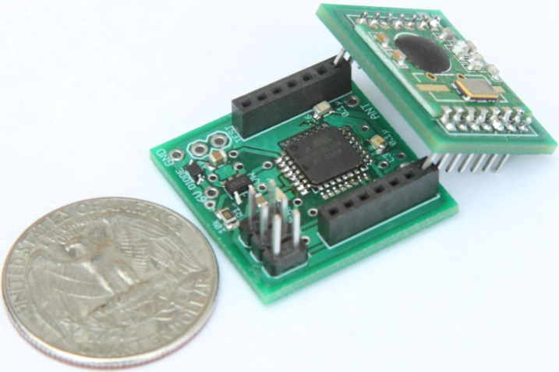
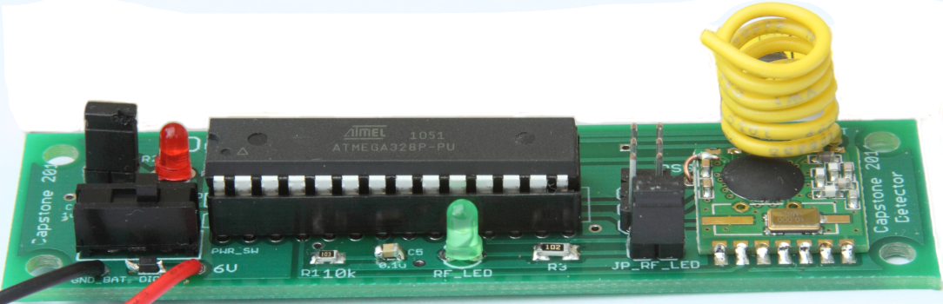
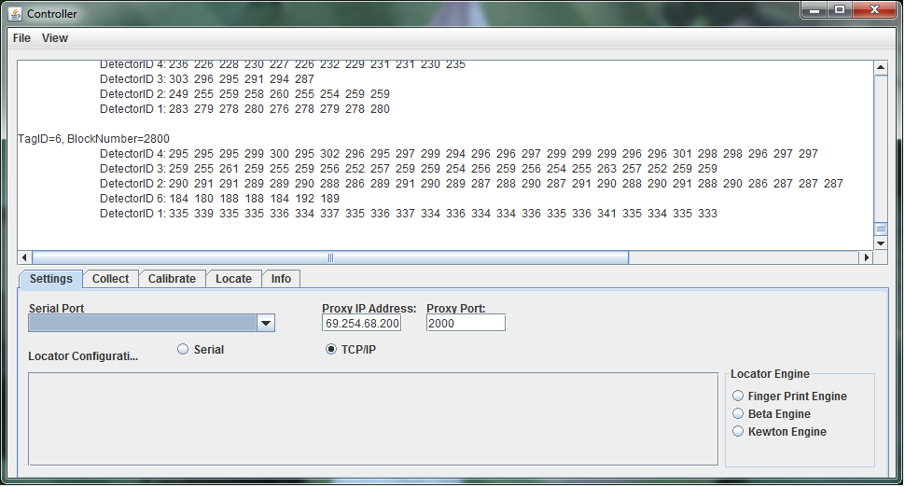
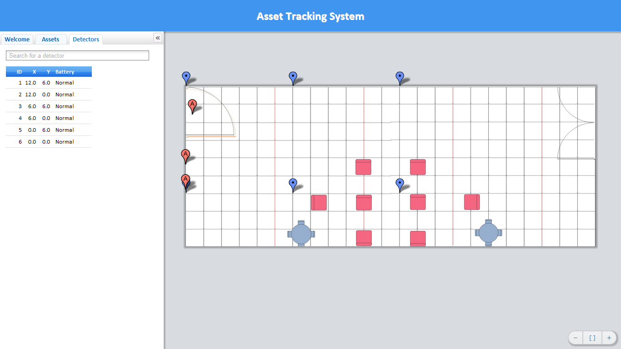
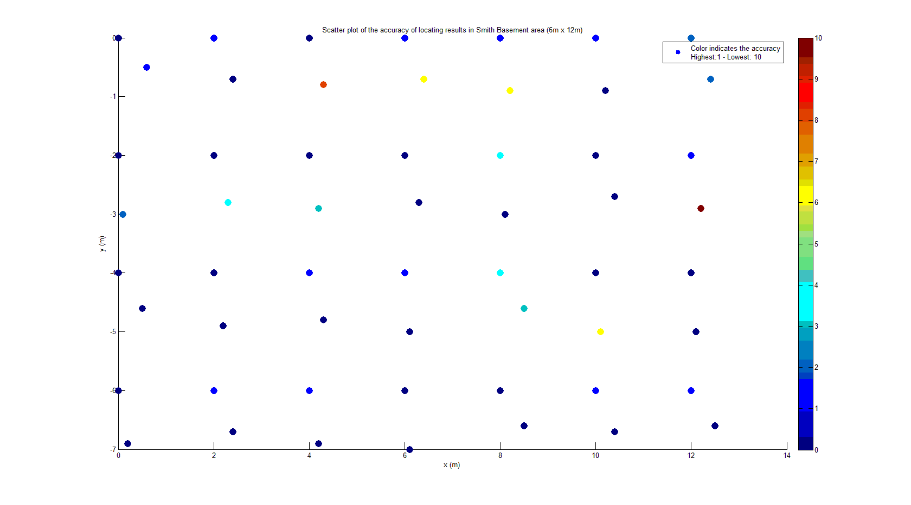

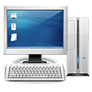



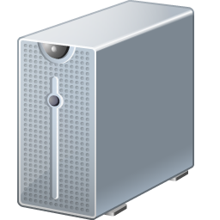



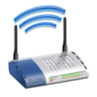



TIU Tracking System
Capstone 2011
Sponsored by Intel
Advisor: Prof. Robert Daasch
Team Members:
Daniel Ferguson – Dung Le
Lynh Pham – Man Hoang – Tri Truong
Introduction
Products
This system uses an RF transceiver network to track mobile assets indoors, where more obvious solutions, such as GPS, are unable to function. A web app is the primary user interface, and is used to query the location of an asset.
Design
Tags, which are placed onto Testing Interface Units(TIUs), periodically broadcast a signal which are picked up by detectors that are placed in various fixed locations within the tracking area. The detectors determine the signal strength of the tags, form a message and relay it, via a mesh network forwarding protocol, until the message reaches the proxy. The proxy then retransmits the message via wifi to the controller. The controller gives the signal strength data to a locating algorithm which calculates its approximate location via statistical analysis. The results are then placed into a database where the web app retrieves the results and displays them on an interactive 2D map.
Asset Tag
Size: 1”x1”x1”
Use ATMega328p MCU
Use 20mm coin cell battery
Battery life: more than 3 months
Use RF12B transceiver at 434MHz
Detector
Size: 3.5”x1”
Use ATMega328p MCU
Use 9V battery/adapter
Use RF12B transceiver at 434MHz
Requirements
Asset tag’s size: 1” x 1” x 1”
Low power consumption
Accurate
Web application as user interface
2D map display
Scalable tracking area
Low cost solution
Features
RF Mesh Network
Composed of small, inexpensive hardware.
Relay messages to proxy via a controlled flooding mechanism.
Collision avoidance using time division
Tags broadcast periodically
Detectors pick up broadcast, determine RSSI, and send results.
Detectors also act as relays.
Controller
Primary link between the mesh network and the back end infrastructure.
Communicates with mesh network
Executes the locating algorithm
Communicates with the Database.
Approach
Test Results
By collecting RF signatures and storing them in a database. The RF signature created by a tag's broadcast can be compared to those stored, and the closest match roughly identifies the location of the tag.
Data originates in the mesh network, and is relayed to controller software that feeds it to a locating algorithm. The locating algorithm calculates the location, gives the results back to the controller, and the controller then places the results into the database.
The locating algorithms implement a standardized interface which facilitates easy integration with the system, and supports the addition of different locating algorithms.
Web Application
Primary user interface.
Interactive 2D map
Search TIU and detector via ID
Show battery level of all elements in the mesh network.
Configure Detector placement
Configure geometry of tracking area
Wi-Fi Proxy
RFM12 receives data from mesh network
Wifi module sends data to the controller.
Fingerprint Algorithm
A progressively constrained, nearest neighbor algorithm, using euclidean distance as the matching metric. Also, several heuristics are employed that further enhance the accuracy and reliability of the locating process.
SQL Database
Tag locations
Battery levels of all transceiver devices
Conclusions
The accuracy of the tracking system needs to be enhanced by considering antenna design and advanced locating algorithm. Noise filter can be implemented on both hardware and software to achieve desired performance.
Users
Web App
Database
Admin
Tag
Department of Electrical and Computer Engineering
Proxy
Detector
Controller

