Slide 1

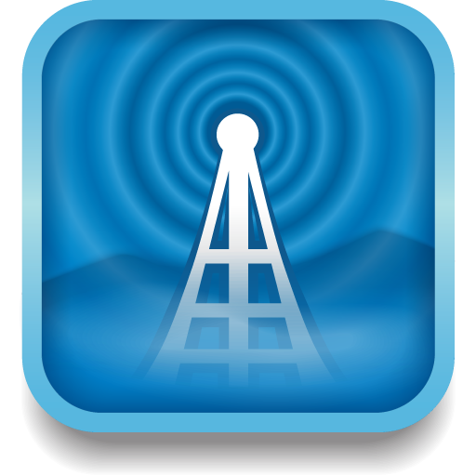




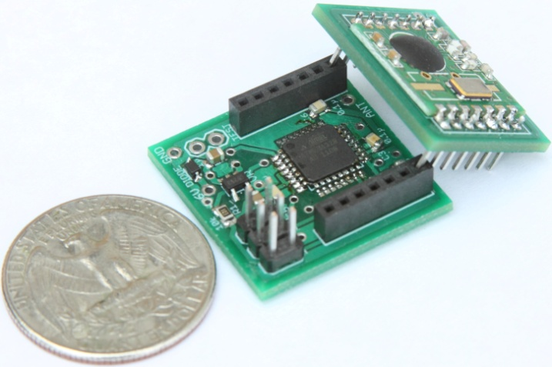

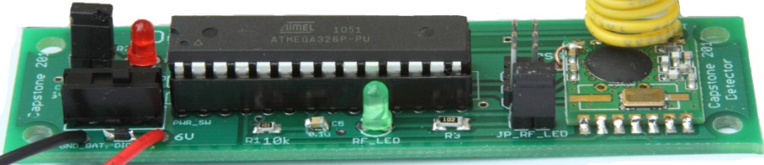

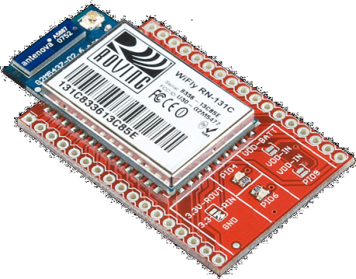




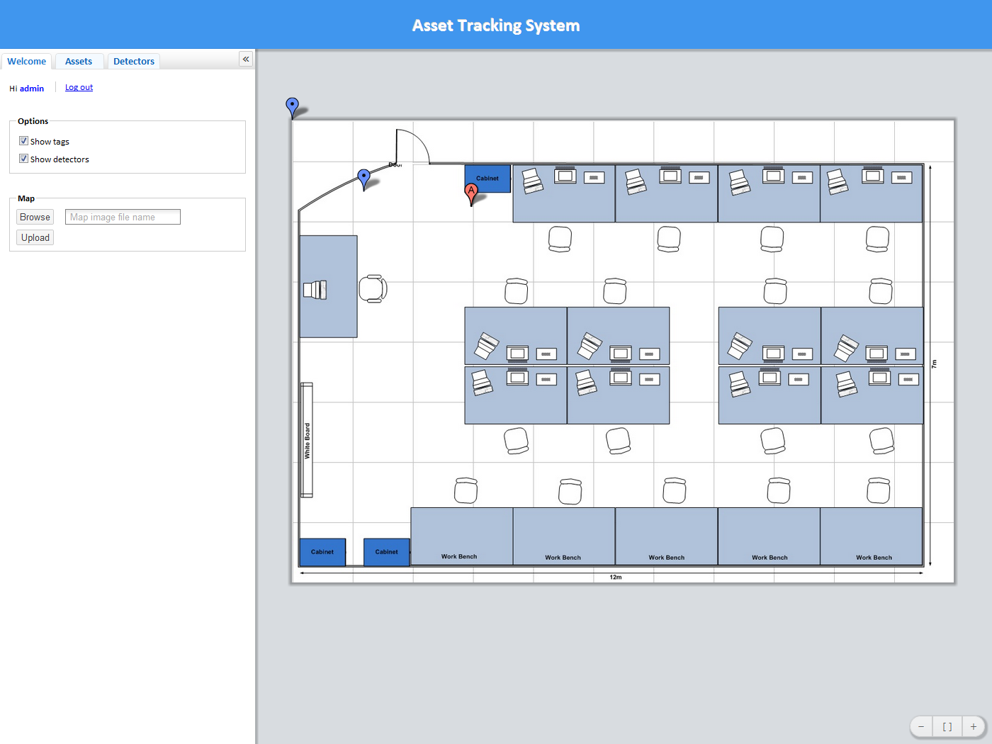

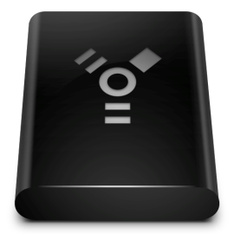






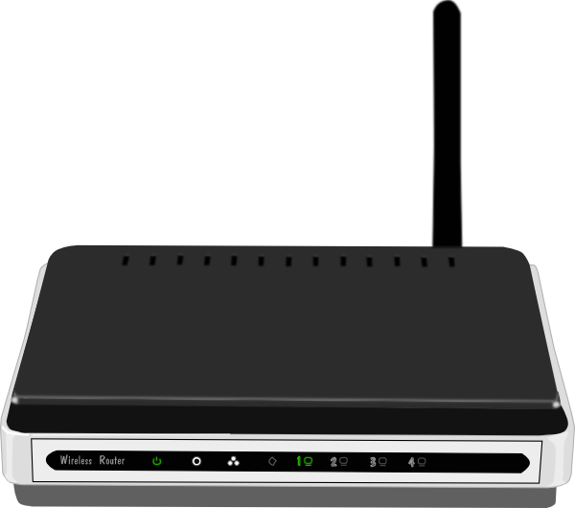


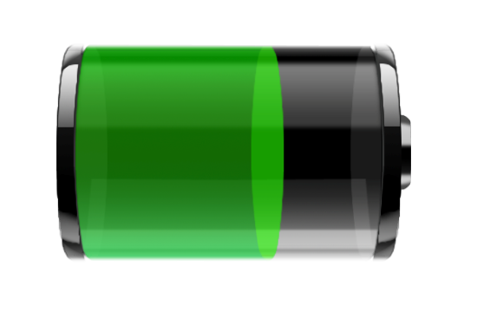



TIU TRACKING SYSTEM
ABSTRACT
METHODS & APPROACH
RESULTS
This system uses an RF transceiver network to track mobile assets indoors, where more obvious solutions, such as GPS, are unable to function. The system determines an assets current location by matching the RF fingerprint of its periodic broadcasts with previously collected fingerprints stored in a database
Asset Tag
Size: 1”x1”x1”
Main board and RF12 breakout board
Use RF12B transceiver with 434MHz
Use MCU ATMega328p
Use coin cell 20mm battery
Battery life: more than 1 month
Java script
Add and remove tag/detector
Change geometry of tracking area
Infrastructure
Locating Algorithm
User Interface
Data Management
Web Application
User and Admin interface
2D map display
Search TIU via ID
View location history of TIUs
Show battery level
Detector
Size: 3.5”x1”
Use RF12B transceiver with
434MHz
Use MCU ATMega328p
Use 9V battery/adapter
RF Transceiver
Mesh Network
Wi-Fi Proxy
Server Computer
Finger-Print
Voting Method
Web Application
User Interface
Admin Interface
Controller
SQL Database
Tracking Area
Battery Level
SQL Database
RSSI-distance model or RF
fingerprinting
Location update interval
Geometry of the tracking area
Identifications, locations, and battery levels of the TIUs
Proxy
Use WiFly 802.11b/g with 2.4GHz
Use RF12B transceiver with 434MHz
Use MCU ATMega328p
Use 9V battery/adaptor
TIU Tracking System
REQUIREMENTS
Admin
Tracking area
Asset tag’s size: 1” x 1” x 1”
Low power consumption
High accuracy
Web application as user
interface
2D map display
Scalable tracking area
Low cost solution
Maintain and update system via Web app
Users
Detector
Detector
Web Server (PHP, HTML5, Java script)
Access tracking info via Web app
Receive tag’s info and measure RSSI
Internet
Tag
Detector
Broadcast RF signal
Controller
Proxy
Data packets are relayed through mesh network of detectors
Process data,
calculate asset tag’s location
Relay all data packets and interface to controller
Battery Life
Accuracy
Detector
Detector
Capacity of lithium coin cell: 240mAh
Transmission time: 3ms every 1 seconds
Active current: 30mA (RF transceiver + MCU)
Sleep current: 0.0425mA
Testing ………
CAPSTONE TEAM
Advantages
Disadvantages
Sponsor: Intel
Advisor: Prof. Robert Daasch
Members: Dung Le
Tri Truong
Lynh Pham
Man Hoang
Daniel Ferguson
Small size
Low power consumption
Easy scalability
Low cost
Noise sensitive
Calibration required
CONCLUSIONS
The tracking system consists of two primary parts: hardware and software. The hardware infrastructure is built upon RF technology. The number of detectors will be scaled in order to achieve the desired accuracy and efficiency..
……………………………….
Department of Electrical and Computer Engineering

