Slide 1

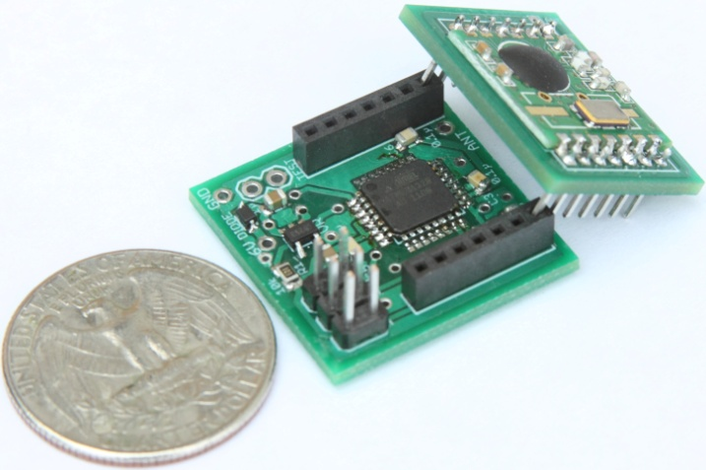
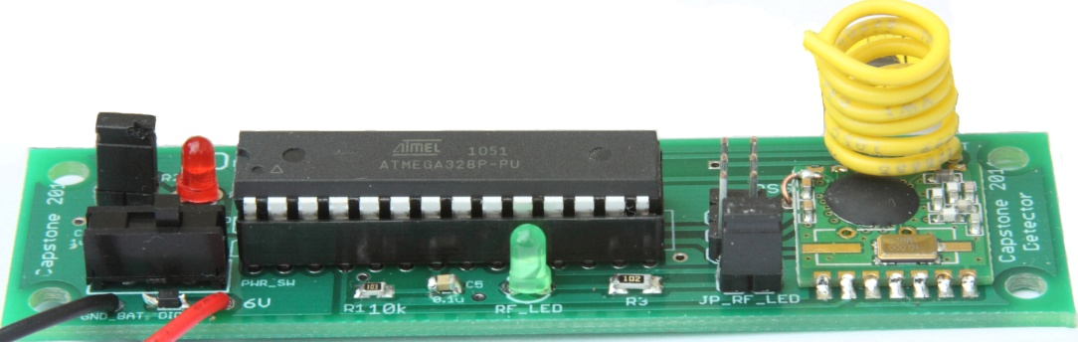




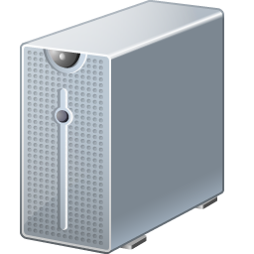




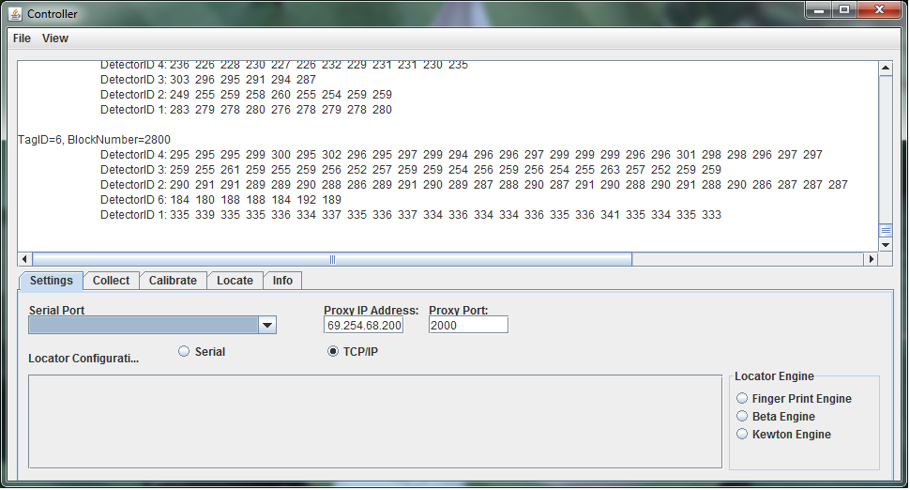

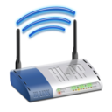
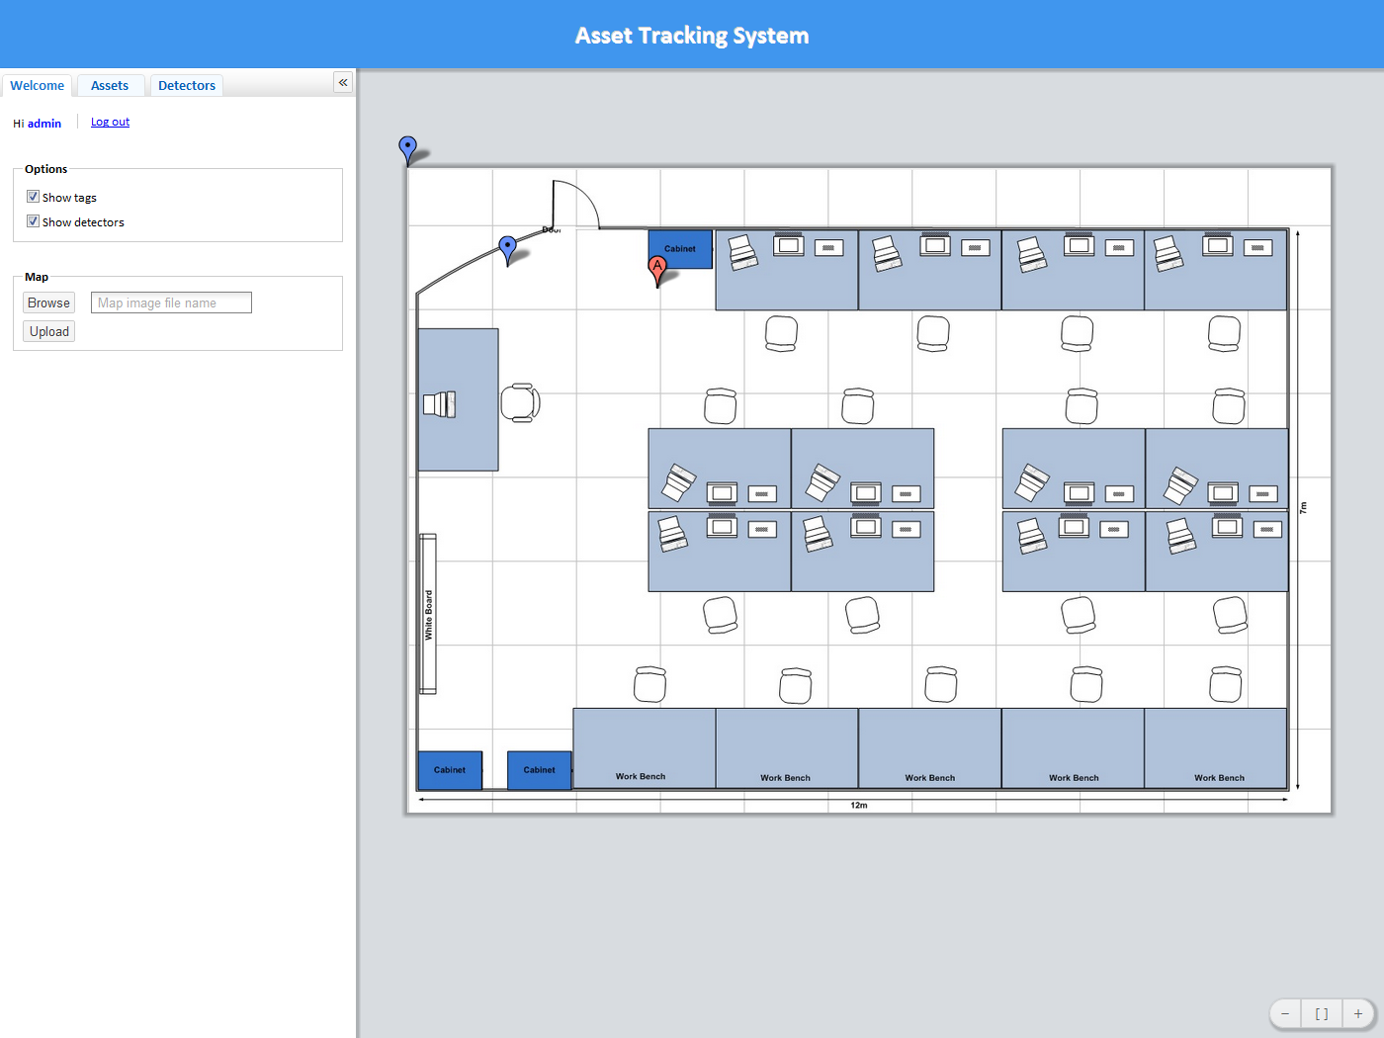
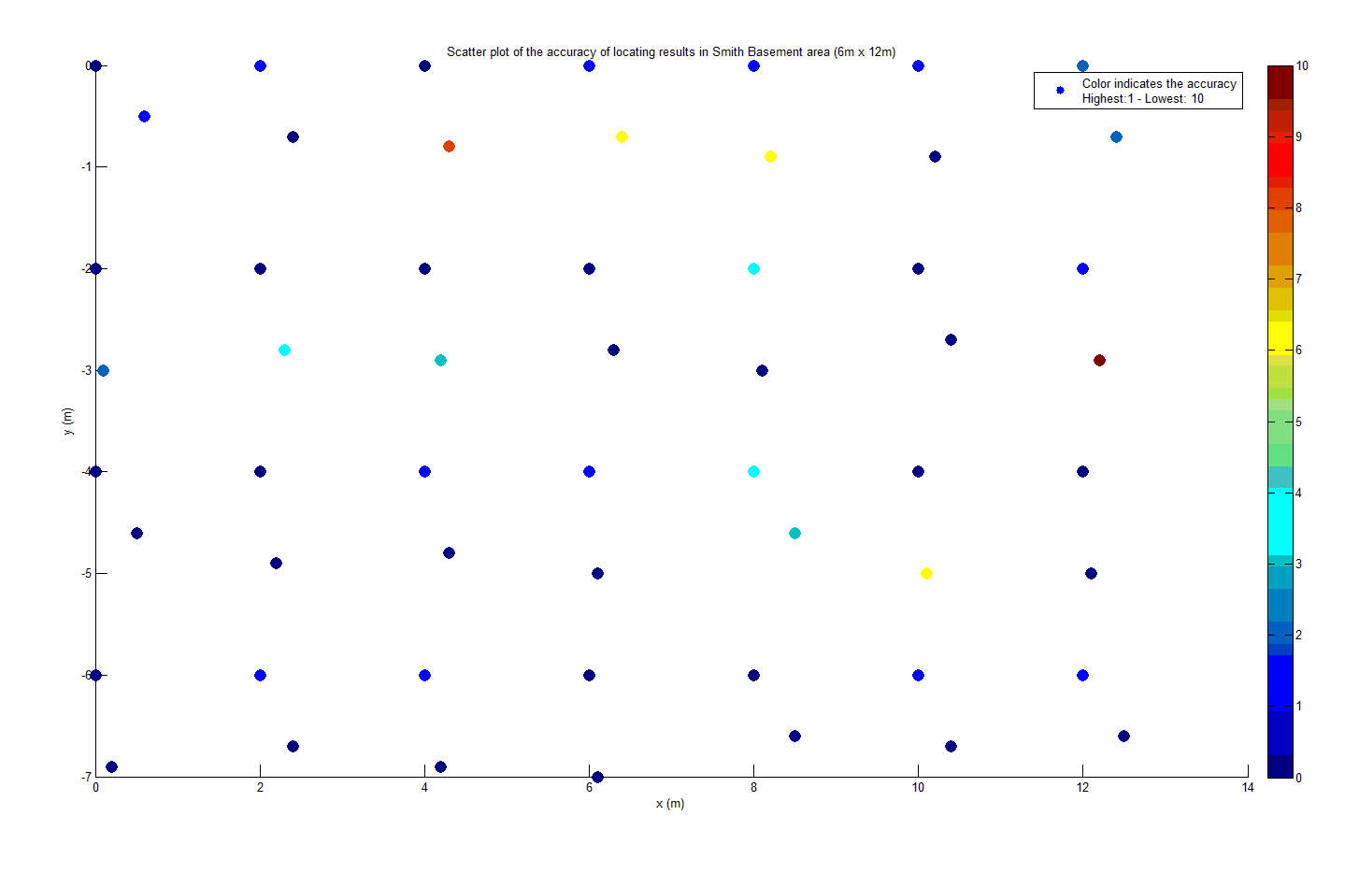
TIU Tracking System
Capstone 2011
Sponsored by Intel
Advisor: Prof. Robert Daasch
Team Members:
Daniel Ferguson – Dung Le
Lynh Pham – Man Hoang – Tri Truong
Introduction
Design
Products
Intel's large and complex validation labs contain many Testing Interface Unit's(TIU) used in validating hardware. A TIU is a custom PCB that provides test points a testing machine can probe. Since the hardware to be tested is varied, there exists a variety of different TIU's, and as such, finding a particular TIU is useful. This is useful because, previously, the testing machine had to be broken down to identify the TIU it was using
Tags are placed onto Test Interface Units (TIUs). The tags broadcast a signal periodically, which is picked up by detectors that are placed in various fixed locations within the tracking area. The detectors determine the strengths of the signals from the tags, form a message and relay it, via the mesh network of other detectors until the message reaches the proxy. The proxy then retransmits the message via Wi-Fi to the Controller. The Controller gives the signal strength data to a locating algorithm which calculates the tags’ approximate locations via statistical analysis. The results are placed into a database where the Web App periodically retrieves the results and displays them on an interactive 2D map.
Asset Tag
Size: 1”x1”x1”
Use ATMega328p MCU
Use 20mm coin cell battery
Battery life: more than 3 months
Use RF12B transceiver at 434MHz
Detector
Size: 3.5”x1”
Use ATMega328p MCU
Use 9V battery/adapter
Use RF12B transceiver at 434MHz
Requirements
Asset tag’s size: 1” x 1” x 1”
Low power consumption
Accurate
Web application as user interface
The tracking region must scale to at least 10,000 sp ft
Low cost solution
Back-end
Front-end
Users
Web App
Database
Tag
Admin
Approach
Controller
Wi-Fi
Proxy
Detector
Our system uses an RF transceiver mesh network to track mobile assets indoors. The system determines an asset’s current location by matching the RF fingerprint, based on signal strength, of a Tags periodic broadcasts with previously collected fingerprints stored in a database.
Why signal strength?
We based our system on signal strength because it has two important features. Since our system cannot rely on line of sight, RF signals satisfy this requirement.
Low power transceivers are available.
Radio Received Signal Strength Indication (RSSI) is a measurement of the amount of power received by antenna. Theoretically, distances can be approximated based on the relationship between transmitted and received signal strength.
Tags are attached to TIUs. They are the beacon with which locations can be calculated. It is critically important that tags preserve power. Therefore they are typically in a low power state, but periodically wake up to broadcast, and then immediately go back to their low power state.
Detectors are responsible for gathering RSSI data for the locating algorithm. They must always be listening for a tag to broadcast. Upon receiving a broadcast from a tag, or another detector, it rebroadcasts the message, which results in messages always propagating toward the proxy.
For scalability, a mesh network of detectors relay all data to a centralized controller where locations of tags are calculated and saved in a database. An easy to use web application provides visualization of tag locations, as well as other maintenance details.
Features
RF Mesh Network
Composed of small, inexpensive hardware
Relay messages to the proxy via a controlled flooding mechanism
Collision avoidance using time division
Tags broadcast periodically
Detectors pick up broadcasts, determine signal strengths, and send results
Detectors also act as relays
Controller
Primary link between the mesh network and the back end infrastructure
Communicates with mesh network
Executes the locating algorithm
Communicates with the Database
Test Results
Web Application
Primary user interface
Interactive 2D map
Search TIU and detector via ID
Show battery level of all elements in the mesh network
Configure tag
Configure detector placement
Configure geometry of tracking area
Wi-Fi Proxy
RFM12 module receives data from the mesh network
Wi-Fi module sends data to the controller
Fingerprint Algorithm
A progressively constrained, nearest neighbor algorithm, using Euclidean distance as the matching metric. Also, several heuristics are employed that further enhance the accuracy and reliability of the locating process
Conclusions
SQL Database
Stores locations and battery information of all tags and detectors
Stores user accounts
The accuracy of the tracking system needs to be enhanced by considering antenna design and advanced locating algorithm. Noise filter can be implemented on both hardware and software to achieve desired performance.
Department of Electrical and Computer Engineering

