Slide 1










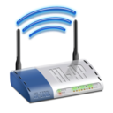
Back-end
Front-end
Users
Web App
Database
Tag
Admin
Controller
Wi-Fi
Proxy
Detector
Location Engine

