Slide 1



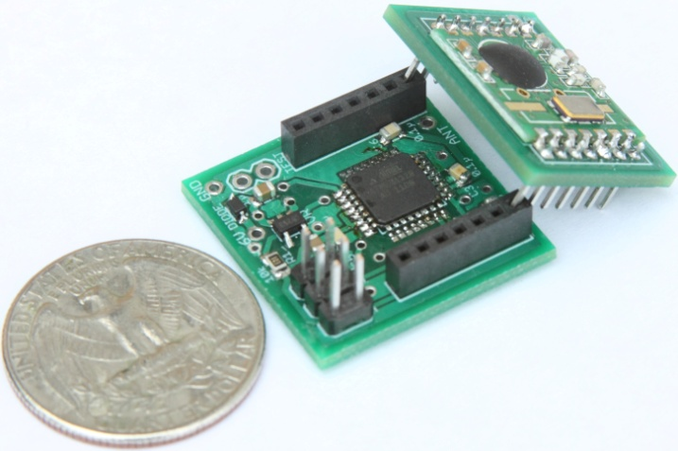

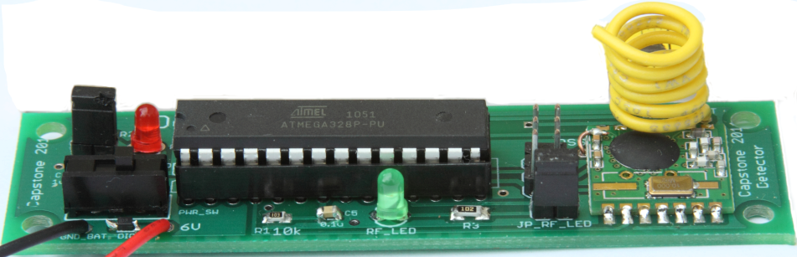

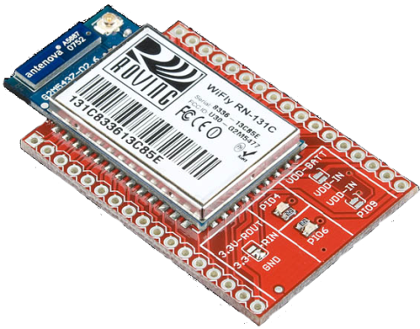


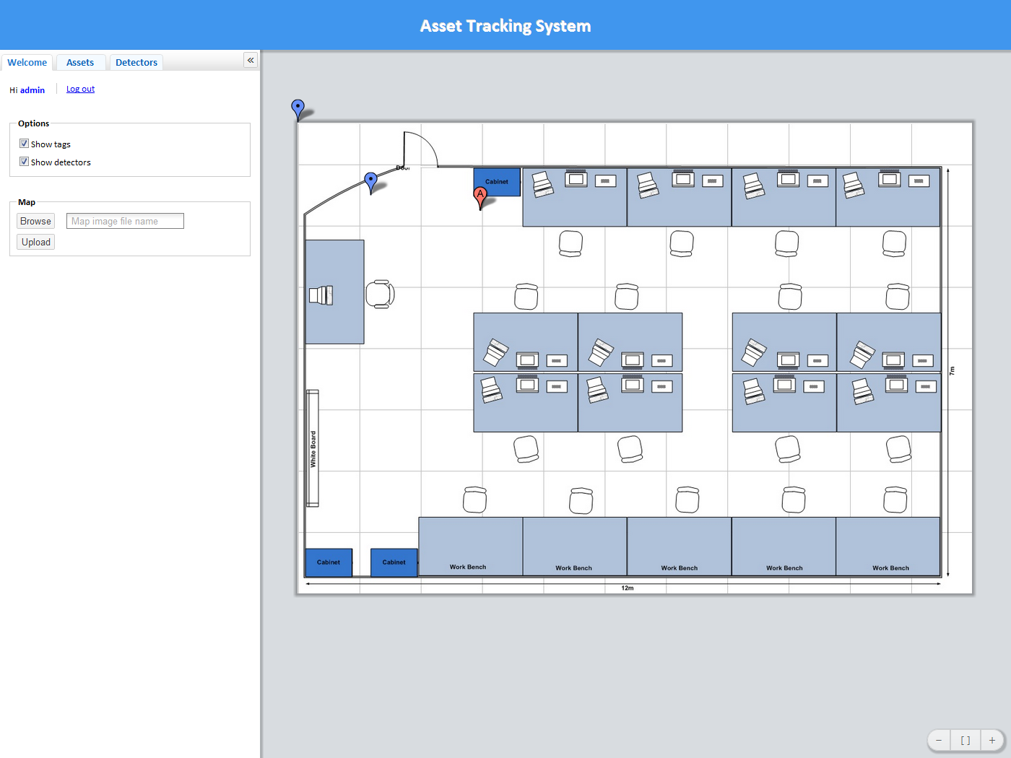
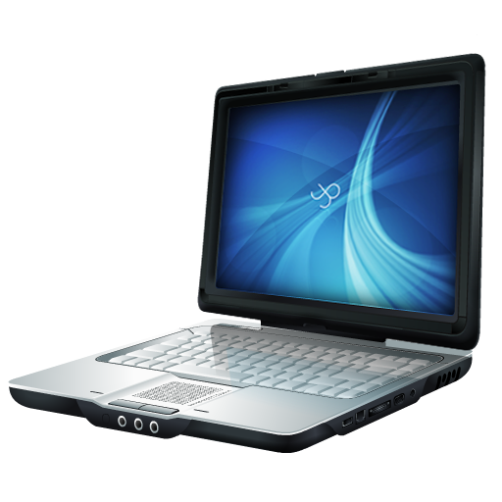


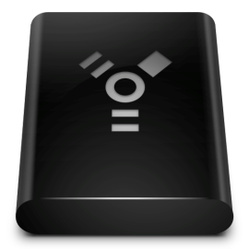



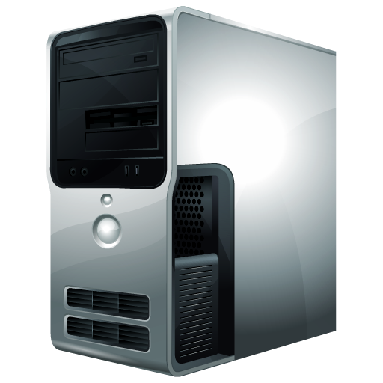

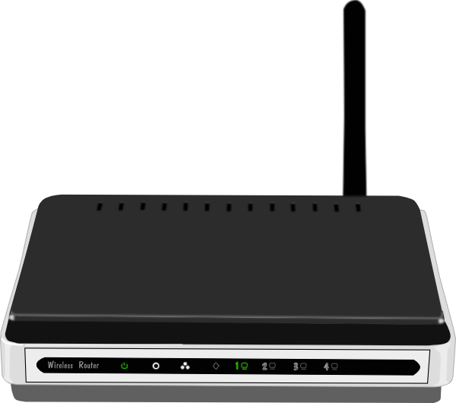

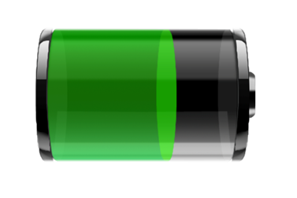



TIU Tracking System
Capstone 2011
Abstract
Design
Results
This system uses an RF transceiver network to track mobile assets indoors, where more obvious solutions, such as GPS, are unable to function. The system determines an asset’s current location by matching the RF fingerprint of its periodic broadcasts with previously collected fingerprints stored in a database
Infrastructure
RF Network
Location Algorithm
Fingerprint
User Interface
Web App
Management
Wi-Fi Proxy
Server Computer
Voting Method
Controller
Web App
Asset Tag
Size: 1”x1”x1”
Use RF12B transceiver at 434MHz
Use MCU ATMega328p
Use coin cell 20mm battery
Battery life: more than 1 month
Controller
Daniel part
……………..
Web Application
User and Admin interface
Interactive 2D map
Search TIU and detector via ID
Show battery level
Add and remove tag/detector
Change geometry of tracking area
Detector
Size: 3.5”x1”
Use RF12B transceiver at
434MHz
Use MCU ATMega328p
Use 9V battery/adapter
Proxy
Use WiFly 802.11b/g at 2.4GHz
Use RF12B transceiver at 434MHz
Use MCU ATMega328p
Use 9V battery/adaptor
SQL Database
RSSI-distance model or RF fingerprinting
Location update interval
Geometry of the tracking area
Identifications, locations, and battery levels of the TIUs
Requirements
Asset tag’s size: 1” x 1” x 1”
Low power consumption
Accurate
Web application as user
interface
2D map display
Scalable tracking area
Low cost solution
Back-end
Front-end
Admin
Users
Detector
Internet
Tag
Team
Sponsor: Intel
Advisor: Prof. Robert Daasch
Members: Dung Le
Tri Truong
Lynh Pham
Man Hoang
Daniel Ferguson
Detector
Battery Life
Accuracy
Controller
Proxy
Capacity of lithium coin cell: 240mAh
Transmission time: 3ms every 1 seconds
Active current: 30mA (RF transceiver + MCU)
Sleep current: 0.0425mA
Testing ………
Detector
Advantages
Disadvantages
Conclusions
The tracking system consists of two primary parts: hardware and software. The hardware infrastructure is built upon RF technology. The number of detectors will be scaled in order to achieve the desired accuracy and efficiency.
Low cost
Small size
Easy scalability
Low power consumption
Noise sensitive
Calibration required
Department of Electrical and Computer Engineering

