Slide 1

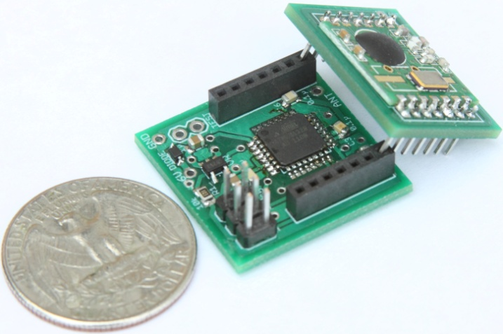
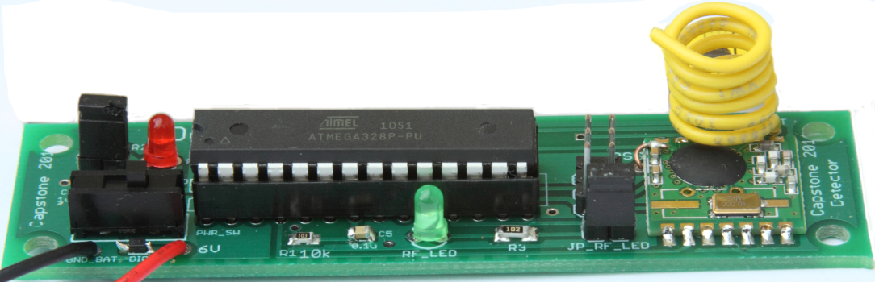





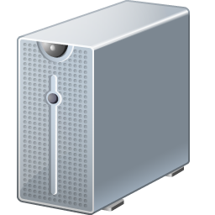



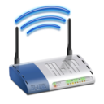

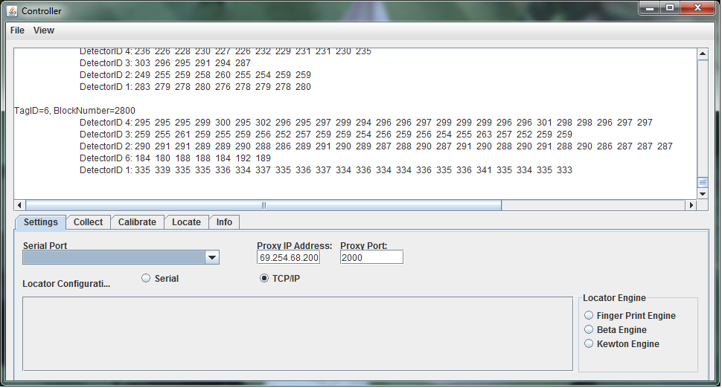

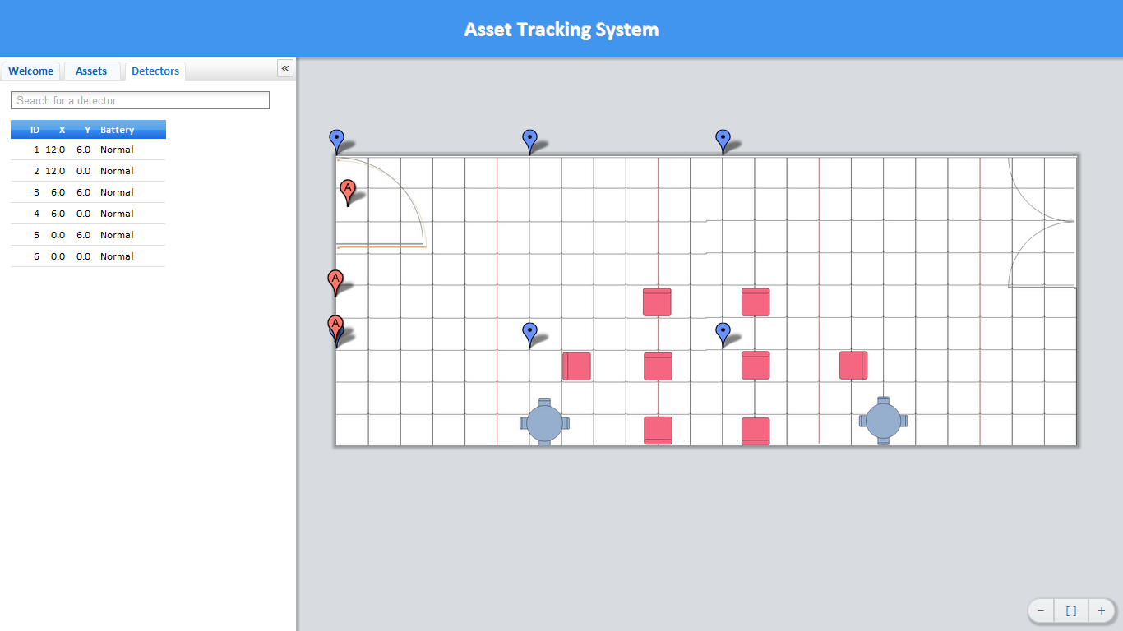
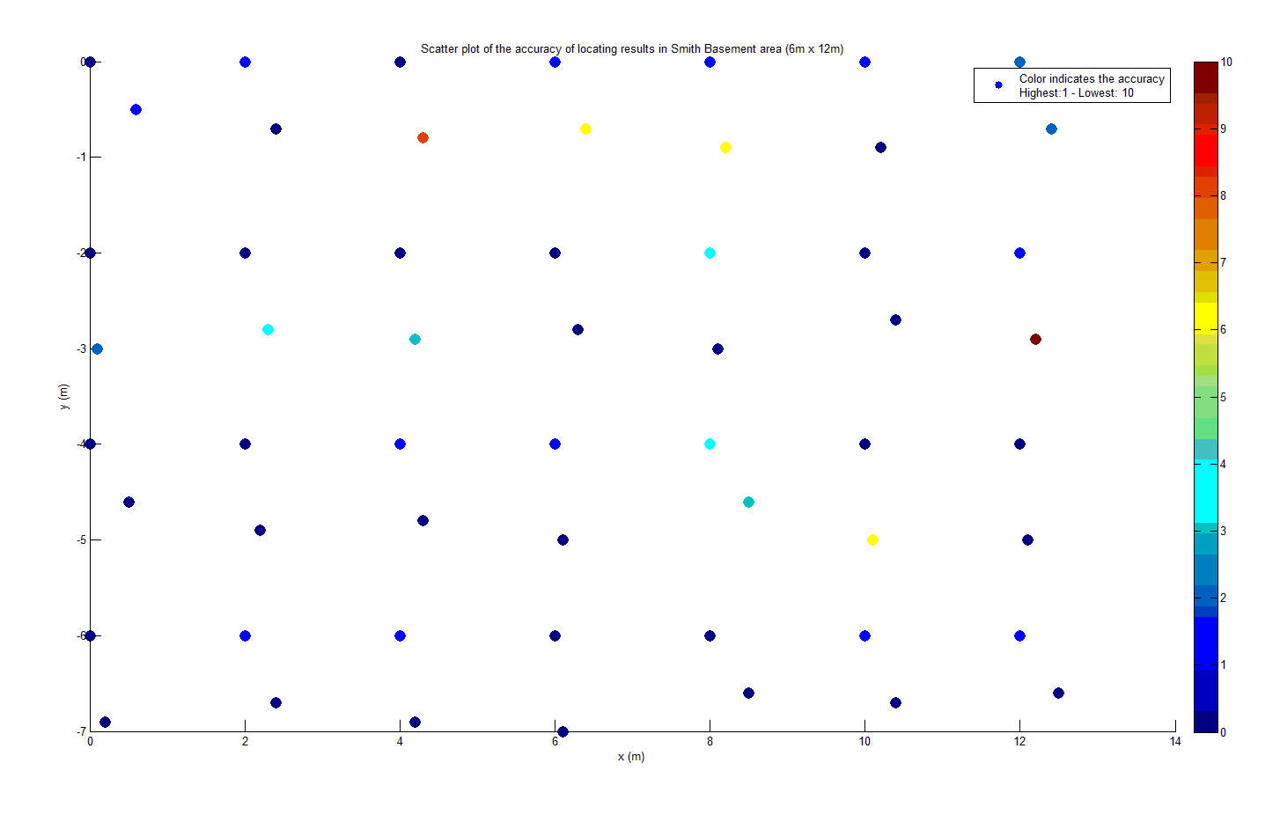
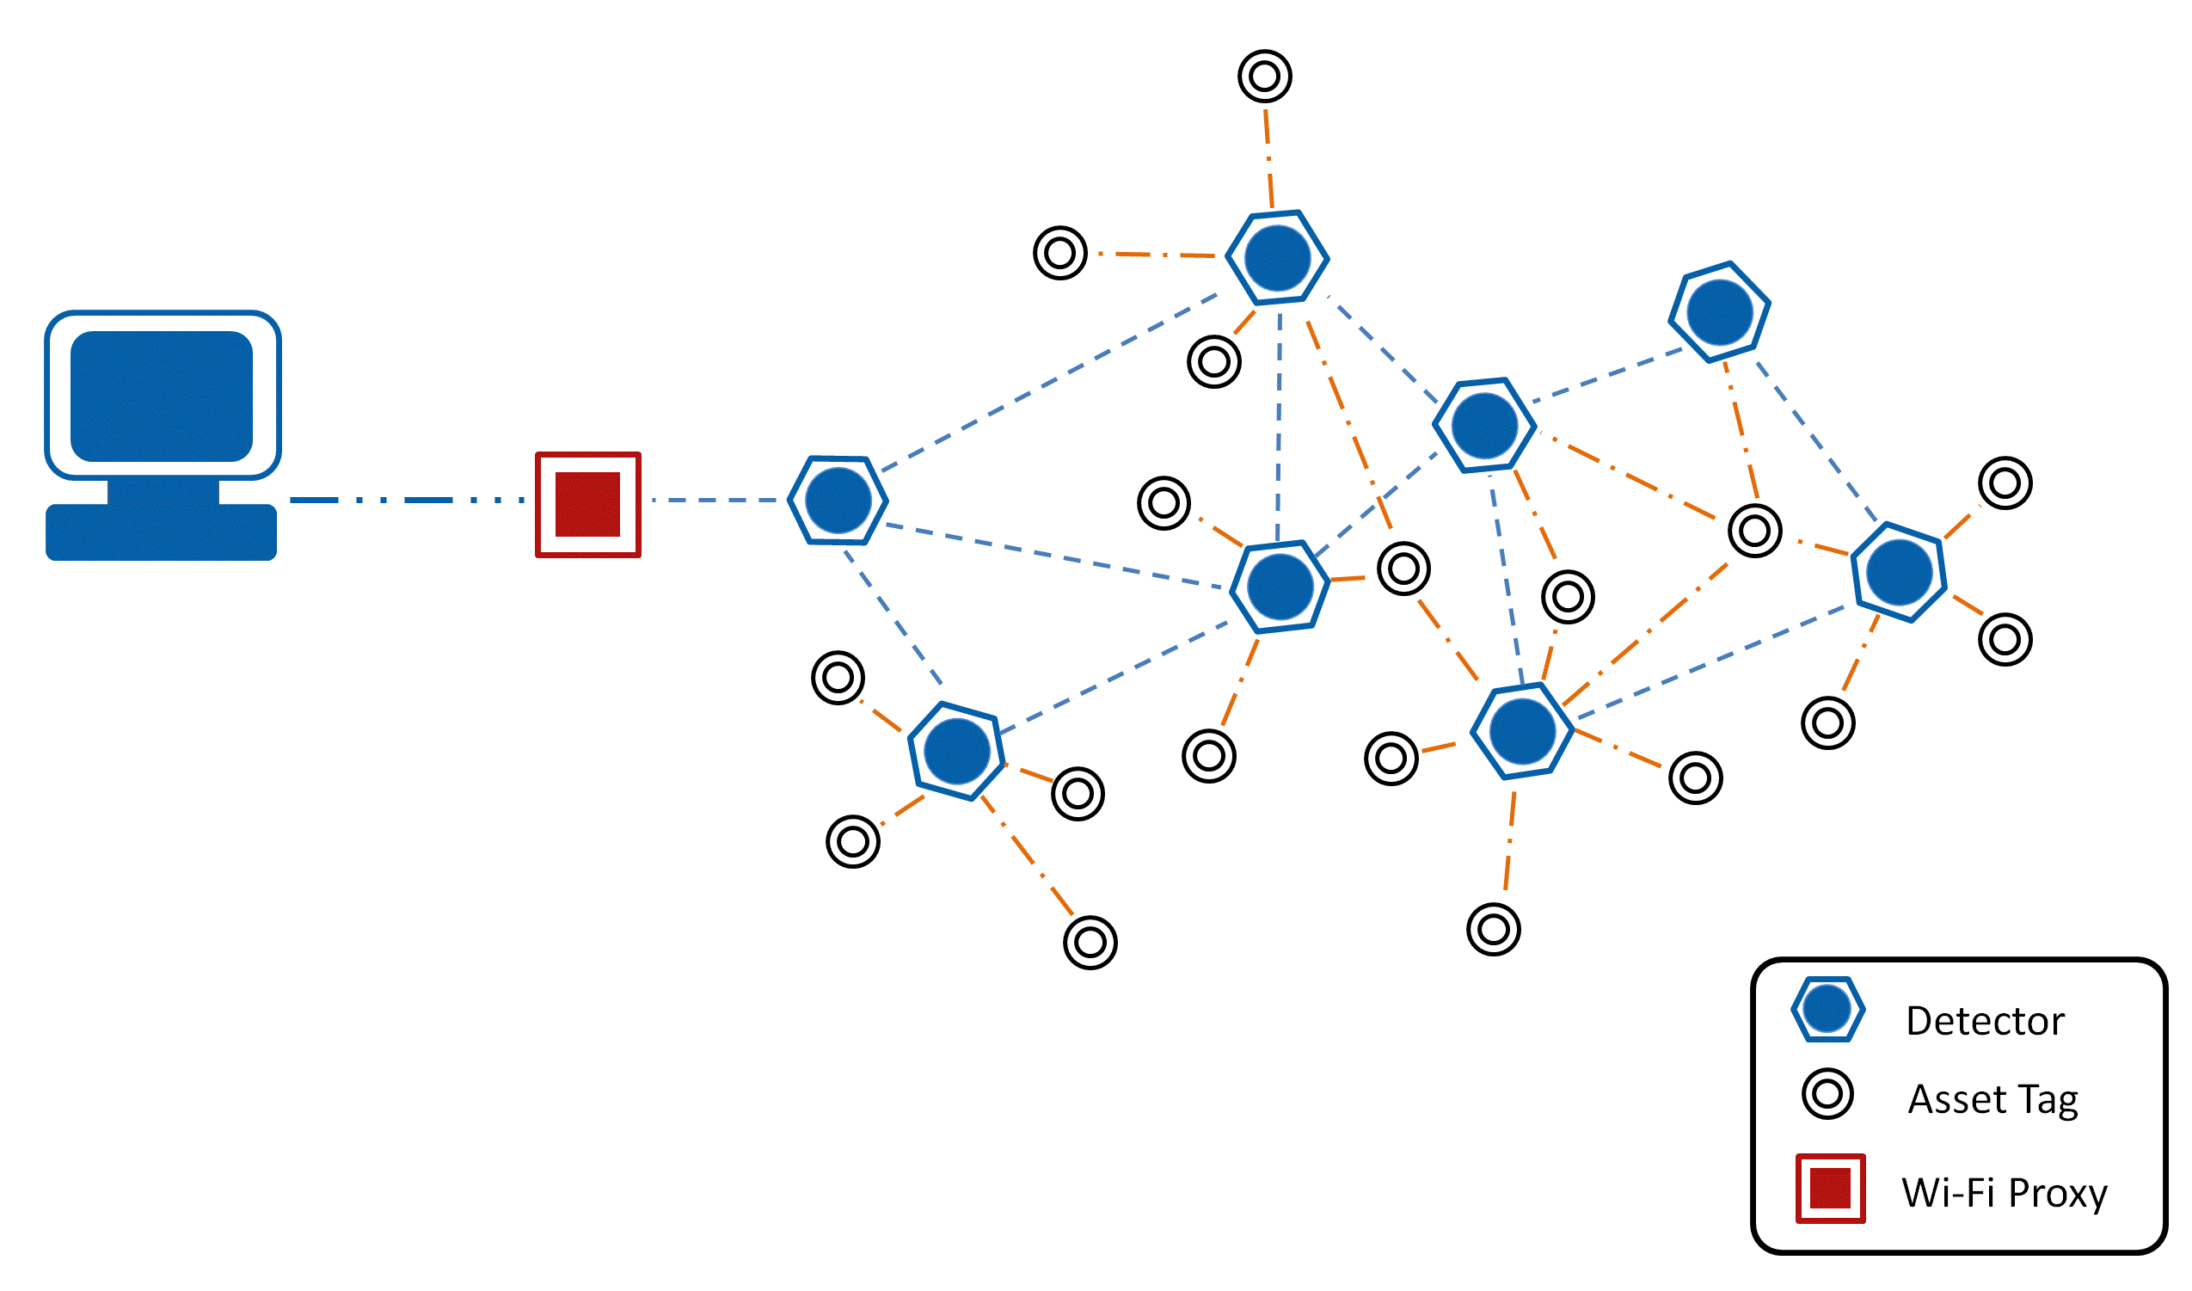
TIU Tracking System
Capstone 2011
Sponsored by Intel
Advisor: Prof. Robert Daasch
Team Members:
Daniel Ferguson – Dung Le
Lynh Pham – Man Hoang – Tri Truong
Introduction
Design
Products
This system uses an RF transceiver network to track mobile assets indoors, where more obvious solutions, such as GPS, are unable to function. The system determines an asset’s current location by matching the RF fingerprint of its periodic broadcasts with previously collected fingerprints stored in a database.
This system uses an RF transceiver network to track mobile assets indoors, where more obvious solutions, such as GPS, are unable to function. The system determines an asset’s current location by matching the RF fingerprint of its periodic broadcasts with previously collected fingerprints stored in a database.
Asset Tag
Size: 1”x1”x1”
Use ATMega328p MCU
Use 20mm coin cell battery
Battery life: more than 3 months
Use RF12B transceiver at 434MHz
Detector
Size: 3.5”x1”
Use ATMega328p MCU
Use 9V battery/adapter
Use RF12B transceiver at 434MHz
Requirements
Users
Web App
Database
Asset tag’s size: 1” x 1” x 1”
Low power consumption
Accurate
Web application as user interface
2D map display
Scalable tracking area
Low cost solution
Admin
Tag
Controller
Proxy
Detector
Features
RF Mesh Network
User and Admin interface
Interactive 2D map
Search TIU and detector via ID
Show battery level
Add and remove tag/detector
Change geometry of tracking area
Controller
Provide utilities to set up the system
Written in Java
Cross platform
Easy to use
Process data and calculate assets’ location
Approach
Test Results
This system uses an RF transceiver network to track mobile assets indoors, where more obvious solutions, such as GPS, are unable to function. The system determines an asset’s current location by matching the RF fingerprint of its periodic broadcasts with previously collected fingerprints stored in a database.
Wi-Fi Proxy
WiFly 802.11b/g at 2.4GHz
RF12B transceiver at 434MHz
MCU ATMega328p
Use 9V battery/adaptor
Web Application
User and Admin interface
Interactive 2D map
Search TIU and detector via ID
Show battery level
Add and remove tag/detector
Change geometry of tracking area
Fingerprint Algorithm
Calibrate and create a database of signal signature.
Locate by matching signal pattern
Interpolate calculated results
SQL Database
RSSI-distance model or RF fingerprinting
Location update interval
Geometry of the tracking area
Identifications, locations, and battery levels of the TIUs
Conclusions
The accuracy of the tracking system needs to be enhanced by considering antenna design and advanced locating algorithm. Noise filter can be implemented on both hardware and software to achieve desired performance.
Mesh Network Concept
Department of Electrical and Computer Engineering

