Slide 1

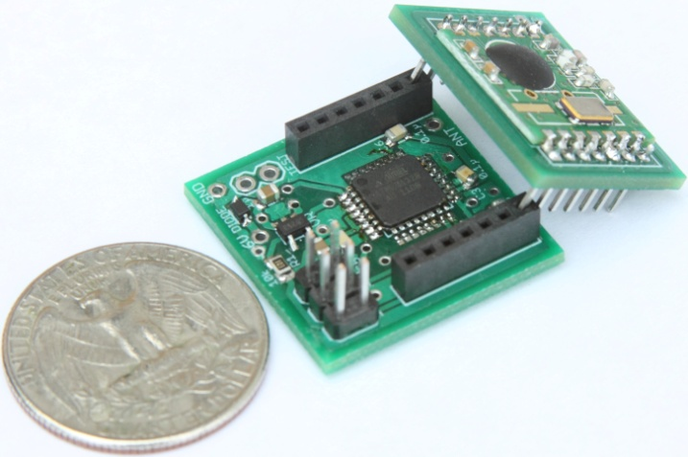
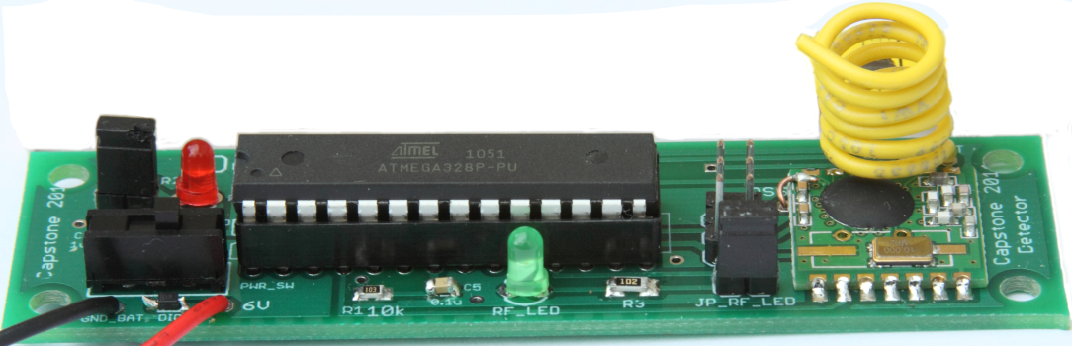
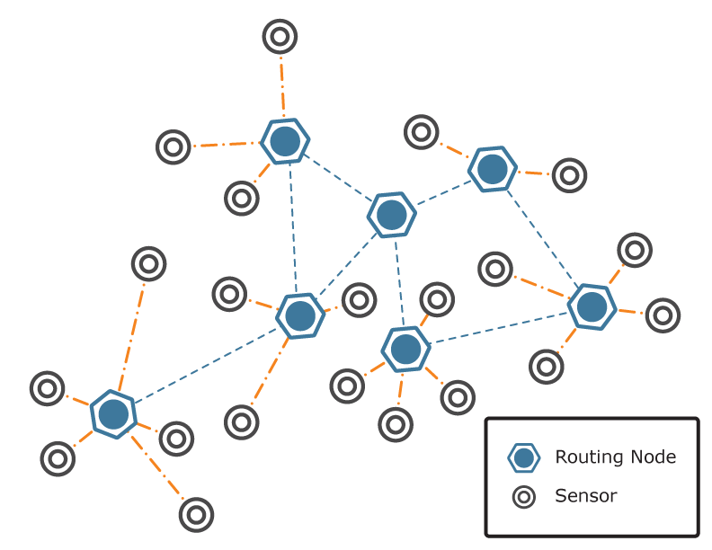
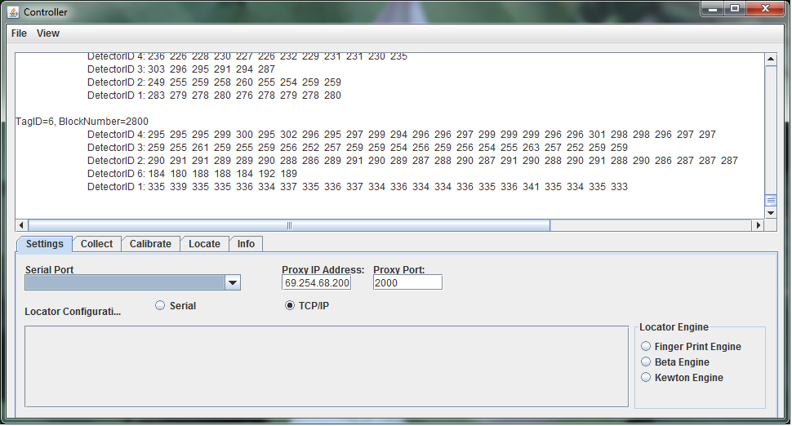
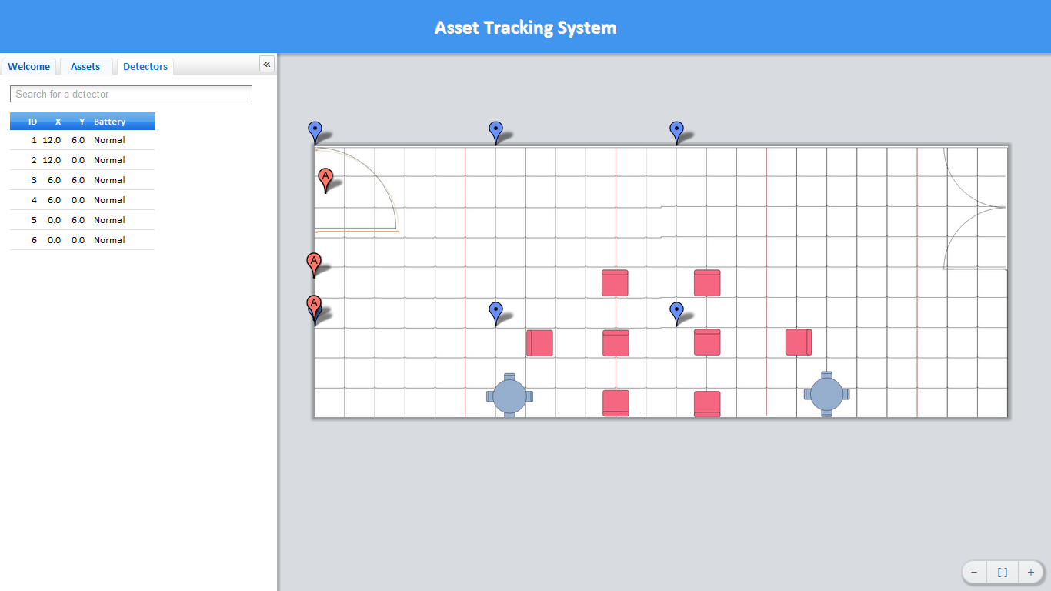
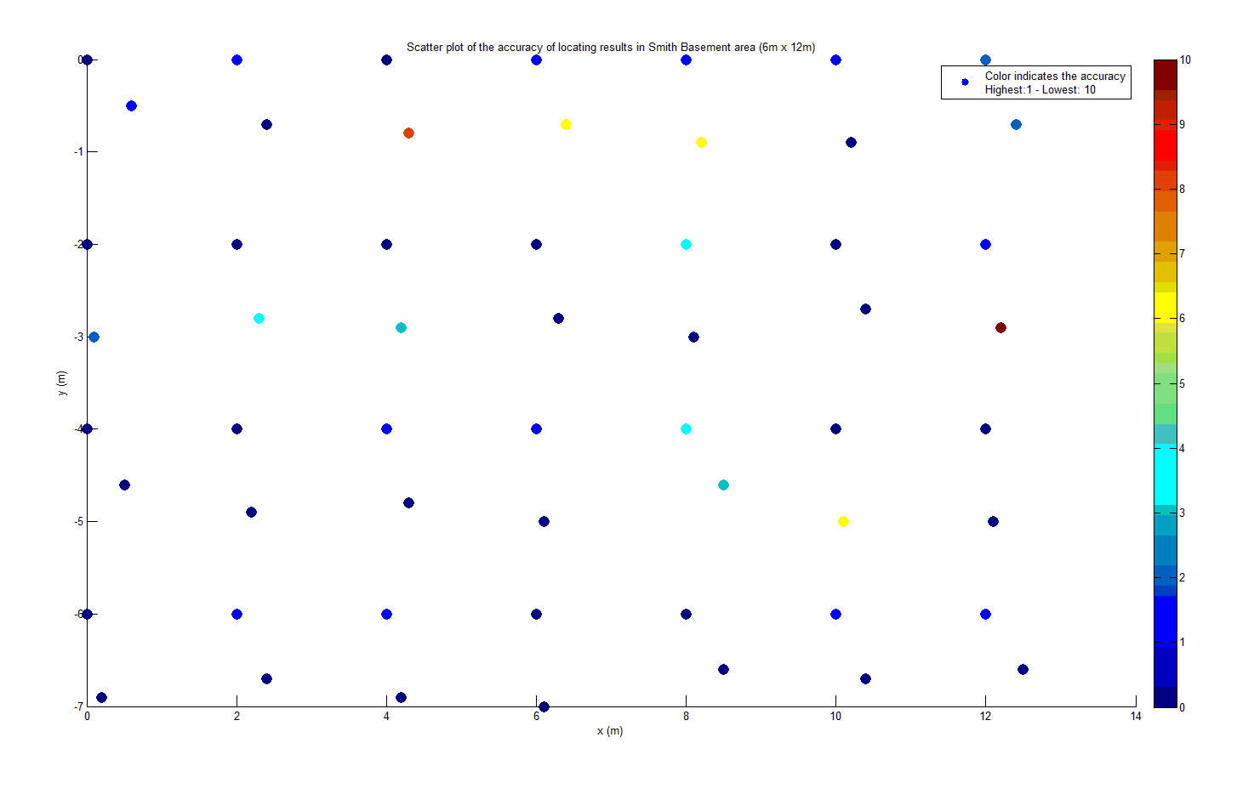
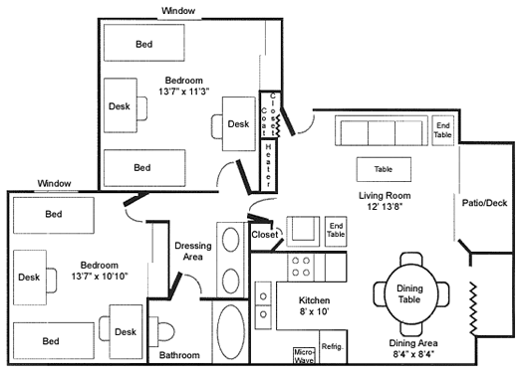
TIU TRACKING SYSTEM
Capstone Project 2011
Advisor: Prof. Robert Daasch
Sponsored by Intel
Team members:
Lynh Pham – Daniel Ferguson
Dung Le – Man Hoang – Tri Truong
Introduction
Design
Products
This system uses an RF transceiver network to track mobile assets indoors, where more obvious solutions, such as GPS, are unable to function. The system determines an asset’s current location by matching the RF fingerprint of its periodic broadcasts with previously collected fingerprints stored in a database.
This system uses an RF transceiver network to track mobile assets indoors, where more obvious solutions, such as GPS, are unable to function. The system determines an asset’s current location by matching the RF fingerprint of its periodic broadcasts with previously collected fingerprints stored in a database.
Asset Tag
Size: 1”x1”x1”
Use RF12B transceiver at 434MHz
Use MCU ATMega328p
Use coin cell 20mm battery
Battery life: more than 1 month
Detector
Size: 3.5”x1”
Use RF12B transceiver at
434MHz
Use MCU ATMega328p
Use 9V battery/adapter
Requirements
Asset tag’s size: 1” x 1” x 1”
Low power consumption
Accurate
Web application as user
interface
2D map display
Scalable tracking area
Low cost solution
Mesh Network Concept
Features
RF Mesh Network
User and Admin interface
Interactive 2D map
Search TIU and detector via ID
Show battery level
Add and remove tag/detector
Change geometry of tracking area
Controller
Provide utilities to set up the system
Written in Java
Cross platform
Easy to use
Process data and calculate assets’ location
Approach
This system uses an RF transceiver network to track mobile assets indoors, where more obvious solutions, such as GPS, are unable to function. The system determines an asset’s current location by matching the RF fingerprint of its periodic broadcasts with previously collected fingerprints stored in a database.
Test Results
Wi-Fi Proxy
WiFly 802.11b/g at 2.4GHz
RF12B transceiver at 434MHz
MCU ATMega328p
Use 9V battery/adaptor
Web Application
User and Admin interface
Interactive 2D map
Search TIU and detector via ID
Show battery level
Add and remove tag/detector
Change geometry of tracking area
Fingerprint Algorithm
Calibrate and create a database of signal signature.
Locate by matching signal pattern
Interpolate calculated results
SQL Database
RSSI-distance model or RF fingerprinting
Location update interval
Geometry of the tracking area
Identifications, locations, and battery levels of the TIUs
Conclusions
The accuracy of the tracking system needs to be enhanced by considering antenna design and advanced locating algorithm. Noise filter can be implemented on both hardware and software to achieve desired performance.
Indoor tracking area
Department of Electrical and Computer Engineering

