Slide 1

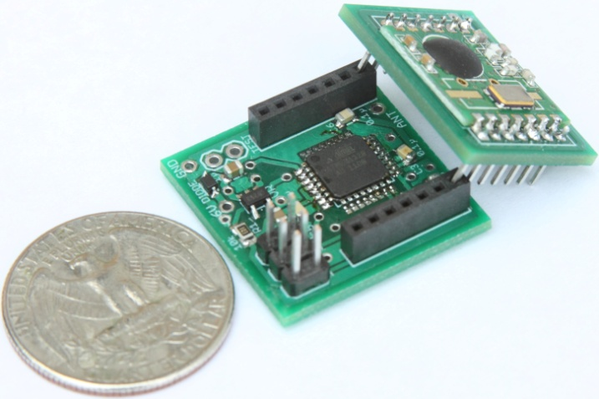
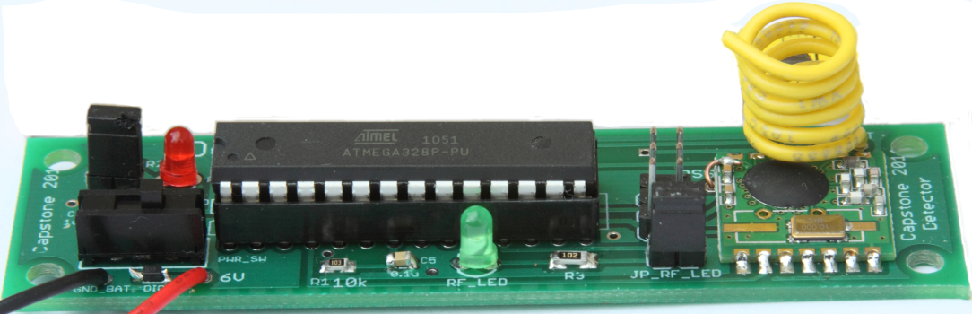





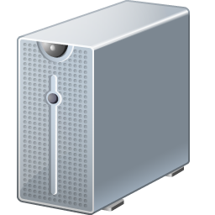



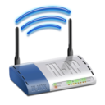

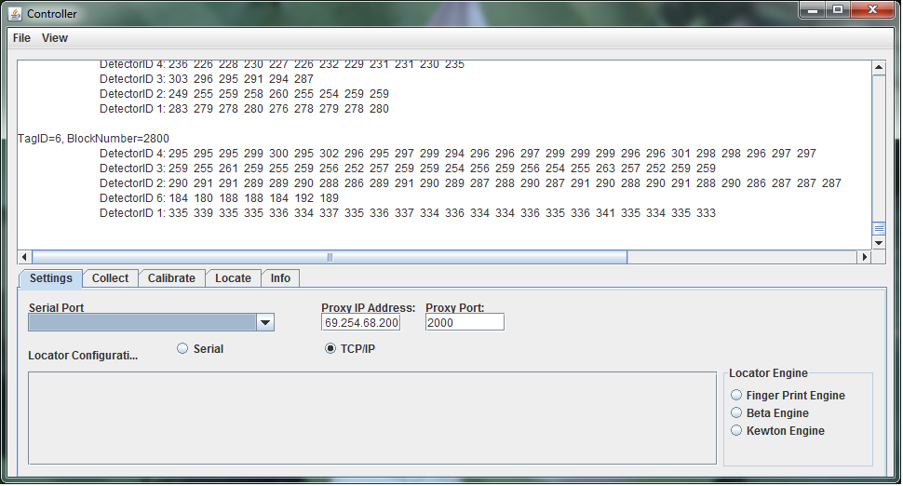

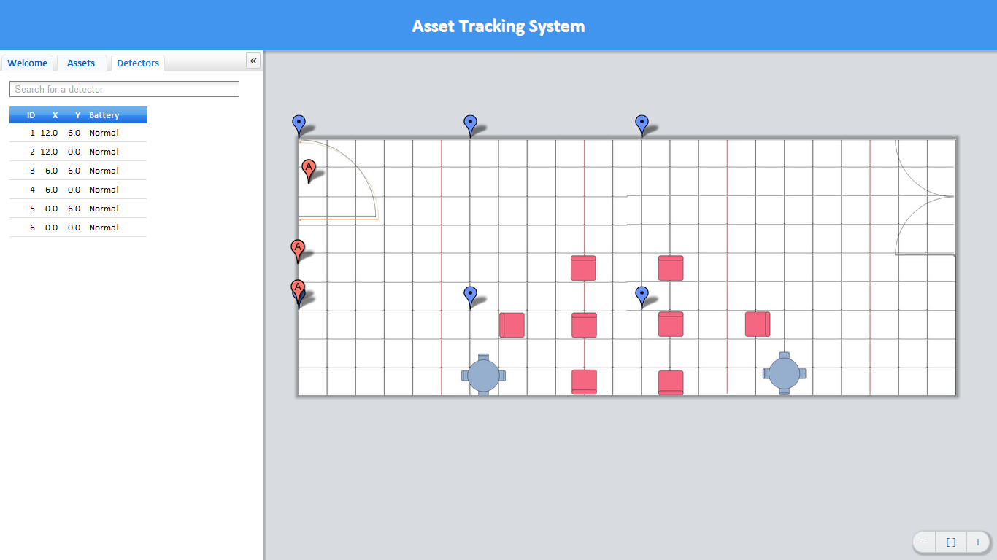
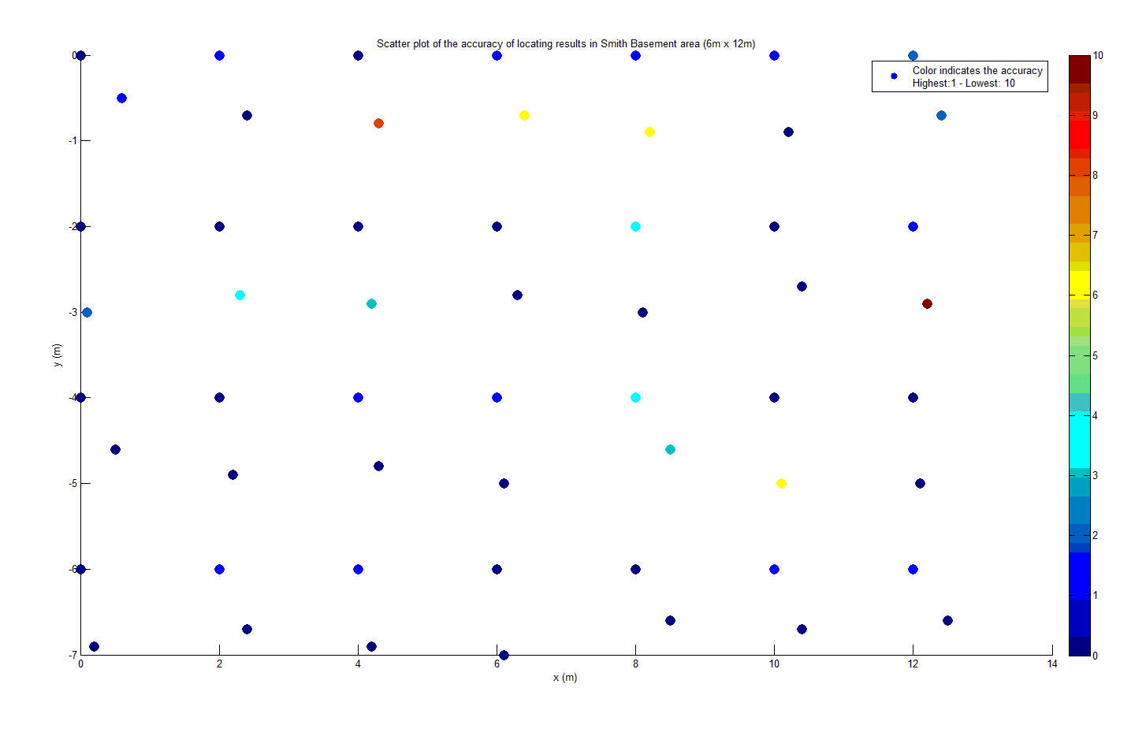
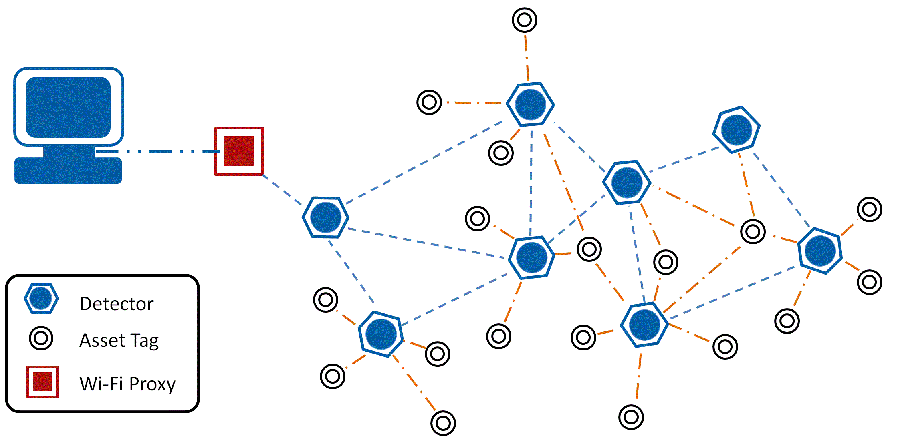
TIU Tracking System
Capstone 2011
Sponsored by Intel
Advisor: Prof. Robert Daasch
Team Members:
Daniel Ferguson – Dung Le
Lynh Pham – Man Hoang – Tri Truong
Introduction
Design
Products
This system uses an RF transceiver network to track mobile assets indoors, where more obvious solutions, such as GPS, are unable to function. The system determines an asset’s current location by matching the RF fingerprint of its periodic broadcasts with previously collected fingerprints stored in a database.
Tags are placed onto Test Interface Units (TIUs). The tags broadcast a signal periodically, which is picked up by detectors that are placed in various fixed locations within the tracking area. The detectors determine the signal strength of the tags, form a message and relay it, via a mesh network of other detectors until the message reaches the proxy. The proxy then retransmits the message via Wi-Fi to the controller. The controller gives the signal strength data to a locating algorithm which calculates its approximate location via statistical analysis. The results are placed into a database where the web app periodically retrieves the results and displays them on an interactive 2D map.
Asset Tag
Size: 1”x1”x1”
Use ATMega328p MCU
Use 20mm coin cell battery
Battery life: more than 3 months
Use RF12B transceiver at 434MHz
Detector
Size: 3.5”x1”
Use ATMega328p MCU
Use 9V battery/adapter
Use RF12B transceiver at 434MHz
Requirements
Users
Asset tag’s size: 1” x 1” x 1”
Low power consumption
Accurate
Web application as user interface
2D map display
Scalable tracking area
Low cost solution
Web App
Database
Admin
Tag
Controller
Proxy
Detector
Features
RF Mesh Network
Composed of small, inexpensive hardware
Relay messages to proxy via a controlled flooding mechanism
Collision avoidance using time division
Tags broadcast periodically
Detectors pick up broadcast, determine RSSI, and send results
Detectors also act as relays
Controller
Primary link between the mesh network and the back end infrastructure
Communicates with mesh network
Executes the locating algorithm
Communicates with the Database
Approach
By collecting RF signatures and storing them in a database, the RF signature created by a tag's broadcast can be compared to those stored in the database and the closest match roughly identifies the location of the tag.
The processing is done in a Java application that has a direct TCP/IP connection to the proxy. Likewise, the proxy is connected to the Controller via an onboard Wi-Fi module and to the mesh network via an RF12 module.
Test Results
Web Application
Primary user interface
Interactive 2D map
Search TIU and detector via ID
Show battery level of all elements in the mesh network
Configure tag
Configure detector placement
Configure geometry of tracking area
Wi-Fi Proxy
RFM12 module receives data from the mesh network
Wi-Fi module sends data to the controller
Fingerprint Algorithm
A progressively constrained, nearest neighbor algorithm, using Euclidean distance as the matching metric. Also, several heuristics are employed that further enhance the accuracy and reliability of the locating process
Conclusions
SQL Database
Stores locations and battery information of all tags and detectors
Stores user accounts
The accuracy of the tracking system needs to be enhanced by considering antenna design and advanced locating algorithm. Noise filter can be implemented on both hardware and software to achieve desired performance.
Mesh Network Concept
Department of Electrical and Computer Engineering

