Slide 1
Introduction
Problem statement
Key requirements
Size
Power
Accuracy

Slide 2
Agenda
System Overview
Hardware
Firmware
Software
Deployment
Results
Conclusions

Slide 3
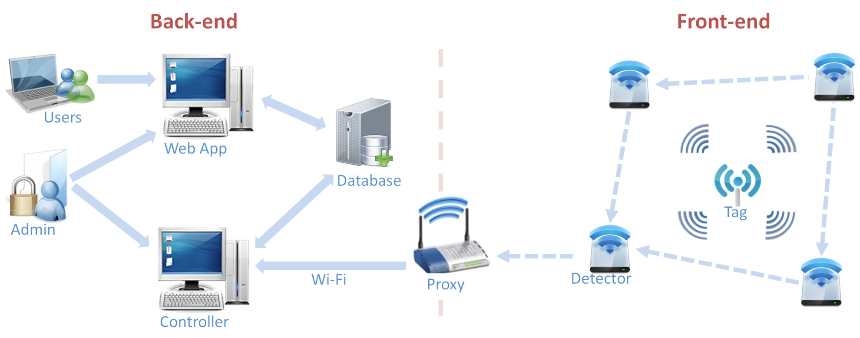
System Overview

Slide 4
Agenda
System Overview
Hardware
Firmware
Software
Deployment
Results
Conclusions

Slide 5
Hardware
Devices
Tag
Detector
Proxy
Components
RF12 transceiver
ATmega328p MCU
WiFly 802.11b/g transceiver
Schematic and layout by Eagle CAD
PCB by Sunstone

Slide 6
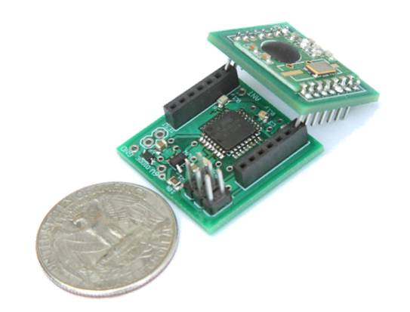
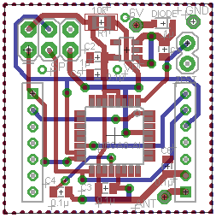
Hardware
Tag
Product
Layout

Slide 7
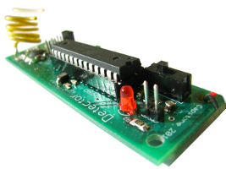
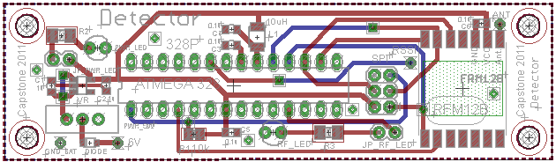
Hardware
Detector
RF12 transceiver
ATmega328p MCU
Status LED
Size: 3.5” x 1”
Product
Layout

