Slide 1
Introduction
Problem statement
Key requirements
Size
Power
Accuracy

Slide 2
Agenda
System Overview
Hardware
Firmware
Software
Deployment
Results
Conclusions

Slide 3
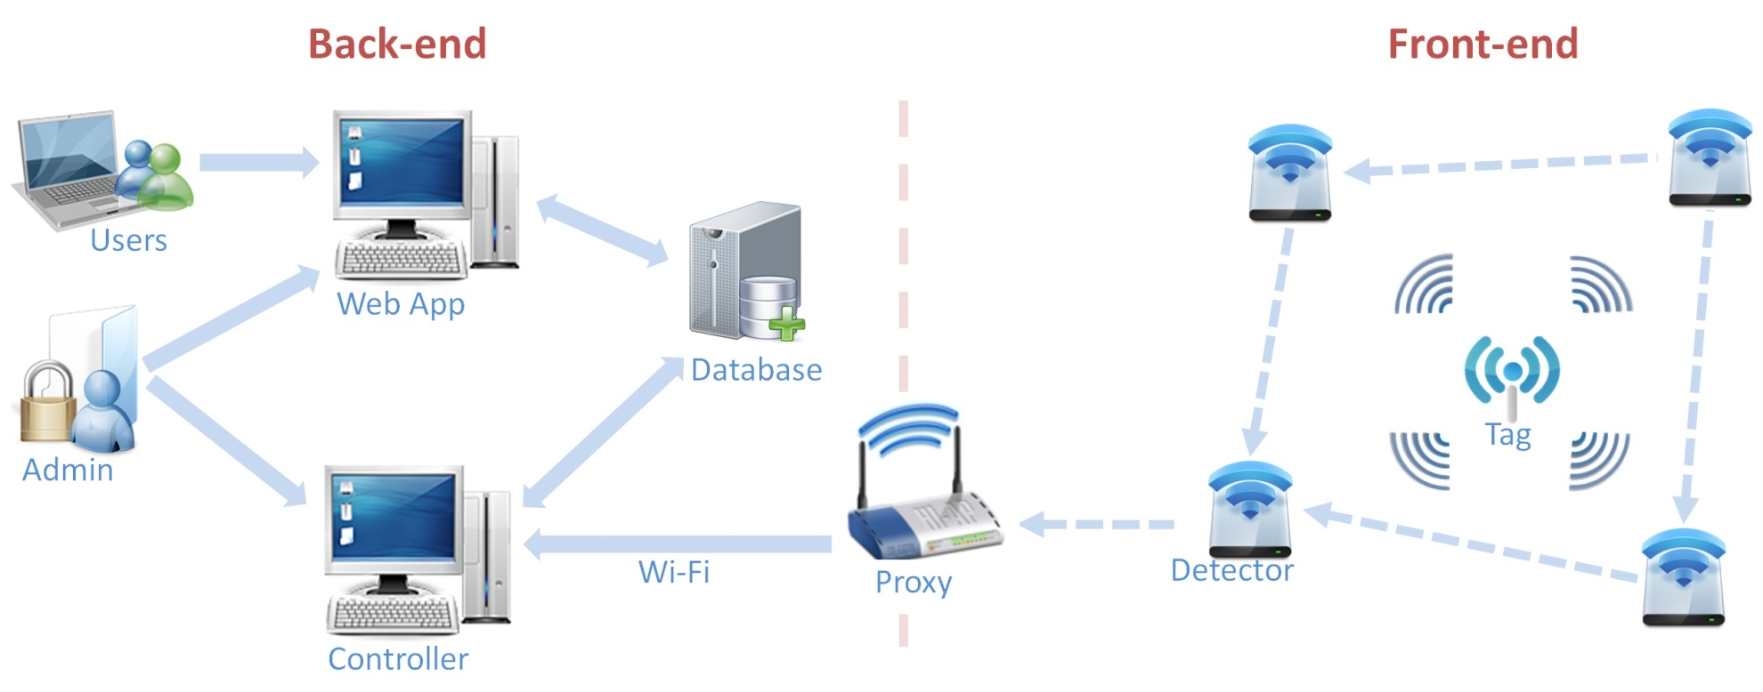
System Overview

Slide 4
Agenda
System Overview
Hardware
Firmware
Software
Deployment
Results
Conclusions

Slide 5
Hardware
Devices
Tag
Detector
Proxy
Components
RF12 transceiver
ATmega328p MCU
WiFly 802.11b/g transceiver
Schematic and layout by Eagle CAD
PCB by Sunstone

Slide 6
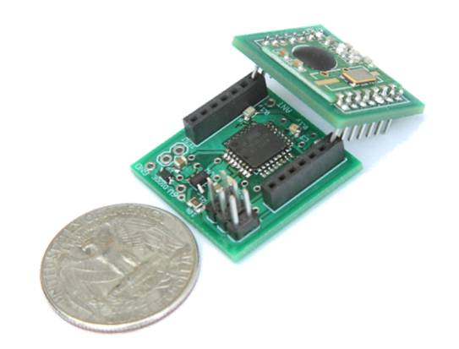
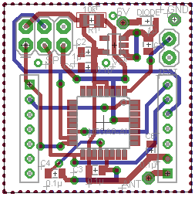
Hardware
Tag
Product
Layout

Slide 7
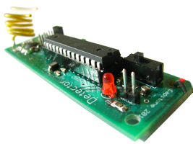
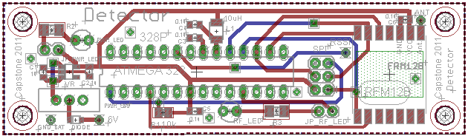
Hardware
Detector
RF12 transceiver
ATmega328p MCU
Status LED
Size: 3.5” x 1”
Product
Layout

Slide 8
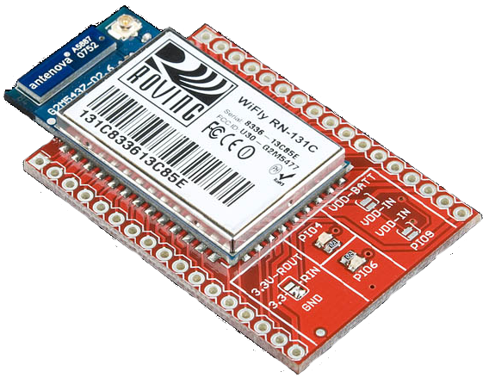
Hardware
Proxy
RF12 transceiver
ATmega328p MCU
WiFly 802.11b/g transceiver
Breadboard prototype
Ceramic antenna

Slide 9
Agenda
System Overview
Hardware
Firmware
Software
Deployment
Results
Conclusions

Slide 10
Firmware
IMAGE

Slide 11
Firmware
Tag
Mostly in low power state
Periodically wakes up to broadcast
Detector
Listen for messages from tags and other detectors
Controlled flooding
Collision avoidance via time division
Proxy
Listens for messages from detectors
Forwards messages to Controller
Generally
All speak a common message format which includes
Battery Information
Infrastructure for a more sophisticated routing protocol
Fixed length

Slide 12
Agenda
System Overview
Hardware
Firmware
Software
Deployment
Results
Conclusions

Slide 13
Software
Controller
Collects data from Proxy
Feed data to Location Engine
Two operating modes
Calibrating
Collects RF signature at calibration points
Stores calibration data in a local database
Locating
Passes calibration data to Location Engine
Collects and sorts data into packets
Feeds the packets to Location Engine
Stores results in MySQL Database

Slide 14
Software

Slide 15
Software

Slide 16
Agenda
System Overview
Hardware
Firmware
Software
Deployment
Results
Conclusions

Slide 17
Agenda
System Overview
Hardware
Firmware
Software
Deployment
Results
Conclusions

