Slide 1

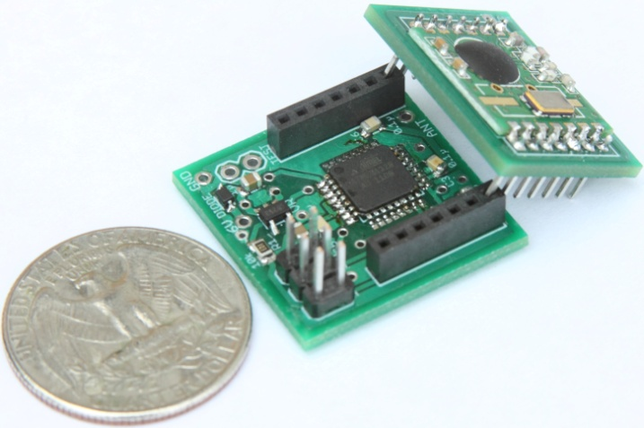
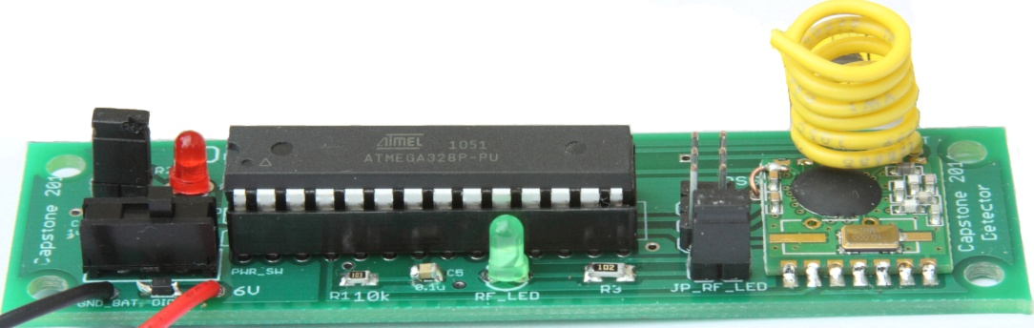




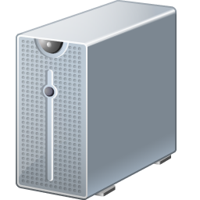





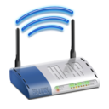
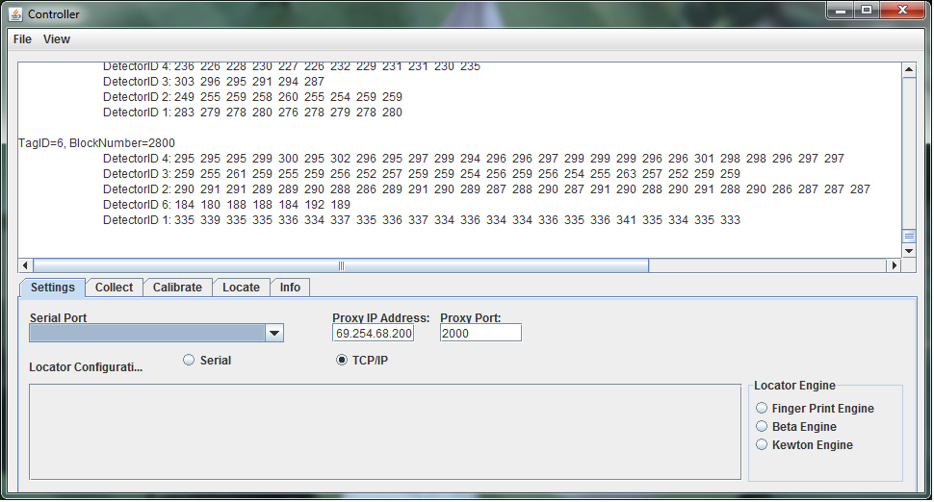
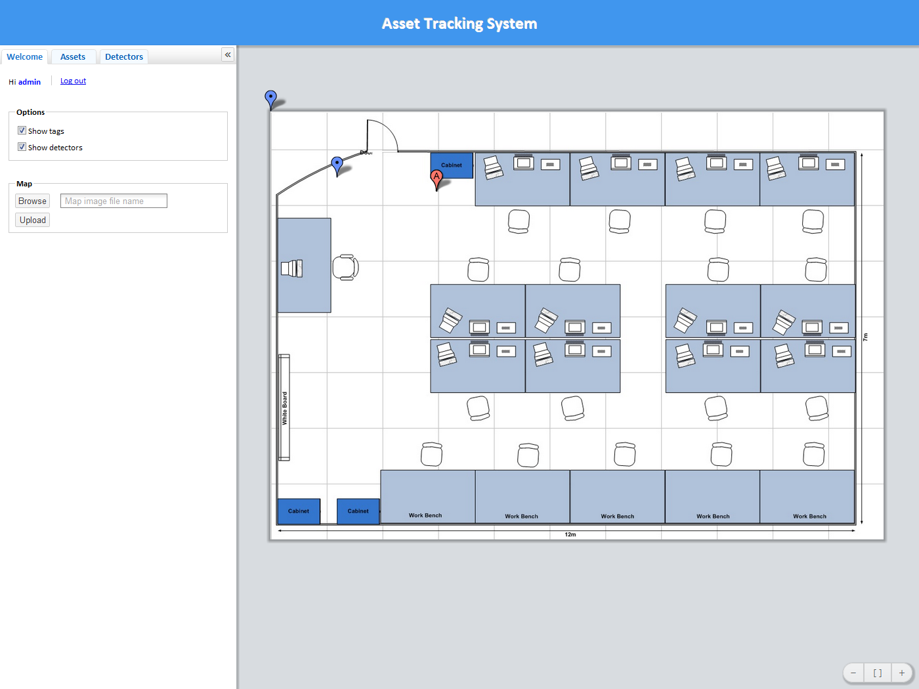
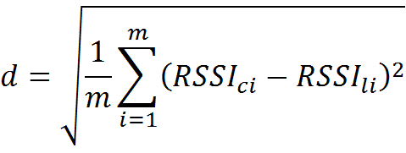
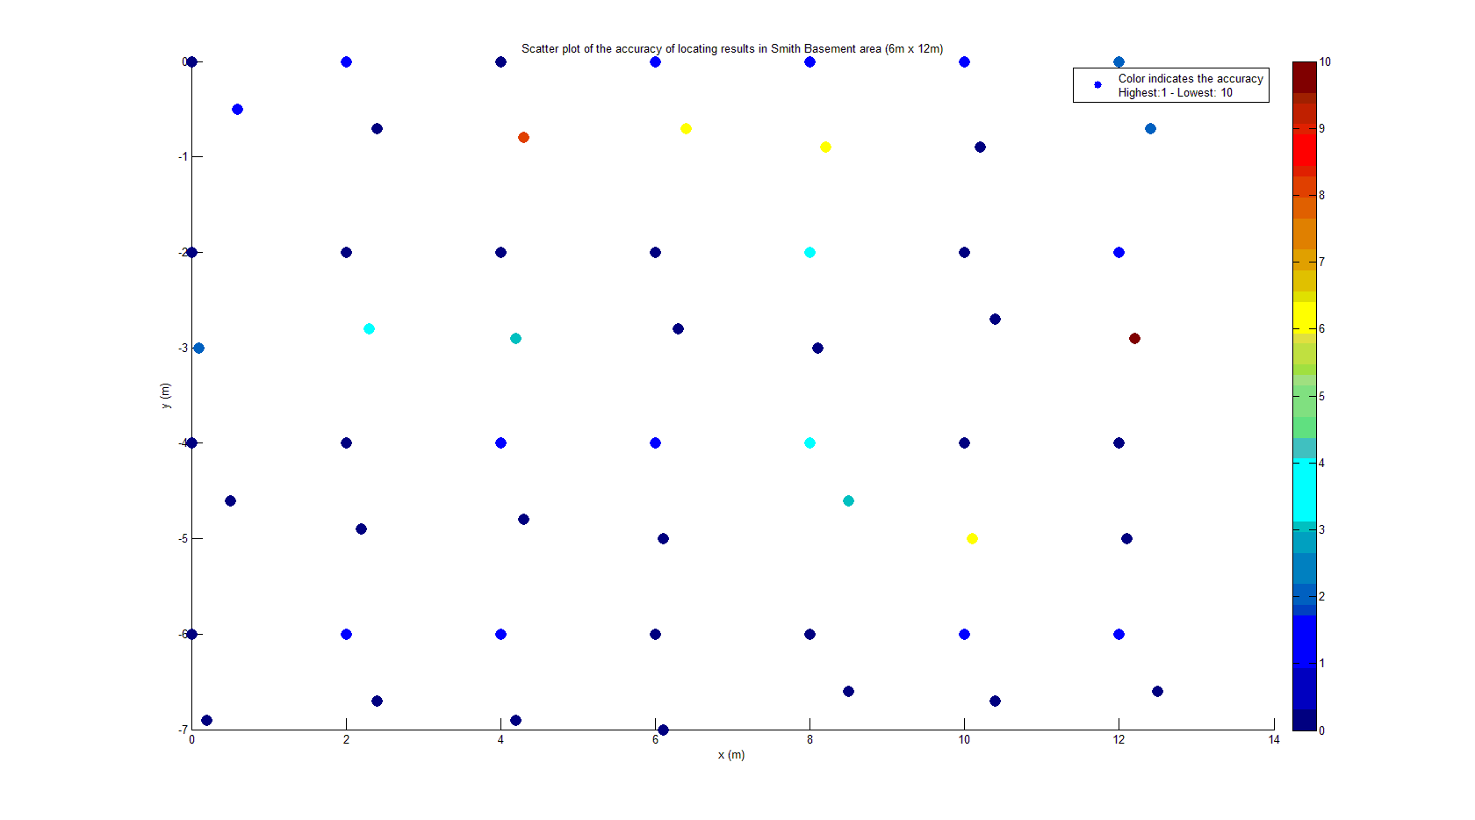
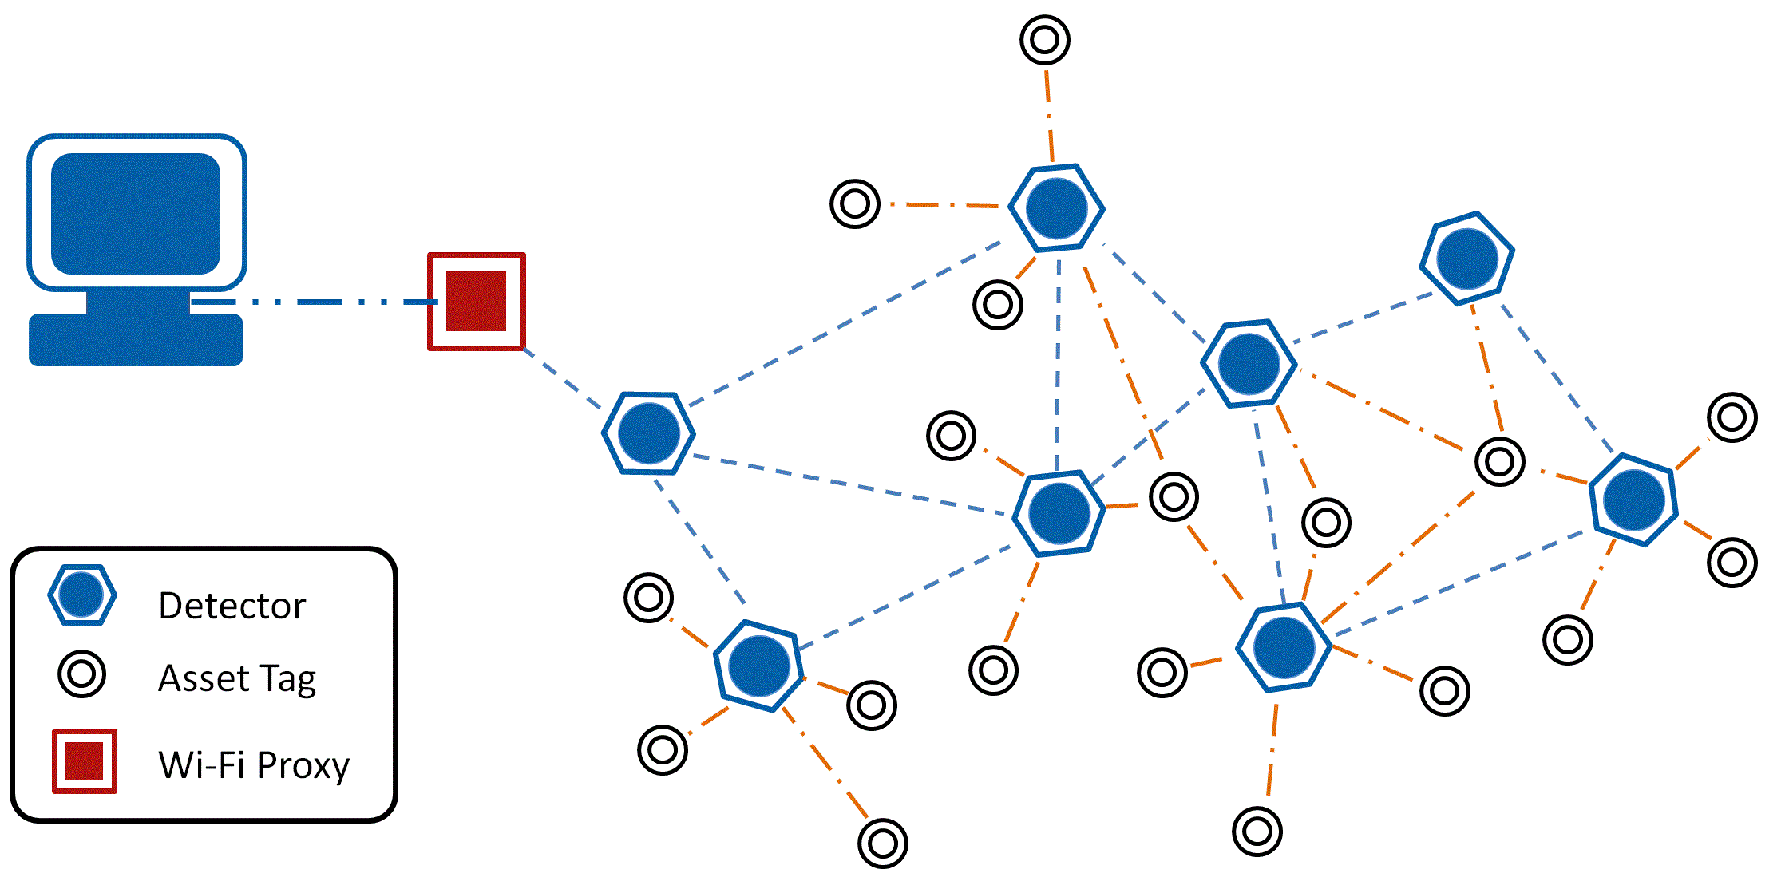
TIU Tracking System
Capstone 2011
Sponsored by Intel
Advisor: Prof. Robert Daasch
Team Members:
Daniel Ferguson – Dung Le
Lynh Pham – Man Hoang – Tri Truong
Introduction
Design
Products
Intel's large and complex validation labs contain many Testing Interface Unit's(TIU) used in validating hardware. A TIU is a custom PCB that provides test points that a testing machine can probe. Since the hardware to be tested is varied, there exists a variety of different TIU's, and as such, finding a particular TIU is useful because, previously, the testing machine had to be broken down to identify the TIU it was using. The guiding requirements are that the system must be small, inexpensive, and low power.
Back-end
Front-end
Users
Web App
Asset Tag
Size: 1”x1”x1”
ATMega328p MCU
RF12B transceiver at 434MHz
20mm coin cell battery
Battery life: 3 months
Cost : $15
Detector
Size: 3.5”x1”
ATMega328p MCU
RF12B transceiver at 434MHz
9V battery/adapter
Cost: $17
Database
Tag
Admin
Approach
Wi-Fi
Proxy
Detector
Our system uses an RF transceiver mesh network to track mobile assets indoors. The system determines an asset’s current location by matching the RF fingerprint, based on signal strength, of a Tags periodic broadcasts with previously collected fingerprints stored in a database.
Why RF signal strength?
Radio Received Signal Strength Indication (RSSI) is a measurement of the amount of power received by antenna. Theoretically, distances can be approximated based on the relationship between transmitted and received signal strength.
We based our system on RF signal strength because alternative choices such as GPS, IR, and Acoustics either cannot work indoors, or requires line of sight. Also, low power RF transceivers are readily available.
- Where d is the Euclidean distance between calibrated RSSI vectors
and located RSSI vector.
- RSSI_{ci} is RSSI signal received by detector i in calibrating phase
- RSSI_{li} is RSSI value received by detector I in locating phase
- m is the number of detectors participating into the locating phase
For scalability, a mesh network of detectors relay all data to a centralized controller where locations of tags are calculated and saved in a database. An easy to use web application provides visualization of tag locations, as well as other maintenance details.
Controller
Back-end Network
Controller
Primary link between the mesh network and the back end infrastructure
Communicates with mesh network
Executes the locating algorithm
Communicates with the Database
Fingerprint Algorithm
A progressively constrained, nearest neighbor algorithm, using Euclidean distance as the matching metric
Heuristics, input and output filters are employed that further enhance the accuracy and reliability of the locating process
Web Application
Primary user interface with an interactive 2D map
Search TIUs and detectors via ID
Show battery level of all elements in the mesh network
Configure tag and detector
Configure geometry of tracking area
SQL Database
Stores locations and battery levels of all tags and detectors
Stores user accounts
Front-end Network
Tags
Attached to TIUs
Periodically broadcast
When not broadcasting, in a low power state
Detectors
Determine RSSI of broadcasting tags
Must always be listening for a tag to broadcast
Rebroadcasts the message, which results in messages always propagating toward the proxy
Messages are relayed to the proxy via a controlled flooding mechanism
Collision avoidance is achieved using time division
Wi-Fi Proxy
Receives data from the mesh network and relays data to the controller
Test Results
Conclusions
The accuracy of the tracking system needs to be enhanced by considering antenna design and advanced locating algorithm. Noise filter can be implemented on both hardware and software to achieve desired performance.
Mesh Network Concept
Department of Electrical and Computer Engineering

