Slide 1






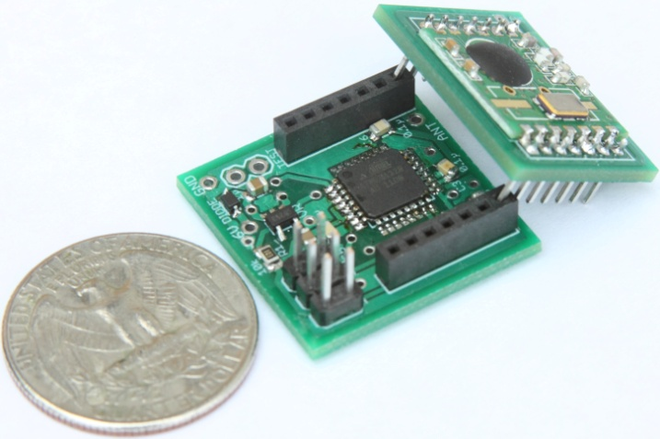
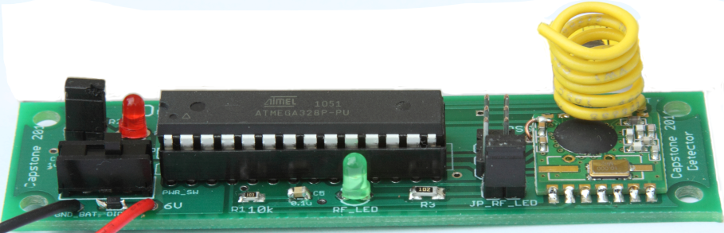

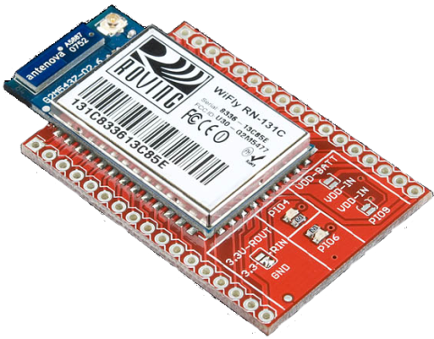



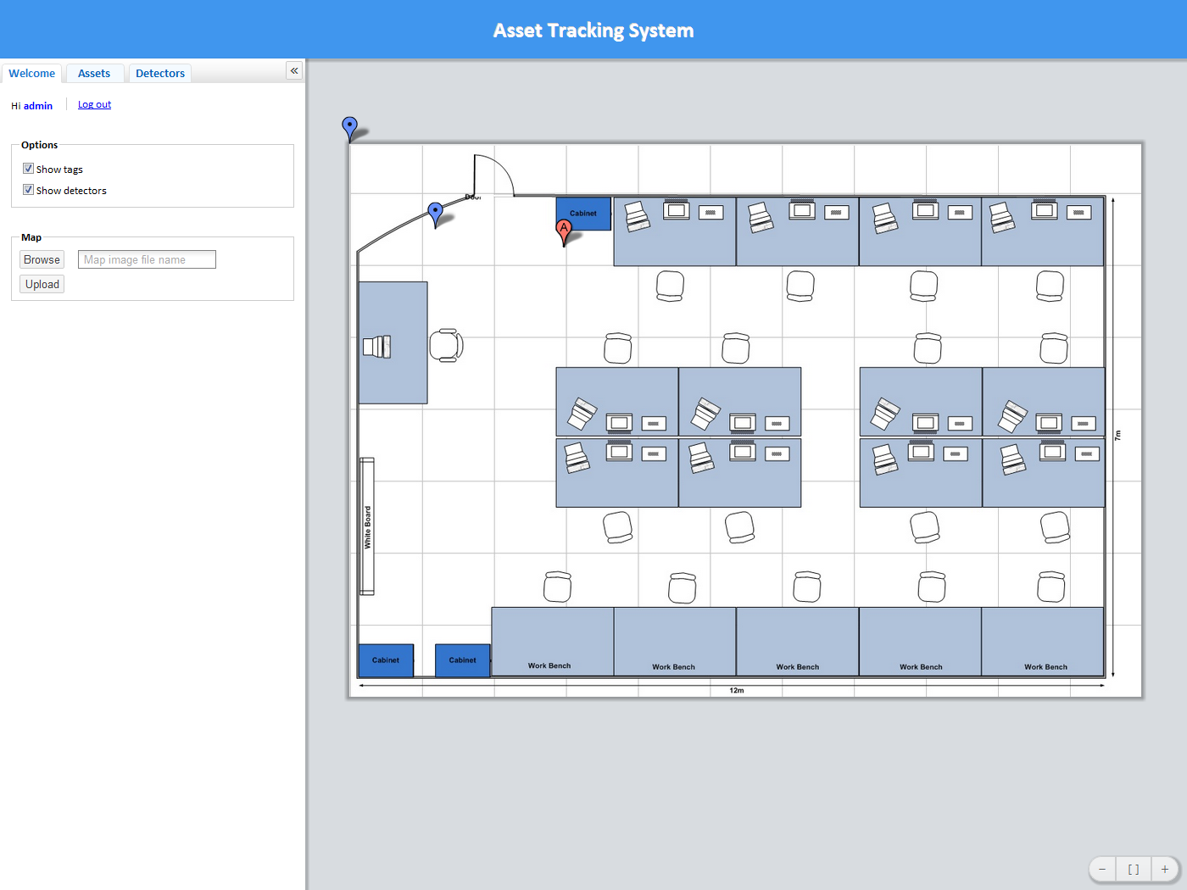


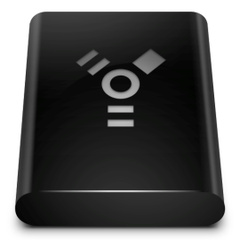






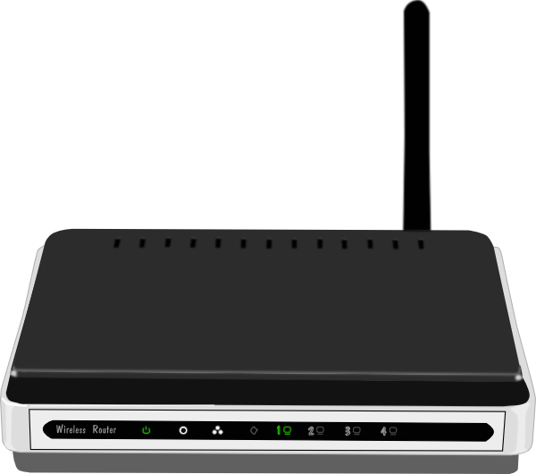

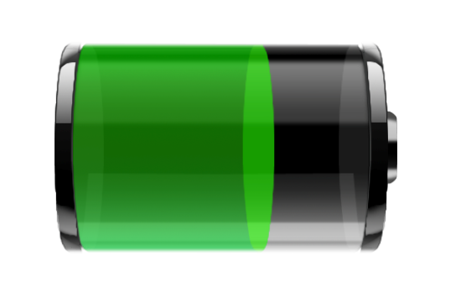



TIU TRACKING SYSTEM
Capstone 2011
ABSTRACT
METHODS & APPROACH
RESULTS
This system uses an RF transceiver network to track mobile assets indoors, where more obvious solutions, such as GPS, are unable to function. The system determines an assets current location by matching the RF fingerprint of its periodic broadcasts with previously collected fingerprints stored in a database
Asset Tag
Size: 1”x1”x1”
Use RF12B transceiver with 434MHz
Use MCU ATMega328p
Use coin cell 20mm battery
Battery life: more than 1 month
Controller
Daniel part
…………………..
Infrastructure
Locating Algorithm
User Interface
Data Management
Web Application
User and Admin interface
Interactive 2D map
Search TIU and detector via ID
Show battery level
Add and remove tag/detector
Change geometry of tracking area
Detector
Size: 3.5”x1”
Use RF12B transceiver with
434MHz
Use MCU ATMega328p
Use 9V battery/adapter
RF Transceiver
Mesh Network
Wi-Fi Proxy
Server Computer
Finger-Print
Voting Method
Web Application
User Interface
Admin Interface
Controller
SQL Database
Tracking Area
Battery Level
Proxy
Use WiFly 802.11b/g with 2.4GHz
Use RF12B transceiver with 434MHz
Use MCU ATMega328p
Use 9V battery/adaptor
SQL Database
RSSI-distance model or RF fingerprinting
Location update interval
Geometry of the tracking area
Identifications, locations, and battery levels of the TIUs
TIU Tracking System
REQUIREMENTS
Back-end
Front-end
Admin
Detector
Asset tag’s size: 1” x 1” x 1”
Low power consumption
High accuracy
Web application as user
interface
2D map display
Scalable tracking area
Low cost solution
Users
Internet
Tag
Detector
Controller
Proxy
Battery Life
Accuracy
Detector
CAPSTONE TEAM
Advantages
Disadvantages
Capacity of lithium coin cell: 240mAh
Transmission time: 3ms every 1 seconds
Active current: 30mA (RF transceiver + MCU)
Sleep current: 0.0425mA
Testing ………
Sponsor: Intel
Advisor: Prof. Robert Daasch
Members: Dung Le
Tri Truong
Lynh Pham
Man Hoang
Daniel Ferguson
Small size
Low power consumption
Easy scalability
Low cost
Noise sensitive
Calibration required
CONCLUSIONS
The tracking system consists of two primary parts: hardware and software. The hardware infrastructure is built upon RF technology. The number of detectors will be scaled in order to achieve the desired accuracy and efficiency..
……………………………….
Department of Electrical and Computer Engineering

