Slide 1
GDM assumptions and background concepts
GDM Workshop
Day 2
Instructor: Jacob Nesslage

Slide 2
Check-in!
How has your own analysis using generalized dissimilarity modeling been going?
Let’s discuss your analysis, your data wrangling struggles, and other issues…

Slide 3
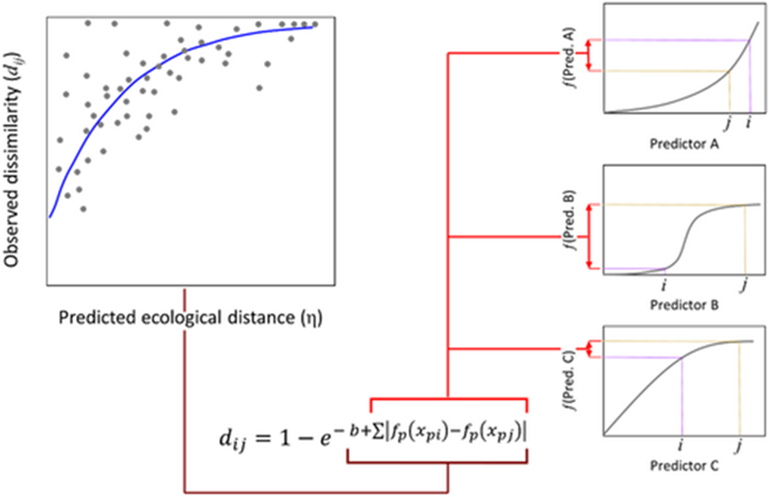
Last time: Statistical framework of GDMs
By assuming that increasing ecological distance must result in increasing dissimilarity monotonically, we can:
Preserve nonlinearity in the response of community dissimilarity to environmental variables
Account for the saturating effect of increasing ecological distance on dissimilarity
Extend models to spatial data easily via I-spline transformation

Slide 4
What statistical concepts underlie GDMs?
Mantel Test
Matrix Regression
Generalized Linear Models

Slide 5
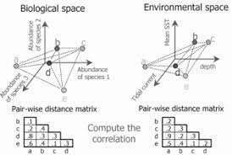
Mantel Test
The Mantel test (Mantel 1988) is a statistical test of the correlation between two matrices.
We can not assess the relationship between the two matrices by evaluating the correlation coefficient between the two sets of distances and testing its statistical significance. The Mantel test deals with this problem.
The procedure adopted is a kind of randomization or permutation test. Rows and columns in the predictor distance matrix are permutated randomly and the correlation is assessed each time.
GDM employs the same random permutation approach in tests of variable importance

Slide 6
Matrix Regression
GDMs are able to utilize these random permutations of matrices through an extension of matrix regression (Smouse 1986, Legendre 1994).
Matrix regression involves a multiple regression of a response matrix on any number of explanatory matrices, where each matrix contains distances or similarities (in terms of ecological, spatial, or other attributes) between all pair-wise combinations of n objects (sample units); tests of statistical significance (R²) are performed by permutation.
GDMs make use of the advantages of matrix regression (regression of multiple distance matrices to a response matrix) and retains the permutations in statistical testing.

Slide 7
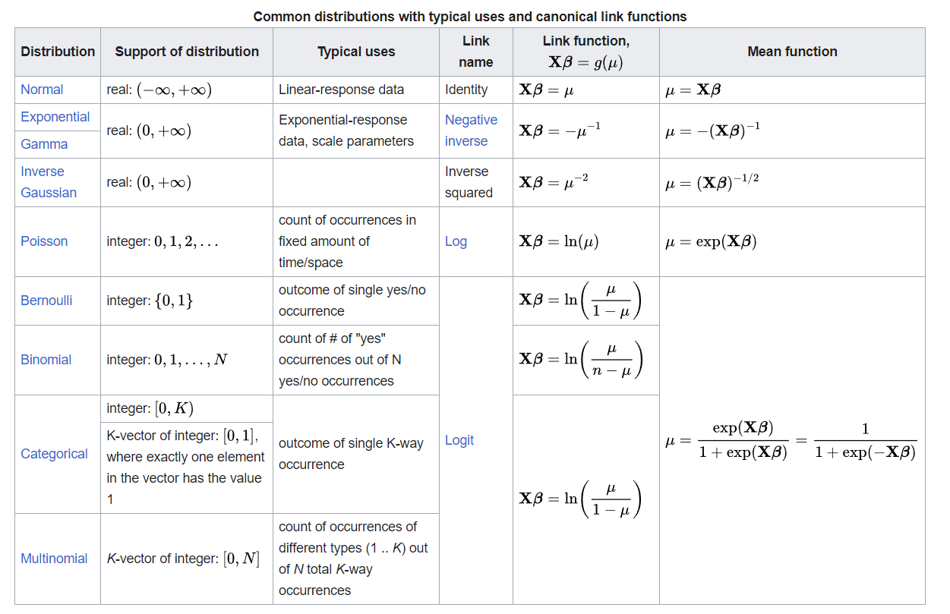
Generalized Linear Models
Generalized linear models (GLM) are a flexible generalization of ordinary linear regression.
The GLM generalizes linear regression by allowing the linear model to be related to the response variable via a link function and by allowing the magnitude of the variance of each measurement to be a function of its predicted value.
Generalized linear models are flexible in that they allow for response variables that have arbitrary distributions (rather than simply normal distributions), and for an arbitrary function of the response variable (the link function) to vary linearly with the predictors (rather than assuming that the response itself must vary linearly).

Slide 8
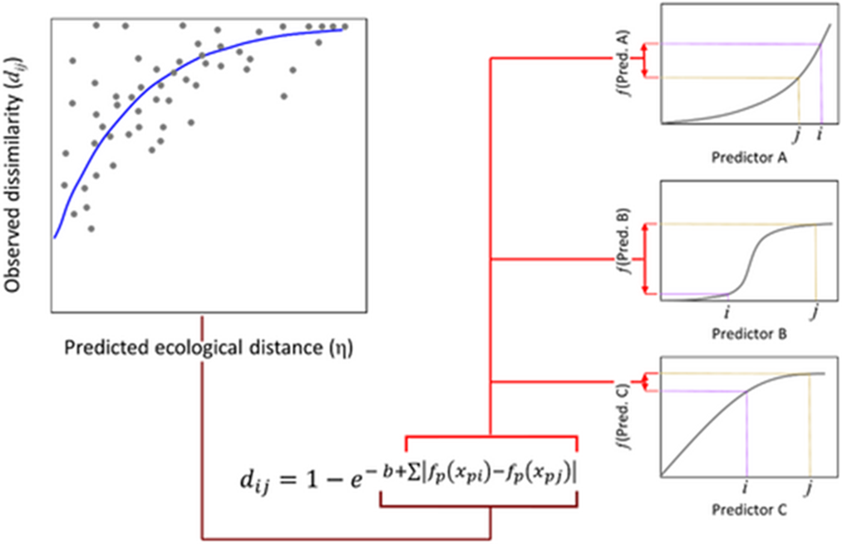
Back to GDMs
Looking again at this familiar equation, we can see that GDMs have a combination of several interesting features
A matrix regression framework in the link function that denotes ecological distance
I-splines to model nonlinear rates of change in environmental gradients
A GLM framework that utilizes an exponential function, modeling saturation with increasing ecological distance
Permutation in model testing and evaluation

Slide 9
Let’s discuss the assumptions
Are there any parts of the modeling framework that are hard to understand?
Matrix regression
I-splines
GLMs
Do you disagree with some of the assumptions?
Does increasing ecological distance really necessitate increasing dissimilarity?
Are there any drawbacks from modeling predictors using I-splines?

Slide 10
Issues to be aware of with GDMs (per ChatGPT) (Also, which identified issues are wrong!)
Sensitivity to Predictor Variables: GDM can be sensitive to the choice of predictor variables used in the model. The selection of predictor variables is crucial, and the inclusion of irrelevant or redundant variables can lead to overfitting or inaccurate results.
Overfitting: Similar to other statistical modeling techniques, GDM can suffer from overfitting if too many predictor variables are included in the model. Overfitting occurs when the model fits the noise in the data instead of capturing the underlying ecological patterns, leading to poor generalization to new data.
Multicollinearity: When predictor variables are highly correlated with each other (multicollinearity), it can lead to instability in the model estimates and difficulty in interpreting the individual contributions of each predictor to the dissimilarity.
Spatial Autocorrelation: GDM assumes that observations are spatially independent, but ecological data often exhibit spatial autocorrelation, where nearby locations tend to have similar ecological characteristics. Ignoring spatial autocorrelation can lead to biased parameter estimates and incorrect inference.
Data Requirements: GDM requires a substantial amount of data to produce reliable results. Insufficient or unbalanced data can lead to biased model estimates and limited model performance.
Nonlinearity: GDM assumes linear relationships between predictor variables and dissimilarity measures. However, ecological processes are often nonlinear, and linear models may not adequately capture complex relationships.
Interpretability: While GDM can provide insights into the relationships between predictor variables and dissimilarity, the interpretation of the resulting coefficients can be challenging, especially when dealing with multiple predictor variables.
Assumption Violations: GDM makes assumptions about the distribution of residuals, homoscedasticity (constant variance), and normality. Violations of these assumptions can impact the validity of model results.
Computational Demands: GDM involves estimating a large number of parameters, especially when dealing with multiple predictor variables and interaction terms. This can lead to increased computational demands and longer processing times.
Model Complexity: GDM models can become quite complex, especially when interactions between predictor variables are included. Complex models might be more difficult to interpret and validate.
Spatial Scale: GDM results can be sensitive to the scale at which the analysis is conducted. The choice of spatial resolution and extent can influence the patterns observed and the ecological insights gained.

