Slide 1
A deeper dive into the concepts of beta diversity and how they relate to GDMs
GDM Workshop
Day 3
Instructor: Jacob Nesslage

Slide 2
Check-in!
How has your own analysis using generalized dissimilarity modeling been going?
Let’s discuss your analysis, your data wrangling struggles, and other issues…

Slide 3






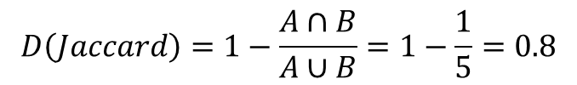
A classic beta diversity example!
Community A
Community B
$$A∩B$$
$$D\left(Jaccard\right)=1−\frac{A∩B}{A∪B}=1−\frac{1}{5}=0.8$$
Note: There are many distance measures that can be used for beta diversity. These are extensively covered in Legendre and de Cacares 2013.

Slide 4
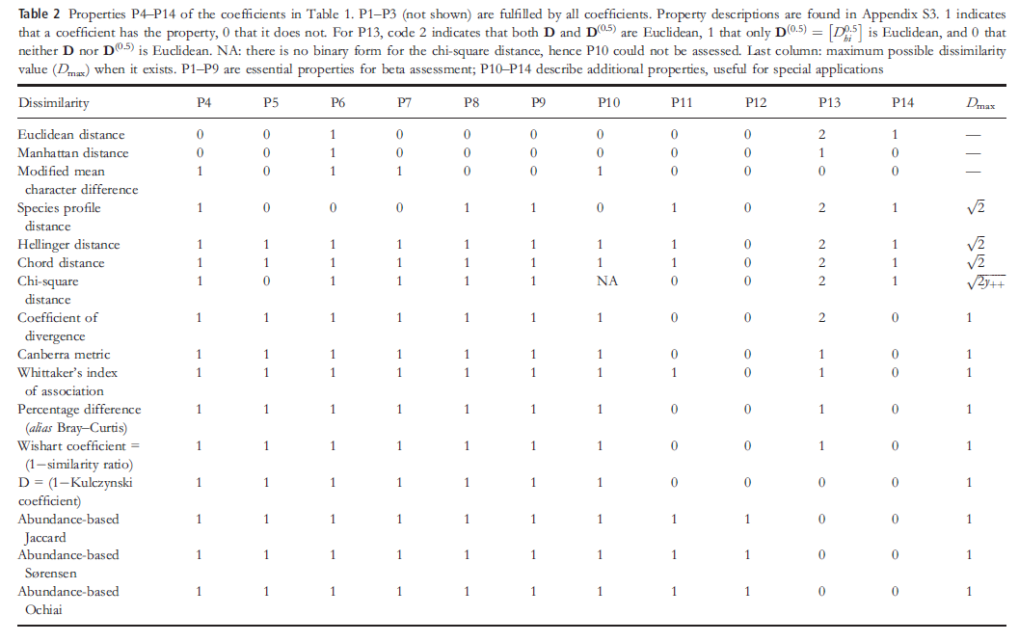
However, there are many dissimilarity metrics… which one do we choose?
Legendre and De Cacares 2013 – Ecology Letters

Slide 5
Properties of Dissimilarity Metrics for Assessing Beta Diversity
Legendre and de Cacares (2013) describe four groups of properties and indicate the reason why we consider them relevant.
The first two groups (i.e. from P1 to P9) contain the minimum requirements for assessing beta diversity.
The remaining two groups (i.e. P10 to P14) are not necessarily required in all beta diversity assessments.
Practitioners should determine whether the context of their analyses requires these latter properties or not

Slide 6
Property class 1: Basic necessary properties.
Properties P1 to P6 must be fulfilled by all distance metrics used for beta diversity assessment.
P1 – Minimum of zero and positiveness.
P2 – Symmetry
P3 – Monotonicity to changes in abundance
P4 – Double-zero asymmetry
P5 – Sites without species in common have the largest dissimilarity
P6 – Dissimilarity does not decrease in series of nested species assemblages

Slide 7
Property class 2: Comparability between data sets
The P7-P9 are needed to appropriately compare beta diversity values calculated for different data tables, even if the sampling unit are the same size (e.g. quadrat size for vegetation) and the sampling effort is the same.
P7 – Species replication invariance
P8 – Invariance to the measurement units
P9 – Existence of a fixed upper bound

Slide 8
Property class 3: Sampling issues
This group of properties is mostly related to sampling issues. The fulfilment of properties P10 and P11 facilitates (but does not ensure) the comparability of beta values obtained from sampling units having different sizes or sampled using different efforts.
P10 – Invariance to the number of species in each sampling unit
P11 – Invariance to the total abundance in each sampling unit
P12 – Coefficients with corrections for undersampling

Slide 9
Property class 4: Ordination-related properties
The remaining properties are not related to the ecological interpretation of a coefficient or the comparability of beta diversity values. They are, however, useful for ordination and linear modelling of community composition data.
P13 – Euclidean property of D or D^{(0.5)}
P14 – Emulated by transformation of the raw frequency data followed by Euclidean distance.

Slide 10
GDM default is Bray-Curtis
Why might lack of this property be problematic for most analyses?
Legendre and De Cacares 2013 – Ecology Letters

Slide 11
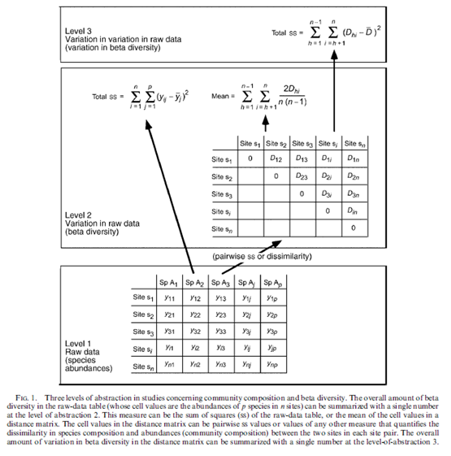
Levels of abstraction in community composition analyses
GDMs are here!
Note that when we are working with beta diversity, we are already working at one level of abstraction from raw data on species abundances.
To move to a framework that assesses variation in beta diversity (such as GDM) we are performing another level of abstraction
This influences the questions we can pursue using these models (see Tuomisto and Ruokalainen 2006)
Tuomisto and Roukalainen 2006 - Ecology

Slide 12
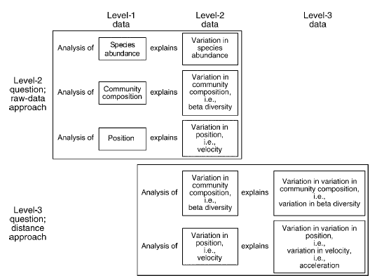
A physics analogy
Tuomisto and Roukalainen 2006 - Ecology

Slide 13
Explaining versus analyzing beta diversity
‘‘Explaining beta diversity’’ is a level-2 question: the response variable is community composition, and what gets explained is variation in community composition (i.e., beta diversity).
In contrast, ‘‘analyzing beta diversity’’ is a level-3 question: the response variable is beta diversity (i.e., variation in community composition), and what gets explained is variation in beta diversity
Consequently, if one aims at ‘‘explaining beta diversity’’ then using the raw-data approach is indicated, whereas if one aims at ‘‘analyzing beta diversity’’ then using the distance approach is indicated
GDM is a Level-3 methodology, so we are analyzing beta diversity and explaining the variation in beta diversity

Slide 14
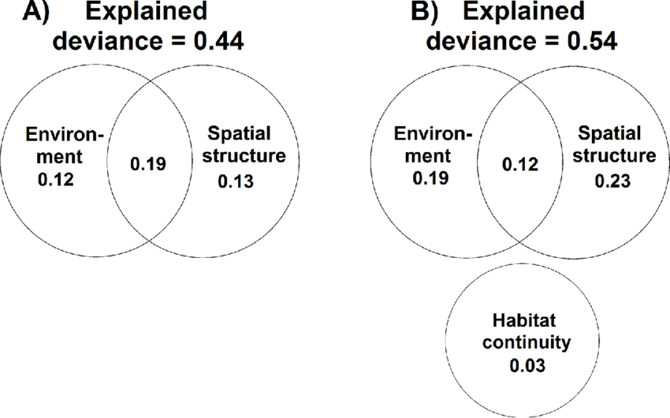
Hypotheses based on partitioning
There are several hypotheses that can be assessed using partitioning of beta diversity metrics and models
Ecological Hypothesis A: Species composition is uniform
Ecological Hypothesis B: Species composition fluctuates in a random, autocorrelated way (e.g., Hubbell 2001)
Ecological Hypothesis C: Species composition is related to environmental conditions (numerous authors).
Radula et al 2020 – Ag. Eco. and Env.

Slide 15
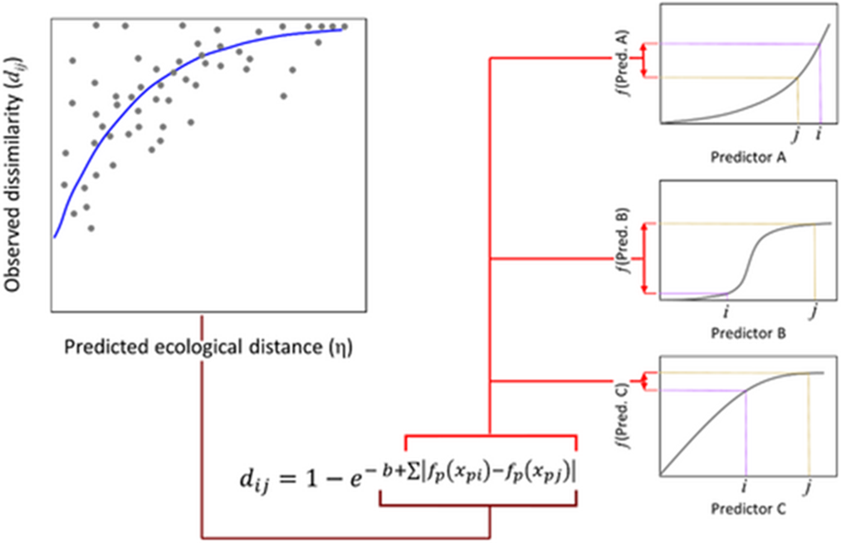
Bringing this back to GDMs
We must pick the appropriate distance metric for assessing dissimilarity in our GDMs, based on our needs
GDMs allow us to ask questions about variation in beta diversity (Level 3) by using dissimilarity inputs (Level 2)
GDMs allow us to explain variation in beta diversity
GDMs allow us to explore the influence of geographic and environmental predictors of species composition, which can aid in exploring potential drivers of variation in beta diversity

