Slide 1
Multi-site generalized dissimilarity modeling: applications of zeta diversity
GDM Workshop
Day 5
Instructor: Jacob Nesslage

Slide 2






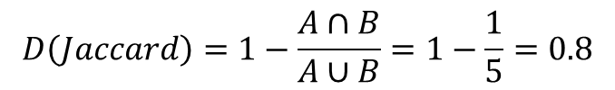
Recall the classic beta diversity example…
Site A
Site B
$$A∩B$$
$$D\left(Jaccard\right)=1−\frac{A∩B}{A∪B}=1−\frac{1}{5}=0.8$$
Note: There are many distance measures that can be used for beta diversity. These are extensively covered in Legendre and de Cacares 2013.

Slide 3
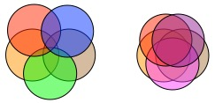
Zeta Diversity – beyond pairwise comparisons
Site A
Site B
Zeta (ζ) diversity, the number of sites shared by multiple assemblages of species, has recently been proposed as a way to overcome the limitations of traditional biodiversity metrics.
Zeta diversity can be divided into ζ₁, the average number of species per site (i.e. alpha diversity), ζ₂, the average number of species shared by any two sites (i.e. beta diversity), ζ₃, the average number of species shared by any three sites, and so on until the maximum number of sites is reached (the number of sites as subscript is referred to as the “order” of zeta).
Note: Zeta diversity was framed in terms of similarity rather than dissimilarity (Hui and McGeoch 2014)
Site E
Site C
Site D

Slide 4
Advantages of zeta diversity
Unifies alpha, beta, and zeta diversity under one framework
Low orders of zeta capture the contribution of most species in the community to turnover.
High orders of zeta only capture the more widespread (common) species since, by definition, rare species cannot be shared by many sites. So, zeta diversity necessarily declines as the order of zeta increases.

Slide 5
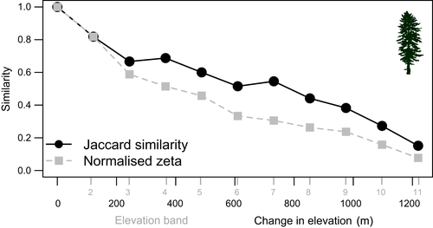
Zeta Decline
The rate of zeta decline and form of the decline can vary though, and this provides more information on the processes structuring communities and the distribution of biodiversity than beta diversity alone. In particular, it distinguishes between turnover in rare and common species.
For example, an exponential decline in zeta diversity implies that the ratio ζi/ζi-1 is constant. From this, we can tell that the chance of finding a common species in a new site is the same as the chance of finding a rare species, meaning that species are randomly distributed amongst sites.
By contrast, if the ratio ζi/ζi-1 increases with the order of zeta (power law), then the chance of finding a common species in a new site is higher than the chance of finding a rare one – an indicator of niche differentiation.

Slide 6
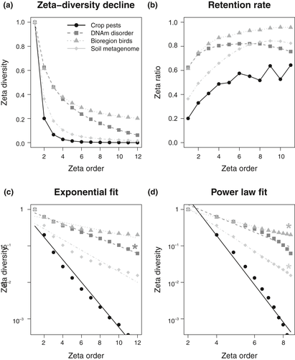
Zeta Decline Example
Shown right is the Normalized Sørensen-equivalent zeta diversity decline for four data sets showing
how the number of shared species decreases with the zeta order;
the species retention rate using the zeta ratio, which shows the degree to which common species are more likely to be retained in additional sites or samples than rare ones with an increase in zeta order;
(d) the form of decline against exponential (comparatively equal probability of species across sites) or power-law fits (comparatively unequal probabilities of the occurrence of species across sites; shown on log axes using normalized zeta).
The best-fit form for each data set is shown with an asterisk (no best fit for Crop pests). Data sets: Crop pests (circles), DNAm disorder (squares), bioregion birds (triangles), soil metagenome (diamonds; Table 2).
McGeoch et al 2019 - Ecology

Slide 7
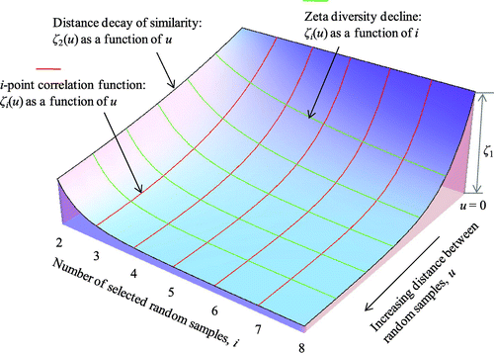
Zeta Decay – Distance decay of zeta diversity
Zeta decay provides information on the spatial or temporal extent of communities (i.e., the extent over which membership is shared).
Zeta decay quantifies change in the number of species shared with increasing distance between sites (or time between surveys). Spatial and temporal compositional similarity for each order of zeta thus provides information on the form of decay for the rare to more common species in the community over time or distance.
Zeta decay, or a plot of zeta diversity across sets of sites that are different distances or times apart, is represented with each zeta order as a different decay curve. Features of interest of zeta decay are
the shape and rate (slope) of decay, and how this differs across orders of zeta;
the absolute distance (or time) over which this decay in shared species occurs; and
the presence or absence of sharp declines in the curves

Slide 8
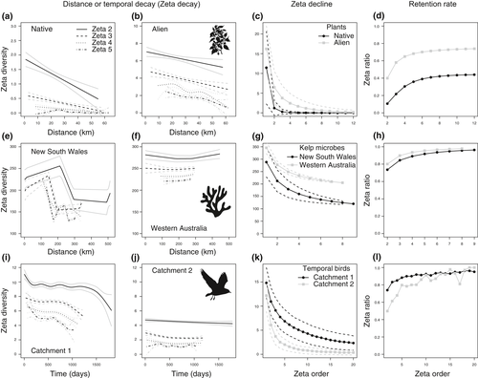
Zeta Decay example
The figure on the right demonstrates zeta diversity decay over space and time, for zeta orders 2–5, showing change in number of species shared with increasing distance between sites, or time between surveys.
For completeness, the zeta diversity decline and the zeta ratio–based retention rates are shown on the right for the same data. (a)–(d) Alien and native plant species on Banks Peninsula (New Zealand); (e), (h) microbial communities associated with kelp in two Australian marine biogeographic regions (NSW, New South Wales [east] and WA, Western Australia [west]); (i), (l) temporal decay in bird communities in two catchments (Catchment 1—below-average rainfall; Catchment 2—average rainfall) over the course of a regional drought (1998–2003). In each case using the ALL combinations scheme (except in temporal birds, which uses DNN; Fig. 1).

Slide 9
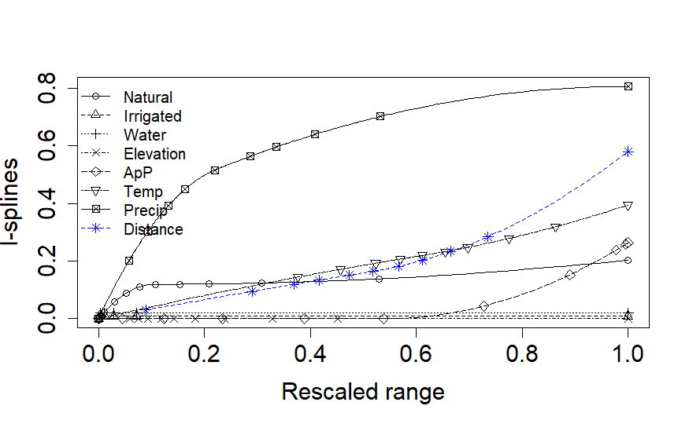
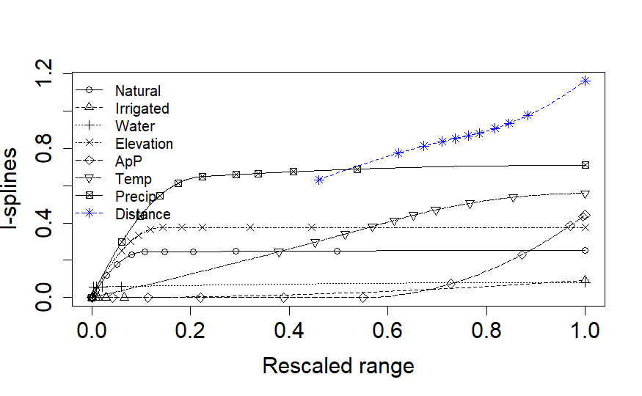
MS-GDM: Multi-Site Generalized Dissimilarity Modeling
Zeta order = 3
As with beta diversity, we can apply a form of GDM to zeta diversity. This implementation is called multi-site generalized dissimilarity modeling (MS-GDM).
MS-GDM has 4 modeling approaches to choose from – GLM, GAM, SCAM, and I-spline based models.
In many ways, the approach and analysis is the same as for GDMs, provided you use the I-spline approach.
Zeta order = 10

Slide 10
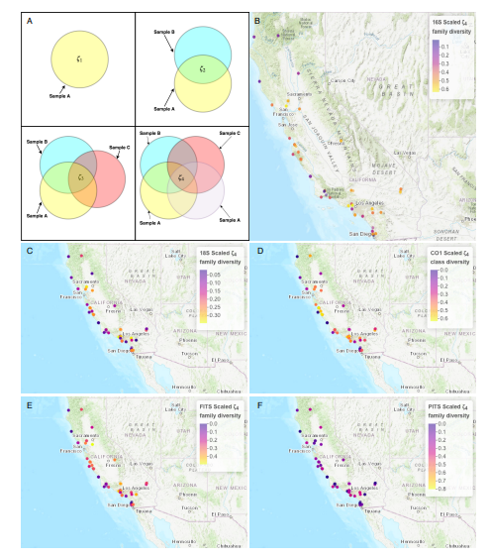
A limitation in spatial analysis
I know of only 1 paper that has tried to map zeta diversity as part of their analysis (Lin et al. 2021 – Ecological Applications)
Ostensibly, zeta diversity could be modeled across entire rasters using MS-GDM. However, the zetadiv package does not provide native support for this in the same way the gdm package does.
Another challenge is that zeta diversity is highly sensitive to distance between sites, which may further complicate interpretation of modeled zeta diversity in a raster space.
Lin et al. 2021 – Ecological Applications

