Slide 1
Project Overview
This project focuses on predicting next-day foreign exchange (FOREX) prices using machine learning techniques.
Two datasets were integrated:
- Historical FOREX price data (via API)
- Macroeconomic indicators (interest rates, oil prices, CPI)
The objective is to forecast currency movements, a task known for its complexity and volatility.

Slide 2
Data Collection and Integration
Data Sources:
- FOREX data retrieved using financial API
- Macroeconomic data retrieved from FRED API
Data Integration:
- Merged datasets using time series (date) as the common key
- Ensured alignment and handling of missing values
This approach allows combining market behavior with economic context.

Slide 3
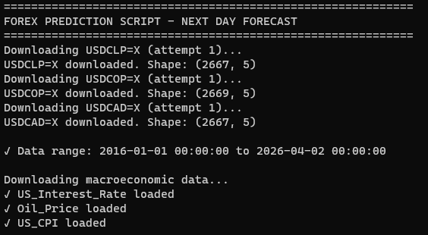
The datasets were collected using financial and macroeconomic APIs.
The historical data spans from 2016 to 2026, ensuring a robust time series for model training.
Macroeconomic indicators such as interest rates, oil prices, and CPI were integrated to enrich the analysis.

Slide 4
Data Processing and Feature Engineering
Key preprocessing steps:
- Handling missing values and normalization
- Creation of lag features (previous days prices)
- Calculation of technical indicators:
* Moving Averages (SMA)
* Relative Strength Index (RSI)
* MACD
* Volatility measures
These features help capture patterns in time series data.

Slide 5
After cleaning and preprocessing, the dataset contained 7,913 observations and 20 features. Feature engineering included technical indicators and lag variables to capture temporal dependencies.

Slide 6
Model Development
Two machine learning models were implemented:
- LightGBM Regressor
- Random Forest Regressor
Training Strategy:
- Time-based split (80% training, 20% testing)
- Avoided random shuffling to preserve temporal structure
Evaluation Metric:
- Mean Absolute Error (MAE)

Slide 7
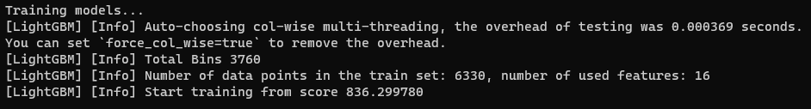
The models were trained using a time-based split, with 80% of the data allocated for training.
This approach preserves the chronological order, which is critical in time series forecasting.

Slide 8

Model Results
The models were evaluated on unseen test data.
Key observations:
- LightGBM generally provided better accuracy
- Random Forest showed stable but slightly less precise predictions
Results indicate that ensemble models are effective for financial forecasting.
The Random Forest model outperformed LightGBM based on the evaluation metric (MAE).
This suggests that ensemble tree-based methods are effective in capturing nonlinear relationships in financial data.

Slide 9
Visualization
The project includes visualization of:
- Historical price trends
- Predicted future values
Charts illustrate:
- Comparison between actual and predicted values
- Transition point between historical data and forecasts

Slide 10
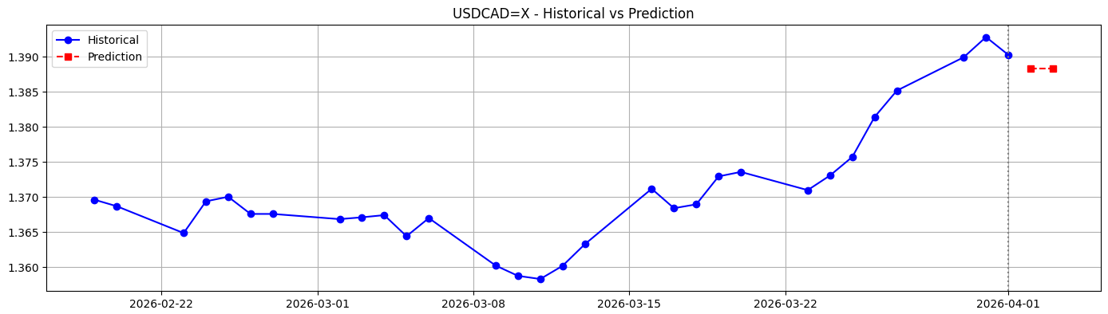
Visualization
The visualization compares historical data with predicted values.
The transition between actual and forecasted values is clearly illustrated, providing insight into model behavior and trend continuation.

Slide 11
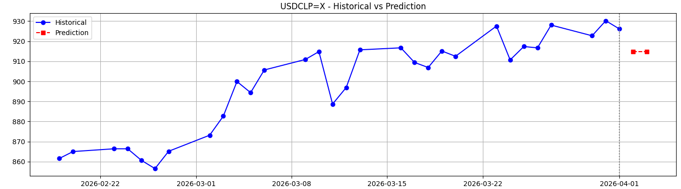
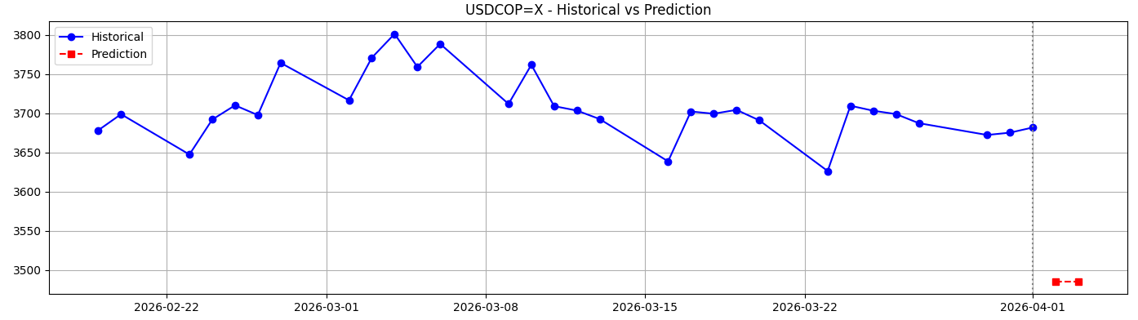
Visualization

Slide 12
What I Learned
Key learnings from this project:
- Importance of feature engineering in time series forecasting
- Value of combining multiple data sources
- Challenges of predicting financial markets
- Differences in model performance and behavior
Hands-on experience with real-world data pipelines and ML models.

Slide 13
Limitations
Several limitations were identified:
- Financial markets are highly volatile and influenced by external factors
- Limited macroeconomic variables included
- Short prediction horizon (next-day only)
- Models do not account for sudden market shocks or news events
Future improvements could address these issues.

Slide 14
Summary and Predictions
Summary:
- Successfully built a machine learning pipeline for FOREX prediction
- Integrated multiple datasets using time series
- Evaluated and selected the best-performing model
Predictions:
- The model generates next-day forecasts for selected currency pairs
- Results can support decision-making but should be used cautiously
This project demonstrates practical application of data analytics in finance.

Slide 15
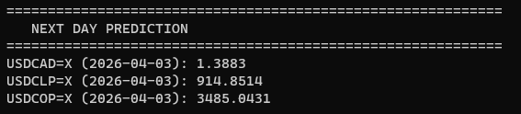
The model generates next-day predictions for multiple currency pairs.
These forecasts demonstrate the practical application of machine learning in financial decision-making.
However, predictions should be interpreted cautiously due to market volatility.

