Slide 1
REBALANCE
Quantifying the Racial Bias Accuracy-Fairness Trade-off
in Machine Learning Across Criminal Justice and Employment
Joshua Oghosasehe Ekogiawe
MSc. Computer science and Technology · Ulster University
B01045839

Slide 2
THE PROBLEM
Fairer algorithms cost accuracy — but how much, and where?
The EU AI Act (2024) requires demonstrable non-discrimination in high-risk domains, including criminal justice and employment — but gives no quantitative threshold for what an acceptable accuracy cost looks like.
THE PROPUBLICA COMPAS FINDING
44.9%
No prior study has measured the racial bias accuracy-fairness trade-off across multiple regulated domains under the same protected attribute and controlled conditions.
false positive rate for Black defendants
23.5%
false positive rate for White defendants
Same criminal history, charge type, and age — disparity attributable to the algorithm.
2

Slide 3
RESEARCH DESIGN
Three Research Questions
1
RQ1
What is the quantitative accuracy cost of applying five AIF360 debiasing techniques across four classifiers to reduce racial bias in criminal justice and employment?
2
RQ2
Does the magnitude of the trade-off vary systematically across the two domains, and is this related to the racial outcome base rate difference?
3
RQ3
Which debiasing technique category is most cost-effective, and does that ranking hold across all four classifier families?
3

Slide 4
CONCEPTUAL FRAMEWORK
Two Testable Hypotheses
H1
H2
Debiasing produces statistically significant accuracy costs in both domains
Post-processing imposes the smallest cost; in-processing the largest
Magnitude varies with the racial outcome base rate difference — consistent with the Chouldechova-Kleinberg impossibility theorem.
Because post-processing only constrains the output decision boundary, while in-processing modifies the learning objective itself.
4

Slide 5
METHODOLOGY
Scoped for Rigour, Not Just Scale
2
5
4
126
Domains
Techniques
Classifiers
Empirical runs
Criminal justice (COMPAS) &
employment (Adult Income)
Spanning all 3 AIF360 categories:
pre, in, and post-processing
Logistic Regression, Random Forest,
XGBoost, MLP
42 conditions × 3 seeds,
mean ± SD reported
Deliberately scoped to what a single-researcher MSc dissertation can execute and analyse rigorously — fixed hyperparameters, 3 seeds, and a reduced but taxonomy-complete technique set, rather than an unproven 108-condition sweep.
5

Slide 6
DEBIASING TECHNIQUES
Five Techniques Across Three Pipeline Stages
PRE
IN
POST
Pre-processing
In-processing
Post-processing
Reweighing
Disparate Impact Remover
Prejudice Remover
Calibrated Equalised Odds
Reject Option Classification
In-processing constrains the classifier by construction (Prejudice Remover is a regularised logistic model) — reported as a single fixed-architecture condition rather than crossed with all four classifiers.
6

Slide 7
DATA
Two Real, Public Datasets — Same Protected Attribute
CRIMINAL JUSTICE
EMPLOYMENT
COMPAS
Adult Income
RECORDS
RECORDS
5,278
43,800
TASK
TASK
Two-year recidivism (non-recidivism = favourable)
Income > $50K (favourable)
BASE RATE GAP
BASE RATE GAP
0.132 (White 0.609 vs Black 0.477)
0.136 (White 0.263 vs Black 0.127)
Race is fixed as the protected attribute (Black vs. White) in both datasets — removing the confound where prior cross-domain studies varied the protected attribute alongside the domain.
7

Slide 8
RESULTS
The Accuracy Cost Is Real — and Technique-Specific
8

Slide 9
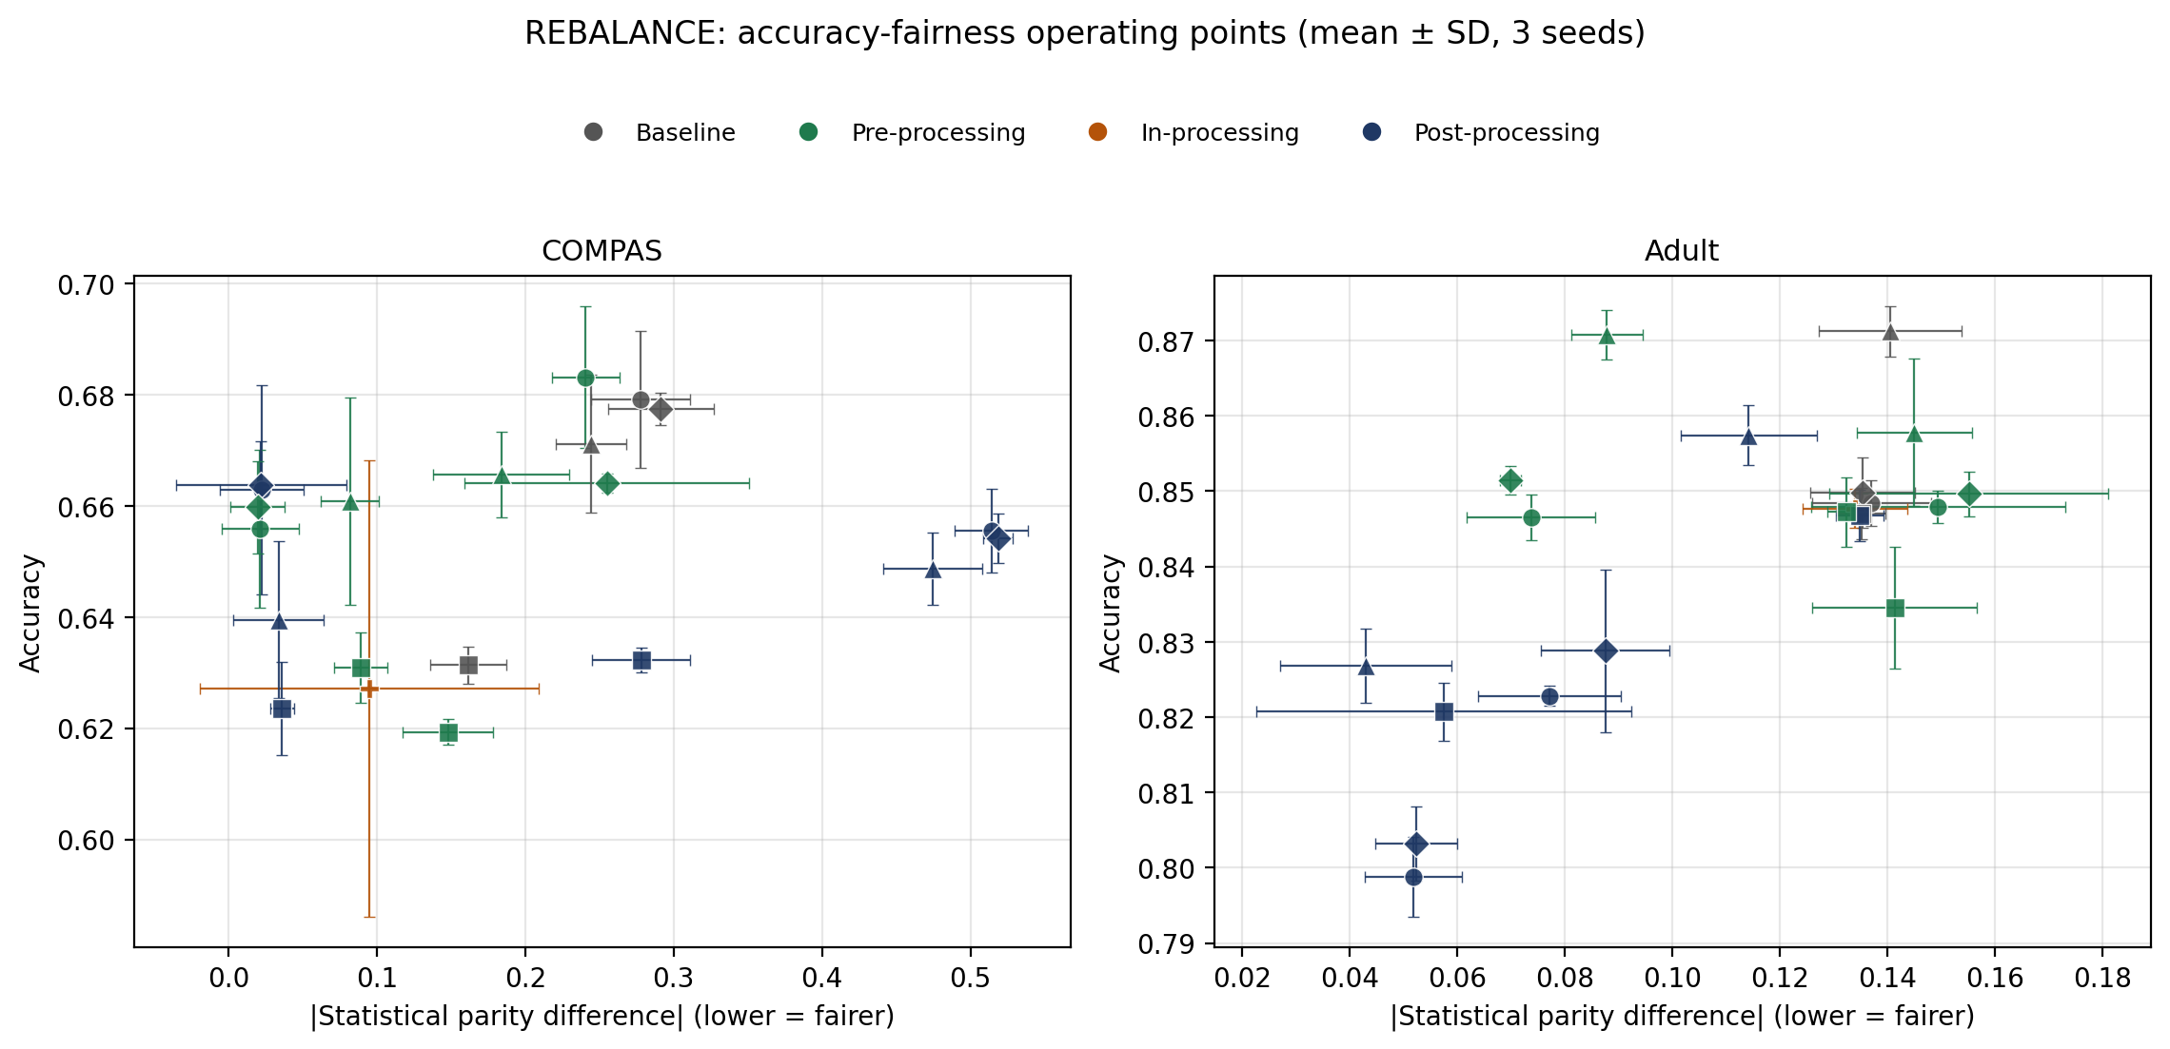
RESULTS
No Single Technique Dominates the Frontier
Non-dominated Pareto points (Table II): COMPAS is anchored by Reweighing and Reject Option at very low disparity; Adult by Reject Option at the lowest disparity, extending to the unmitigated baseline at highest accuracy. The achievable trade-off is a curve, not a single best answer.
9

Slide 10
KEY FINDING
The Same Technique Can Help or Hurt, Depending on Domain
Calibrated Equalised Odds
Adult Income
COMPAS
+0.034
−0.203
Fairness IMPROVED ↑
Fairness WORSENED ↓
Δ |Statistical Parity Difference|
Δ |Statistical Parity Difference|
Because Calibrated Equalised Odds optimises a false-negative-rate calibration criterion, not statistical parity directly — and COMPAS's larger baseline disparity interacts with that criterion differently than Adult's. Practical implication: technique choice cannot be fixed once and reused across deployment contexts.
10

Slide 11
DISCUSSION
Hypotheses Revisited
H1
Supported
13 of 33 technique-classifier comparisons reached statistical significance (p < 0.05) despite the conservative 3-seed design — fairness improvement is not free in either domain.
H2
Partially supported
Prejudice Remover (in-processing) was the costliest on COMPAS, as predicted — but post-processing (Reject Option) was NOT uniformly cheapest; pre-processing was consistently cheaper across both domains.
11

Slide 12
LOOKING AHEAD
Limitations and Future Work
LIMITATIONS
FUTURE WORK
3-seed budget — sufficient for descriptive stats, underpowered for strict significance testing
Fixed rather than per-condition Bayesian-optimised hyperparameters
5 of 9 AIF360 techniques evaluated
Two-domain scope (criminal justice, employment)
Extend to the remaining 4 AIF360 techniques
Increase seed count to sharpen statistical power
Extend the controlled design to further regulated domains as suitable public datasets become available
12

Slide 13
CONCLUSION
The Trade-off Is Real, and It Is Not Universal
Across 126 empirical runs, two domains, five techniques, and four classifiers, the accuracy cost of racial bias mitigation is measurable — but no single technique is cheapest everywhere. The same technique can improve fairness in one domain while worsening it in another, when its target criterion doesn't match the domain's disparity structure.
For organisations under the EU AI Act: debiasing technique choice must be re-evaluated per deployment domain — it cannot be selected once and reused.
Thank you — questions welcome
Joshua Oghosasehe Ekogiawe · Ulster University · B01045839

