Slide 1
Chapter 18: Classification & Introduction to Taxonomy

Slide 2
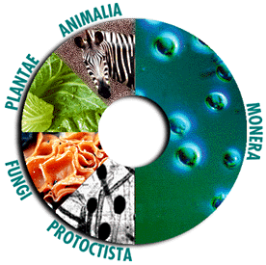
Classification
The grouping of objects or information based on similarities
There are more than 1 million described species of plants and animals
  Many millions still left undescribed

Slide 3
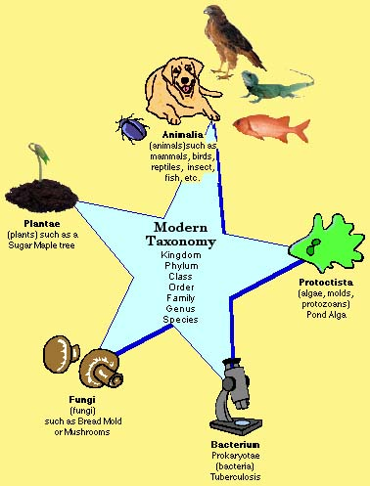
Taxonomy
Science of classification (grouping things)
  Process of classifying biodiversity based on evolutionary relationships
  Means to organize biological diversity
  Groups and names organisms based on different characteristics

Slide 4
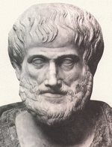
Early Taxonomic Systems
Aristotle (350 B.C.)
  Developed the 1st widely accepted system of biological classification
  Everything grouped as plant or animal
Plants Animals
Herbs Shrubs Trees Land Sea Air

Slide 5
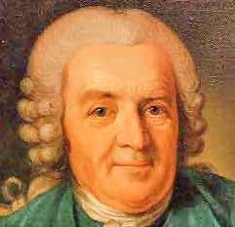
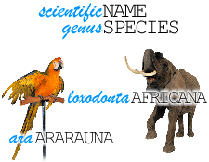
Early Taxonomic Systems
Carolus Linnaeus (1753)- use of a species name
Based on looking at physical and structural similarities
    Revealed relationships of organisms
Binomial nomenclature
    Gave each species 2 names (scientific name)
    Genus and species
    Genus is a group of similar species
Developed the modern system of taxonomy

Slide 6
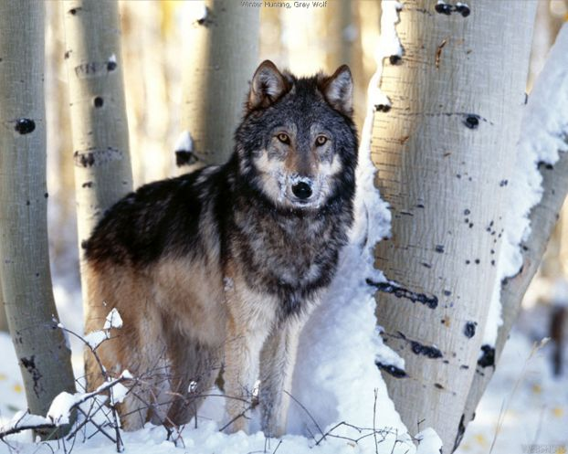

Latin was the language used (no longer used and is not being changed)
  Genus name→ always capitalized
  species name→ always lowercase
  both names MUST be underlined or italicized
  Ex: Canis lupus (wolf)
  Ex: Homo sapiens (human)

Slide 7

Ex: Felis domesticus (housecat)
  Felis domesticus var.
    Indicates more than one variety

Slide 8
Scientific names are often:
  Descriptive (Acer rubrum→ red maple)
  Named after someone (genus→ Linnea)
  Descriptive of where an organism lives (D. californica)
  Named after person who first described the organism (D. californica Torr)
Many organisms have common names
  Can be misleading
  Can have more than 1 common name, depending on the area it is found in

Slide 9
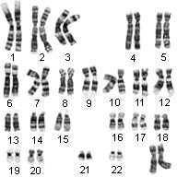
Modern Taxonomy
Now based on evolutionary relationships
Taxonomists study:
  Structural similarities
  Chromosomal structure (karyotypes)
  Reproductive potential
  Biochemical similarities
    Comparing DNA and amino acids
  Embryology/development
  Breeding behavior
  Geographic distribution

Slide 10
7 taxonomic categories:
Kingdom → largest, most general group
  Phylum → called a division with plants
Class
Order
Family
Genus
Species → smallest, most specific group
Grouped genera into families, families into orders, orders into classes, classes into phyla, and phyla into kingdoms
Species can interbreed with each other

Slide 11
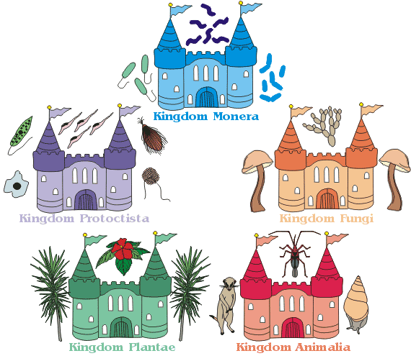
1969: 5-Kingdom System
Monera, Protista, and Fungi kingdoms added to the 2 established kingdoms
Kingdoms defined based on 2 main characteristics
    Possession of a true nucleus (prokaryote or eukaryote)
    How it gets food
      Heterotroph
      Autotroph
      Decomposer

Slide 12
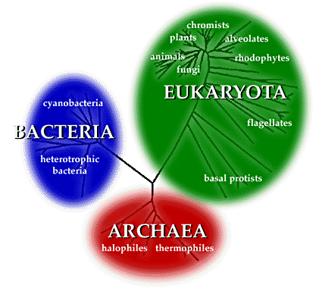
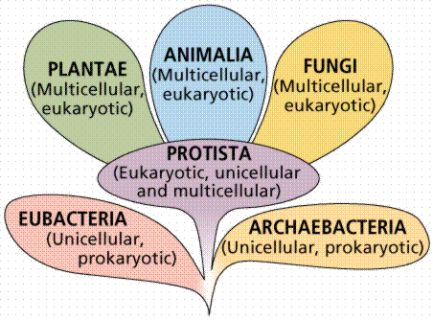
1980’s: 3-Domain System
Bacteria have distinct differences
All eukaryotic kingdoms grouped into one domain (Eukarya)
Monera kingdom split into 2 domains (Archaea and Eubacteria)

Slide 13
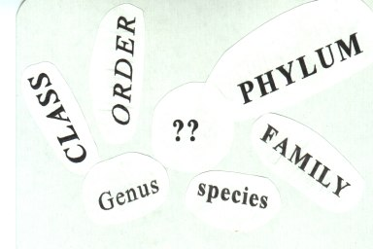
How Living Things are Classified
Groups of organisms called taxa or taxons
Organisms arranged in groups ranging from very broad to very specific characteristics
  Broader taxons have more general characteristics and more species within it
  Smallest taxon→ Species
  Largest taxon→ Kingdom

Slide 14
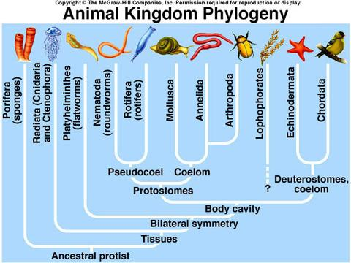
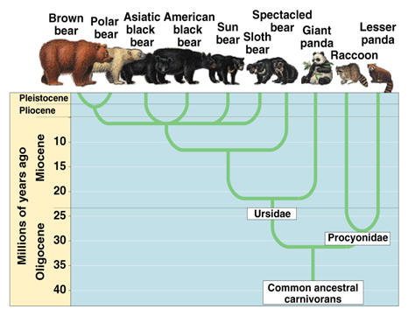
Phylogeny
a family tree for the evolutionary history of a species
  The root of the tree represents the ancestral lineage
  Tips of the branches represent descendents of the ancestor
  Movement upward shows forward motion through time
  Speciation: split in the lineage
      Shown as a branching of the tree

Slide 15
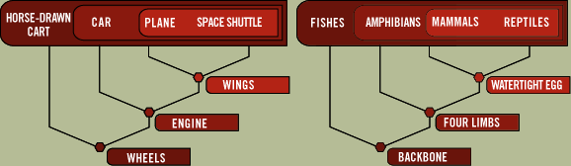
Cladistics
System of classification based on phylogeny
Derived characteristics/traits: appear in recent parts of a lineage but not in older members

Slide 16
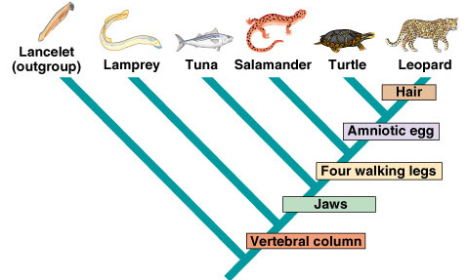
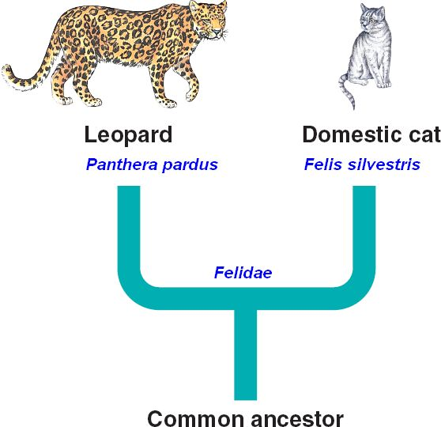
Cladogram
A branching diagram to show the evolutionary history of a species
Helps scientists understand how one lineage branched from another in the course of evolution

Slide 17
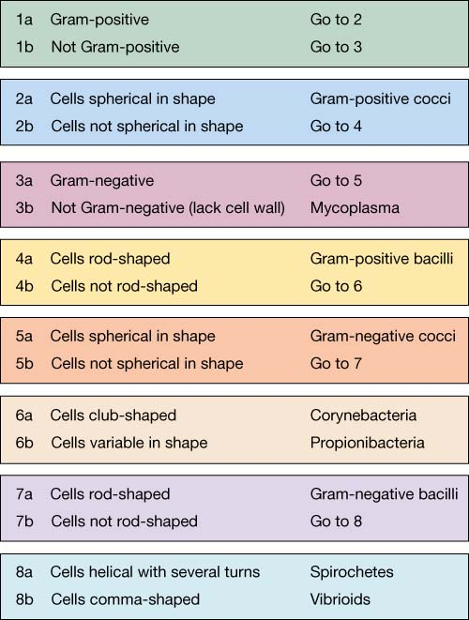
Dichotomous Key
Way of identifying organisms by looking at the physical characteristics
Uses a series of questions to group into a hierarchy classification

Slide 18
Chapter 18 Review #1:
On what language are scientific names based?
How should the scientific name of a species be written?
Which part of the name Homo erectus identifies the genus?
List in order from smallest to largest the 7 categories in Linnaeus’s system of classification.

Slide 19
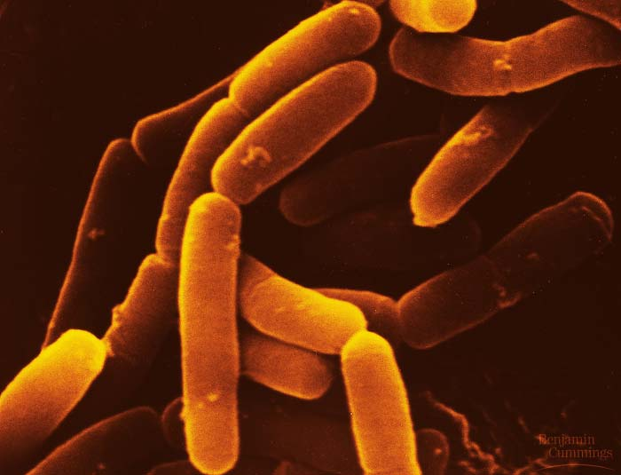
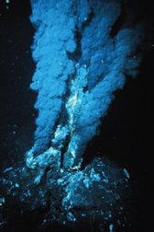
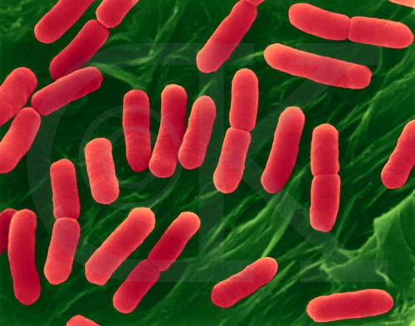
The Six Kingdoms of Organisms
Prokaryotes:
  Microscopic
  Prokaryotic (Lack a nucleus)
  Can be autotrophs (photosynthetic or chemosynthetic) or heterotrophs
  Unicellular

Slide 20
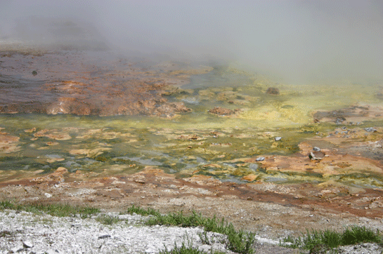
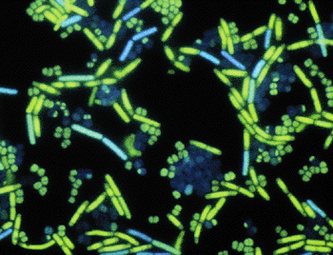
2 kingdoms (Archaebacteria and Eubacteria)
  Archaebacteria live in extreme environments like swamps, deep-ocean hydrothermal vents (oxygen-free environments)
    Cell walls not made of peptidoglycan
    Ex: Methanogens, Halophiles
  Eubacteria live in most habitats
    Cell walls made of peptidoglycan
    Ex: E. coli, Streptococcus, cyanobacteria

Slide 21
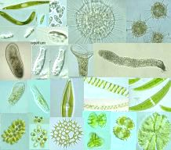
The Six Kingdoms of Organisms
Protista
  Eukaryotic (has a nucleus)
  Some have cell walls of cellulose
    Some have chloroplasts
  Can be autotrophs or heterotrophs (some can be fungus-like)
  Most are unicellular; some are multicellular or colonial
  Ex: amoeba, paramecium, slime molds, euglena, kelp
  Lacks complex organ systems
  Lives in moist environments

Slide 22
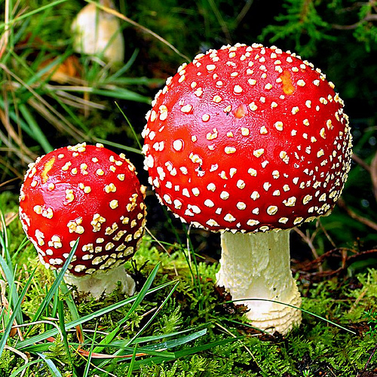
The Six Kingdoms of Organisms
Fungi
Eukaryotes
Cell walls of chitin
Heterotrophs
Most multicellular; some unicellular
Ex: mushrooms, yeast
Absorbs nutrients from organic materials in the environment
Stationary

Slide 23
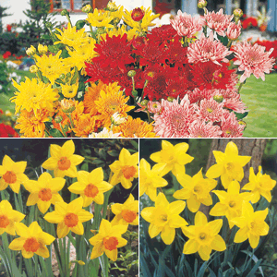
The Six Kingdoms of Organisms
Plants
Eukaryotes
Cell walls of cellulose
Autotrophs
Multicellular
Photosynthetic→ contains chloroplasts
Ex: mosses, ferns, trees, flowering plants
Cannot move
Tissues and organ systems

Slide 24
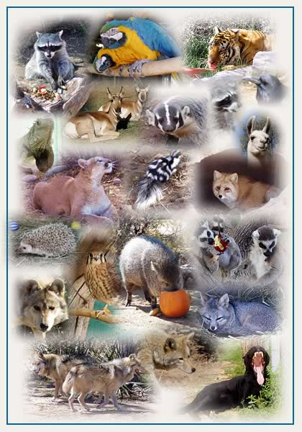
The Six Kingdoms of Organisms
Animalia
Eukaryotes
Do not have a cell wall or chloroplasts
Heterotrophs
Multicellular
Ex: sponges, worms, insects, fish, mammals (nurse young)
Mobile

Slide 25
Chapter 18 Review #2:
In taxonomy, each level of classification is referred to as a (an) ______.
Characteristics that appear in recent parts of a lineage but not in its older members are called ___.
  Taxons c. Cladograms
  Derived characters d. Genes
  3. The group of organisms that can be larger than a kingdom is called a ___.
  a. domain b. species c. phylum d. class

