Slide 1


Extraction of additional rating dimensions from reviews
Capstone Project
DSI1011
Joomart Achekeev
All images and raw data are owned by yelp.com

Slide 2

Contents
Introduction
Data
Preprocessing
Modelling
Results

Slide 3
Introduction
The original idea was to extract additional dimensions such as food quality or speed of service out of the text reviews in the yelp dataset.
While working on the project an additional idea popped up to generate an ‘average’ text review, mean() of all the reviews but in text
Then Streamlit
Then GAN
Streamlit
Data
Dimensions
GAN
‘Mean’ review

Slide 4
Data
Yelp academic dataset for 2019. Includes 6'835'403 (6.8 Gb) review of 160'585 (121 Mb) business data.
It includes such data as business ID, address, reviews, reviewer id, review id, dates and other data.
This dataset is provided free of charge for academic purposes.

Slide 5
Preprocessing
Chunking: Even for a powerful cloud computing instance the yelp dataset was too big. using chunking method, chunked up the dataset into 9 chunks with 1_000_000 reviews each.
Restaurants: Deleted all the reviews data that was not about the restaurants.
Combining: Combined all the processed chunks into single dataset.
Time cut-off: Data contained reviews dating back to 2004, to be on the safe side deleted every review that was before 01-01-2011.
Rearranging: Rearranged the columns and deleted the unneeded columns
Language: cleared non English reviews with langdetect library and its method .detect()
US only: Yelp data includes data for Canada also, created a filter and fed the whole dataset to it.

Slide 6
Modelling
The modelling includes 'handmade' dimensions analysis, similar to the sentiment analysis and BERT model fed with a single string from all reviews for a single business.
Dimension markers include synonyms for such words as tasty, delicious, fast, slow, quick, comfortable and others from https://www.thesaurus.com/. These dimensions, after lemmatization are used to count the single string reviews for each business and are used to calculate through a series of transformations ratings on a 1 to 5 scale for food quality, service speed, service quality, and atmosphere (more thoroughly can be seen in the code)
BERT model. The special standalone summarize method of the model with certain hyperparameters is used to summarize the reviews into a single mean review. The review is then returned to the dataframe to its corresponding business_id.

Slide 7
Results
X
Streamlit
✓
Data
Dimensions
X
GAN
‘Mean’ review
✓

Slide 8
Results (4.5 food quality index)
The Green Mesquite BBQ (4 star yelp rating)
Had a late lunch at 2 pm on a Tuesday with my husband. I would definitely visit them again if I am in the area and craving BBQ. I am not a fan of get your meat and add your sause, same with Bill Miller...What happened to BBQ on the Actual Pit? I didn't like the BBQ sauce that was on it.
Habana Soco Restaurant (4 star yelp rating)
Growing up, my mom had a friend who was from Key West. I was thinking it was Mexican food, but when the chips and salsa didn't appear, I realized I was not in the typical "tex-mex" venue we often hit. I recommend to the ceviche and the Maduros Frito as appetizers as this the first place I've eaten in the US that tastes like home. The restaurant has cuban employees and atmosphere feels good but once our food arrives ropa vieja was salty ... way too much salty.
Titaya's Thai Cuisine (5 star yelp rating)
Yummy, yummy, yummy - my favorite Thai restaurant in Austin! My favorite is the Gang Dang curry (with chicken but the tofu is amazing here) and the Jungle curry is nice, but my friend who LOVES spicy stuff said it wasn't as hot as he'd like. Pad see ew is always a must for me and I can say that this place did the dish justice but it wasn't over the top extraordinary. Either way, I know I will have a great meal in a great restaurant. If I lived here, this would be my go-to spot for Thai food.

Slide 9
Results (4.5 food quality index)
The Green Mesquite BBQ (4 star yelp rating)
Food Quality Index: 3.5
Service Speed Index: 3.5
Service Quality Index: 4.5
Atmosphere Index: 2.3
Habana Soco Restaurant (4 star yelp rating)
Food Quality Index: 4.5
Service Speed Index: 2
Service Quality Index: 4.5
Atmosphere Index: 3.5
Titaya's Thai Cuisine (5 star yelp rating)
Food Quality Index: 4.5
Service Speed Index: 3.5
Service Quality Index: 4.5
Atmosphere Index: 3.5

Slide 10
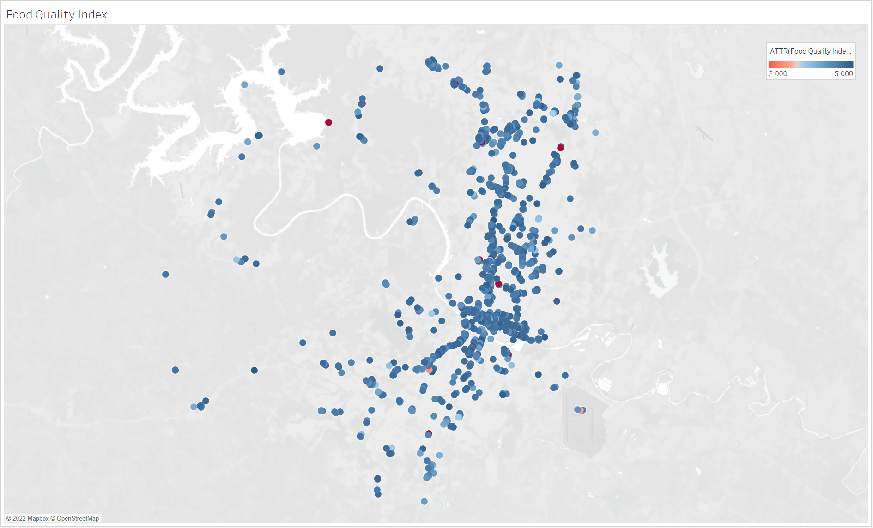
Results

Slide 11
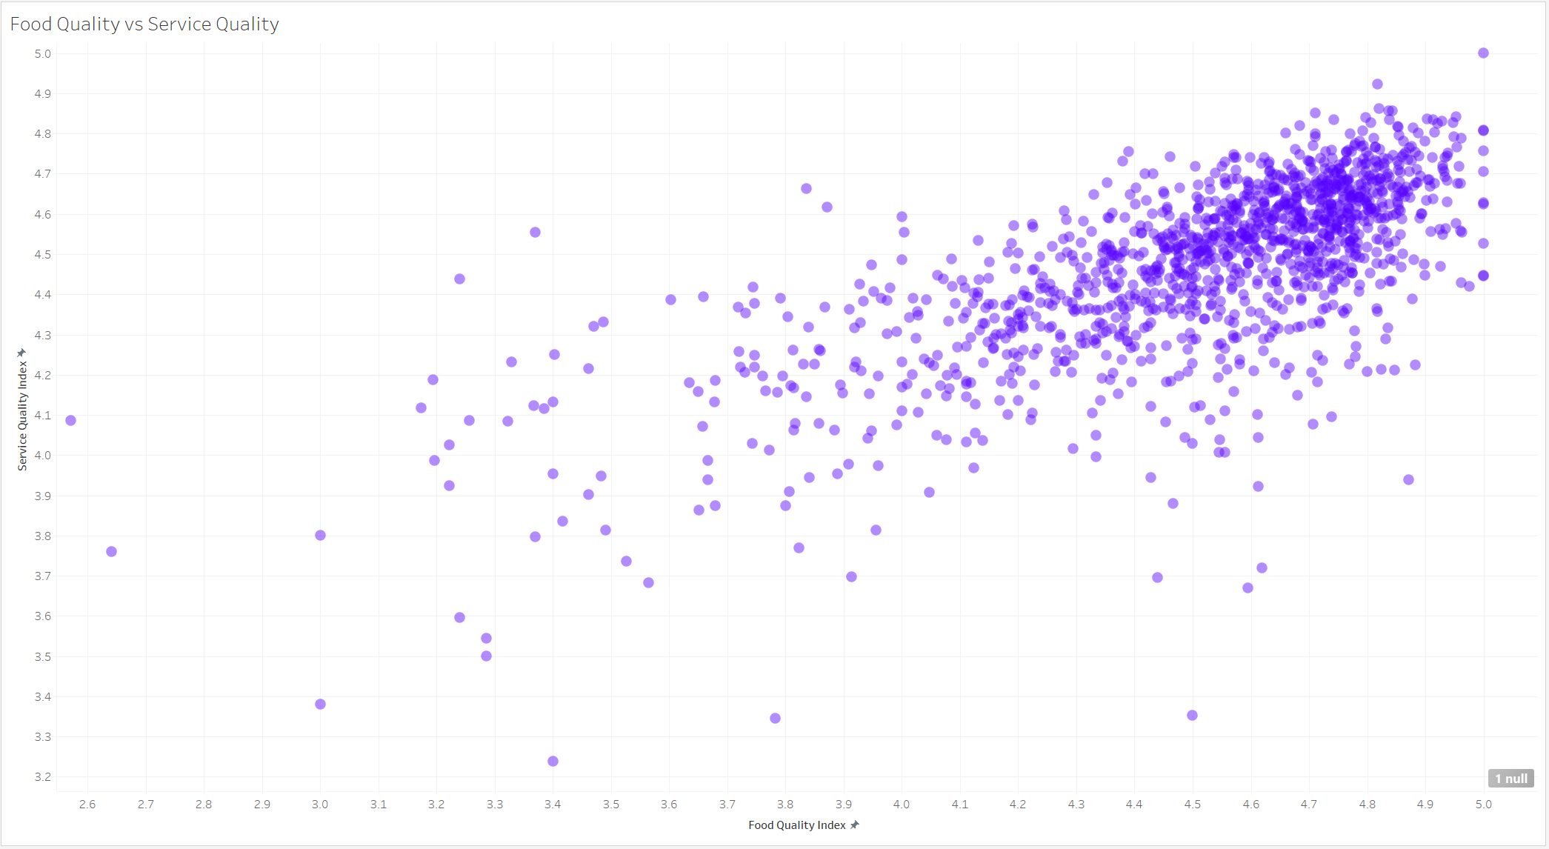
Results

Slide 12
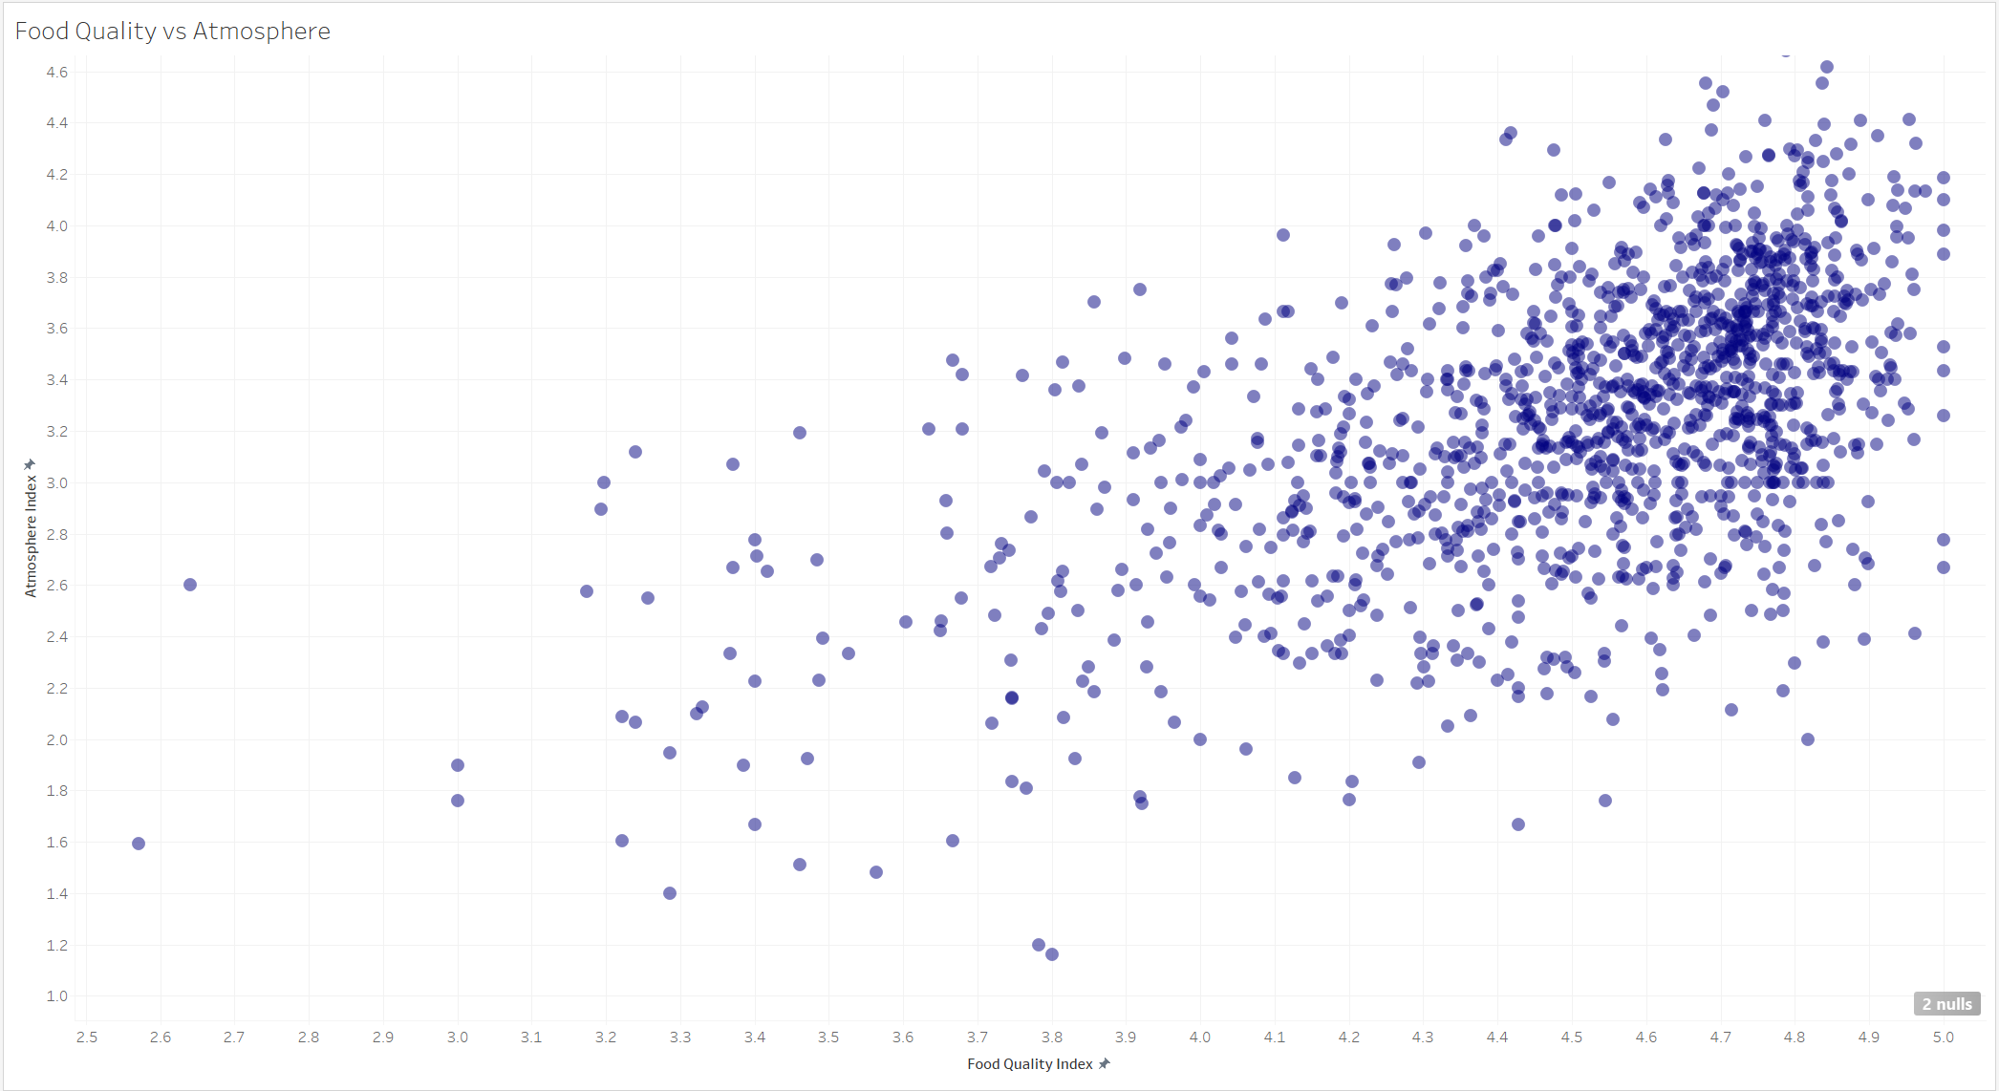
Results

Slide 13
Skills gained
Cloud computing basics
Multiprocessing basics
General understanding of GAN
Pickling everything
.loc and not df[df[‘something’] ==‘other’] = value
additional libraries useful for NLP such as langdetect

