Slide 1
PowerPoint Demo
Text boxes
Tables
Charts
Pictures

Slide 2
Textboxes
Textbox 1
Textbox 2

Slide 3
Tables

Slide 4
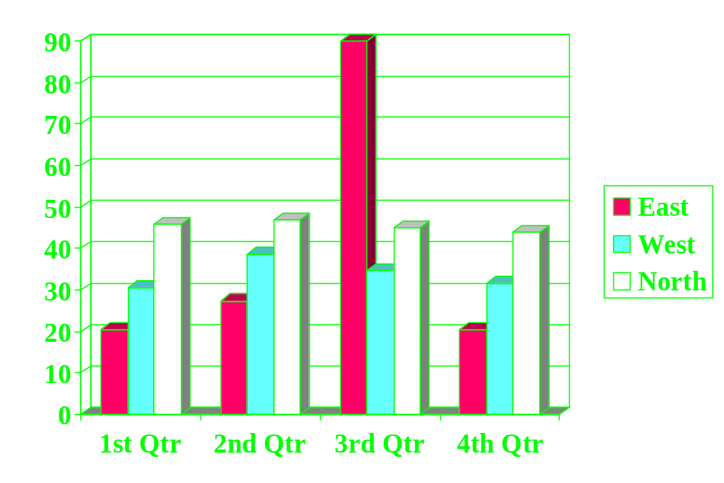
Charts

Slide 5

Pictures

