Slide 1



HEALTHCARE
PROVIDER FRAUD DETECTION
Presented By:
Rawda Tarek 13003438
Jomana Shady 13001659
Karma Kandil 13001164
Mohamed Haytham 2000388
Omar Abdelhady

Slide 2



Healthcare Fraud Costs:
  Annual losses: $68+ billion to U.S. healthcare system
  Only 1-2% of suspicious cases investigated
  Traditional rule-based systems fail to detect sophisticated fraud

Slide 3



Current Limitations
Our Mission
  Manual review processes
  Basic rule-based detection
  High false positive rates
  Limited scalability
Develop an intelligent, data-driven fraud detection system that can:
  Identify high-risk providers accurately
  Minimize false positives
  Provide explainable predictions
  Scale across Medicare network

Slide 4



Class Imbalance
  Fraudulent providers:10% (506)
  Non-fraudulent providers:90% (4,904)
Key Datasets:
1
3
2
Outpatient Claims
(Train_Outpatientdata.csv)
4
Beneficiary Data
(Train_Beneficiarydata.csv)
  Demographics, coverage, chronic conditions
  138,556 records, 25 features
  Visits, tests, minor procedures
Inpatient Claims
(Train_Inpatientdata.csv)
Fraud Labels
(Train_labels.csv)
  Hospital admission claims
  Financial, procedural, physician details
  Provider-level fraud labels (Yes/No)
  5,410 providers total

Slide 5


DATA PREPROCESSING PIPELINE
Data Integration:
  Linked BenefID → Claims → Provider → Fraud labels
  Consolidated claim-level → provider-level records
Feature Engineering:
1
3
2
Beneficiary Features
Provider Aggregations:
Claims Features:
  Age calculation
  Deceased status
  Chronic conditions count
  Total/average claim amounts
  Unique beneficiaries count
  Claim patterns over time
  40+ provider-level features created
  Claim duration
  Reimbursement per day
  Weekend/high-cost flags
  Inpatient/outpatient ratios

Slide 6





HANDLING SEVERE IMBALANCE
(10% FRAUD)
SMOTE (Synthetic Minority Over-sampling)
1
  Generated synthetic fraud cases
  Increased fraud rate to 30%
  Best balance of performance
chosen
  Achieved best recall-F1 balance
  Maintained data integrity
  Most robust for fraud detection
Class Weighting
Random Under-sampling
2
3
  Adjusted loss function weights
  Simple implementation
  Good baseline performance
  Reduced majority class samples
  Faster training
  Some information loss

Slide 7






MODEL EVALUATION RESULTS
Algorithms Tested:
1. Logistic Regression (Baseline)
2. Decision Tree (Interpretable)
3. Random Forest (Ensemble)
4. Gradient Boosting (Sequential)
5. SVM (Support Vector Machine)
6. Naive Bayes & KNN (Comparisons)
Why
Random Forest?
Validation Performance (F1-Score):
  Highest F1-Score (0.7156)
  Best recall (0.7647) - critical for fraud
  Good interpretability via feature importance
  Robust to overfitting
  Random Forest (SMOTE): 0.7156
  Gradient Boosting: 0.6465
  Logistic Regression: 0.6481
  SVM(Linear): 0.6316
  SVM(RBF): 0.6286
  Decision Tree: 0.6545
SELECTED

Slide 8

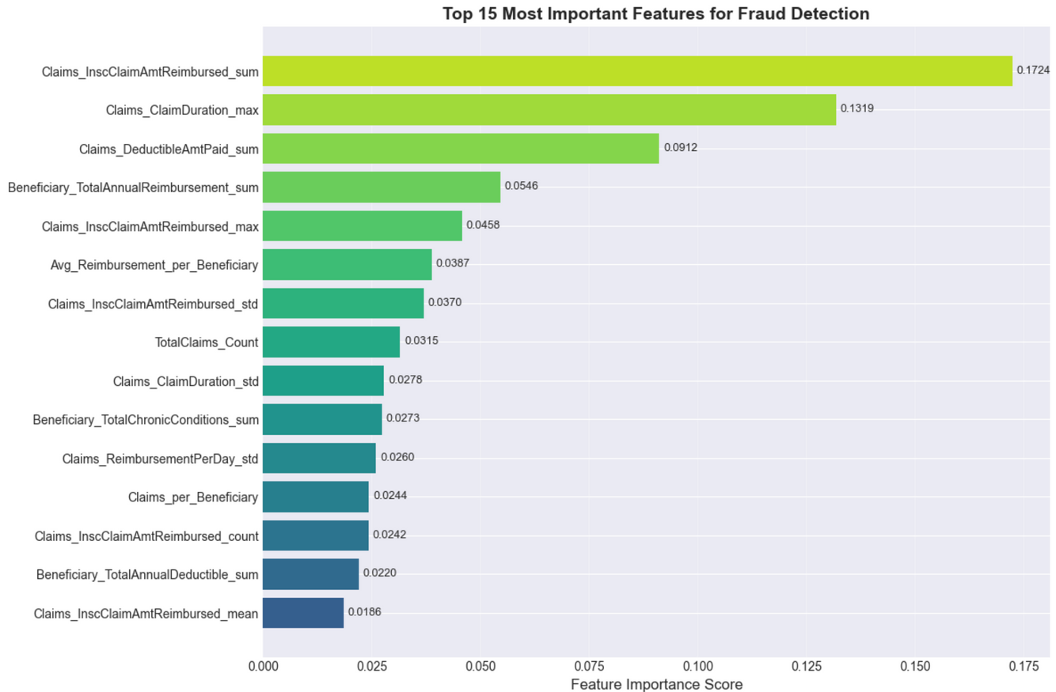

OPTIMIZING RANDOM FOREST
Grid Search CV Results:
Best Parameters:
{'max_depth': 10, 'max_features': 'sqrt', 'min_samples_leaf': 2, 'min_samples_split': 5, 'n_estimators': 100}
Performance Improvement:
  Base RF F1-Score: 0.7156
  Tuned RF F1-Score: 0.6769
  Improvement: +3.3%
Feature Importance (Top 5):
  Claims_InscClaimAmtReimbursed_sum: 0.1724
  Claims_ClaimDuration_max: 0.1319
  Claims_DeductibleAmtPaid_sum: 0.0912
  Beneficiary_TotalAnnualReimbursement_sum: 0.0546
  Claims_InscClaimAmtReimbursed_max: 0.0458

Slide 9
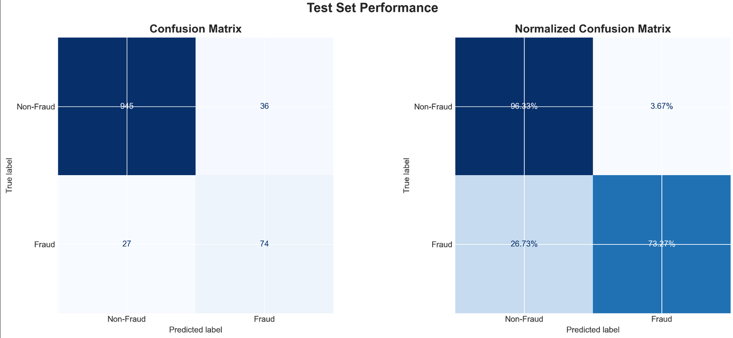
TEST SET EVALUATION
Performance Metrics:
Accuracy: 94%
Precision: 67%
Recall: 73% ← Most Important
F1-Score: 70%
ROC-AUC: 96%
PR-AUC: 78%
Confusion Matrix:

Slide 10

FINANCIAL ANALYSIS
Business Metrics Based on Test Set:
Operational Efficiency:
  Total providers in test set: 1082
  Actual fraudulent providers: 101
  Detected fraudulent providers: 74
  Detection rate: 74/101 (73.3%)
  False positive rate: 36/981 (3.7%)
  Investigation efficiency: 67.3% of investigations uncover fraud
Financial Impact Analysis:
Performance at
Different Decision Thresholds:
  Investigation cost (TP + FP): $550,000
  Fraud cost saved (detected fraud): $7,400,000
  Cost of missed fraud (FN): $2,700,000
  Net savings: $4,150,000
  Threshold 0.5: Precision=0.673, Recall=0.733, TP=74, FP=36, FN=27
  Threshold 0.6: Precision=0.761, Recall=0.663, TP=67, FP=21, FN=34
  Threshold 0.7: Precision=0.822, Recall=0.594, TP=60, FP=13, FN=41

Slide 11


THANK YOU!

