Slide 1
Agile -DevOps Transformation – Name of Company
Jomcy PAPPACHEN
Solution Architect – Cloud and DevOPs

Slide 2
DevOps Consulting
DevOps consultation
DevOps Assessment
DevOps Maturity assessment
End to End DevOps Implementation
Legacy Repository migration to Git
Process Transformation design and Implementation
DevOps Management and Support
Manage the health of your continuous delivery pipeline
Release management support
DevOps Framework Design and Tool chain proposal
Training and Adoption
Continuous deployment support
Infrastructure automation support
Solution designing based on industrial best practices and leading DevOps tools to automate & measure the performance of the delivery pipeline
DevOps Implementation strategy Planning
Tools consolidation and streamline process design
Assessment Report
Integrate framework for Test Automation
Branching strategy definition
Automated build and continuos delivery of application and InfrastructureBuild and Deployment automation and orchestration of Containers for Microservices

Slide 3
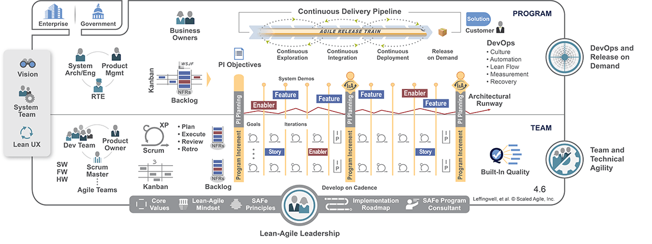
Agile-DevOps integrated flow

Slide 4

Essential Elements considered for Transformation
Tech
DevOps and Releasability
System Demo
Inspect and Adapt
IP Iteration
Architectural Runway
Mgmt
Lean-Agile Principles
Real Agile Teams and Trains
Cadence and Synchronization
PI Planning
Lean-Agile Leadership

Slide 5
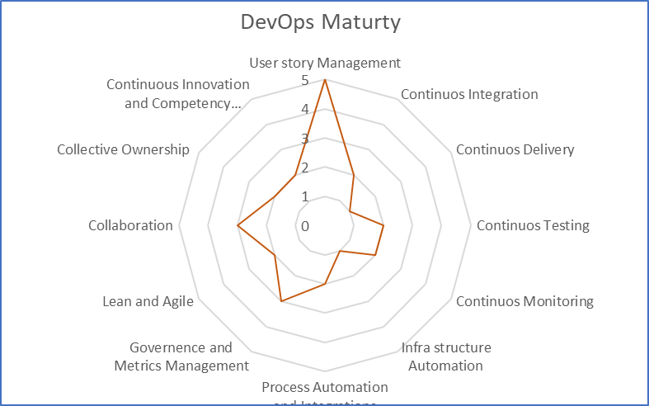
Continuous Assessment - DevOps Maturity
 |  | Score ( 1- 5)
1 | Requirements Management
2 | Continuos Integration
3 | Continuos Delivery
4 | Continuos Testing
5 | Continuos Monitoring
6 | Infra structure Automation
7 | Process Automation and Integrations
8 | Governence and Metrics Management
9 | Lean and Agile
10 | Collaboration
11 | Collective Ownership
12 | Continuous Innovation and Competency Improvement

Slide 6
Thank you

Slide 7
Scope
Lead the DevOps transformation journey for H&R Block by rolling out the foundational processes for the Agile/DevOps, providing the support and guidance for the DevOps teams, and creating an environment for continues learning and improvement.
Coaching and mentoring team to build CICD Platform for the legacy application using Azure DevOps
Work closely with the Executive leadership and peers in effectively managing the change.
Mentor offshore development teams to integrate DevOps standards and best practices into their software development lifecycle.
Define and facilitate the adoption of consistent Agile processes across the organization by assisting with defining and training the standards, managing communication, and change management
Mentor and coach the team through the changes to transform the organization effectively. Be the leader of the culture change.
Design DevOps framework with Azure DevOps for the application set ( Based on the technology stack)
Drive the change across the organization by working closely with the team, peers and senior leadership
Conduct annual and quarterly reviews on the DevOps Adoption

Slide 8
Approach
Assessment
Standardization
Automation
Shift left
Continuous Improvement
Assessment and Analysis of the application sets
AS-IS build and deployment process
Feasibility analysis on moving to Azure CICD pipeline
Understand current
Work flow and Approvals
Environment and Infra structure assessment
Build and deployment process
Change request Process
Work flow and Approvals
Infra structure standardization
Identify Tools set and Process
Propose new tool set and standardize the process
Coach team to Use Azure DevOps and third party tools for creating CICD framework
Team to maintain quality documentation for enterprise-wide solutions, standards, and best practices
Teams to be self-reliant and responsible for their applications from requirements through maintenance
DevOps Metrics Tracking and CI
AS-IS Analysis Report
Recommendation of Tools and Process
DevOps Framework Design with new set of tools and Processes
Continuous progress Monitoring and coaching
Continuous progress Monitoring and coaching
Continuous progress Monitoring and coaching

Slide 9
Approach(2)
Due Diligence
Sandbox
DEV
SIT,UAT,PTE
PROD
Due Diligence/Assessment and Gap Analysis
Create a Sandbox environment for each Application
Rollout to DEV environments
Rollout to Higher Environments
Rollout to Production
Change request Process
Continuous Feedback

Slide 10
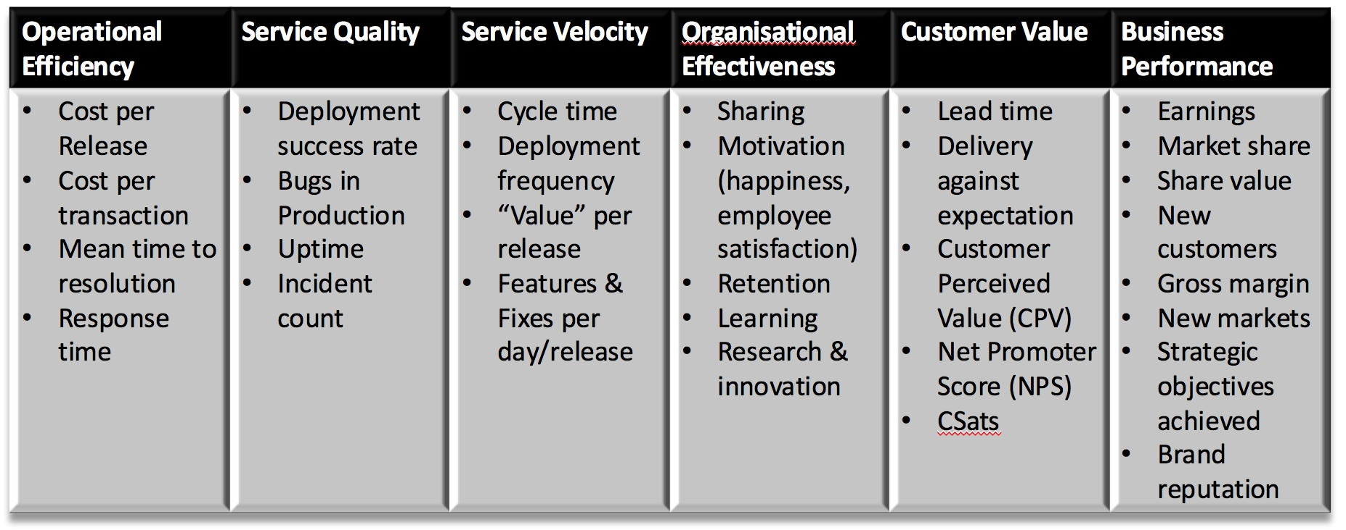
DevOps Metrics

Slide 11
Coaching
Application teams how to begin or improve their CICD pipelines
application teams to build monitoring into their applications and configure alerts
developers how to write quality unit tests and integrate into pipelines
application teams how to leverage IaC in their pipelines
Team to maintain quality documentation for enterprise-wide solutions, standards, and best practices
Teams to be self-reliant and responsible for their applications from requirements through maintenance

Slide 12
Thank You

Slide 13
The Ten Essential Elements
Lean-Agile Principles
Real Agile Teams and Trains
Cadence and Synchronization
PI Planning
DevOps and Releasability
System Demo
Inspect and Adapt
IP Iteration
Architectural Runway
Lean-Agile Leadership
Notes:
The Ten Essential Elements
#1 – Lean-Agile Principles SAFe practices are grounded in fundamental Lean-Agile principles. That’s why you can be confident that they apply well in your case. And if the practices don’t directly apply, the underlying principles can guide you to make sure that they are moving on a continuous path to the ‘shortest sustainable lead time, with best quality and value to people and society.’
#2 – Real Agile Teams and Trains Real Agile Teams and Agile Release Trains (ARTs) are fully cross-functional. They have everything, and everyone, necessary to produce a working, tested increment of the solution. They are self-organizing and self-managing, which enables value to flow more quickly, with a minimum of overhead. Product Management, System Arch/Eng, and Release Train Engineer provide content and technical authority, and an effective development process. Product Owners and Scrum Masters help the Dev teams meet their PI Objectives. The Agile teams should engage the customer throughout the development process.
#3 – Cadence and Synchronization Cadence provides a rhythmic pattern, the dependable heartbeat for the development process. It makes routine those things that can be routine. Synchronization allows multiple perspectives to be understood and resolved at the same time. For example, synchronization is used to pull the various assets of a system together to assess solution-level viability.
#4 – PI Planning No event is more powerful in SAFe than PI Increment (PI) planning. It’s the cornerstone of the PI, which provides the rhythm for the ART. When 100 or so people work together toward a common mission, Vision, and purpose, it’s amazing how much alignment and energy it creates. Gaining that alignment in just two days can save months of delays.
#5 – DevOps and Releasability DevOps provides the Culture, Automation, Lean-flow, Measurement, and Recovery capabilities to enable an enterprise to bridge the gap between development and operations. Releasability focuses on the enterprise’s ability to deliver value to its Customers more often and according to the demands of the market. Together they allow an organization to achieve better economic results by having more frequent releases and faster validation of hypotheses.
#6 – System Demo The primary measure of the ART’s progress is the objective evidence provided by a working solution in the System Demo. Every two weeks, the full system— the integrated work of all teams on the train for that iteration—is demoed to the train’s stakeholders. Stakeholders provide the feedback the train needs to stay on course and take corrective action.
#7 – Inspect and Adapt Inspect and Adapt is a significant event held every PI. A regular time to reflect, collect data and solve problems, the inspect and adapt assembles teams and stakeholders to assess the solution, and define and take action on the improvements needed to increase the velocity, quality, and reliability of the next PI.
#8 – IP Iteration The Innovation and Planning Iteration occurs every PI and serves multiple purposes. It acts as an estimating buffer for meeting PI objectives, and provides dedicated time for innovation, continuing education, and PI planning and Inspect and Adapt events. It’s like extra fuel in the tank: Without it, the train may start straining under the ‘tyranny of the urgent’ iteration.
#9 – Architectural Runway Architectural Runway consists of the existing code, components and technical infrastructure necessary to support the implementation of high priority, near-term features, without excessive delay and redesign. Without enough investment in the architectural runway, the train will slow down, needing to redesign for each new Feature.
#10 – Lean-Agile Leadership For SAFe to be effective, the enterprise’s leaders and managers must take responsibility for Lean-Agile adoption and success. Executives and managers must become Lean-Agile leaders who are trained—and then become trainers in—these leaner ways of thinking and operating. Without leadership taking responsibility for the implementation, the transformation will likely fail to achieve the full benefits. Essential SAFe Assets.

Slide 14
Agile Release Train
The Ten Essential Elements
Three Lean Enterprise competencies:
Lean-Agile Leadership
Team and Technical Agility
DevOps and Release on Demand

Slide 15
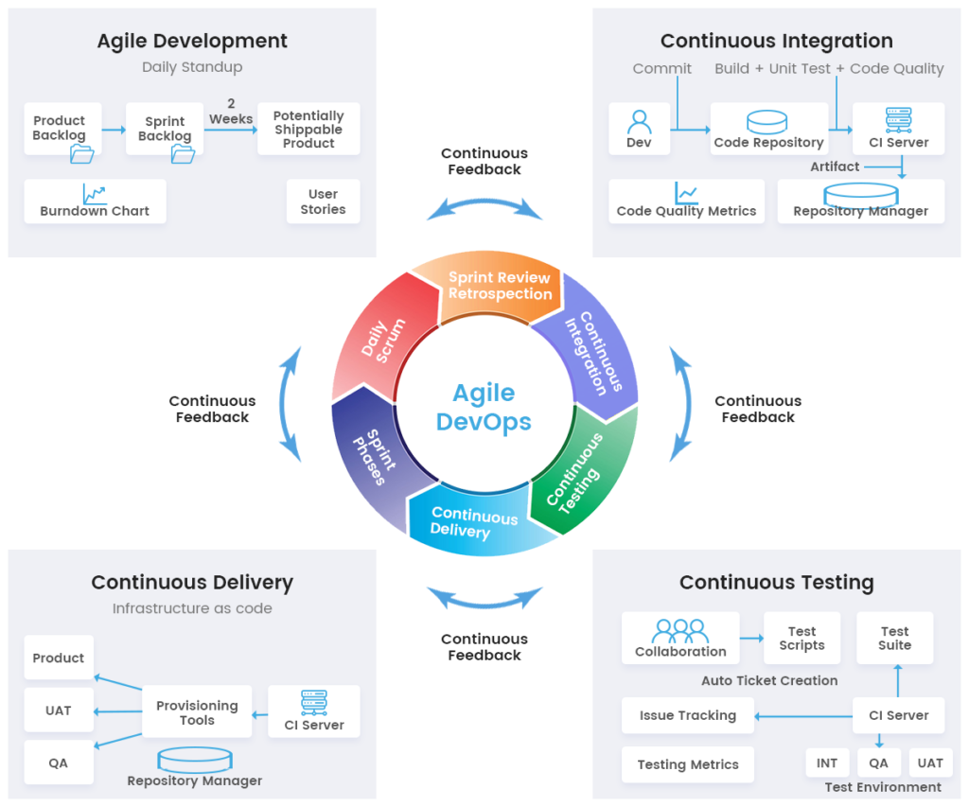

Slide 16
