Slide 1



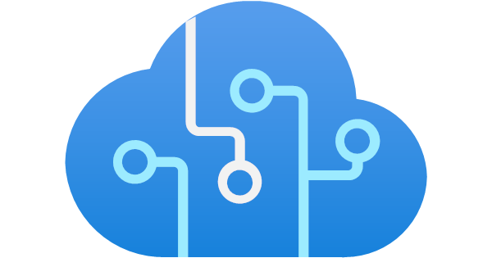


ChatGPT Front-End
You could have multiple agents/plugins/tools in the same chat session
General Chat Agent
AAD RBAC
AAD RBAC
Question
Short-term Chat history
Response
Business User
Front-End App
Azure App Service
Azure OpenAI - ChatGPT
Response
AAD RBAC
Long-term Chat history
Encrypted at test
Blob Storage

Slide 2





Hybrid Architecture
You could have multiple agents/plugins/tools in the same chat session
Search Agent
AAD RBAC
Search Query
Hybrid Index/es
Filename
Tile:
Content:
TileVector
ContentVector
FileLocation
Vector
AAD RBAC
AAD RBAC
Question
St Chat history
Azure OpenAI ChatGPT Search Query
Azure OpenAI - Embeddings
Cognitive Search Hybrid
Response
Hybrid Index/es
Business User
Front-End App
Azure App Service
Azure Functions
Preprocessing
Response
Chat history + New context
Top K
Azure OpenAI - ChatGPT
Split Files
Forms Recognizer
AAD RBAC
Long-term Chat history
Encrypted at test
Create Index
Chunk Files
Storage Trigger
CosmosDB
AAD RBAC
Save previous responses
Encrypted at test
CosmosDB

