Slide 1







GYMMERZ
Team
Language
Challenge
Scope
Conclusion

Slide 2


GYMMERZ
Language
Challenge
Team
Scope
Conclusion

Slide 3


GYMMERZ
Team
Language
Challenge
Scope
Conclusion

Slide 4

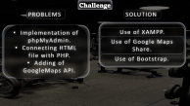
GYMMERZ
Team
Language
Challenge
Scope
Conclusion

Slide 5

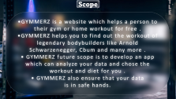
GYMMERZ
Team
Language
Challenge
Scope
Conclusion

Slide 6


GYMMERZ
Team
Language
Challenge
Scope
Conclusion

Slide 7


Team
Anna
Giridhar
George
Jambunathan
2
3
Jomin
Arin
Johnson
Walwaikar
1
4

Slide 8







Language
HTML
CSS
Bootstrap
JavaScript
PHP
Notes:
https://unsplash.com/photos/c-YzuJ6Q6jk

Slide 9

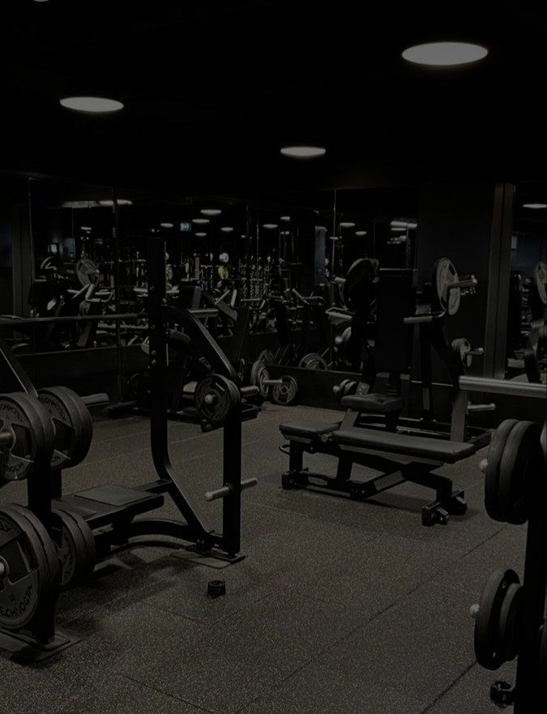
Challenge
PROBLEMS
SOLUTION
Implementation of phpMyAdmin.
Connecting HTML file with PHP.
Adding of GoogleMaps API.
Use of XAMPP.
Use of Google Maps Share.
Use of Bootstrap.
Notes:
https://unsplash.com/photos/80VEluDXWos

Slide 10



Scope
•GYMMERZ is a website which helps a person to their gym or home workout for free .
•GYMMERZ helps you to find out the workout of legendary bodybuilders like Arnold Schwarzenegger, Cbum and many more .
• GYMMERZ future scope is to develop an app which can analyze your data and chose the workout and diet for you .
• GYMMERZ also ensure that your data is in safe hands.
Notes:
https://unsplash.com/photos/kccyPqZezm0

Slide 11


Conclusion
In conclusion, GYMMERZ is your ultimate fitness destination. GYMMERZ offer a wide range of gym destination, personalized training programs, and a supportive community to help you achieve your fitness goals.

