Slide 1

SMART INDIA HACKATHON 2026
TITLE PAGE
Problem Statement ID –26101
Problem Statement Title-Develop an AI enabled learning platform that identifies competency gaps, recommends personalized training through integration with the iGOT Karmayogi ecosystem, and capable of generating Quizzes and Multiple choice questions (MCQs) from uploaded learning materials to strengthen capacity building in India's Official Statistical System.
Theme- Smart Education
PS Category- Software
Team ID-
Team Name- Team Viksit

Slide 2
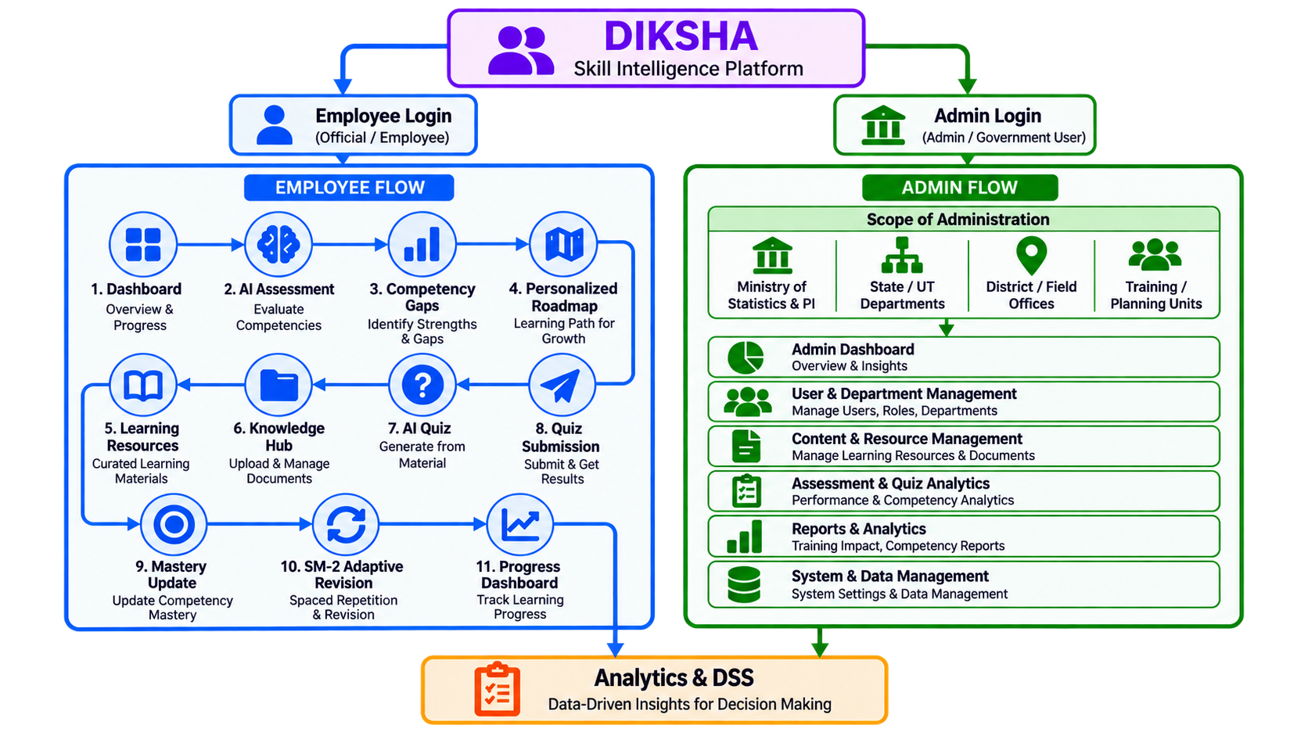
IDEA TITLE
Team Viksit
Proposed Solution
AI-Based Competency Profiling Build role-specific employee skill profiles.
Intelligent Competency Gap Detection Identifies the gap between an employee’s current skills and role-specific competency requirements.
Personalized Learning Roadmap Generate targeted learning roadmaps.
iGOT Karmayogi Integration Map gaps to relevant Karmayogi learning resources.
AI-Powered Adaptive Quiz Generation Generate AI-powered MCQs from learning material.
AI Learning Assistant
Provide contextual learning guidance.

Slide 3
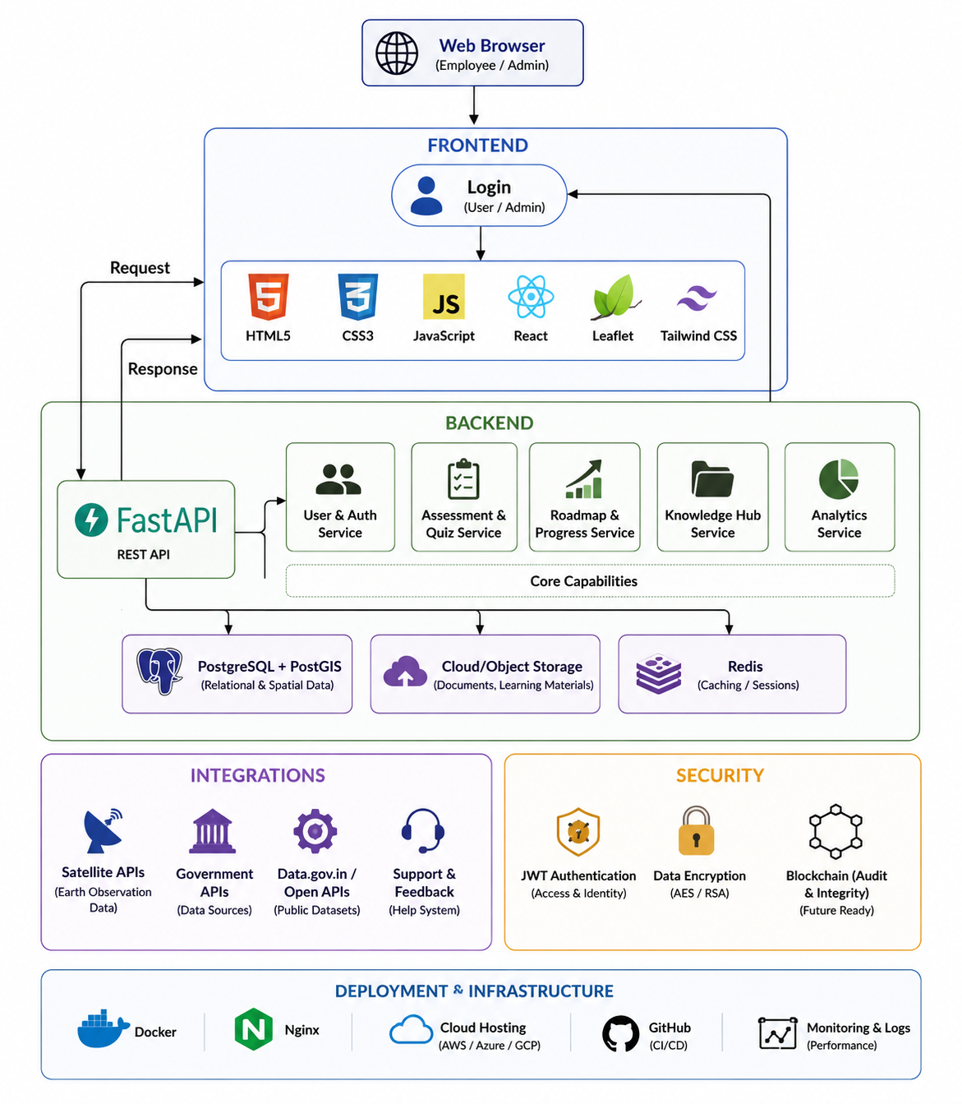
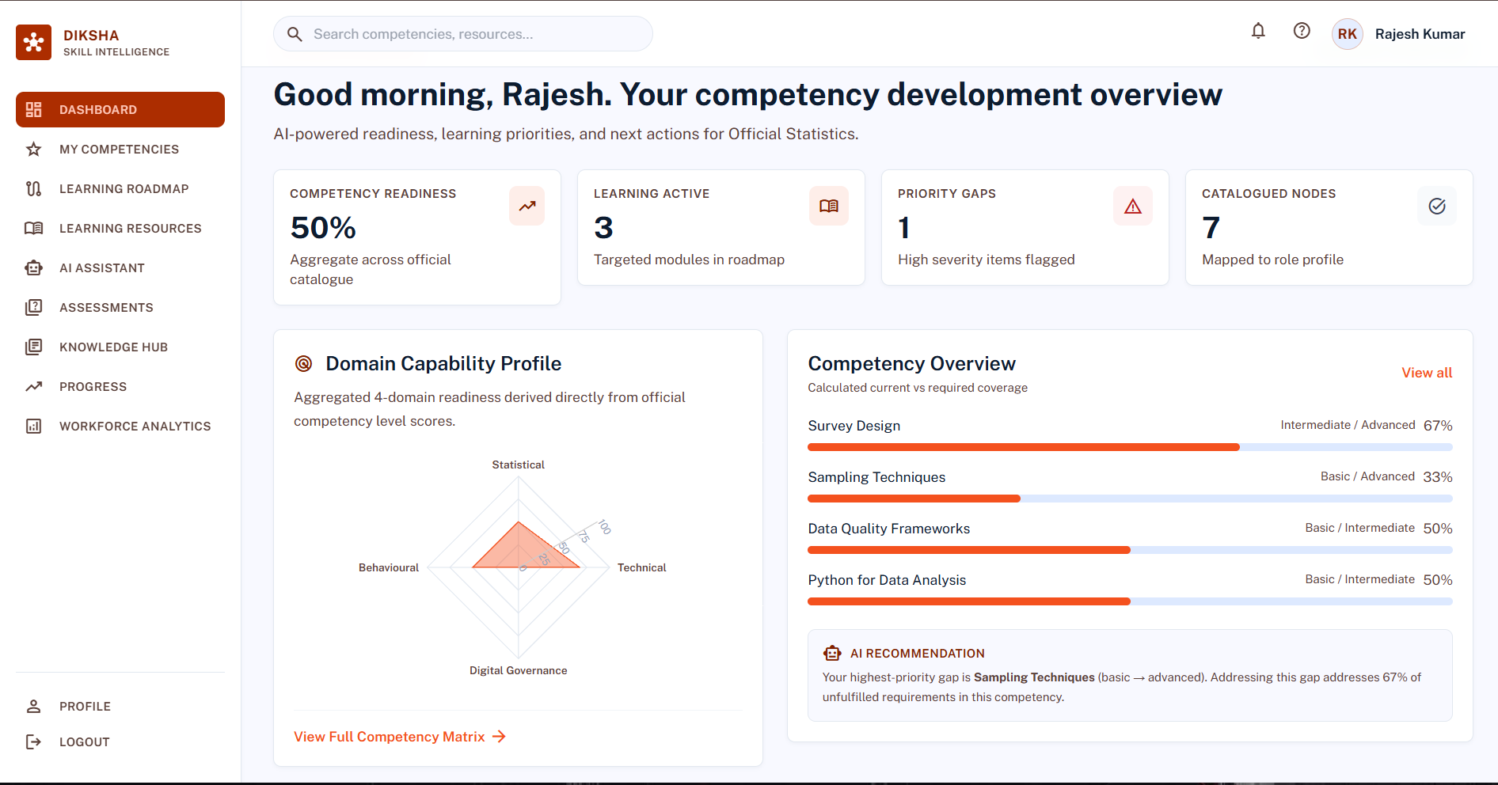
TECHNICAL APPROACH
Team Viksit
FastAPI: REST-based backend & AI/data integration.
Backend: FastAPI + Pydantic — modular REST APIs and validated data contracts.
Adaptive Engine: Mastery scoring + SM-2 forgetting curve.
Next.js + Recharts: Interactive platform & dynamic analytics.
Gemini AI: Competency analysis & dynamic assessment generation
iGOT Integration: against iGOT Karmayogi's course-catalogue and enrolment-tracking APIs

Slide 4
FEASIBILITY AND VIABILITY
Team Viksit
FEASIBILITY
VIABILITY
1.Technical
1. Economic
API-ready: Fits existing government digital infrastructure.
Data-ready: Required datasets available for pilot deployment.
Pilotable: Can be validated with selected roles before scale-up.
Incremental implementation: Can start with a limited department/role and expand after validation.
Cost-efficient: Reduces recurring manual assessment and training effort.
Reusable investment: One platform can serve multiple roles and departments.
Phased deployment: Pilot first, expand based on measurable results.
2.Operational
2.Operational
Easy adoption: Web-based; no special hardware required.
Workflow-compatible: Complements existing training processes.
Maintainable: New roles and content can be added easily.
User scalability: Supports expansion from pilot users to department-wide deployment.
Content scalability: New competencies, roles and learning resources can be added incrementally.
Data scalability: Can progressively integrate additional statistical datasets and government sources
3.Legal & Ethical
Privacy-first: Collects only essential user data.
Controlled access: Role-based visibility of employee information.
Responsible AI: Explainable outputs with human oversight.
3.Social
Workforce development: Enables continuous upskilling of statistical officials.
Long-term impact: Improves knowledge retention and institutional capability.

Slide 5
IMPACT AND BENEFITS
Team Viksit
BENEFITS | IMPACTS
1.Employee
1.Workforce
Targeted Learning — Focuses training on actual competency gaps.
Instant Feedback — Shows strengths, weaknesses and next priorities.
Better Retention — Timely revision reinforces important skills.
Higher Competency Levels — Builds stronger role-specific capabilities.
Continuous Upskilling — Creates an ongoing learning and improvement cycle.
2.Administrative
2.In System-Level
Less Manual Effort — Automates assessment and progress monitoring.
Clear Visibility — Shows competency status and priority gaps across employees.
Faster Intervention — Helps identify who needs support and where.
Improved Statistical Capacity — Strengthens the capability of the Official Statistical System.
Better Data Quality — Skilled officials contribute to more reliable statistical outputs.
Evidence-Based Planning — Workforce competency insights support better training and resource decisions.

Slide 6
RESEARCH AND REFERENCES
Team
Viksit
MoSPI – Ministry of Statistics & Programme Implementation: Official source for India's Official Statistical System, statistical programmes, publications and datasets.
https://www.mospi.gov.in/
2. MoSPI Microdata Portal (NADA): Provides access to official unit-level datasets such as PLFS, ASI, HCES and ASUSE used as the statistical-data foundation.
https://microdata.gov.in/NADA/index.php/catalog
3. iGOT Karmayogi: National digital learning platform providing role/competency-oriented learning resources for government officials; serves as a reference for the capacity-building ecosystem.
https://www.igotkarmayogi.gov.in/
4. National Accounts Statistics – MoSPI: Official statistical framework covering indicators such as GDP, GVA, GSDP and related national accounts data.
https://www.mospi.gov.in/
5. Mission Karmayogi / Competency-Driven Capacity Building: Reference for competency-based, continuous professional development of government officials.
https://www.igotkarmayogi.gov.in/

