Slide 1
NOVA
Our Idea : Word Blitz
Objective : Progressing to the highest level possible
Rules : Given a random word, user to input required number of synonyms, meaning or words related to the given word within the time limit
Features: Timer, dictionary and thesaurus usage in the coding, web based game with input functions, counter, leader board function of all the players after the game

Slide 2
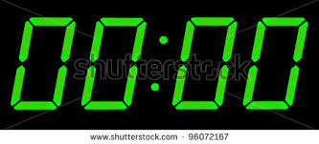

Given Word
Words input that are accepted will be appear here in black
Words input that are rejected will appear here in red
Either a digital or non-digital clock will be used as the timer
A counter that starts from the required number of synonyms, meaning or words related to the word. Game will proceed on to the next level after counter hits 0
5
Words to be keyed in here by the user

Slide 3
LEADER BOARD
Name | Level | Date
Nicholas Low | 24 | 24/5/2014
Andrew Low | 22 | 23/5/2013
Jeremy Ong | 20 | 26/5/2014
Benedict | 19 | 1/6/2014
Yu Long | -5 | 19/5/2014

