Slide 1

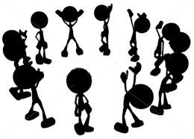

WORD BLITZ
Instructions
Progressing to the highest level
Given a random word, user
to input required number
of synonyms, meaning or
words related to the given
word within the time limit
FUN and KILLS BOREDOM
EDUCATIONAL

