Slide 1
Stop, Verify, or Explore?
State-Aware Value-of-Compute Routing for Autoregressive LLM Reasoning
GSM8K · Qwen2.5-1.5B / 3B

Slide 2
Motivation
Reasoning problems require different test-time compute.
Always using extra compute increases token cost even when not needed.
Can routing from initial reasoning state improve accuracy–cost tradeoff?

Slide 3
One-Step Post-Hoc Routing
Generate an initial reasoning trace and answer.
Choose exactly one action: STOP, VERIFY, or SC-3.
STOP keeps initial answer, VERIFY re-solves, SC-3 votes across 3 answers.

Slide 4
Oracle and Utility
Utility = correct(action) − λ × normalized_cost(action).
Oracle selects the best action per example using full rollout outcomes.
Oracle sets an upper bound for learned controllers.

Slide 5
Learned Controllers
Features: question length, numeric tokens, trace length, initial answer, etc.
Oracle-action classifiers: LogisticRegression + RandomForest.
Value predictor estimates accuracy and token cost for each action.

Slide 6
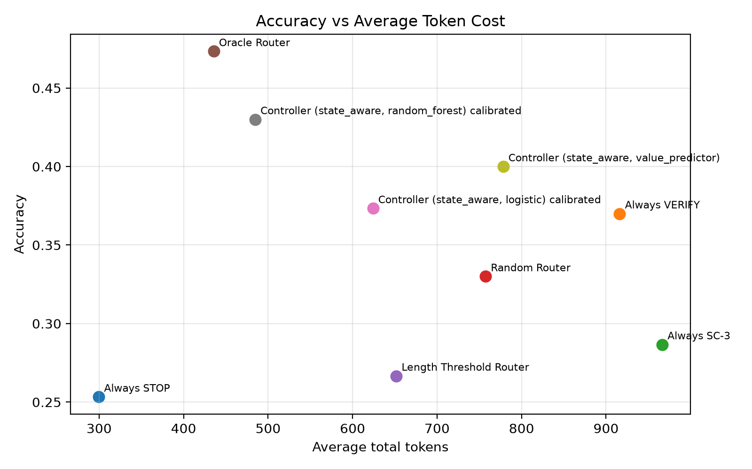
Key Result: Accuracy vs Average Token Cost
Oracle routing achieves the best accuracy with much lower token cost than Always VERIFY.
Calibrated Random Forest also recovers a large portion of the oracle gain.

Slide 7
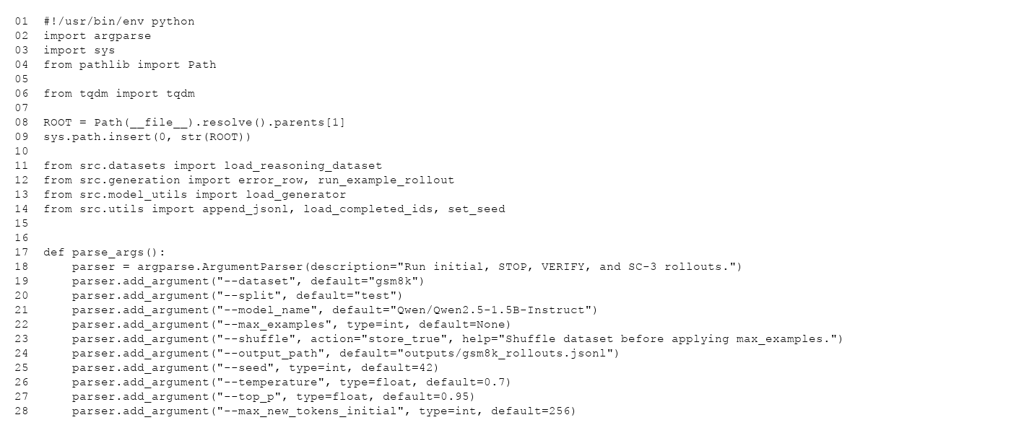
Example Implementation: Rollout Script
This script performs initial reasoning, VERIFY, and SC-3 generation for each GSM8K example.

Slide 8
Limitations
Only GSM8K dataset was evaluated.
3B experiments were limited to 100 examples.
Entropy/confidence features remain unimplemented.

Slide 9
Conclusion
Adaptive routing improves accuracy–compute tradeoff.
Oracle demonstrates a strong value-of-compute signal.
Learned controllers recover part of the gain, especially Random Forest.

