Slide 1
Vision for Robotics Singulation
Chris Powers and Michael Laskey

Slide 2
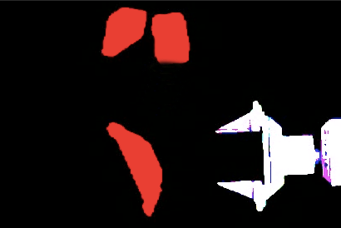
Goals
Detection of singulation
Reduction of variance in state in images

Slide 3
Secondary Goal
Minimize assumptions about environment
Lighting
Color
Objects

Slide 4
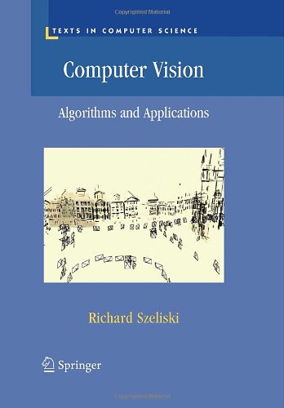

Slide 5
Segmentation
Detect each object separately
Measure distance between objects to detect singulation
General technique for computer vision

Slide 6
Snakes
Outline each object to segment them
Latch onto contours by minimizing “energy” cost function with gradient descent
E_{cont} keeps points equally spaced
E_{curv} enforces smoothness
E_{image} attracts to contours

Slide 7
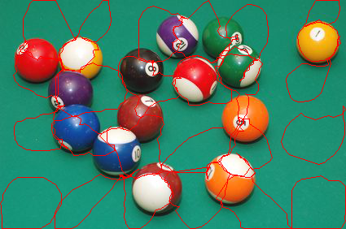

Slide 8
Snakes
Disadvantages
Computationally expensive
36 s for 200 x 160 image
Initial snake positions important
Too general; can assume more about setup in robotics
Fixed background
Fixed lighting

Slide 9
Connected Components
Associates groups of pixels into object clusters to segment them
Distance determined by definition of singulation
Assumes image is binary- knows if a given pixel belongs to an object
Fast after using sparse edge pixels for distance checks

Slide 10
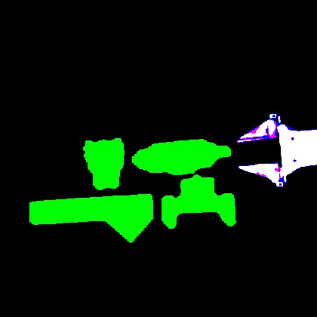
Connected Components

Slide 11
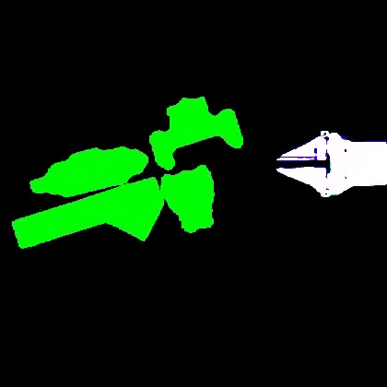
Connected Components

Slide 12
Connected Components
Applying assumptions about setup to YuMi
Find “object pixels” in point cloud by subtracting out any pixels below table’s depth

Slide 13
Sources
http://www.cs.utah.edu/~manasi/coursework/cs7960/p5/project5.html
https://www.cse.unr.edu/~bebis/CS791E/Notes/DeformableContours.pdf

