Slide 1

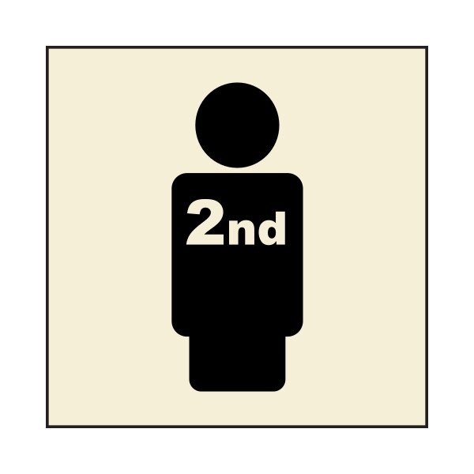
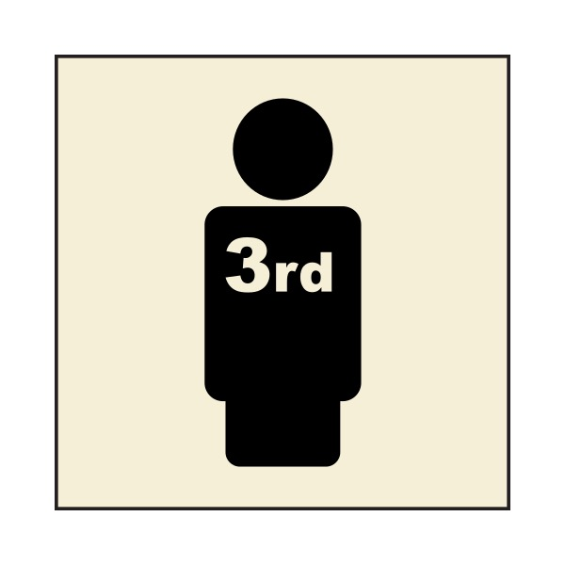
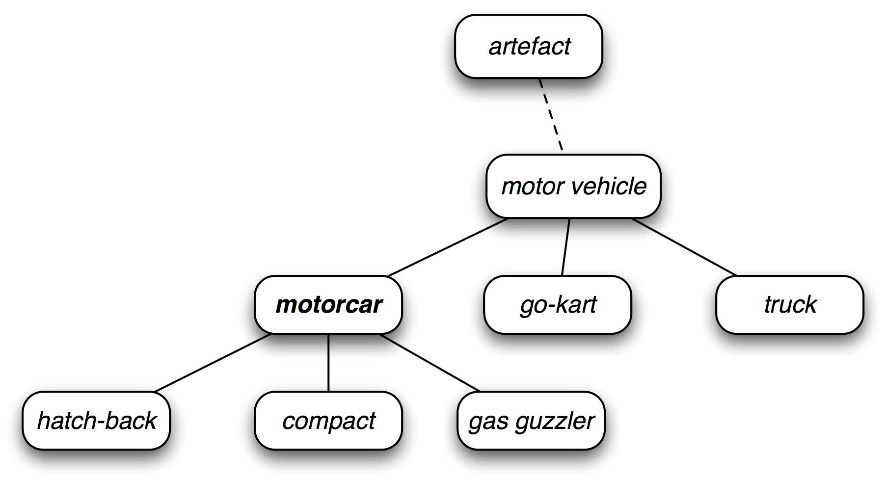
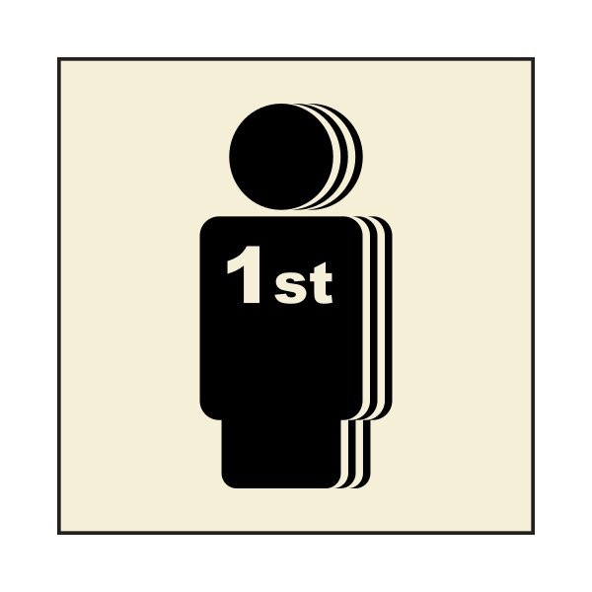
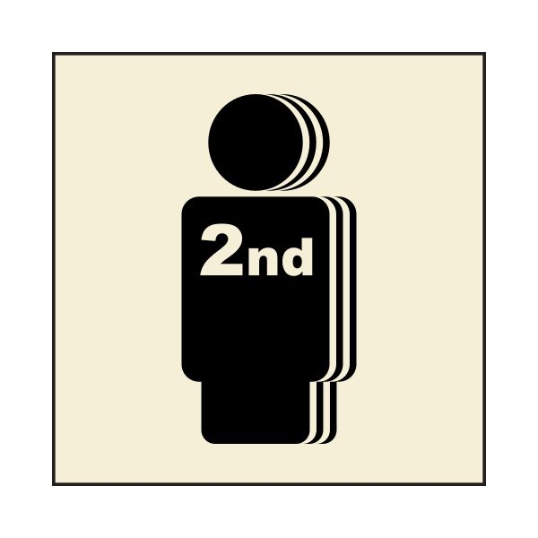






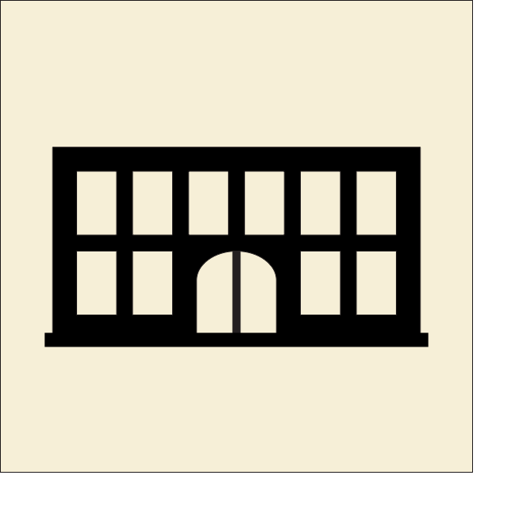





Picmoji - English Translator
Alexander Beatty
Kenyon College
Abstract
Emojis (continued)
Methodology
This project lays the groundwork for studying how sentiment changes as information is selectively converted from (a) text to imagery and then from (b) image/text to interpretation. The first process is guided by Artificial Intelligence embedded within Natural Language Processing while the second processes a product of human intelligence and interpretation.
A significant aspect of the visual language is the inclusion of the first, second, and third person
WORDNET SYNSET
Background
I / ME
YOU
HE / SHE
The design aesthetic for this project was inspired by the imagery of the Austrian philosopher and Political Economist, Otto Neurath’s ISOTYPE (International System Of Typographic Picture Education). Neurath, with the help of Gerd Arntz, a Germain artist who specialized in Japanese style woodcuts, sought to develop a highly intuitive visual language comprised of simple, modular, and easily repeatable icons. The intent of the project was to easily educate people on economic concepts with minimal text and numbers. Neurath believed that by teaching the concepts though simple imagery, it could be easily understood by a far wider range of people, regardless of the language they spoke.
Although the Isotypes were never intended to be used as an entire language on its own, the additive nature and simple, high contrast imagery gave the language far more potential to communicate complete ideas than similar visual languages.
Similar to emojis currently available on smartphones, Neuraths Isotypes could not be used as words to write out sentences because there aren't defined parts of speech. Without the ability to identify the subject and verb of a sentence, it is impossible to communicate effectively.
In a digital imaging course at Kenyon College, we were assigned to create visual languages such as emojis. Inspired by the aesthetic and potential of Neurath’s work, I sought to develop a similar visual language with the addition of essential elements of modern language such as parts of speech, tense, and person.
WE / US
YOU (ALL)
THEY
• Another key element is the ability to identify verbs in the sentences
• The verbs are signified by a black circle and the inverted color of the icon
TO GO TO BUY TO DRIVE TO EAT TO CALL
Methodology
Conclusions
Our goal is to study how textual sentiment is transformed by the process of translating selective words into emojis. We accomplish this by observing how human observer interpretations of sentiment changes between the original all word text and the modified text containing some emojis substituted for key words.
We start with a emoji lexicon of 75 images each representing one core word like ‘love’ or ‘car’. Each of these 75 core words is then expanded to a set of synonyms using WordNet synsets(1) resulting in an expanded lexicon of X words. Each of the core words in the original 75 emoji lexicon along with their synonyms map to a common emoji image. For example:
< car emoji image> maps to the word ‘car’
The word ‘car’ is in synset <car.n.01> which includes the synonym words ‘auto’, ‘automobile’, ‘machine’ and ‘motorcar’.
Before we can search for the core words and associated synonyms for replace them with their corresponding emoji we have to first preprocess the original text. This preprocessing includes the standard NLP cleaning operations of tokenizing strings into distinct words, lowercasing, removing punctuation, and stemming. WordNet synsets contain root English words like ‘run’ which should map to all variants including ‘ran’ and ‘running’. We use the Python library Natural Language Toolkit(2) to tokenize, and stem text that is input.
After selectively substituting emojis for key words in the original text we are left with a sequence of words in text form and emojis in image form. We use the Python library Pillow(3) to then convert words from text from into images sized to be compatible with our emoji images. Next concatenate the images of words and emojis together preserving the sequence order of the original text.
In its current state, this project stands a proof of concept on which to be developed further in the future. We have found that a visual language can be utilized with Artificial Intelligence embedded in NLP to communicate ideas with a similar structure to english sentences.
Future Developments
We have found that in order to truly test the effectiveness of the program, we must first greatly expand the visual language. After we have a more expansive vocabulary, we plan to utilize double blind testing to evaluate the success of the system in communicating the intended concepts. The test will begin with a written English sentence. The program will translate the sentences into the visual language. A participant who has not seen the original sentence will try to translate the new visual sentence back into English text. The success of the system will be evaluated by the similarity between the original sentence and the participant’s translation.
We also hope to utilize this system with languages other than English.
Utilizing the same test, we hope to see potential changes in sentiment as word order varies.
The Emojis
How it works:
• The images start with a base image such as the icons on the left
• Icons are then added to the base nouns to create more specific words
BUILDING
HOSPITAL
Acknowledgements
https://wordnet.princeton.edu/
https://www.nltk.org/
https://python-pillow.org/
CAR
AMBULANCE
BUILDING
FACTORY
POWER PLANT

