Slide 1
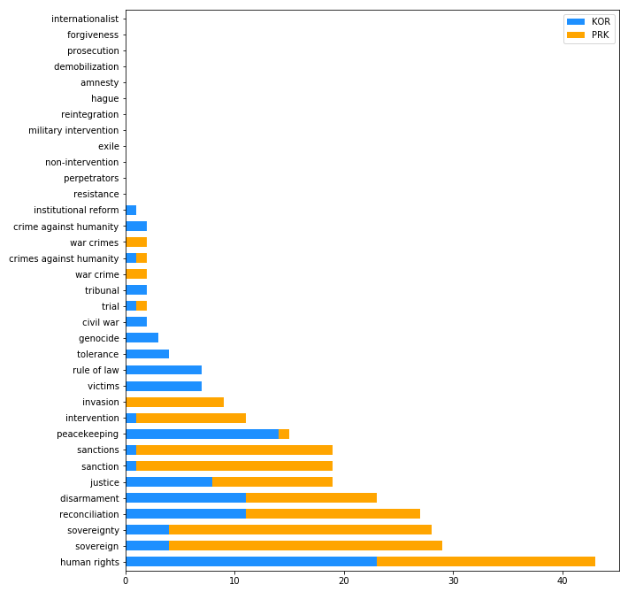
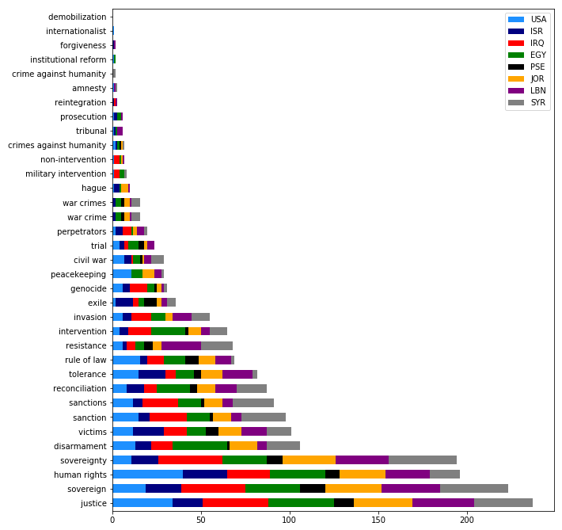
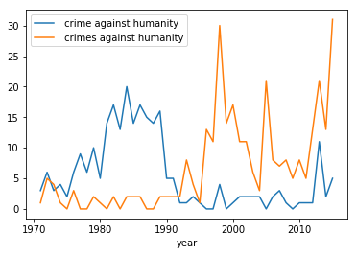
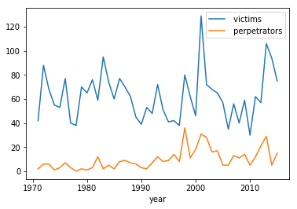
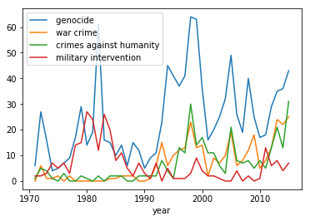
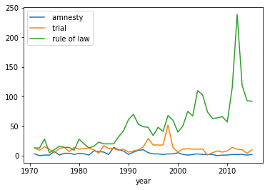
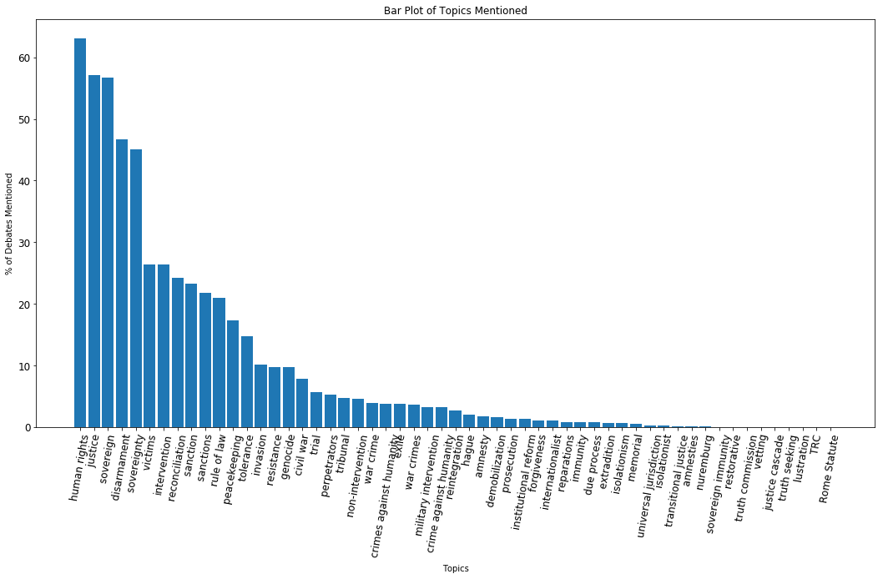
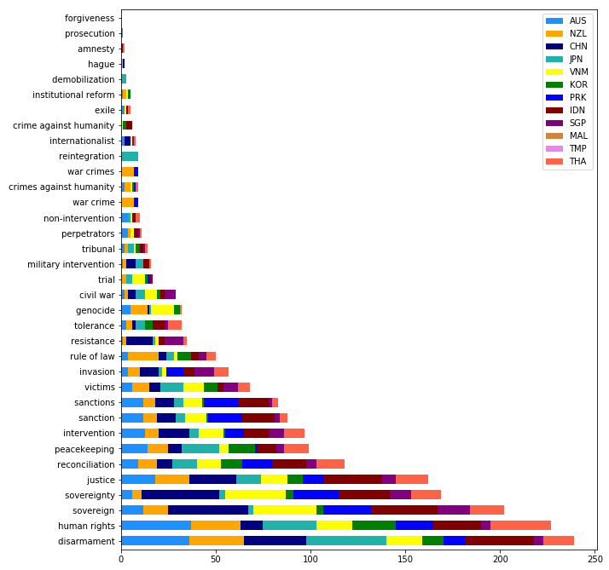
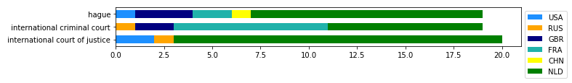
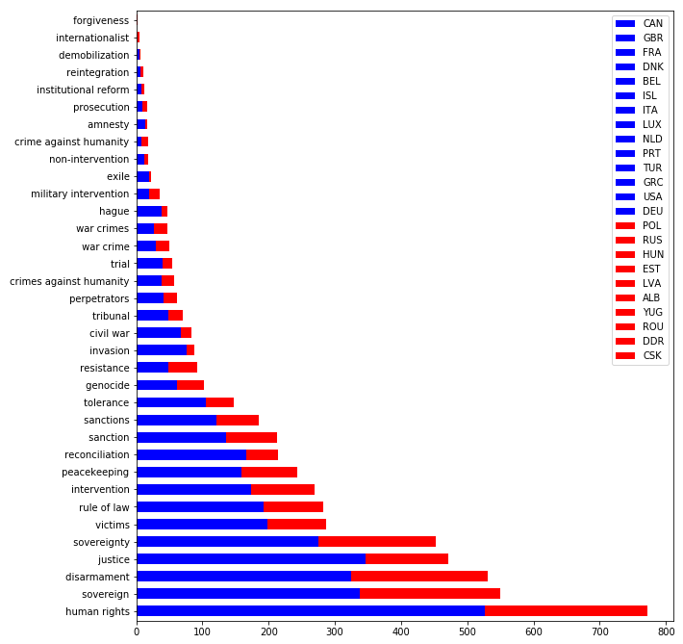
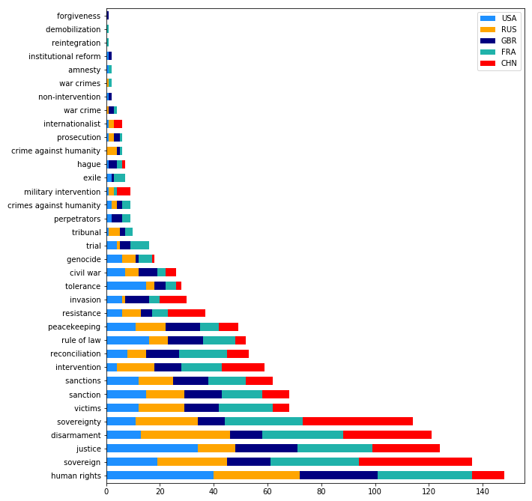
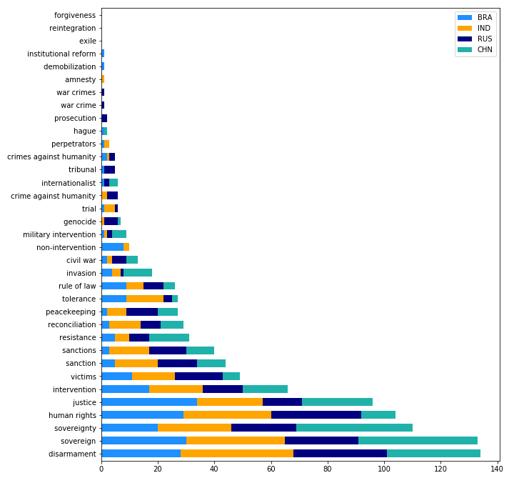
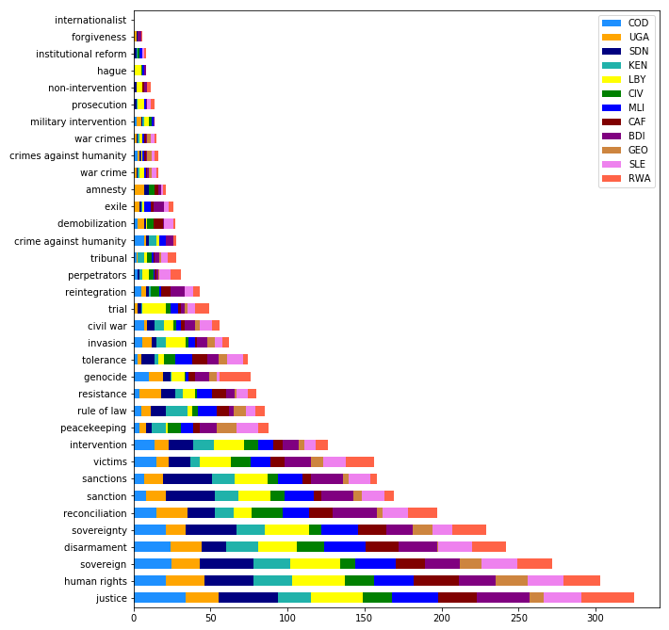
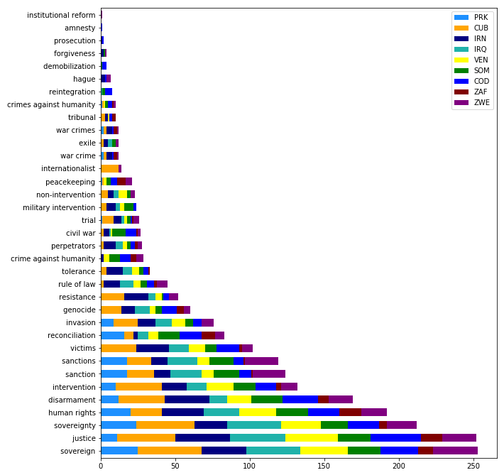
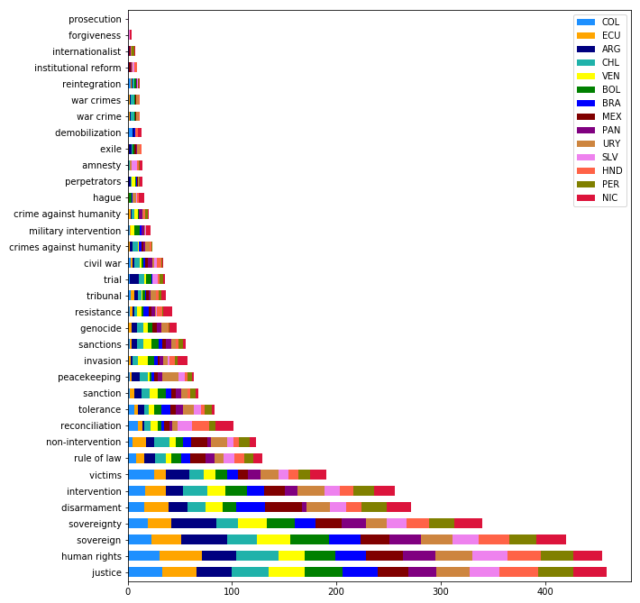
Transitional Justice Terminology Analysis in United Nations General Assembly Speeches (1971-2015)
Michael Lahanas
Artificial Intelligence for the Humanities: Text, Image and Sound, Kenyon College
Abstract
Results
North Korea and South Korea
Middle Eastern Countries and USA
In this project, I used Python to process, filter, and create visualizations for a dataset of UN General Assembly speeches from every member state from 1971-2015. I divided my dataset into a variety of different regional and political combinations that reflect historical alliances, rivalries, and interests of major nations. Then, I input a dictionary of terms that relate to the emerging field of transitional justice, as well as human rights. While some terms showed up rarely, the times they did were closely tied with the sociopolitical history of the countries that mentioned them.
Term Usage Over Time
Oceania and Asia
The Netherlands, Security Council, and International Justice Institutions
NATO v. Eastern Bloc
Security Council
Top 5 Countries For Select Terms
War Crimes: Bosnia and Herzegovina, Croatia, Luxembourg, Lesotho, Sweden
Crimes Against Humanity: Estonia, Hungary, Netherlands, Costa Rica, Lesotho
Genocide: Rwanda, Armenia, Cuba, Bosnia and Herzegovina, Burundi
Tribunal: Croatia, Bosnia and Herzegovina, Tanzania, Mauritius, Rwanda
Prosecution: Libya, Belgium, Gambia, Rwanda, Slovenia
Amnesty: Uganda, El Salvador, Nicaragua, Luxembourg, Cote d’Ivoire
Rule of Law: Austria, Philippines, Netherlands, Denmark, Bangladesh
Reconciliation: Ireland, Burundi, Chad, Cambodia, Togo
Intervention: Cuba, Chile, Nicaragua, Libya, Afghanistan
Non-Intervention: Chile, Uruguay, Paraguay, Mexico, Brazil
Military Intervention: Pakistan, Angola, Yemen, Bolivia, Somalia
Sovereignty: Cuba, China, Iraq, Cambodia, Vietnam
Justice: Iran, Venezuela, Bolivia, Saudi Arabia, Libya
Human Rights: Netherlands, Austria, Ireland, Costa Rica, Germany
Reintegration: Sierra Leone, Burundi, Bosnia and Herzegovina, Liberia, Japan
Forgiveness: Philippines, Antigua and Barbuda, Malawi, Solomon Islands, Jamaica
Perpetrators: Trinidad and Tobago, Denmark, Ireland, Iran, Fiji
Victims: Colombia, Costa Rica, Iran, Nicaragua, Cuba
Disarmament: Romania, Ukraine, China, Mongolia, Japan
Exile: Cambodia, Palestine, Uganda, Israel, Costa Rica
Introduction
Every year, a representative from every member state of the United Nations gives a speech to the General Assembly in New York. In that speech, they lay out foreign and domestic policy goals, and occasionally even make calls to action to the international community. Sometimes, they use their time to highlight great successes that their country has achieved a particular industry or field of expertise. So, when I came across a dataset of UN General Assembly speeches, I wanted to see if I could use Python to track the usage of transitional justice/human rights terminology in them. I suspected that Western democracies would use them more frequently than non-Western autocracies. Additionally, I believed that certain countries with histories of violence and experience with transitional justice mechanisms would drop them in their speeches. Transitional justice, “refers to the ways countries emerging from periods of conflict and repression address large-scale or systematic human rights violations so numerous and so serious that the normal justice system will not be able to provide an adequate response.”
BRIC Countries
States w/ Open International Criminal Court Investigations/Other TJ Mechanisms
Conclusions
Methodology
As I suspected, Western democracies led the pack with more frequent mentions of terms like human rights, and rule of law. Meanwhile, countries like Russia, China, Venezuela, and Cuba tended to mention sovereignty more often – a hint at their more unique foreign policy agendas. Curiously, justice was also one that was mentioned far more often by this cluster of countries. Sanctions were also close behind this language, more heavily for some countries that are subject to them than others. Additionally, there has been a significant uptick in the use of some transitional justice terminology in the late 1990s, just as what author Kathryn Sikkink called the “justice cascade” was truly beginning to pick up steam.
Unfortunately, a great many terms specific to the burgeoning field of transitional justice remain unmentioned in General Assembly speeches. This does not, however, mean that they are being neglected by international diplomats – presumably they are being discussed in different settings at the UN. Still, the fact that some are being used at all, and can be traced to countries with a historical relationship to transitional justice mechanisms means that this dataset remains a rich resource for scholars to understand trends in diplomatic language over the last forty years.
I input the following terms to create my transitional justice/human rights dictionary:
amnesty, universal jurisdiction, transitional justice, civil war, truth commission, intervention, peacekeeping, trial, justice cascade, truth seeking, invasion, reparations, extradition, memorial, prosecution, rule of law, vetting, lustration, disarmament, demobilization, reintegration, forgiveness, institutional reform, reconciliation, genocide, hague, war crime, war crimes, human rights, TRC, amnesties, crime against humanity, immunity, sovereign immunity, sovereign, exile, restorative, tribunal, Rome Statute, justice, victims, perpetrators, resistance, military intervention, non-intervention, isolationist, due process, sovereignty, isolationism, internationalist, tolerance, nuremburg, sanctions, crimes against humanity, sanction.
Then, I did frequency analysis and clustering over time using a Python notebook for select terms, as well as for specific countries (identified by ISO 3166-1 alpha-3 country codes) across the entire corpus.
Historic Outliers
Latin America
Acknowledgements
Much thanks to Professors Chun and Elkins for helping us navigate a new and exciting field, Joe Philleo for his Kaggle notebook that helped me get started, Professor McAllister for her excellent Politics of Transitional Justice seminar, and of course, Kenyon College itself for launching a digital humanities course.

