Slide 1
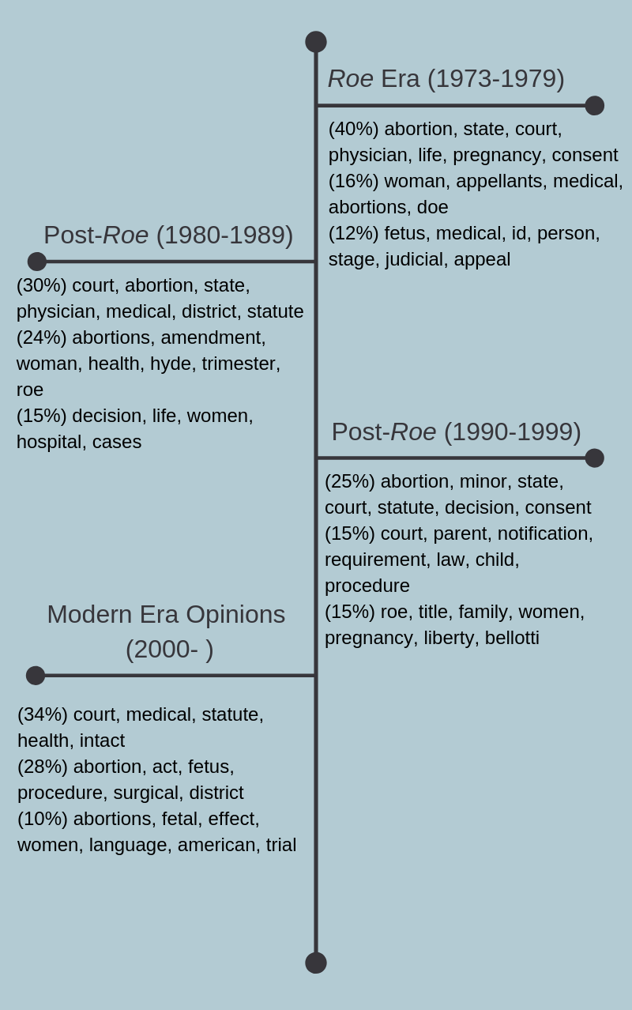
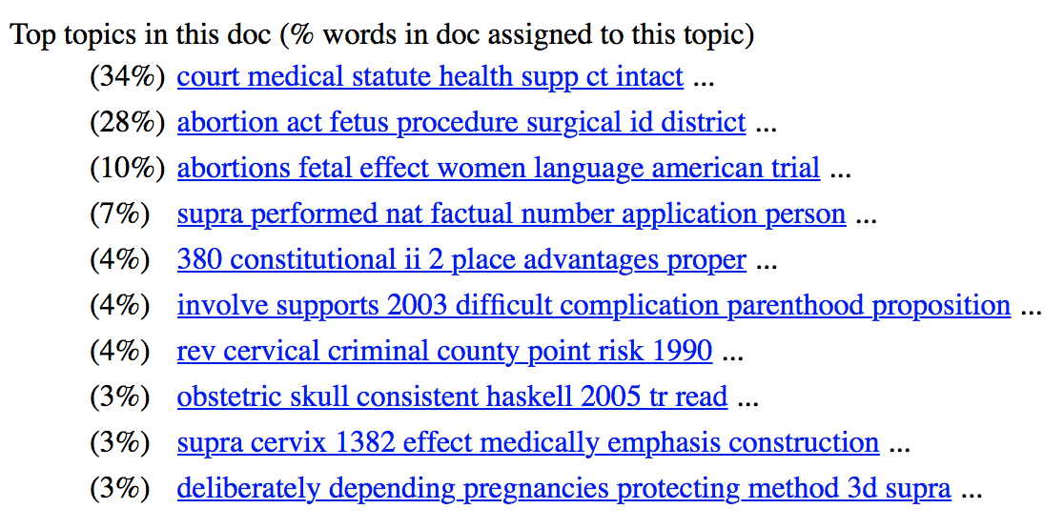
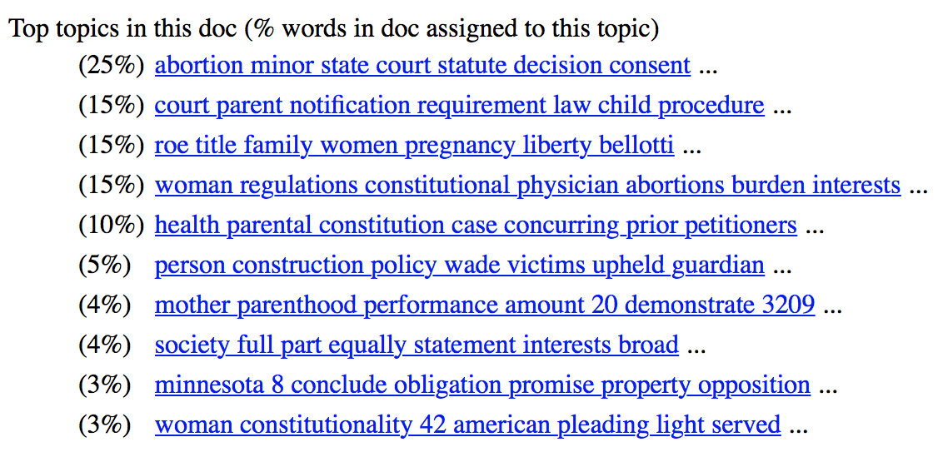
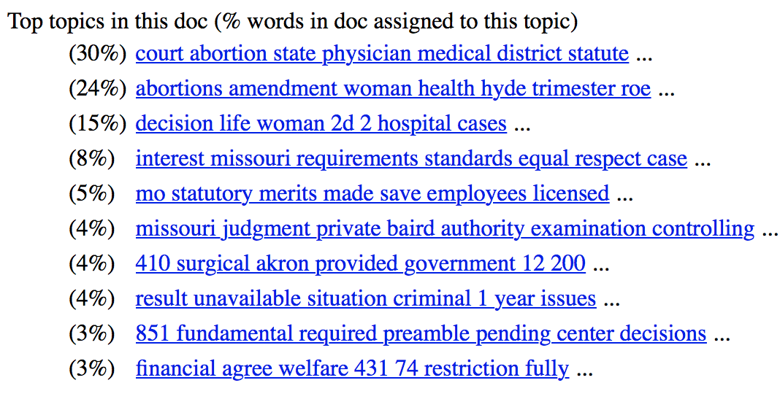
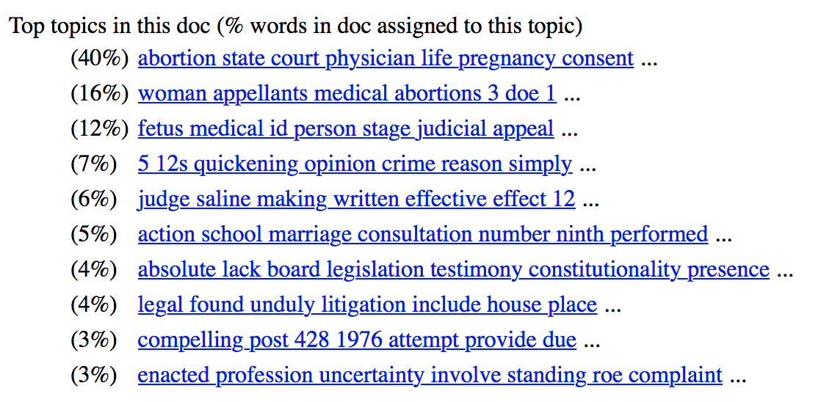
Topic Modeling Analysis of Supreme Court Opinions Focusing on Privacy Rights in the Context of Abortion Law
Ellen Morrissey
Kenyon College Digital Humanities Department
Research Question
History of Jurisprudence
Analysis & Conclusion
What can topic modeling analysis of Supreme Court opinions over time reflect about the Supreme Court’s procedural tendencies and changing views on a specific area of Constitutional law?
The Supreme Court’s judicial opinions on abortion begin in 1973 with the landmark decision Roe v. Wade. In this decision, the Court found that individuals have a right to procure an abortion under the guarantee of a right to privacy found in the Fourteenth Amendment and various other Amendments in the Bill of Rights. The Court balanced this interest against the United States’ interest in protecting the potential life of the fetus. In navigating this balance, the Court established a three-tier framework based in the three trimesters of pregnancy for determining when the fundamental right to abortion is being violated. The right is greater towards the beginning of the pregnancy, but as fetal development progresses the government gains a legitimate interest in its well-being and has more leeway for restricting the right to abortion. For about fifteen years afterwards, the Court focused centrally on working out the specifics and logistics of the Roe decision. In 1989, however, in Webster v. Reproductive Health Services, the Court began to slightly alter the jurisprudence surrounding abortion by ruling that the government had no requirement to help fund access to abortion except in cases which would threaten the life of the mother. In 1992, the Court continued this line of regulation when it ruled in Planned Parenthood of Southeastern Pennsylvania v. Casey that some regulations by the government on access to abortions, like mandatory waiting periods and parental consent for minors, were legitimate. In the 2007 Gonzales v. Carhart decision, the Court banned a method of abortion that it found to be disrespectful to the sanctity of life, despite the scientific evidence that it did not endanger the mother’s health. This slow chipping away at the Roe v. Wade decision through minor regulations and deviations from its initial framework defines the modern period of abortion jurisprudence, eventually resulting in a departure from the initial three-trimester framework established in Roe for a more flexible sliding scale of fetal viability, and the replacement of the strict scrutiny standard for the government’s regulation of the right to abortion with the less rigid undue burden standard.
I categorized the three largest topics as follows, in order from largest to smallest: 1) general judicial subject; 2) specific area of law; 3) basis of judicial decision. Below, are the conclusions I drew about the shift in the makeup of these topics and what they represent in relation to how the Court functions and how its rulings about abortion have changed over time.
1) General Judicial Subject
In both the seventies and eighties groups of opinions, this topic is very general, with references to “physician,” “abortion,” and “pregnancy.” It indicates that the Court is ruling on abortion, and also that it is the beginning of this area of jurisprudence for the Supreme Court. In the nineties group of opinions, however, we see the introduction of some more specific terms, like “minor” and “consent,” showing that the Court has now moved to more specific regulations of the subjects of abortion law. The final group of opinions from the twenty-first century has words that reference abortion more generally, but also includes the word “intact.” This is likely in reference to the subject of Gonzales v. Carhart, which determined the legal status of the intact dilation and extraction procedure for abortion. This is interesting, as it shows the general directions the Court has been taking in regards to abortion law in each decade, first approaching it most generally, then approaching the more specific extraneous subjects to the law, and finally the methods by which abortion is performed. This final direction, however, raises a question for me about whether medical procedures should be regulated so specifically by the Court, considering they are legal scholars and not medical professionals.
2) Specific Area of Law
In the seventies group of opinions, this topic is still very general, making references to “woman,” “appellants,” and “abortion,” which makes sense considering it is the beginning of this area of jurisprudence, so it would not yet have gained specificity. In the eighties group, we see the word “hyde,” which is in reference to the proposed Hyde Amendment that would have outlawed abortion. We see the Court, here, responding to legislative reactions to the Roe v. Wade decision. The nineties group of opinions makes references to “parent” and “notification,” which shows a continuation of the Court’s specific responses to legislation, in this case laws being passed to regulate minors’ access to abortion, which was a repeated subject in the opinions of that era. The topic for the twenty-first century group of opinions uses words like “procedure” and “fetus,” which makes sense considering the Court’s move into regulating the medical procedures surrounding abortion. Interestingly, this topic makes no mention of “woman,” like the seventies topic does, but instead references “fetus.” This effectively represents the shift in the balancing of rights in favor of the potential life of a fetus, and the relaxing of the strict scrutiny previously required to limit a woman’s right to abortion.
3) Basis of Judicial Decision
In this topic from the seventies group of opinions, the terms used are once again very general, making references to “appeal” and “medical.” These terms show how the Court relies on facts and non-binding legal documents in early cases such as these, as opposed to non-existent precedent. In the eighties topic, we see the introduction of words like “decision” and “cases,” which are likely references to past decisions by the Court on abortion. This makes sense in that time period, as the abortion rulings of the eighties were largely about specifying the logistics of applying Roe v. Wade. This reference to precedent continues in the nineties topic, as evidenced by the words “Roe” and “Bellotti,” which are both the names of parties in past Supreme Court abortion cases. Interestingly, however, the twenty-first century topic for this category diverges from the legalistic nature of the past two decades. The only judicial word in the topic is “trial,” which would likely not be a word used to reference precedent. This indicates a return to the facts of the case in ruling about abortion, and reflects the recent move away from the framework established in Roe v. Wade.
The above analyses show that topic modeling can be a useful tool to empirically exemplify the shifts in Supreme Court rulings about abortion law that have been already established by legal scholars. We can see a divergence from the initial framework of Roe v. Wade and the placement of greater weight in the potential life of the fetus as a legitimate justification for government regulation of abortion. Also, since legal language is so closely tied to legal concepts, this analysis can be a useful way to gain new perspectives on these shifts in jurisprudence. It also is an effective means by which to raise important and interesting questions about what the Court relies on in its rulings, as represented by the rhetoric and terminology employed, like its recent move towards medical logistics as an area of focus.
Background on Legal Content Analysis
Legal scholars have been known to, in their analysis of the law, borrow from academic methodologies belonging to subjects ranging from economics to moral philosophy. A relatively new method of empirical legal analysis has been employed using machine learning and content analysis. The bulk of the studies done using this method tend to analyze large textual datasets, and, in doing so, attempt to use word frequency in legal text corpuses to draw conclusions about writing style or the larger ideological or judicial-reasoning phenomena indicated by language use. Oftentimes, these studies draw comparisons between data from different time periods in order to track temporal changes in these subjects. Content analysis is especially applicable to law, as stated in Law, Fact, and the Threat of Reversal From Above: “participants in the legal process who want to convey a particular message must use a relatively limited and predictable set of terms.” This means that changes in the language used in legal documents is especially noteworthy, as judicial thought leaders can often be identified by their use of unique, new terminology in their opinions.
Methodology
In my research project, I thought it would be interesting to try approaching a smaller dataset than those found in the research I read on legal content analysis. Specifically, I hone in on Supreme Court opinions about reproductive rights relating to abortion that deal substantively with the right to privacy. Reproductive rights are a hot button issue in today’s political climate, especially in light of recent changes to the ideological makeup of the Court, which makes this area of focus especially relevant for analysis. I used the guiding components laid out in Systematic Content Analysis of Judicial Opinions to model this project: (1) selecting cases; (2) coding cases; and (3) analyzing the case coding. I compare topic models of opinions on abortion-related reproductive rights grouped by decade, starting with the landmark 1973 Roe v. Wade opinion. The text of the opinions I use comes from Court Listener, and the topic modeling method I use is MALLET, through a GUI-equipped version called Topic Modeling Tool. The settings for the topic modeling were: 300 iterations, 4 topic threads, and 7 printed topic words.
Results
Below, are the results of my topic modeling analysis of the Supreme Court opinions, separated by year. On the left, are screenshots of the raw results from Topic Modeling Tool placed chronologically. On the right, I’ve cleaned up the results and placed the top three topic modeling categories on a timeline. The percentages indicate the prevalence of the topic in the documents, and the words are repeated representatives of the topic.
Cases Analyzed
Roe v. Wade (1973)
Doe v. Bolton (1973)
Planned Parenthood v. Danforth (1976)
Maher v. Roe (1979)
Colautti v. Franklin (1979)
Bellotti v. Baird (1979)
Harris v. McRae (1980)
Williams v. Zbaraz (1980)
H.L. v. Matheson (1981)
City of Akron v. Akron Center for Reproductive Health (1983)
Planned Parenthood Association of Kansas City, Mo. v. Ashcroft (1983)
Simopoulos v. Virginia (1983)
Thornburgh v. American College of Obstetricians and Gynecologists (1986)
Webster v. Reproductive Health Services (1989)
Hodgson v. Minnesota (1990)
Ohio v. Akron Center for Reproductive Health (1990)
Rust v. Sullivan (1991)
Planned Parenthood of Southeastern Pa. v. Casey (1992)
Lambert v. Wicklund (1997)
Mazurek v. Armstrong (1997)
Stenberg v. Carhart (2000)
Ayotte v. Planned Parenthood of Northern New England (2006)
Gonzales v. Carhart (2007)
Whole Woman’s Health v. Hellerstedt (2016)
Carlson, K., Livermore, M. A., & Rockmore, D. (2016). A Quantitative Analysis of Writing Style on the U.S. Supreme Court. SSRN Electronic Journal. doi:10.2139/ssrn.2554516
CourtListener. (n.d.). Retrieved December 18, 2018, from https://www.courtlistener.com/
Hall, M. A. (2008). Systematic Content Analysis of Judicial Opinions. California Law Review,96(1). Retrieved December 18, 2018.
Katz, D. M., Bommarito, M. J., Seaman, J., Candeub, A., & Agichtein, E. (2011). Legal N-Grams? A Simple Approach to Track the ‘Evolution’ of Legal Language. SSRN Electronic Journal. doi:10.2139/ssrn.1971953
Liu, J. (2013, January 16). A History of Key Abortion Rulings of the U.S. Supreme Court. Retrieved from http://www.pewforum.org/2013/01/16/a-history-of-key-abortion-rulings-of-the-us-supreme-court/#post
Senderle. (2018, November 28). Senderle/topic-modeling-tool. Retrieved December 18, 2018, from https://github.com/senderle/topic-modeling-tool
Smith, J. L. (2014). Law, Fact, and the Threat of Reversal From Above. American Politics Research,42(2), 226-256. doi:10.1177/1532673x13488997

