Slide 1
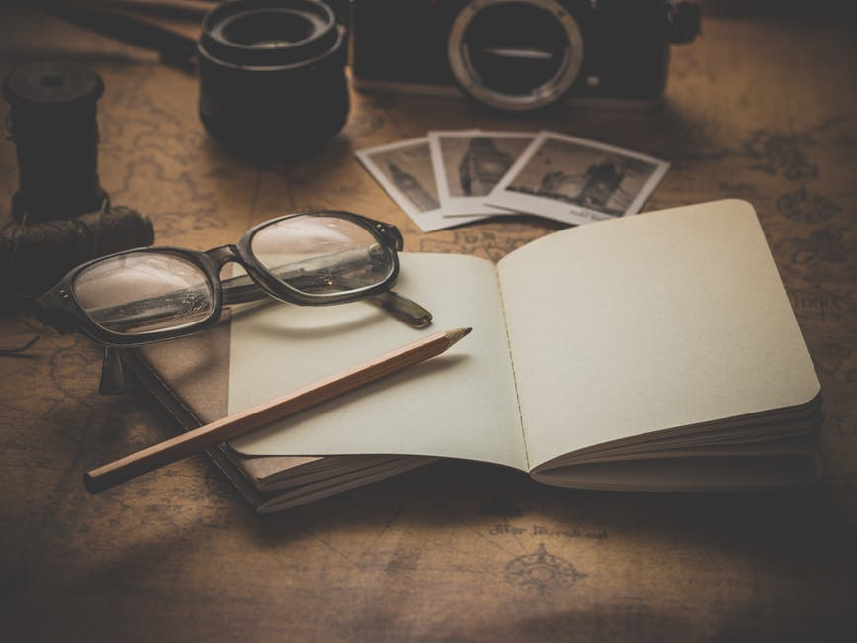
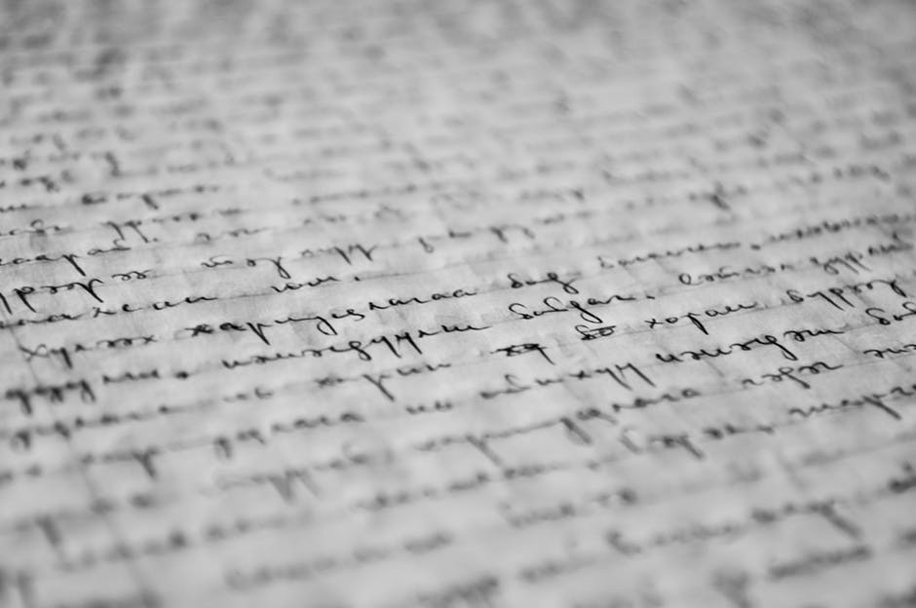


Artificial Intelligence as a Tool for Creative Writers
By Jacob Bozeman
IPHS / CWL 391: Artificial Intelligence for the Humanities
Kenyon College, Taught by Professors Chun and Elkins
Abstract
Conclusion
Although largely a field for advances in science, tech, and lifestyle, artificial intelligence has made great steps in approaching creative fields and processes. The popular “script written by an AI” (See: An AI Wrote this Movie and Its Strangely Moving on Ars Technica) and “AI writes Harry Potter fanfiction” (See: Botnik) made their rounds in online communities to much laughter and entertainment. The issue, though, is that the creation generated by artificial intelligence is just that: laughable. It is entertaining for its comedic effect, its odd and unexpected twists, and its inhuman narration. It strikes at precisely what is thought makes humans laugh, the unexpected. But in order to create art that is more reputable and respectable, there will need to be major advancements in the technology currently available. That being said, AI already shows promising signs of accomplishing another purpose, that of a tool to creative writers as they create on their own. It could potentially augment the writing process by making it more streamlined and insightful. Consider artificial intelligence like those used in stylometry that allows a writer to identify elements of his style and craft that they may not notice on his own (such as overuse of certain words, resemblances to other authors, clichés in theme or character, et cetera). Consider an artificial intelligence that can suggest possible solutions to problems of plot, setting, or narrative. Imagine a technology that can act as a qualified and legitimately helpful critic at all levels of the creative process.
Right now, the ability of AI to function as a legitimately useful resource for creative writers is limited. However, there remains great potential for the development of tools that can very effectively augment the work that creative writers do. Although AI may not be able to be a successful creative writer on its own merits—granted, who’s to say—it has the potential to augment writing as an ever-present assistant and editor for creative writers. Going beyond the squiggly red and blue lines of word processor proofreading programs, these tools would deal with writers as an essential element at the depths of the creative process, such as in the production of consistent theme, character arcs, audience, and the finer points of style. With all of the trial and error currently underway (not to mention the financial support of big corporate names), this kind of assistant may be just around the corner.
Research
The scope of this project is to survey the existing examples of AI generated creative writing and analyze its value as both an artist and a potential tool where successful. Findings on this front were largely as expected: not that impressive. One project that many proponents of creative AI hold up is the short story “The Day a Computer Writes a Novel,” which was written by an AI for the Japanese Hoshi Shinichi Literary Award and made it past the first round of submissions (See: AI Written Novella Almost Won Literary Prize on Smithsonian Mag). Ultimately, the judges determined that the story “did not cut it against its human competition,” and cited character descriptions as one of its greatest limitations. So while independent creation may be a ways ahead of us, some forms of AI are already showing potential as assistants. Turnitin developed an AI that they claim can “help people become better writers” and explains that writing is a skill that can be learned, and thus reproduced (See: How a Robot Improved My Writing on Quartz). This is true in a lot of ways. There many rules that writers use to self-regulate their creations, such as staying concise, showing rather than telling, and understanding your audience. But many writers, from newbies to veterans, forget to stick to these instructions and require reminders from their editors to get them back on track. If an AI can fill this role as an ever-present digital assistant, then the whole process of creative writing can be streamlined and improved.
There are a number of big names who are already stepping into the creative playing field of artificial intelligence. Google has engaged with visual art through Deep Dream, and the Washington Post has “robo-journalists” that have written close to 1,000 articles (See: Artificial Intelligence Creativity Future on Digital Trends). There is money being poured into this field, and it might only be a matter of time before more significant advances are made. Octavia Butler said, “You don't start out writing good stuff. You start out writing crap and thinking it's good stuff, and then gradually you get better at it.” Artificial Intelligence seems to be following her advice.
Acknowledgements
Newitz, Annalee, and UTC. “Movie Written by Algorithm Turns out to Be Hilarious and Intense.” Ars Technica, Ars Technica, 9 June 2016, arstechnica.com/gaming/2016/06/an-ai-wrote-this-movie-and-its-strangely-moving/.
Lewis, Danny. “An AI-Written Novella Almost Won a Literary Prize.” Smithsonian.com, Smithsonian Institution, 28 Mar. 2016, www.smithsonianmag.com/smart-news/ai-written-novella-almost-won-literary-prize-180958577/.
Newton, Derek. “Want to Be a Better Writer? Try Letting a Robot Tell You What to Do.” Quartz, Quartz, 4 June 2017, qz.com/997006/how-a-robot-improved-my-writing/.
Dormehl, Luke. “Truly Creative A.I. Is Just around the Corner. That's a Big Deal.” Digital Trends, Digital Trends, 5 Jan. 2018, www.digitaltrends.com/cool-tech/artificial-intelligence-creativity-future/.
Baraniuk, Chris. “For AI to Get Creative, It Must Learn the Rules--Then How to Break 'Em.” Scientific American, 25 Jan. 2018, www.scientificamerican.com/article/for-ai-to-get-creative-it-must-learn-the-rules-mdash-then-how-to-break-lsquo-em/.
Criticisms / Ideas
Scientific American published an article titled, “For AI to Get Creative, It Must Learn the Rules—Then How to Break ‘Em.” There, they discuss the strengths of artificial intelligence, such as forward-thinking beyond human capabilities (exemplified in games of Chess and Go). What it currently lacks, though, is context for much of human life and the cross-connections between different works of art that humans might understand intuitively. In order for AI to handle this, the author suggests that Ai must first learn the rules of writing, and then learn when and how to break them, which has been a difficult concept for artificial intelligence in the past.

