Slide 1
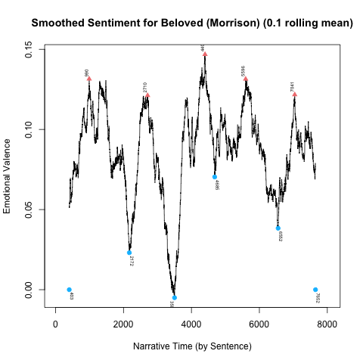
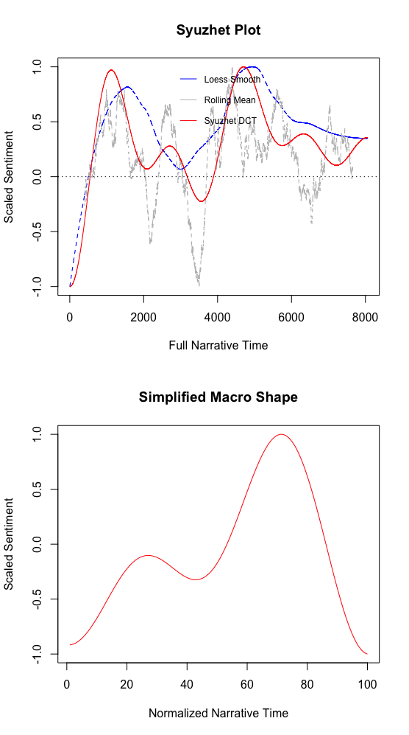
Sethe’s Icarus Moment:
Sentiment Analysis and Toni Morrison’s Beloved
Willow Green Jon Chun, Katherine Elkins
Comparative World Literature and Integrated Program in Humane Studies
Introduction
Literary Analysis
In her novel, Beloved, Toni Morrison uses a non-linear narrative, complex storylines and focalizations, and ambivalent yet binary language to explore the liminal space created by intergenerational trauma after slavery. Her work is know for its intentionality (see Playing in the Dark) and complexity. It deals with the liminality of good and evil and complex “positive” and “negative” events.
We used Syuzhet sentiment analysis to map Beloved’s narrative arc, see if it matched any traditional arcs, and explore potentially pivotal high emotional valences.
The passage at Peak 3 is a “negative” event because Sethe kills her daughter, but the sentiment analysis suggests Morrison uses positively charged language. Her words choices include: “flower,” “sweet,” “pleasure, and “cheery blue sky” alongside the description of the event itself (174-180). The passage at Valley 4 narrates the murder through Sethe’s words and Paul D’s reactions. Morrison populates the text with: “gnawing,” ”selfishness,” “helpless,” and ”danger” as well as “safety” and “love” which might explain the more ambivalent valence (compared to other valleys).Peak 3 is during the event, while Valley 4 is revisits the event in a conversation between Sethe and Paul D.
By writing positive valence into the moment itself and negative valence into the recollection, Morrison suggests that the moment of the murder was positive, but, upon reflection, the moment becomes tainted.
By having the sudden negative crux be Valley 4’s retelling of the same event, she creates a narrative “rememory” of her own, suggesting that a single moment can be revisited as a different narrative crux. The emotions associated changes its impact.
Since Peak 3 is the height of this Icarus narrative, Morrison may be suggesting that, though Sethe thought she was flying into freedom by taking agency, her act of “love” was destructive. The map suggests that killing Beloved is both her height and her downfall. Morrison suggests that a ”positive” action can result in a ”negative” spiral.
Methodology
After cleaning the text, we used the Syuzhet package in R to test the emotional valance of Beloved over narrative time.
We plotted the arc using a DCT with a low pass of 9, a Loess smoothing model, and a rolling mean of .1.
We used those peaks and valleys to do a literary analysis of their significance.
Contextualizing the RM Peaks and Valleys
Peak 1: Denver tells her mother about the white dress. Sethe defines “rememory” of Sweet Home.
Peak 2: After Baby Suggs Sermon.
Peak 3: Morrison narrates Sethe’s murder of Beloved.
Peak 4: Sethe’s first-person description of Sweet Home.
Peak 5: Denver on the threshold of seeking help.
Valley 1: Paul D arrives. Denver. reveals her loneliness.
Valley 2: Paul D tells Sethe about his trauma with the bit.
Valley 3: Beloved and Paul D in the cold house. Beloved and Denver in the cold house.
Valley 4: Paul D’s focalization. Sethe describes the murder.
Valley 5: Failed escape from Sweet Home.
Valley 6: Women exorcise Beloved. Paul D returns.
Results
The crux points aligned with hypothesized crux points, but their measured relative positive and negative emotional valance was unexpected.
For instance, Baby Suggs’ Sermon was hypothesized as the height of positive valance but was measured as the most ambivalent peak.
The shared peak of the models is Peak 3 on the .1 RM mapping, labelled here as “Morrison narrates Sethe’s murder of Beloved.” This scene was hypothesized as the most negative crux because it describes the murder of Beloved, but the sentiment analysis labelled it as the most positive.
The most negative crux is labelled here as “Beloved and Paul D in the cold house. Beloved and Denver in the cold house.” While this scene was an expected valley, it was not expected to have the most negative association.
The contrast between expected crux and emotional valance suggests that Morrison is complicating the relationship between events and their expected emotional resonance.
Conclusion
The sentiment analysis reveals that Beloved has an Icarus arc, with the distant-narration of Sethe’s murder of her own baby as the peak valence, but Morrison complicates emotional valance by telling the same scene as both peak and valley, positive and negative. In the context of a novel about slavery and trauma, Morrison’s alternating valence suggests that what is “positive” or ”negative” is not inherent. Valence depends on perspective and orientation in time.
In the future, we would adjust our parameters to see more exact peaks and valleys and work with gensim word embeddings to analyze the underlying diction.
The Simplified Macro Shape suggests a narrative arc cloisest to the Icarus model. The emotional valance starts low, most of the novel is spent reach towards a peak, and, upon reaching that peak, there is a sudden drop to negative emotional valance.
Though the three models do not correlate perfectly, they share a peak at about the 70% (5,000) sentence marker of narrative time.
Since the models did not overlay as exactly as expected, we mapped the .10 RM curve to contextualize the peaks and valleys underlying the potential narrative structure, focusing on the shared peak and its significance.
Acknowledgements
Special thanks to Professor Chun for the coding and visualizations and to Professor Elkins for supporting the literary analysis.
References
Morrison, Toni. Beloved. Vintage, 2004.
Jockers, Matthew L. “Revealing Sentiment and Plot Arcs with the Syuzhet Package.” Matthew
L. Jockers, February 2, 2013, www.matthewjockers.net/2015/02/02/syuzhet/.

