Slide 1
AI Updates
July 04, 2025
"Pivoting isn't failure. Sticking with the wrong thing is"
- Varun Mohan, Windsurf
Crowd-sourced "LM Arena" Leaderboard
Baidu Ernie 4.5 Open-Sourced
Huawei's Pangu ProE MoGE Architecture
Terminal-Based AI
AI Agents for Coding
Dr. Ilya Sutskever, Open Univ. 2025
Google Gemma 3n
Go-Browse from CMU
Polaris Math Reasoning Models
TOWER+ Multilingual LLM Framework
Amazon new AI model for robotics
Claude can use Gemini CLI to process big codebase
Microsoft AI diagnoses better than doctors
OpenAI Charge $10M+ for Consulting Services
Claude Desktop Extensions
Oracle building data centers
Hugging Face shuts down HuggingChat
Deep Agent from Abacus AI
Use ChatGPT as Photo Editing Studio
Apple MLX Framework
The 5-Word Fix Makes AI Prompts 10x Smarter
Cluely - cheat on everything (startup)
Grok 3.5 Cancelled, Grok-4 coming in July
Tencent Hunyuan-A13B open source
Inception AI's Mercury Diffusion LLM
OpenAI's Deep Research API & Prompts
Elon Musk's xAI raises $10 Bln in debt and equity
China builds AI Computing Center in Tibet
"Future be like tab tab tab" - Andrej Karpathy
2024Nvidia GB202 is the largest Blackwell chip
Tesla - first driverless delivery of a new car
FastHTML and MonsterUI
Test AI Agents using "Judge" Agent
Inception Labs - Mercury diffusion LLM
Speech-to-Text Systems
Largest Quantum Computers
First Computer Bug
Jobs, Layoffs

Slide 2
Crowd-sourced "LM Arena" Leaderboard
https://lmarena.ai/?leaderboard
Starting Elo rating = 1000
https://en.wikipedia.org/wiki/Elo_rating_system
Text - July 01
Webdev - June 16
LM Arena secures $100M to expand AI benchmarking (at $600M valuation)
Model | Score
gemini-2.5-pro | 1463
o3-2025-04-16 | 1449
chatgpt-4o-latest-20250326 | 1441
gpt-4.5-preview-2025-02-27 | 1436
claude-opus-4-20250514 | 1417
gemini-2.5-flash | 1415
deepseek-r1-0528 | 1413
gpt-4.1-2025-04-14 | 1411
grok-3-preview-02-24 | 1408
o1-2024-12-17 | 1399
o4-mini-2025-04-16 | 1398
deepseek-v3-0324 | 1396
qwen3-235b-a22b-no-thinking | 1396
deepseek-r1 | 1395
claude-sonnet-4-20250514 | 1393
minimax-m1 | 1391
gemini-2.5-flash-lite-preview-06-17-thinking | 1387
claude-3-7-sonnet-20250219-thinking-32k | 1385
hunyuan-turbos-20250416 | 1382
o1-preview | 1383
Model | Score
Gemini-2.5-Pro-Preview-06-05 | 1433
DeepSeek-R1-0528 | 1409
Gemini-2.5-Pro-Preview-05-06 | 1408
Claude Opus 4 (20250514) | 1406
Claude Sonnet 4 (20250514) | 1382
Claude 3.7 Sonnet (20250219) | 1357
Gemini-2.5-Flash-Preview-05-20 | 1305
GPT-4.1-2025-04-14 | 1257
Claude 3.5 Sonnet (20241022) | 1238
DeepSeek-V3-0324 | 1207
DeepSeek-R1 | 1198
o3-2025-04-16 | 1190
GPT-4.1-mini-2025-04-14 | 1189
Qwen3-235B-A22B | 1187
Mistral Medium 3 | 1174
Gemini-2.5-Flash-Preview-04-17 | 1157
o3-mini-high (20250131) | 1136
Claude 3.5 Haiku (20241022) | 1133
o4-mini-2025-04-16 | 1102
o3-mini (20250131) | 1092
China
China
https://openlm.ai/chatbot-arena/
https://beta.lmarena.ai
Web Leaderboard https://web.lmarena.ai/leaderboard
LLM Leaderboard - by @LlmStats https://llmworld.net/llm_leaderboards/
LLM Leaderboard - by StackAI https://www.stack-ai.com/llm-leaderboard
LLM Leaderboard - by Artificial Analysis https://artificialanalysis.ai/leaderboards/models
Open LLM Leaderboard - by Hugging Face https://huggingface.co/open-llm-leaderboard
LLM Leaderboard - by Vellum https://www.vellum.ai/llm-leaderboard
AI Benchmarking Hub https://epoch.ai/data/ai-benchmarking-dashboard
x.ai
China
China
China
China
China
China
M
China
China

Slide 3

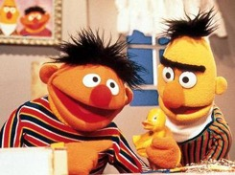

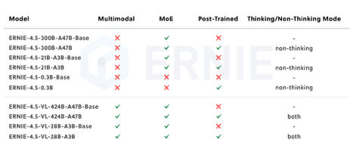
Baidu Ernie 4.5 Open-Sourced
Chinese search giant Baidu ("Chinese Google") has open-sourced a family of SOTA multi-modal LLMs
There are 10 models (sizes from 300 Mln params small dense model to 424 Bln params MoE)
Dense Models: ERNIE 4.5-0.3B, 0.5B, 1.8B, and 4B
MoE Models: ERNIE 4.5-MoE-3B, 4B, 6B, 15B, 47B, and 424B total parameters (with varying active parameters)
Multimodal - can handle text and images
Novel "heterogeneous modality structure" that allows parameter sharing across different modalities (text/image) while maintaining dedicated parameters for each
The largest Ernie 4.5 model beats DeepSeek v3, Qwen 3 from Alibaba, and competitive with OpenAI's o1 performance levels
Apache 2.0 license (fully permissive), completely free to use and modify; Comes with dev toolkit "Ernie Kit" for training, fine-tuning, and optimization; comes with "Fast Deploy" multi-hardware deployment solution for easy inference setup
Uses specialized post-training methods including supervised fine-tuning, direct preference optimization, and a proprietary method called UPO (Unified Preference Optimization)
Supports both "thinking" and "non-thinking" model variants
https://ernie.baidu.com/blog/posts/ernie4.5/
https://www.youtube.com/watch?v=cE951f15hPs
https://www.marktechpost.com/2025/07/01/baidu-open-sources-ernie-4-5-llm-series-scaling-from-0-3b-to-424b-parameters/
https://huggingface.co/collections/baidu/ernie-45-6861cd4c9be84540645f35c9
Ernie (left) & Bert (right)
Sesame Street, 1977

Slide 4


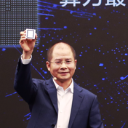
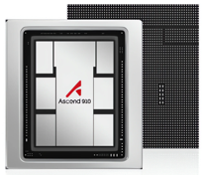
Huawei's Pangu ProE MoGE Architecture
Huawei's Pangu ProE MoGE Archiotecture
MoGE = Mixture of Grouped Experts
Experts are divided into equal groups
For each token, experts are selected from each group rather than individually. This ensures balanced computational load across all participating devices
72B params, 16B active params
Trained on Huawei's own Ascend NPU chips
Competitive with Qwen 2.5, GLM4, Jamba 3, and Llama 4 Scout
4,828 tokens/second (on their hardware)
This positions Huawei as a potential challenger to Nvidia's dominance in the AI hardware space
https://www.youtube.com/watch?v=RdT7A20SaG8 - video
Huawei's Ascend NPU (Neural Processing Unit) is a series of AI chips designed by Huawei to accelerate machine learning tasks
These NPUs, like the Ascend 910 and 910C, are built on the Da Vinci architecture and are specifically designed for deep learning workloads
They offer high performance for both training and inference
They are a key component of Huawei's full-stack Ascend AI infrastructure, aiming to compete with Nvidia's GPUs in the AI chip market

Slide 5
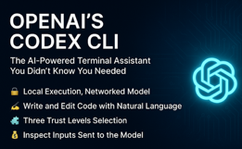
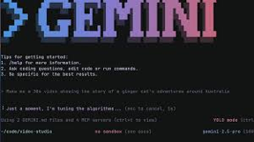
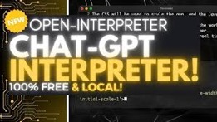
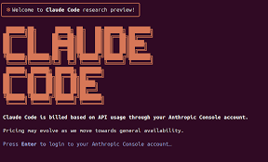
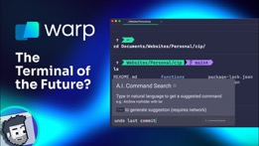
Terminal-Based AI
Gemini CLI open-sourced agentic Gained 30K+ GitHub stars quickly; coding, debugging, automation; users get 1000 Gemini 2.5 Pro requests per day for free, which comes down to the equivalent of Claude Code’s $200/month plan
Anthropic Claude Code - terminal based
OpenAI Codex CLI - terminal based
Open Interpreter - popular open-source project that brings a ChatGPT-like interface to the terminal
Warp - modern terminal app that integrates AI-powered suggestions, command completions, and reusable workflows, aiming to make terminal usage more efficient and collaborative

Slide 6
AI Agents for Coding
Codiga - https://www.codiga.io - code analysis, completion, review
Pixee - https://www.pixee.ai - code quality/security
Sourcery - https://sourcery.ai - real time code refactoring
FauxPilot - https://github.com/fauxpilot/fauxpilot - open-source copilot
Tabby - https://github.com/TabbyML/tabby - open-source, code completion
ZenCoder - https://zencoder.ai - coding agent
OpenAI Codex CLI – https://github.com/openai/codex - Open-source CLI coding agent, multimodal input, local code manipulation
Open Interpreter – https://github.com/OpenInterpreter/open-interpreter - Open-source, lets LLMs execute code locally. Also data analysis, browser automation, and multimedia editing
Warp – https://www.warp.dev - in-Terminal AI agents for coding, debugging, and workflow automation. Multi-step task execution. Collaboration, customization, and speed
OpenCode - https://github.com/sst/opencode - in Terminal, open-source, multi-agent, supports 75 models, install with npm
Here is a list of AI Assistants (can be easily tripled):
Bolt - https://bolt.new - fast chat-based website/app build/prototype
Lovable - https://lovable.dev - fast for simple apps and prototypes
v0 - https://v0.dev - Powerful AI code generation and refactoring
Replit - https://replit.com , Replit Ghostwriter - code and text generation
Cursor - https://www.cursor.com - conversational AI coding
Windsurf - https://codeium.com/windsurf - like cursor
Qodo - https://www.qodo.ai ( = codeium)
GitHub Copilot - https://github.com/features/copilot - Microsoft, supports multiple models
base44 - https://base44.com - coding assistant
AskCodi - https://askcodi.com - Reliable, context-aware code completion and explanations
AugmentCode - https://www.augmentcode.com - VSCode, chat/agent
Snyk - https://snyk.io - AI-powered security analysis
Aider - https://aider.chat - in-terminal CLI code assistant, free, customizable
Claude Code - https://www.anthropic.com/claude-code - in terminal
Claudia - https://getclaudia.org - GUI for Claude Code
Cline - https://cline.bot - for VS Code (former Claude Dev), privacy-focused
Devin - https://devin.ai - by Cognition Labs, $500/month
Tabnine - https://www.tabnine.com - AI code completion, privacy, personalization
Amazon CodeWhisperer - https://docs.aws.amazon.com/codewhisperer - code suggestions, AWS APIs
Amazon Q Developer - https://aws.amazon.com/q/developer/
Google Gemini Code Assist - https://codeassist.google - VSCode coding assistant
Google Gemini CLI - in Terminal
Visual Studio IntelliCode - https://visualstudio.microsoft.com/services/intellicode - local, free
JetBrains AI Assistant - https://www.jetbrains.com/ai/ - paid, in JetBrains IDE only
CodeRabbit - https://www.coderabbit.ai - code review
Cline update (v3.15 → v3.18)
Gemini CLI & Claude Code in terminal integration, better terminal control
Free Grok 3 access
SAP AI core integration - Connect to both Claude and GPT models via SAP
Claude 4 optimization (better performance)
Self-knowledge - answer question about using Cline itself
Diff edit success rate jumped from 64.4% to 84.3% on complex "hard mode" tests
Better reliability and token efficiency
Race condition fixes in plan-and-act mode
Improved search and replace parsing
35 new MCP servers added to marketplace, including AWS , DynamoDB
Multiple bug fixes and UX improvements

Slide 7
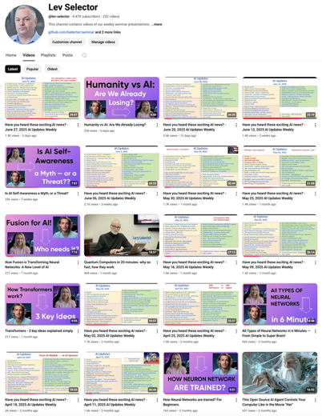
Subscribe to this channel
https://www.youtube.com/@lev-selector
Get notified about new videos
We post a video every Friday
Links to slides are under the videos

Slide 8
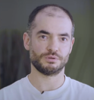
Dr. Ilya Sutskever, Open Univ. 2025
Dr. Ilya Sutskever, Honorary Doctor of Philosophy Degree, 2025
https://www.youtube.com/watch?v=t3TfmU0l5vM
I was born in Russia and my parents immigrated to Israel when I was five. I was going to school and I was a good student, and my parents were looking for an environment where I could learn more. At some point by sheer chance we stumbled upon the Open University and I started taking classes in the 8th grade.
It was the best experience possible. I got my books - by the way, the Open University books are very clearly written. I just got those books and I read them and I understood to the point where I remember there being a before and an after. I became confident that if I just read something very slowly I would eventually understand it, so that was very helpful. Also, I studied math and computer science and got a very strong foundation.
When my parents moved to Toronto, one of the first things I did was to go to the Toronto Public Library and try to find a book on machine learning rather than finishing high school. Once again, what I tried to do was to become a transfer student to the University of Toronto. The great stroke of luck of being in Toronto is that Jeff Hinton was there. This was the place to be - those were the most forward-looking ideas in AI in the world back then. So I was able to join the University of Toronto as a transfer student in 2002.
Computers could play computer games a little bit and they could play chess and checkers, and that was it. I remember thinking a very big computer could play chess no problem, but how can it learn? How is learning possible at all? Can computers learn? Somehow I felt that if you had the answer to the learning question, then everything else would follow.
As a result of the AlexNet paper that we wrote in grad school, some companies expressed a desire to acquire our company, which didn't exist, so we needed to create a company. Eventually Google acquired us and so I joined Google. The idea that the large neural network can do anything was further supported by some of the research we've done at Google.
Then the opportunity to start OpenAI presented itself. I was in the Bay Area and it felt like how can I be here and not really try a real, serious startup with all these illustrious people that came together? So I decided to go for it. We continued working at OpenAI.
Deep learning is a big idea and quite a few people contributed to it, and I'm happy that I was able to contribute to it as well. But with AI, unfortunately the future is not so simple. AI is exciting because it's powerful - you have the power to do stuff. What kind of stuff would you imagine the AI would do if the AI became powerful enough? If the AI became capable enough, we'll have incredible healthcare. What if an AI was doing medical research? That would be amazing. You could do so much more, you could cure so many diseases and maybe extend life. I think those are really wonderful things.
But if an AI can do this, what else can it do? And ultimately the answer is going to be everything. One of the challenges is that AI is going to be both extremely unpredictable and unimaginable. It's unimaginable. How can we prepare? We need to prepare. It's not clear how. And then eventually the power of AI is going to be so vast - the idea that an AI can build the next generation of AI, the intelligence explosion - holy moly, what do you do about that?
The problem with AI is that it is so impactful, it is so powerful. It can solve everything, but it can also do everything. And all these questions don't have answers right now.
I want to express my deepest gratitude to the Open University for giving me this honorary degree. I find it so meaningful because for quite some time, Open University for me represented all of academia and all of interesting learning. It's really closing a circle in a way that's very meaningful.

Slide 9
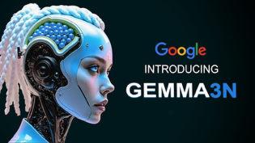



AI Updates 1
Google Gemma 3n
for mobile, multimodal (text, audio, image, video) AI model
only 3GB of RAM
effective parameters: E2B and E4B (raw parameter counts is 5B and 8B respectively), architectural innovations allow them to run with a memory footprint comparable to traditional 2B and 4B models, operating with as little as 2GB (E2B) and 3GB (E4B) of memory
the first <10B model to score over 1300 on the LMSys Arena
new MatFormer architecture, making it natively flexible
open ecosystem support, with day-zero integration from partners like @huggingface, @ollama, @awnihannun for MLX, @UnslothAI, and @ggerganov for llama.cpp/GGUFs
also image encoder for Gemma 3n
https://www.youtube.com/watch?v=eJFJRyXEHZ0&t=1s
Go-Browse from CMU - Graph-Based Framework for Scalable Web Agent Training
https://www.marktechpost.com/2025/06/24/cmu-researchers-introduce-go-browse-a-graph-based-framework-for-scalable-web-agent-training/
Polaris Math Reasoning Models
University of Hong Kong, Bytedance Seed, and Fudan University unveil Polaris-4B and Polaris-7B - post-training RL-tuned models
Outperform larger counterparts in math and logic reasoning tasks
TOWER+ - Multilingual LLM Framework
Open-weight LLM (2B ... 72B), high-fidelity translation
Robust instruction-following

Slide 10





AI Updates 2
Cluely - startup to "cheat on everything" using AI
https://finance.yahoo.com/news/why-a16z-vc-believes-cluely-210644108.html
Grok 3.5 - Cancelled, Grok-4 coming in July
Elon Musk's xAI raises $10 Bln in debt and equity
xAI has raised $5 Bln in debt and $5 Bln in equity https://www.cnbc.com/2025/07/01/elon-musk-xai-raises-10-billion-in-debt-and-equity.html
Tencent Hunyuan-A13B open source
MoE 80B (13.5B active), has Mamba layers
256K context window
optimized for tool calling and coding
competitive with Qwen-A22B and OpenAI's o1
Inception AI's Mercury Diffusion LLM
First commercial-scale diffusion LLM
Tailored for chat applications
OpenAI's Deep Research API & Prompts
uses o3/o4-mini models
open-sourced the full prompts and methodology for its prompt rewriter. Details on adding multi-agent support with MCP
The feature has been integrated into LangChain and LangGraph, as announced by @hwchase17 and @sydneyrunkle.

Slide 11



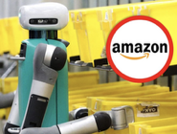

AI Updates 3
China builds AI Computing Center in Tibet
Harness the natural cold, abundant solar power and innovative waste heat recovery
Yajiang-1- a cutting-edge computing centre perched in the cradle of Tibetan civilisation along the Yarlung Tsangpo River, is up and running at an altitude of 3,600 metres (11,800 feet)
The facility, the first major hub of the “Eastern Data, Western Computing” project on the Tibetan Plateau
"Future be like tab tab tab" - Andrej Karpathy, Aug 2024
https://x.com/karpathy/status/1827921103093932490
Nvidia GB202 is the largest Blackwell chip
Nvidia’s RTX PRO 6000 Blackwell features the largest GB202 configuration to date
https://chipsandcheese.com/p/blackwell-nvidias-massive-gpu
Tesla - first driverless delivery of a new car
June 27 - Model Y drove from the Gigafactory in Austin, TX to an apartment building
https://www.cnbc.com/2025/06/28/tesla-first-driverless-delivery-new-car-to-customer.html
Amazon new AI model for robotics
Warehouse robotics for faster deliveries
Amazon - 1+ Mln robots in 300 facilities worldwide
https://www.aboutamazon.com/news/operations/amazon-million-robots-ai-foundation-model

Slide 12

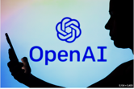

AI Updates 4
Claude can use Gemini CLI to process big codebase
add instructions to CLAUDE.md to have Claude use the Gemini CLI in non-interactive mode (passing the -p param with a prompt to just get a response back from the CLI) when it needs to gather information about a large part of the codebase.
That way you get the best of both worlds, Claude doesn't waste context and Gemini doesn't waste your time
https://www.reddit.com/r/ChatGPTCoding/comments/1lm3fxq/gemini_cli_is_awesome_but_only_when_you_make/
Claude
Gemini CLI
Microsoft AI framework diagnoses better than doctors
They created a testing environment using 304 real medical mysteries
And AI system simulating 5 doctors working together as a team
https://x.com/DrDominicNg/status/1939816655829475648
OpenAI Charge $10M+ for Consulting Services
OpenAI is building a high-level consulting business
OpenAI hired nearly a dozen "forward-deployed engineers,” many from Palantir, to guide customers through model customization and app development
Customers must commit at least $10M for access to OpenAI researchers, with some deals reaching hundreds of millions over multiple years
https://www.theinformation.com/articles/openai-takes-page-palantir-doubles-consulting-services

Slide 13





AI Updates 5
Claude Desktop Extensions
Download a .dxt file, open with Claude Desktop, click "Install"
https://www.anthropic.com/engineering/desktop-extensions
Claude Apps - Interactive Apps in Artifacts
https://medium.com/@joe.njenga/claude-apps-launched-new-interactive-ai-apps-marketplace-269c18f0c847
Oracle building data centers
Partnership with ByteDance, investing Billions into data centers in Singapore and Malaysia (world's second-largest AI hub)
Oracle was leasing datacenter capacity in 2023-25; It secured over $130 Bln in contracts for the next 12 months, including Stargate
https://semianalysis.com/2025/06/30/how-oracle-is-winning-the-ai-compute-market/
Hugging Face shuts down HuggingChat
It was launched in April 2023 giving access to open-source models
https://dataconomy.com/2025/07/02/7-huggingchat-ends-as-hugging-face-retools-for-whats-next/
Deep Agent from Abacus AI - https://deepagent.abacus.ai
Webdev (with live backends, DBs, ...), content creation (PPTs, images, ...), discover new online tools - and use them. Visual canvas. Self-prompting, script execution, improves over time.
Use ChatGPT as Photo Editing Studio
Prompt: "Create a high contrast close portrait of my face focusing on front head, in black and white closeup, 35mm lens, 4k HD quality, Giving proud expression, water droplets on my face, black shadow background o face, is visible with my profile looking sharper, adding wet hair, Ratio 4:3" - https://x.com/therealedanharr/status/1937008879986172160

Slide 14
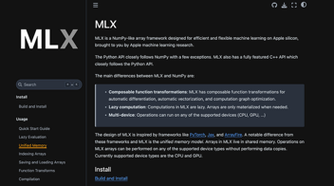

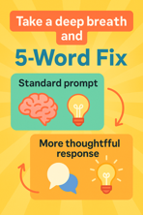
AI Updates 6
Apple MLX Framework
MLX (Machine Learning eXchange) is Apple's machine learning framework designed specifically for Apple Silicon (M1, M2, etc.) processors
It is a NumPy-like array framework optimized for Apple's unified memory architecture. Designed to efficiently run machine learning models on Apple Silicon chips. Uses both CPU and GPU cores seamlessly through Apple's Metal Performance Shaders
Over 5,000 MLX models have been uploaded to Hugging Face!
https://x.com/awnihannun/status/1939880107906412963
"The 5-Word Fix That Made My AI Prompts 10x Smarter"
Adding the phrase “Take a deep breath and” at the beginning of prompts increases the quality of the responses
Design a prompt like a product interface.
Give detailed description.
Give persona/role.
Describe the constraints, output, formatting.
https://levelup.gitconnected.com/the-5-word-fix-that-made-my-ai-prompts-10x-smarter-fdecfe7af866

Slide 15


FastHTML and MonsterUI
MonsterUI is a UI framework for FastHTML for building beautiful web interfaces with minimal code
https://monsterui.answer.ai
https://himalayanhacker.substack.com/p/from-giving-up-on-coding-to-shipping
from fasthtml.common import *
from monsterui.all import *
# Choose a theme color (blue, green, red, etc)
hdrs = Theme.blue.headers()
# Create your app with the theme
app, rt = fast_app(hdrs=hdrs)
@rt
def index():
socials = (('github','https://github.com/AnswerDotAI/MonsterUI'),
('twitter','https://twitter.com/isaac_flath/'),
('linkedin','https://www.linkedin.com/in/isaacflath/'))
return Titled("Your First App",
Card(
H1("Welcome!"),
P("Your first MonsterUI app", cls=TextPresets.muted_sm),
P("I'm excited to see what you build with MonsterUI!"),
footer=DivLAligned(*[UkIconLink(icon,href=url) for icon,url in socials])))
serve()

Slide 16
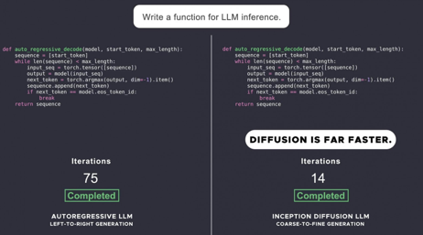
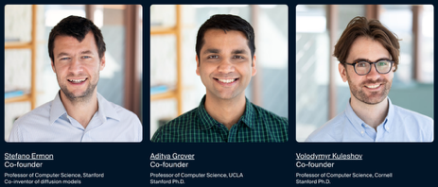
Inception Labs - Mercury diffusion LLM
Mercury - family of dLLMs (diffusion LLMs)
First successful application of diffusion to discrete data such as text and code
Mercury is up to 10x faster than frontier speed-optimized LLMs (over 1000 tokens/sec on NVIDIA H100s)
Mercury Coder - available to test in a playground
https://chat.inceptionlabs.ai
https://www.inceptionlabs.ai
https://www.inceptionlabs.ai/news
https://x.com/ArtificialAnlys/status/1894932634322772372
https://machine-learning-made-simple.medium.com/is-the-mercury-llm-the-first-of-a-new-generation-of-llms-b64de1d36029
https://www.youtube.com/watch?v=X1rD3NhlIcE - video
Current LLMs are autoregressive, meaning that they generate text left to right, one token at a time, sequentially. Diffusion models operate with a "coarse-to-fine" generation process, where the output is refined from pure noise over a few "denoising" steps
Diffusion models can continually refine their outputs, correct mistakes and hallucinations.
For these reasons, diffusion used for video, image, and audio generation, including Sora, Midjourney, and Riffusion.
Diffusion models are usually relatively small (can run locally)
Mercury Coder Mini: 1,119 tokens/second on an H100 GPU
Mercury Coder Small: 737 tokens/second
This is 3-10x faster than Claude 3.5 Haiku and Gemini 2.0 Flash
Inception Labs, Palo Alto, CA
founded by professors from Stanford, UCLA, and Cornell

Slide 17
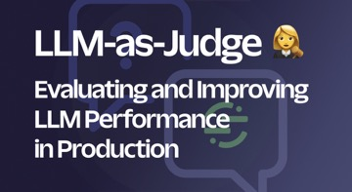
Test AI Agents using "Judge" Agent
Scenario Testing to solve the fundamental challenge of testing non-deterministic systems
Traditional software testing relies on deterministic behavior:
given input X, expect output Y.
But this doesn't work with Agents where variability is itself is a feature, allowing agents to adapt
Human testing miss long tail of unexpected interactions. Fixing in one place can break things in many other places. The combinatorial explosion of possible interactions with multiple workflows and tools makes manual testing absolutely impractical
LLM-as-a-judge - using 3-agents architecture:
Your agent (the AI system being tested)
User agent - simulates a human user
Judge agent - evaluates the interaction
This approach transforms testing from manual execution to automatic scenario definition and testing.
https://substack.com/home/post/p-167152592

Slide 18
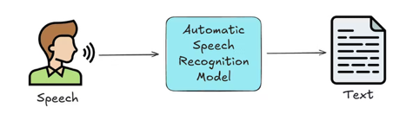
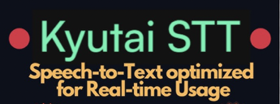
Speech-to-Text Systems
OpenAI's Whisper (via API) - best accuracy, fast
Google Cloud Speech-to-text (Gemini)
AssemblyAI Universal-2 - developer friendly
Amazon transcribe
Microsoft Azure Speech to Text
Groq-distil-Whisper (English only)
Deepgram - fast (for real time)
Pixno (photes.io) 98%
Aiko (Whisper-based)
Otter.ai 96%
Kyutai Labs Speech-to-Text Model:
open-source
ranked 1st among streaming models on the Open ASR Leaderboard
runs on devices like Macs and iPhones

Slide 19
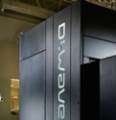

Largest Quantum Computers
>4,400 qubits - Advantage2 by D-Wave (Canada/US/Germany) - quantum annealer
1,180 qubits - Phoenix by Atom Computing (US)
1,121 qubits - Condor by IBM (US,Germany,Japan)
1,000-Qubit - ez-Q Engine 2.0 by QuantumCTek (tested on 504 qubit) - China
255 "photons" - Jiuzhang 3.0 - photonic quantum computing prototype - China
216 qubits - Borealis - Xanadu (Canada)
105 qubits - Willow - Google Quantum AI (US)
105-qubit - Zuchongzhi 3.0 - University of Science and Technology of China (USTC) - China
72-qubit - Origin Wukong by Origin Quantum, China
56 qubits - H2 - Quantinuum (US/UK)
36 qubits - Forte - IonQ (US)
D-Wave recently achieved a major quantum computing breakthrough
Their annealing quantum computer, the Advantage2 prototype, solved complex simulations of magnetic materials in minutes as opposed to million years it would take by a classical computer
Published in Science (peer-reviewed)
The quantum computer's performance was not only faster but also highly accurate
The Advantage2 system features over 1,200 qubits in the prototype and a full-scale system with more than 4,400 qubits, improved qubit connectivity (20-way connections), doubled coherence time, and enhanced energy scale
https://ir.dwavesys.com/news/news-details/2025/Beyond-Classical-D-Wave-First-to-Demonstrate-Quantum-Supremacy-on-Useful-Real-World-Problem/default.aspx
path to the first million-qubit processor for quantum computers
https://www.livescience.com/technology/computing/this-result-has-been-more-than-a-decade-in-the-making-millions-of-qubits-on-a-single-chip-now-possible-after-cryogenic-breakthrough
Microsoft is working on "topological qubit" that is theoretically less noisy.
The Goal: A "Logical Qubit". Quality over Quantity.
In early 2025, Microsoft demonstrated a "Majorana 1" processor.
Azure Quantum: The Hybrid Ecosystem, hardware from partners like Quantinuum and Ion, alongside Microsoft's own systems

Slide 20
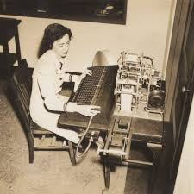
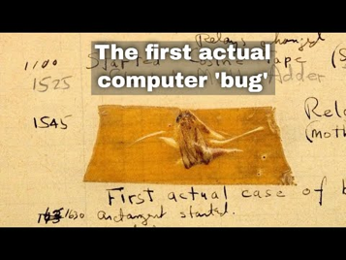
First Computer Bug
There is a famous story about Grace Hopper pulling a moth out of the Mark II computer (1947). Engineers discovered a moth trapped in one of the relays, which was causing the computer malfunction. The moth was removed and taped into the computer’s logbook with the note: “first actual case of bug being found.”
Grace Hopper, a pioneering computer scientist and U.S. Navy officer, is often credited with discovering or popularizing this incident. She was telling this story in her many public lectures.
The story has become legendary, and the terms “bug” (for a technical error) and “debugging” (for fixing such errors) entered the lexicon of computer science.
However, the use of “bug” to describe technical problems predates this incident, with Thomas Edison using the term in the 1800s.

Slide 21
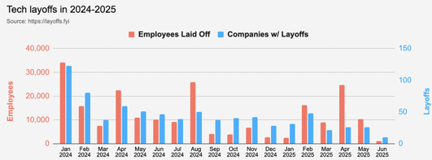
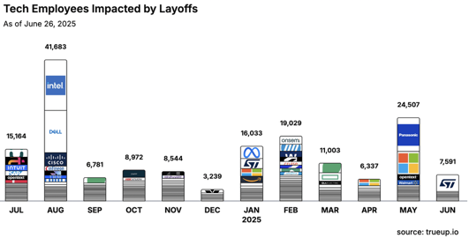
Jobs
https://layoffs.fyi
https://trueup.io/layoffs
Tech Layoffs in 2025: 63,443 people
Compared to 2024: 152,922 people
https://layoffs
Microsoft laying off about 9,000 employees (July 2)
https://www.cnbc.com/2025/07/02/microsoft-laying-off-about-9000-employees-in-latest-round-of-cuts.html

Slide 22
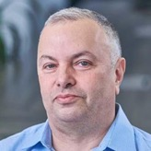

About the Speaker
Lev Selector, Ph.D.
40+ years of software engineering, data science, and building teams (hiring, training, and managing)
Ph.D. in mathematical modeling and computer simulations
Interests:
Generative AI, Using LLM with your data
Local AI for Local Private Data
Cloud architecture, fin-tech, application security
Find/connect: Linkedin, GitHub, YouTube, Google
https://eais.ai
Enterprise AI Systems

Slide 23
Thank You!

