Slide 1
How to write and Self-publish a Book

Slide 2
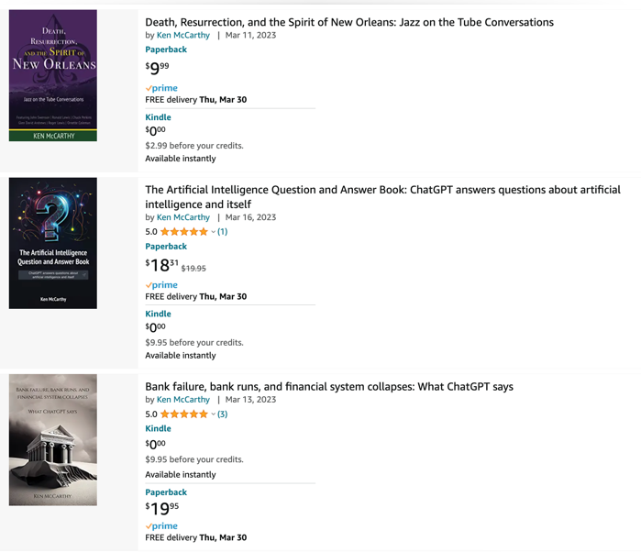
Publish a book in 1 day with ChatGPT and Amazon Kindle
In March 2023 Ken McCarthy has published 3 books using ChatGPT.
For one of them it took him just 12 hours from start to uploading to Kindle.
First you ask ChatGPT about the topics, create table of contents.
Then for each chapter you ask for a list of subtopics.
Then for each of subtopics you ask ChatGPT to write text.
Finally you combine all pieces together.

Slide 3


Do you need a publisher?
Nowadays you can write a book in MS Word,
and submit to Amazon.
You can choose whether you want to make the book strictly electronic (Kindle),
or a paper book (POD = Print-on-Demand).
.. POD = Print On Demand .. KDP = Kindle Direct Publishing
This process is so much simpler than in the old days
when you had to go through a publishing company.
Thirty years ago, the word "publishing" have meant
producing a minimum of 20-30 thousand copies of the book,
and then delivering these books to thousands of
bookstores across the country.
Nowadays you can still use the services of publishing companies.
These companies have professional editors and designers.
They can do all technical work around producing and marketing the book.
Publishing companies make most of their money from book sales.
Some publishing companies will do all the work for free.
Other companies may ask for thousands of dollars up-front.
POD: Books are printed "on-demand"
when they are ordered on the website
KDP: electronic books

Slide 4
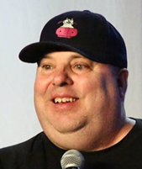
How to write a book "in 90 minutes"
.. The 90-Minute Book - by Dean Jackson
.. https://www.amazon.com/90-Minute-Book-Dean-Jackson/dp/1494294230
Main ideas:
select a topic, select title
make 1-page plan for interview (questions) - 30 min
conduct the interview, make audio recording (1 hr)
transcribe audio into text (just google for transcribe interview – there are many options, prices from 0 to $1.50/page
edit text into a book - find editor at upwork.com ($100)
self-publish on amazon: .. POD = Print On Demand .. KDP = Kindle Direct Publishing
Good reviews - https://self-publishingschool.com/self-publishing-on-amazon/
A course - https://bookschool.scribemedia.com/how-to-publish-a-book-course/
Dean Jackson
Helping Entrepreneurs & Realtors Make More Money

Slide 5
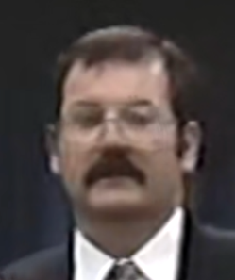
How to write a book "in two weeks"
How To Write A Book On Anything In 14 Days or Less… GUARANTEED!!
A Professional’s Guide
The complete, no-holds-barred Success System for getting your marketable book written faster than you ever thought possible and succeeding as a published author!
Steve Manning 905-686-4891
e-mail: Steve@WriteABookNow.com
ISBN 0-9692613-1-4 Retail price: $399.95
Select a topic
Test several titles
Make a list of chapters (n=10)
Make a list of sub-chapters (m=7) – thus you have n*m "buckets"
Fill buckets with content (3/4-page text per bucket) – no editing
Edit buckets in reverse order (from the end of the book)
Steve Manning

Slide 6

Course on Publishing a Book
A course on publishing: .. https://bookschool.scribemedia.com/how-to-publish-a-book-course/
Publishing Course Lessons
Prepare Your Manuscript
1. Pick Your Book Title
2. Write Your Book Dedication
3. Write Your Book Acknowledgements
4. Copyediting and Proofreading Your Manuscript
5. Write Your Book Description
6. Write Your Author Bio
Design Your Book
7. Get a Great Author Photo
8. Get Blurbs For Your Book
9. How to Get a Great Book Cover
10. Design Your Book Layout
Publish Your Book
11. How to Pick the Right Publishing Option
12. What to Charge For Your Book
Tucker Max
https://www.tuckermax.com
https://en.wikipedia.org/wiki/Tucker_Max

Slide 7
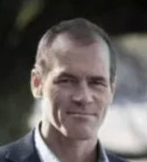
How to self-publish "the same day"
There are detailed instructions on formatting your book: .. https://kdp.amazon.com/en_US/help/topic/G202145400
Once you have your book as files (text and cover), you can submit it to Amazon Kindle
following these steps: .. https://self-publishingschool.com/self-publishing-on-amazon/
Scott Allan
Step 1. Create an Amazon Kindle Direct Publishing (KDP) Account
Step 2. Add a new Kindle ebook (a “new title”)
Step 3. Set Your Primary Language
Step 4. Enter your book title and subtitle
Step 5. Enter the Author name
Step 6. Enter your book description
Step 7. Verify your publishing rights
Step 8. Choose your keywords
Step 9. Choose two categories for your book
Step 10. Choose the right age range (if this applies)
Step 11. Choose your book release option
Step 12. Select DRM rights
Step 13. Upload your book
Step 14. Upload your book cover
Step 15. Preview your book
Step 16. ISBN and Publisher (optional)
Step 17: Upload your book when you are ready

Slide 8
Formatting your Book
Front and back covers (and spine) of the book:
page size: 5.5"w x 8.5"h
spine: 0.493"w x 8.5"h (!!! fix spine width)
bleeding - 1/16"
Note: bleeding = extra size to allow artwork to reach
the edge of a page (page printed - then trimmed).
image size (!!! fix spine width):
height = 8.75" (8.5" + (1/16)*2)
width = 11.618" (5.5 + 0.493" + 5.5 + (1/16)*2)
Cover - 3 photoshop image files : front, back, and spine.
Image sizes:
For front and back add 1/8 on every side for bleeding.
So the image size should be 8.75 x 5.75.
Spine will be approximately 5/8".
We need to add 1/16 on each side for bleeding.
So the size of the image for the spine is 8.125 x 0.75"
The images can be 300 dpi or 600dpi.
We can use color photographs and /or graphics as needed.
Note: Image Mode in photoshop should be "CMYK color".
Note: The bar codes will be placed on the bottom of the back cover.
So don't put text there.
Here are formatting instructions from Kindle
.. https://kdp.amazon.com/en_US/help/topic/G202145400
Book Text - in MS Word:
Set paper size to 8.5" x 5.5"
Layout Margins: 0.5"
Font: Times
Font size: 11 (small - 10, in tables - 9)
Bold Titles: 11", 16", 20"
Page numbers – bottom
Note: printing is done 4 pages at a time.
Last page should be blank.
Table of contents in Microsoft Word
- https://shaunakelly.com/word/numbering/tableofcontents.html
In main text apply
"Heading 1" style to chapter titles,
"Heading 2" to sub-headings, "Heading 3" to sub-sub, etc.
Click on page where you want TOC to appear,
go to menu:
References > Table of Contents.

Slide 9
Using GenAI
Technical Approach:
Use GenAI to select topic, title
Generate table of contents (10 chapters?)
Then for each chapter generate titles of sub-chapters
Let's say: 10 chapters x 10 subchapters = 100 pieces
Use AI to fill each piece with content.
Use another AI to edit the whole book
Use another process to "Humanize" the text
(to avoid being flagged by AI content detectors)
Finally the book can be nicely written into a formatted MS Word document.
https://github.com/lselector/seminar/tree/master/2022/py2docs
Book Generator Tool
https://rocketwriter.ai/pricing
https://go2.designrr.io/wordgenie2
https://wordgenie.de/en/
AI content detectors:
https://originality.ai
https://www.zerogpt.com
https://contentatscale.ai
https://gowinston.ai
https://copyleaks.com
https://www.turnitin.com
https://gptzero.me
Text Humanizers:
https://humbot.ai
https://undetectableai.ai

Slide 10
Services
Kindle Direct Publishing – you submit your own book
.. https://kdp.amazon.com
Amazon Publishing – they will do all the work for you (for a fee)
.. https://amazonpublishinghub.com
Upwork – hire an editor or designer
.. https://www.upwork.com

