Slide 1
How AI Tells Stories Narrative2020 Conference March 2020 New Orleans
Natural Language Generation and Stories
Jon Chun
Kenyon College

Slide 2


Slide 3
Overview
History
From Rules to Statistics
From Dialog to Narratives
Current State of the Art
Deep Neural Nets Transformer Architecture Digital Humanities Research
Future Directions
Bigger Data Better Human Models

Slide 4
GPT-2
OpenAI.org (Feb 14, 2019)
Notes:
Better Language Models and Their Implications
https://openai.com/blog/better-language-models/

Slide 5
In a shocking finding, scientist discovered a herd of unicorns living in a remote, previously unexplored valley, in the Andes Mountains. Even more surprising to the researchers was the fact that the unicorns spoke perfect English.
The scientist named the population, after their distinctive horn, Ovid’s Unicorn. These four-horned, silver-white unicorns were previously unknown to science.
Now, after almost two centuries, the mystery of what sparked this odd phenomenon is finally solved.
Dr. Jorge Pérez, an evolutionary biologist from the University of La Paz, and several companions, were exploring the Andes Mountains when they found a small valley, with no other animals or humans. Pérez noticed that the valley had what appeared to be a natural fountain, surrounded by two peaks of rock and silver snow.
Pérez and the others then ventured further into the valley. “By the time we reached the top of one peak, the water looked blue, with some crystals on top,” said Pérez.
Pérez and his friends were astonished to see the unicorn herd. These creatures could be seen from the air without having to move too much to see them – they were so close they could touch their horns.
Notes:
Better Language Models and Their Implications
https://openai.com/blog/better-language-models/ (GPT-2, 2/14/2019)
https://openai.com/blog/language-unsupervised/ (GPT)
https://en.wikipedia.org/wiki/OpenAI#GPT-2 (Wiki)

Slide 6
History
Notes:
Better Language Models and Their Implications
https://openai.com/blog/better-language-models/

Slide 7
Computational Narratives
Dialog
Eliza
Gaming
Voice Assistants
Story
Journalism
Structured Summaries
Gaming
Narrative
Analysis
Generation
Frameworks

Slide 8
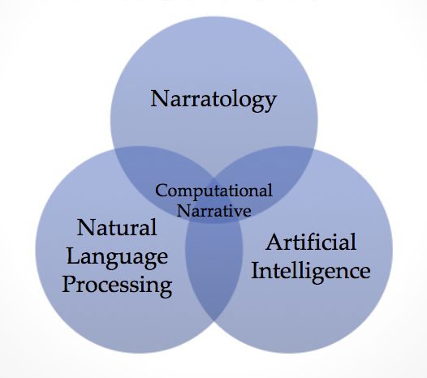
Notes:
https://movingai.com/aigames17/slides/WNAIG-Short-CN-Gap.pdf

Slide 9
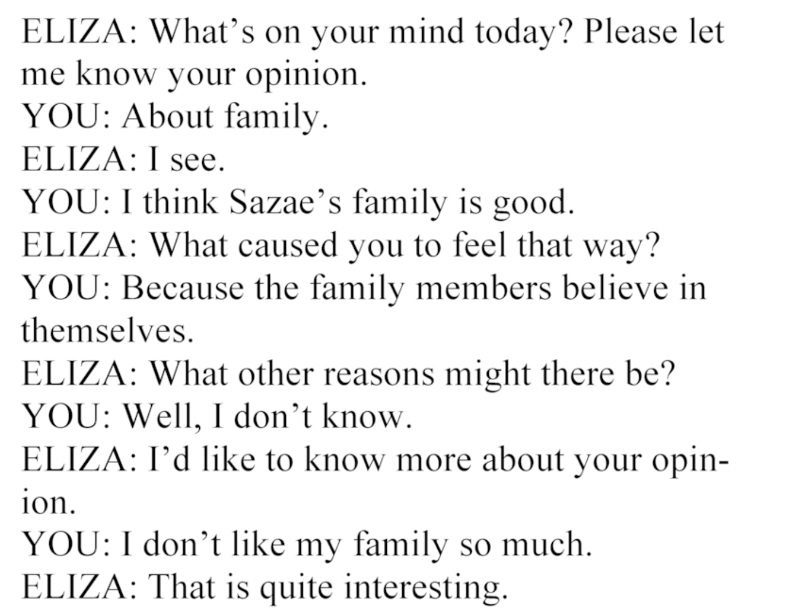
ELIZA (Weizenbaum 1966)

Slide 10

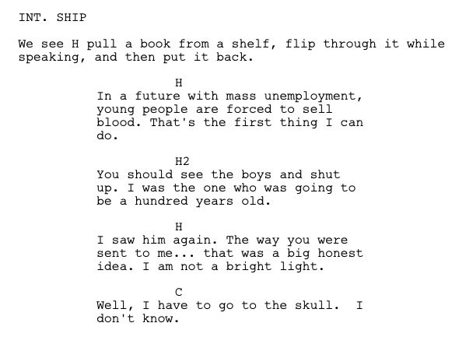
Notes:
https://arstechnica.com/gaming/2016/06/an-ai-wrote-this-movie-and-its-strangely-moving/
https://en.wikipedia.org/wiki/Sunspring
https://www.docdroid.net/lCZ2fPA/sunspring-final.pdf
https://www.imdb.com/title/tt5794766/
http://karpathy.github.io/2015/05/21/rnn-effectiveness/
https://towardsdatascience.com/the-arti-canon-neural-text-generation-2a8f032c2a68
https://github.com/OKStateACM/AI_Workshop/wiki/LSTM-Generator
https://github.com/lephong/lstm-rnn
https://medium.com/build-and-learn/fun-with-text-generation-pt-1-markov-models-in-awk-5e1b55fe560c
https://drmysterian.com/how-to-code-a-python-markov-chain-text-generator/

Slide 11
Current State of the Art
Notes:
Better Language Models and Their Implications
https://openai.com/blog/better-language-models/

Slide 12
Working with GPT-2
Corpus Preparation
Fine Tuning
Human Supervision

Slide 13
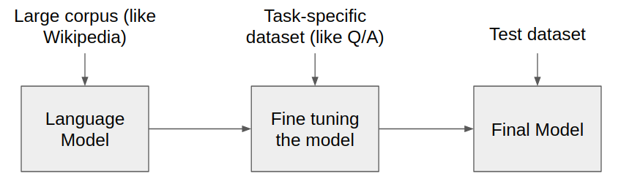
Pretrained Language Models
Notes:
https://towardsdatascience.com/pre-trained-language-models-simplified-b8ec80c62217

Slide 14

What is a Language Model
Notes:
https://medium.com/dair-ai/aspects-of-language-captured-by-bert-32bc3c54016f

Slide 15
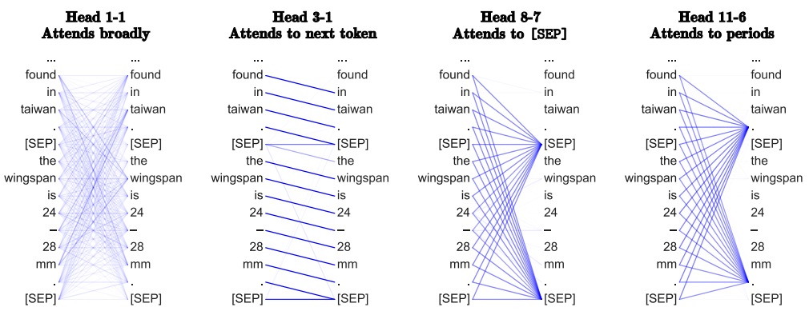
Language Model with Attention

Slide 16
Digital Humanities Research
Research Corpora
TV Screenplay
Play
Novel
TV Episode & Plot Summary
Case Studies
Sex in the City
Four Chekhov Plays
Proust In Search of Lost Time
The Family Guy

Slide 17
Sex in the City
TV Screenplay Dialog
Research Outline
HBO Comedy TV Series
Discontinuous Dialog
Semantically Sparse
Heavily Contextual
Details
603,571 Word Corpus
94 Episodes (1998-2004)
Candace Bushnell 1997 Book
4 Single Women in NYC
30-40s Professional Hipsters
Notes:
https://en.wikipedia.org/wiki/Sex_and_the_City

Slide 18
Sex in the City: TV Screenplay Dialog
After 200 epochs with loss=2.26

Slide 19
ANDAN noddy-no
CARRIE "Well, it's only one sentence in that case, but if you want to keep it simple, why not just say, "the world needs to learn about what you've been through in jail, and who you are in the here?"? No, thank you."
IRANDA You can tell me everything I want about them, or I can get them to be my friends.
CARRIE "And, well, it's the truth, right? The world needs to know."
IRANDA "We just don't know anything."
CARRIE I don't wanna tell them anything unless they've told me everything.
IRANDA "Of any of them, of any of them, I couldn't tell you my whole life story, because it's too personal. It's too real. It's too close to my home. This is about her, right? This is my sister-in-law. Why should I pay him."
IRANDA This is her sister-in-law.
IRANDA "I'm sorry, I feel weird about this."
IRANDA he said it was the one sentence he meant to say.
IRANDA It's true.
IRANDA "I'm sure she's got a good heart, but I'm not going to talk to her."
IRANDA "I'm not even saying it in terms of what I'm done in your name."
IRANDA I'm not getting married.
CARRIE "I could not tell them it, because it was a lie. But we decided that since it did come out as true, we had to have a lie detector."
CARRIE I was totally fucked. I was having a nervous breakdown.
Notes:
After 200 epochs with loss=2.26

Slide 20
ANDAN noddy-no
CARRIE "Well, it's only one sentence in that case, but if you want to keep it simple, why not just say, "the world needs to learn about what you've been through in jail, and who you are in the here?"? No, thank you."
IRANDA You can tell me everything I want about them, or I can get them to be my friends.
CARRIE "And, well, it's the truth, right? The world needs to know."
IRANDA "We just don't know anything."
CARRIE I don't wanna tell them anything unless they've told me everything.
IRANDA "Of any of them, of any of them, I couldn't tell you my whole life story, because it's too personal. It's too real. It's too close to my home. This is about her, right? This is my sister-in-law. Why should I pay him."
IRANDA This is her sister-in-law.
IRANDA "I'm sorry, I feel weird about this."
IRANDA he said it was the one sentence he meant to say.
IRANDA It's true.
IRANDA "I'm sure she's got a good heart, but I'm not going to talk to her."
IRANDA "I'm not even saying it in terms of what I'm done in your name."
IRANDA I'm not getting married.
CARRIE "I could not tell them it, because it was a lie. But we decided that since it did come out as true, we had to have a lie detector."
CARRIE I was totally fucked. I was having a nervous breakdown.
Notes:
After 200 epochs with loss=2.26

Slide 21
Sex in the City: TV Screenplay Dialog
After 600 epochs with loss=2.06

Slide 22
CARRIE No. She was feeling like a complete failure. The fact that Sam had let her down and was crying...
SAMANTHA What can I say? I'm sorry.
SAMANTHA "No, I'm sorry, sweetheart."
SAMANTHA Thank you.
CARRIE "The next few days, Samantha and I drove together down a strange road, where life and love were both at stake."
CARRIE "As we approached the end of the week, I started to think that maybe I should be sleeping with someone else before the end of the month."
CARRIE "My friends and I spent weeks dating, planning, and ultimately, going to bed together."
CARRIE "But if this was the beginning of a relationship, what was it all about? Was it merely a matter of time?"
CARRIE The end of a relationship had two major components that Samantha and I did not wish to discuss further.
SAMANTHA No way.
SAMANTHA You guys are just here to have fun.
SAMANTHA Come up.
CARRIE Samantha and I had long been waiting for that moment when the relationship really hit us all at once.
SAMANTHA Let's see. Did you have a problem?
CARRIE "Yes, some things never stay. We did. But, it's important to know that the past few days have been great."
CARRIE I think we're in love.
SAMANTHA You should really stop saying ""I love you"" for one last time and call me.
SAMANTHA What's happening? How are you gonna deal with your friends?
CARRIE "I haven't seen them all week. And one of them got really angry and I felt like crying. So, I thought, maybe the last time we went to lunch...
SAMANTHA "What's happening! Are you guys in a relationship? A relationship was all I felt a few days ago."
Notes:
After 600 epochs with loss=2.06

Slide 23
CARRIE No. She was feeling like a complete failure. The fact that Sam had let her down and was crying...
SAMANTHA What can I say? I'm sorry.
SAMANTHA "No, I'm sorry, sweetheart."
SAMANTHA Thank you.
CARRIE "The next few days, Samantha and I drove together down a strange road, where life and love were both at stake."
CARRIE "As we approached the end of the week, I started to think that maybe I should be sleeping with someone else before the end of the month."
CARRIE "My friends and I spent weeks dating, planning, and ultimately, going to bed together."
CARRIE "But if this was the beginning of a relationship, what was it all about? Was it merely a matter of time?"
CARRIE The end of a relationship had two major components that Samantha and I did not wish to discuss further.
SAMANTHA No way.
SAMANTHA You guys are just here to have fun.
SAMANTHA Come up.
CARRIE Samantha and I had long been waiting for that moment when the relationship really hit us all at once.
SAMANTHA Let's see. Did you have a problem?
CARRIE "Yes, some things never stay. We did. But, it's important to know that the past few days have been great."
CARRIE I think we're in love.
SAMANTHA You should really stop saying ""I love you"" for one last time and call me.
SAMANTHA What's happening? How are you gonna deal with your friends?
CARRIE "I haven't seen them all week. And one of them got really angry and I felt like crying. So, I thought, maybe the last time we went to lunch...
SAMANTHA "What's happening! Are you guys in a relationship? A relationship was all I felt a few days ago."
Notes:
After 600 epochs with loss=2.06

Slide 24
Originality vs Randomness (temperature = 0.7)
GPT-2
CARRIE "My friends and I spent weeks dating, planning, and ultimately, going to bed together."
CARRIE "But if this was the beginning of a relationship, what was it all about? Was it merely a matter of time?"
CARRIE The end of a relationship had two major components that Samantha and I did not wish to discuss further.
Original
CARRIE I'm gonna burn your bagel.
IRANDA Don't.
CARRIE "If he hasn't, it's just a matter of time."
IRANDA He's not having an affair.
Notes:
https://github.com/minimaxir/gpt-2-simple

Slide 25
Sex in the City: TV Screenplay Dialog
After 1600 epochs with loss=1.56

Slide 26
TOM You can keep your apartment.
TOM "It's a great place, it's peaceful."
TOM I like that.
CARRIE he'll be missed.
CARRIE "So, just you?"
TOM "No, actually just me."
CARRIE I'm sure.
CARRIE He's really turning his life around.
CARRIE "Oh, God, I don't understand."
CARRIE You have five children and he is single? .
TOM I got to go.
TOM Have a nice life.
CARRIE He has a life?
TOM "No, I can't. I have a job."
Notes:
After 1600 epochs with loss=1.56

Slide 27
TOM You can keep your apartment.
TOM "It's a great place, it's peaceful."
TOM I like that.
CARRIE he'll be missed.
CARRIE "So, just you?"
TOM "No, actually just me."
CARRIE I'm sure.
CARRIE He's really turning his life around.
CARRIE "Oh, God, I don't understand."
CARRIE You have five children and he is single? .
TOM I got to go.
TOM Have a nice life.
CARRIE He has a life?
TOM "No, I can't. I have a job."
Notes:
After 1600 epochs with loss=1.56

Slide 28
Sex in the City: TV Screenplay Dialog
After 4800 epochs with loss=0.40

Slide 29
AIDAN I see the Spirit.
CARRIE And that's a very good sign.
AIDAN "If you see the Spirit, you're the man to beat."
CARRIE "That was the last night I saw the man to beat."
CARRIE "I had used my workout as a springboard to land on my feet, but the Goddesses had warned me not to let my guard down once again."
CARRIE That's why I recently came into my bedroom and started to read.
AIDAN "Oh I didn't get enough sleep last night, either."
AIDAN "Yeah, right."
CARRIE What?
AIDAN "The Goddesses said tonight was the end of the line. I wanted to run and cover as much of it as possible, but I was too stunned by Zeus'"
CARRIE Sparks flew between us.
AIDAN What did they say?
CARRIE "It was quiet, calm, collected, impressive. Like a picture taken with a fountain pen."
AIDAN "The beginning of the next phase begins. Among the many, many sculptural relationships I hope to smash are those of a man with little more than a haircut and a hand sized condom."
CARRIE With the mustache.
AIDAN I know.
CARRIE "No, the mustache."
Notes:
After 4800 epochs with loss=0.40

Slide 30
AIDAN I see the Spirit.
CARRIE And that's a very good sign.
AIDAN "If you see the Spirit, you're the man to beat."
CARRIE "That was the last night I saw the man to beat."
CARRIE "I had used my workout as a springboard to land on my feet, but the Goddesses had warned me not to let my guard down once again."
CARRIE That's why I recently came into my bedroom and started to read.
AIDAN "Oh I didn't get enough sleep last night, either."
AIDAN "Yeah, right."
CARRIE What?
AIDAN "The Goddesses said tonight was the end of the line. I wanted to run and cover as much of it as possible, but I was too stunned by Zeus'"
CARRIE Sparks flew between us.
AIDAN What did they say?
CARRIE "It was quiet, calm, collected, impressive. Like a picture taken with a fountain pen."
AIDAN "The beginning of the next phase begins. Among the many, many sculptural relationships I hope to smash are those of a man with little more than a haircut and a hand sized condom."
CARRIE With the mustache.
AIDAN I know.
CARRIE "No, the mustache."
Notes:
After 4800 epochs with loss=0.40

Slide 31
Originality vs Randomness (temperature = 0.7)
GPT-2
CARRIE What?
AIDAN "The Goddesses said tonight was the end of the line. I wanted to run and cover as much of it as possible, but I was too stunned by Zeus'"
CARRIE Sparks flew between us.
AIDAN What did they say?
CARRIE "It was quiet, calm, collected, impressive. Like a picture taken with a fountain pen."
Original
CARRIE Miranda arrived home later to an empty apartment.
CARRIE "And for the first time, she really didn't like it."
CARRIE "While Miranda and I worked out our inner goddesses, Baird was working the male out of Charlotte."
BAIRD You look great.
CHARLOTTE "I'm sorry, I can't do this."
Notes:
https://github.com/minimaxir/gpt-2-simple

Slide 32
Originality vs Randomness (temperature = 0.7)
GPT-2
CARRIE What?
AIDAN "The Goddesses said tonight was the end of the line. I wanted to run and cover as much of it as possible, but I was too stunned by Zeus'"
CARRIE Sparks flew between us.
AIDAN What did they say?
CARRIE "It was quiet, calm, collected, impressive. Like a picture taken with a fountain pen."
Original
IRANDA "My hips don't pop, I'm a guy."
CARRIE You're insane.
IRANDA "This isn't helping me find my inner goddess, only my inner humiliation."
GODDESS INSTRUCTOR And reach back.
GODDESS INSTRUCTOR Reach for the stars.
CARRIE We're out of here.
Notes:
https://github.com/minimaxir/gpt-2-simple

Slide 33
Sex in the City: TV Screenplay Dialog
After 8400 epochs with loss=0.15

Slide 34
IRANDA "After the fifth song, I began to notice patterns in his behaviour."
IRANDA "For example, when he was stressed, he was more receptive."
IRANDA "When he was happy, he was more expressive."
IRANDA That's human.
CARRIE "While some of these women were certainly showing signs of emotional well-being, it was clear that Tony was tapping into an emotional void."
TONY "I'm gonna go, it's my favourite song."
IRANDA "You're ogling me, right?"
TONY "No, I'm just a little ticked off that people aren't usually as spontaneous with their relationships."
IRANDA I'm dating a guy right now and we're having a dialogue.
TONY You're ogling me.
IRANDA You're ogling the wrong guys.
CARRIE It's an unwritten rule for New York nightlife: Everyone is either gay or they're bisexual.
CARRIE "It is, at best, a step in the right direction."
SAMANTHA I can't believe I used to like that song.
IRANDA I'm sorry.
IRANDA Are you guys seeing anyone?
SAMANTHA No one special.
IRANDA "I'll check my availability, and we'll move on to the food battle."
SAMANTHA I have a radio.
CARRIE I do not have a radio.
IRANDA You have a fucking radio.
CARRIE Don't play games.
IRANDA "For a radio station, it's a very low-risk, very safe investment."
SAMANTHA I'll be fine.
SAMANTHA I have a whole life to prepare for.
SAMANTHA My hair dryer needs to be refilled.
Notes:
After 8400 epochs with loss=0.15

Slide 35
IRANDA "After the fifth song, I began to notice patterns in his behaviour."
IRANDA "For example, when he was stressed, he was more receptive."
IRANDA "When he was happy, he was more expressive."
IRANDA That's human.
CARRIE "While some of these women were certainly showing signs of emotional well-being, it was clear that Tony was tapping into an emotional void."
TONY "I'm gonna go, it's my favourite song."
IRANDA "You're ogling me, right?"
TONY "No, I'm just a little ticked off that people aren't usually as spontaneous with their relationships."
IRANDA I'm dating a guy right now and we're having a dialogue.
TONY You're ogling me.
IRANDA You're ogling the wrong guys.
CARRIE It's an unwritten rule for New York nightlife: Everyone is either gay or they're bisexual.
CARRIE "It is, at best, a step in the right direction."
SAMANTHA I can't believe I used to like that song.
IRANDA I'm sorry.
IRANDA Are you guys seeing anyone?
SAMANTHA No one special.
IRANDA "I'll check my availability, and we'll move on to the food battle."
SAMANTHA I have a radio.
CARRIE I do not have a radio.
IRANDA You have a fucking radio.
CARRIE Don't play games.
IRANDA "For a radio station, it's a very low-risk, very safe investment."
SAMANTHA I'll be fine.
SAMANTHA I have a whole life to prepare for.
SAMANTHA My hair dryer needs to be refilled.
Notes:
After 8400 epochs with loss=0.15

Slide 36
Originality vs Randomness (temperature = 0.7)
GPT-2
TONY You're ogling me.
IRANDA You're ogling the wrong guys.
CARRIE It's an unwritten rule for New York nightlife: Everyone is either gay or they're bisexual.
CARRIE "It is, at best, a step in the right direction."
Original
IRANDA "Somewhere between Gen X and Y, they blended and made XY."
CARRIE "I did the ""date the bisexual guy"" thing in college."
CARRIE they All ended up with men.
SAMANTHA So did the bisexual women.
CHARLOTTE Which is why there are no men left for us.
Notes:
https://github.com/minimaxir/gpt-2-simple

Slide 37
Sex in the City: TV Screenplay Dialog
After 8600 epochs with loss=0.14

Slide 38
CARRIE Do you want to share some secrets? Maybe you were right; maybe the other shoe is even stronger than you thought.
CARRIE Maybe there is a time when a husband and wife can co-exist.
CARRIE "Maybe in life, when you throw a wrench in the works you get nothing but what you threw."
CARRIE "Or in Benjamin's case, 'twas the saying that every bride gets their firstborn."
AIDAN "Jesus Christ, it's your first birthday."
CARRIE That's the thing about roman numeral systems.
CARRIE "Every 12th, 42nd and 42nd birthday, a new one begins."
CARRIE The first ones that don't include daughters.
CARRIE "So, three months fixed up, how's that working out for you?"
AIDAN Good.
CARRIE "Yeah, me and Aidan are +++."
AIDAN Yeah.
CARRIE It's good.
CARRIE "We're still a ways from being able to add a baby to our family, but I'm happy for you."
CARRIE "If I were to get pregnant, that would be a wonderful thing, I would be able to do."
AIDAN Not having a baby would be a detriment.
CARRIE But could you conceive?
AIDAN We're in completely different places right now.
CARRIE "You don't have to tell me about the baby, do you?"
AIDAN I knowthings might be different after a certain age.
CARRIE "No, I could tell you my mother didn't want one."
CARRIE "And, by the way, I'm not pregnant."
AIDAN I know.
CARRIE "And by the way, you have the lowest possible Spouse I've ever met."
CARRIE Maybe even chimney.
AIDAN You're bad.
CARRIE "and, by the way, you are dating a woman who works in publishing."
CARRIE You know?
AIDAN I'm trying to find my inner ravisher.
Notes:
After 8600 epochs with loss=0.14

Slide 39
CARRIE Do you want to share some secrets? Maybe you were right; maybe the other shoe is even stronger than you thought.
CARRIE Maybe there is a time when a husband and wife can co-exist.
CARRIE "Maybe in life, when you throw a wrench in the works you get nothing but what you threw."
CARRIE "Or in Benjamin's case, 'twas the saying that every bride gets their firstborn."
AIDAN "Jesus Christ, it's your first birthday."
CARRIE That's the thing about roman numeral systems.
CARRIE "Every 12th, 42nd and 42nd birthday, a new one begins."
CARRIE The first ones that don't include daughters.
CARRIE "So, three months fixed up, how's that working out for you?"
AIDAN Good.
CARRIE "Yeah, me and Aidan are +++."
AIDAN Yeah.
CARRIE It's good.
CARRIE "We're still a ways from being able to add a baby to our family, but I'm happy for you."
CARRIE "If I were to get pregnant, that would be a wonderful thing, I would be able to do."
AIDAN Not having a baby would be a detriment.
CARRIE But could you conceive?
AIDAN We're in completely different places right now.
CARRIE "You don't have to tell me about the baby, do you?"
AIDAN I knowthings might be different after a certain age.
CARRIE "No, I could tell you my mother didn't want one."
CARRIE "And, by the way, I'm not pregnant."
AIDAN I know.
CARRIE "And by the way, you have the lowest possible Spouse I've ever met."
CARRIE Maybe even chimney.
AIDAN You're bad.
CARRIE "and, by the way, you are dating a woman who works in publishing."
CARRIE You know?
AIDAN I'm trying to find my inner ravisher.
Notes:
After 8600 epochs with loss=0.14

Slide 40
Originality vs Randomness (temperature = 0.7)
GPT-2
CARRIE Do you want to share some secrets? Maybe you were right; maybe the other shoe is even stronger than you thought.
CARRIE Maybe there is a time when a husband and wife can co-exist.
CARRIE "Maybe in life, when you throw a wrench in the works you get nothing but what you threw."
Original
CARRIE "Charlotte and Trey's separate interests had become more than separate bedrooms. They'd become a real separation. Meanwhile, I tried to find a way for my single self and my couple self to co-exist."
CARRIE "Meanwhile, I tried to find a way for my single self and my couple self to co-exist."
AIDEN There you go. Yowza! Where are you going all dressed up like that?
CARRIE I told You yesterday I was going out.
Notes:
https://github.com/minimaxir/gpt-2-simple

Slide 41
Originality vs Randomness (temperature = 0.7)
GPT-2
CARRIE Do you want to share some secrets? Maybe you were right; maybe the other shoe is even stronger than you thought.
CARRIE Maybe there is a time when a husband and wife can co-exist.
CARRIE "Maybe in life, when you throw a wrench in the works you get nothing but what you threw."
Original
CARRIE And then I realized it.
CARRIE "I didn't have a relationship pattern, I had a between-relationship pattern."
CARRIE "I always went back to John after every devastating soul-shattering, gut-wrenching break up."
CARRIE "He was sweet, handsome, uncomplicated."
Notes:
https://github.com/minimaxir/gpt-2-simple

Slide 42
Chekhov
Four Plays
Research Outline
Russian Short Fiction
Four Classic Plays
Verbal (dialog)
Non-Verbal (directions)
Psychologically Profound
Details
125,019 Word Corpus
The Seagull (1895)
Uncle Vanya (1898)
The Three Sisters (1900)
The Cherry Orchard (1903)
Early Modernist Theatre
Notes:
https://en.wikipedia.org/wiki/Anton_Chekhov

Slide 43
Which did Chekhov write? (200 epochs, loss=2.22)
A.
I cannot go on living like this, I am tired of it. I have lost all interest in the present; I am bored, too. My first love, my passion, the past--all gone, and I am tired of it all. [Pause.]
B.
No, mother. I did that in a moment of insane despair, when I had lost all control over myself. It will never happen again. [He kisses her hand]
Notes:
https://github.com/minimaxir/gpt-2-simple

Slide 44
Which did Chekhov write? (200 epochs, loss=2.22)
A.
I cannot go on living like this, I am tired of it. I have lost all interest in the present; I am bored, too. My first love, my passion, the past--all gone, and I am tired of it all. [Pause.]
B.
No, mother. I did that in a moment of insane despair, when I had lost all control over myself. It will never happen again. [He kisses her hand]
Notes:
https://github.com/minimaxir/gpt-2-simple

Slide 45
Which did Chekhov write? (200 epochs, loss=2.22)
A.
There is another, much less important, element in the composition of fiction: love. If a play should have no love for any one, it is not a real play, even if there is no real scene or real speech in it.... One ought to give a real-life example of friendship. I have an example all one desires: my play. One can hardly call it a play, when all you get is a story, one can only call it a recitation.
B.
[The STATION-MASTER stands in the middle of the drawing-room and recites “The Magdalen” by Tolstoy. He is listened to, but he has only delivered a few lines when a waltz is heard from the front room, and the recitation is stopped. Everybody dances. TROFIMOV, ANYA, VARYA, and LUBOV ANDREYEVNA come in from the front room.]
Notes:
https://github.com/minimaxir/gpt-2-simple

Slide 46
Which did Chekhov write? (2800 epochs, loss=0.15)
A.
SONIA. I have loved him now for five years, I have loved him more than one loves one's mother. I seem to hear him beside me--
SONIA. [Not recognizing him] Is that you? [Kissing his hands] How do you do?
ASTROFF. Well, I am home at last, and off I go. [A pause.]
B.
SONIA. I have loved him now for six years, I have loved him more than one loves one's mother. I seem to hear him beside me every moment of the day. I feel the pressure of his hand on mine. If I look up, I seem to see him coming, and as you see, I run to you to talk of him. He is here every day now, but he never looks at me, he does not notice my presence. It is agony.
Notes:
https://github.com/minimaxir/gpt-2-simple

Slide 47
Which did Chekhov write? (2800 epochs, loss=0.15)
A.
SONIA. I have loved him now for five years, I have loved him more than one loves one's mother. I seem to hear him beside me--
SONIA. [Not recognizing him] Is that you? [Kissing his hands] How do you do?
ASTROFF. Well, I am home at last, and off I go. [A pause.]
B.
SONIA. I have loved him now for six years, I have loved him more than one loves one's mother. I seem to hear him beside me every moment of the day. I feel the pressure of his hand on mine. If I look up, I seem to see him coming, and as you see, I run to you to talk of him. He is here every day now, but he never looks at me, he does not notice my presence. It is agony.
Notes:
https://github.com/minimaxir/gpt-2-simple

Slide 48
Which did Chekhov write? (2800 epochs, loss=0.15)
A.
SONIA. I have loved him now for five years, I have loved him more than one loves one's mother. I seem to hear him beside me--
SONIA. [Not recognizing him] Is that you? [Kissing his hands] How do you do?
ASTROFF. Well, I am home at last, and off I go. [A pause.]
B.
SONIA. I have loved him now for six years, I have loved him more than one loves one's mother. I seem to hear him beside me every moment of the day. I feel the pressure of his hand on mine. If I look up, I seem to see him coming, and as you see, I run to you to talk of him. He is here every day now, but he never looks at me, he does not notice my presence. It is agony.
Notes:
https://github.com/minimaxir/gpt-2-simple

Slide 49
Which did Chekhov write? (8200 epochs, loss=0.04)
A.
see such black grained spots. As will not leave their tinct.”
[A horn is blown behind the stage.]
TREPLIEFF. Attention, ladies and gentlemen! The play is about to begin.
[A pause] I shall commence. [He taps the door with a stick, and speaks in a loud voice] O, ye time-honoured, ancient mists that drive at night across the surface of this lake, blind you our eyes with sleep, and show us in our dreams that which will be in twice ten thousand years!
B.
see that their labour is not rewarded, and they are not remembered for their genius, but for their blindness and their deafness. Their struggles are ended; they are like those of the phantoms that drive at night across the surface of this lake, blind you our eyes with sleep, and show us in our dreams that which will be in twice ten thousand years! I, you, will go in a moment--we will stand here talking till the end of our lives and thinking that we have escaped this minefield by some secret road that no one knows what.
Notes:
https://github.com/minimaxir/gpt-2-simple

Slide 50
Which did Chekhov write? (8200 epochs, loss=0.04)
A.
see such black grained spots. As will not leave their tinct.”
[A horn is blown behind the stage.]
TREPLIEFF. Attention, ladies and gentlemen! The play is about to begin.
[A pause] I shall commence. [He taps the door with a stick, and speaks in a loud voice] O, ye time-honoured, ancient mists that drive at night across the surface of this lake, blind you our eyes with sleep, and show us in our dreams that which will be in twice ten thousand years!
B.
see that their labour is not rewarded, and they are not remembered for their genius, but for their blindness and their deafness. Their struggles are ended; they are like those of the phantoms that drive at night across the surface of this lake, blind you our eyes with sleep, and show us in our dreams that which will be in twice ten thousand years! I, you, will go in a moment--we will stand here talking till the end of our lives and thinking that we have escaped this minefield by some secret road that no one knows what.
Notes:
https://github.com/minimaxir/gpt-2-simple

Slide 51


Slide 52
Proust
Novel
Research Outline
One of the Longest Novel
Recalled Memory
Detailed Observations
Philosophical Interpretations
Longer/Complex Interactions
Details
1,840,162 Word Corpus
7 Volumes over (1909-1922)
Vol 1-6: Moncrieff English Translation (1924-1930)
Vol 7: Stephen Hudson (Sydney Schiff) English Translation (1931)
355M GPT-2 Model (193
Notes:
http://gutenberg.net.au/plusfifty-n-z.html#proust
https://en.wikipedia.org/wiki/C._K._Scott_Moncrieff
https://www.amazon.com/TIME-REGAINED-Translated-Stephen-Hudson/dp/B009Z3543Q

Slide 53
Proust: In Search of Lost Time
After 200 epochs with loss=3.28

Slide 54
On the other hand, at the sight of the young M. de Guermantes, I should never have given one to doubt that he would be one of those people who, had they been able on principle to get into the habit of marrying a girl of their own choice, would always have preferred to be one of the few people, and for whom the family had been the indispensable source of everything that they had accomplished. Indeed to them, all the other people, the others had only for their protection the family of an unknown person, and the only alternative that they ever offered to it was always the family of an unknown person. And if there was never anything but an unknown person but a family, then I can tell you what it was exactly. A family that, before, it may have been, was unknown to the man who came to love it, and, afterwards, it may have been to a new lover whom it had not known which gave the thing its charm. The same thing was the case in the case of a man who had found for him in a woman the only possible wife. In the eyes of others he became nothing more than a married man, but he had never yet found for himself in the love of a wife for whom he had become in all that he had done, in an unknown or a married person, in all the other people that he had known.
We had also arrived at the conclusion that he, in so far as he loved her, must necessarily have become her, and that he had never felt what for him at first he regarded as his own. Of course, as soon as he had seen her I would have liked to hear M. de Guermantes tell me, on all fours, the words which he had used so often to her that I should never have been able to believe in a word:
"She looked beautiful; she was the most beautiful woman whom I have ever met. I am a great admirer of her family; they had her to their friends the very instant that I was here. I felt it more than anything possible! I feel that she would make an excellent wife."
But, after having been with her all day, when I went into those apartments we might easily have seen nothing more than a woman in her bathing-vessel, for the sun had risen and the wind was blowing, and the air was calm and fresh.
It was not possible, alas! to do a few things
Notes:
After 200 epochs with loss=2.22

Slide 55
Proust: In Search of Lost Time
After 1000 epochs with loss=3.11

Slide 56
of of her head. But there in particular, and above all in all the faces of the others who I had known, her face seemed still to know it all and that my eyes felt still the same loneliness. Moreover, for, although she was perhaps not quite capable of seeing those faces for yourself, in the end, I was quite certain that my eyes would always see her face before the rest; they looked like those who seek from others in order to find that which they want. How frequently have we seen faces that were quite different!
Besides, and just as often she did not look at us with such an indifference as other people, whose faces she seemed to view but did not see, did not even look at us at the same moment as our eyes, so that her eyes seemed to be following us as far as the other's, her face followed hers like a sort of cloud-sphere, and that the face of one was often obscured by other's upon which were obscured eyes or otherwise
At these intervals I had a terrible dream. She appeared to me disappointingly in every one of those faces; I had not the same feeling about all the rest that it gave me, and that face of hers seemed to me even more dissimilar from the others than I could have been capable of imagining, while her face itself was still somewhat of one face, which I still must ask myself as many questions as if it had been a real person, why she had not changed, why, in this case, it appeared so different from all the rest who appeared to be human, why all the faces had appeared so different. And then another dream came and a second, and these were so few that I could never think of them all. But these two dreams, I was sure of her having had no other! But I believed them when they were of an entirely different nature from the first. This is because they gave me an entirely different impression of her. So far as I could see her face and her lips were blank, and yet they seemed to me filled with so many strange and complex expressions that all I could say was that she was that of a woman whom I had never seen before, and who could not possibly have been myself, I could not say whether these examples of their faces were due no real cause, I could not confirm with what a certainty it appeared, I could only imagine their meaning, I imagined her in various aspects, not knowing that I was seeing her face in a completely different light than I could have conferred upon it from myself, nor that she could have been that of a woman I did not know. And yet these two little visions remained a continuance of the same face, of the same features, of my own dream, as were those of those of my own past.
Even the idea of going to the Dauphic Gardens was a sort of refusal, because, though it was not my face that I was going to see, it seemed to me in my imagination as though I had thought of visiting the Dauphic Gardens at Balbec because they could offer me pleasure, or because it felt to me as though I was going to the Dauphon and was wondering whether that could lead me toward her, at her whose house I had not lived, whether that would lead me toward her, where at the moment when I had thought of going she was there, to look at a piece of scenery in a city, perhaps in the countryside, would perhaps at least take me, as the sea might have done, to go fishing, and then, as the sun shone on the distant sky, when I had returned to my room where I had seen a solitary figure which had not been Balbec, would have been the place to which Odette had gone to look in the distance. If the idea of going to the Dauphou was one of those notions which, as soon as a desire for the opposite person arises, prevent us from imagining the other person, are for it the only sort of sense, the only kind of feeling; to make it seem true, it is an imperfect, a gross, a mental reconstruction. It is not only we who, once we have accepted the suggestion of going on a journey, are unaware whether we are actually going to the opposite place, and we ourselves of that same person who has obviously deceived us; in short, the opposite thing is that we think of everything else as well. And all these little dreams which I had had, moreover, on the same day, on the same night, for they came as a sudden interruption to me as to the rest of my
Notes:
After 1000 epochs with loss=3.11

Slide 57
Proust: In Search of Lost Time
After 1400 epochs with loss=2.99

Slide 58
"I believe that I am not." (And for a moment he was silent, indifferent, not at all concerned with how to make the most beautiful benevments of the mind more easily attained, so much so as to say as many as twenty times, which made him so sad.) "Are you unhappy?" he asked.
"No. I am not in any way unhappy in the least."
"Why, thank you!" cried Saint-Loup, his voice breaking like a fraction of a shattered glass, "I can never imagine where you are going."
"Do let me tell you something: we went to luncheon as a rule at Balbec, and I was always asking Françoise what she thought of us there; she would tell me all sorts of things only about ourselves, that it was a little too cold. But, in fact, there were several of us in the restaurant, and I remember all of the time the way in which you talk about women whom one doesn't know.
"I must confess, yes," he added in a loud voice, "that Françoise was, as far as I remember, one of those women who were very much in my mind's eye, I had always a fondness for her, she was the one who could always bring her something new."
But the old servant whom Saint-Loup had so often met, who, so far as she was concerned, was as much as an actress, was also as great, even more so than those famous actors whom an actor, with great skill as far as technique were concerned, often took to his table, was one of the most striking, the most different persons that he could imagine; the most distinguished actor's face was often entirely obscured by the dark moustache of the leading man and, when his name had come to their mind, the actors who followed him, all looked more curiously at it than the ordinary actor would at a portrait of Jules Verne.
One had seen at the theatre a woman who, as a rule, had taken up her own quarrels, but had always been at this party, the souvenir of one of those old-timeeries in which the roles are always changed and a new girl, an actress, appears suddenly; this new girl was, for some reason, quite unlike the old, but always the same person at the party, the same one to give a piece of advice to a new girl, her whole life—in the old scene—had passed by. Thus in a scene in which we may be quite sure, just as at any other, that which will occur next in the book of Gilberte in a minute or two, our life in society, in the life that we had known before, has always been, like the life which we know, an interval of which those who have lived it on contrary to what we did or planned to do must make up our mind, have already conceived the possibility, must not be surprised by those events that will be remembered in future by us who have been living it at an earlier period, and will even repeat them somewhere, the new scene having been the first that happened.
As for the artist, the new society was in no way so much an evolution of it, but rather simply their consequence, for it was always their consequence: in the first days of their marriage, if he had a daughter, was he not, perhaps, the type of person whom she had never known? But if Gilberte was not in society, was she not, as one might say, quite a long way from her father's house? Perhaps, at her age, there were times in which she was perfectly acquainted with the ordinary family.
And this was undoubtedly, as we saw, the case with all sorts of people in society in the second days after the wedding.
Certainly, the whole of society was quite apart from that time of year in which Gilberte was in the habit of meeting people at
Notes:
After 1400 epochs with loss=2.99

Slide 59
Proust: In Search of Lost Time
After 2000 epochs with loss=2.89

Slide 60
Robert-de Saint-Jean, the Prince's dear and humble friend, who was also M. de Norpois's old friend, on whom the other rested his trust, would not have taken his duty in this respect for granted, but by the act of 'knowing' a man who was in a position to know the people of whom he knew little or knew nothing would have given a 'better view' than the one who did know them, though the other would doubtless have believed that the position he held was less noble.
This had led M. de Norpois to treat, with contempt, an opportunity in his letters if any of these persons were introduced to him, though it were merely in a sense in which, in an earlier period(for example, for the writer of his letters at Balbec to the 'Prince' was not yet M. de Norpois), Norpois was a 'man in the highest society' or 'one of Paris's most notable men.' Norpois found it sufficient to express the contempt which so many eminent men feel towards those who are in a position to know them. He was unable to express his contempt exactly, but after a manner of speaking, so as not to appear moved by it, and a smile, in order to emphasise how little he knew himself: "When I have seen you," he would say, "I have had as great difficulty in meeting him." He never hesitated to say that the Prince and Norpois, together, were 'manageable.'
The Prince was in 'a posh position.' The name of this 'man' means, when one speaks, the same sort of thing, more particularly in this case, to the senior officer who has led the expedition, on the point of taking a command from M. de Norpois. 'It would be a shock to my new troops' would have died 'when I see at the end of my column that 'Prince' whose own marriage was to my father the cousin of the Rothschild. To say that Norpois was 'a man in the upper world' was to say that the Prince was a 'man in the middle class.' Norpois caught in the same way, by the act of 'knowing,' would find that the Prince had been, but with some small improvements.
Norpois, in conversion to his old fashion, said, when Prince Foggi mentioned the Prince to him: "He did mention him to Prince Foggi? The Prince of Norpois is a man of the world," for the reasons mentioned in the article and in the chapter on Prince Foggi in The Complete Poets' Collection. "Certainly not," replied Prince Foggi, "he knows him as well as I know my mother and grandmother."
The Prince's explanation was satisfactory to M. de Norpois, but M. de Norpois was angry at Norpois that his own cousin should be called Prince Foggi. "In any case, she is a 'man in the high world,' Prince Foggi," replied Prince Foggi in the most emphatic fashion, in the manner that people who have suffered at the hands of a surgeon who has been told that he will suffer next week and thinks that he can now 'live proudly' in the hospital in which he had been discharged when he had been 'most severely beaten,' to the patient who at one time had asked him to be his ward: "My dear; I don't believe that your family cares whether people are called Prince Foggi or Prince Foggi," M.de Norpois returned the compliment not to Prince Foggi but to the head of his medical institute: "How charming you are. We can easily tell you, if you are serious about not being called Prince Foggi, how to do it." The Prince did not want to be called Prince Foggi because of the difference between 'Prince' and 'Foggia,' which Prince Foggi liked to see, and 'Norpois' having been 'called' in the name of 'Prince Foggi,' not merely because he believed Norpois to mean Prince Foggi, but because the two people who should come next to him were Prince Foggi and Norpois, and he would not call them 'Norpois' unless they too were referred to in this way, so as not to seem to be of the same race. Prince Foggi had made a mistake in saying that a place was, more or less, of the same description. M. de Norpois liked names to appear 'Foggi.' H
Notes:
After 2000 epochs with loss=2.89

Slide 61
The Family Guy
TV Episode & Plot Summaries
Research Outline
Fox TV Animated Comedy
Everyday Situations Twisted
Distinctive Voices
Off Color Humour
Contrast: South Park and Seinfeld
Details
135,665 Word Corpus
16 Seasons (1999-present)
329 Episodes (to Season 17)
Wikipedia Episode Summaries
Seth MacFarlane
Notes:
Compare/Constrast with South Park and Seinfeld
https://en.wikipedia.org/wiki/Family_Guy
https://en.wikipedia.org/wiki/List_of_Family_Guy_episodes

Slide 62
Family Guy: Episode & Plot Summaries
After 200 epochs with loss=1.92

Slide 63
[EPISODE NAME]: I_Was_a_Slap
[SUMMARY]: "I Was a Slap" is the fourth episode and the 209th overall episode of the animated comedy series Family Guy. "I Was a Slap" follows Lois after she leaves Peter, who is a successful actor, for another man. Peter then becomes depressed after Lois finds out that Peter is gay. He decides to try to fix Lois' relationship with him by dating another man, but decides against it. After Lois finds out Brian is gay, he confesses to her in Peter's closet and Brian tells Peter and Lois that he wants a baby daughter; he then proceeds to try to murder Lois at the suggestion of Stewie. After Lois leaves the house, Peter and Brian have sex and Lois calls him a "bad boy". The episode ends when Brian tells Peter he should get his own television show.
Notes:
After 200 epochs with loss=1.92
https://en.wikipedia.org/wiki/Family_Gay

Slide 64
Family Guy: Episode & Plot Summaries
After 5200 epochs with loss=0.06

Slide 65
[EPISODE NAME]: The_Book_of_Joe
[SUMMARY]: "The Book of Joe" is the second episode of the thirteenth season of the animated sitcom Family Guy, and the 233rd episode overall. It aired on Fox in the United States on October 5, 2014, and is written by Mike Desilets and directed by Mike Kim. In the episode, Peter helps Joe fulfill his dream of getting a book published, only to take over as the writer. In the meantime, Brian develops an extreme thirst for exercise.
[PLOT]: The neighbors are invited over to Joe's house for a pool party, and while looking around the house, Peter discovers that Joe has been writing a children's book called The Hopeful Squirrel about a paraplegic squirrel. Peter offers his support even though Joe has doubts about it. Joe sends his book to a publisher and they pick it up, but he decides to use the pen name "David Chicago" as his co-workers on the police force do not support creativity. At a book reading, his wheelchair and monotonous voice intimidate the children and Peter decides to step in for him, becoming a success. Joe and his agent Blake Walker enlist Peter to become the "face" of the pen name. Joe has some misgivings, but decides to go along with it. When interviewed by Tom Tucker, his humorous pokes at the handicapped get
under Joe's skin while the fans find it funny. Joe confronts Peter over his angle on the book, but Peter uses the threat of the publisher's support and Joe quits the project.
Meanwhile, at a coffee shop, Brian obsesses over a runner named Chloe (voice by Mae Whitman) he sees and tries to impress her, scoring a date. When he arrives to pick her up, she decides they should go for a run and he achieves a “runner's high” more powerful than
Notes:
After 5200 epochs with loss=0.06 (Part 1)
https://en.wikipedia.org/wiki/The_Book_of_Joe

Slide 66
Real Plot Summary: “The Book of Joe”
The neighbors are invited over to Joe's house for a pool party, and while looking around the house, Peter discovers that Joe has been writing a children's book called The Hopeful Squirrel about a paraplegic squirrel. Peter offers his support even though Joe has doubts about it. Joe sends his book to a publisher and they pick it up, but he decides to use the pen name "David Chicago" as his co-workers on the police force do not support creativity. At a book reading, his wheelchair and monotonous voice intimidate the children and Peter decides to step in for him, becoming a success. Joe and his agent Blake Walker enlist Peter to become the "face" of the pen name. Joe has some misgivings, but decides to go along with it. When interviewed by Tom Tucker, his humorous pokes at the handicapped get under Joe's skin while the fans find it funny. Joe confronts Peter over his angle on the book, but Peter uses the threat of the publisher's support and Joe quits the project.
Meanwhile, at a coffee shop, Brian obsesses over a runner named Chloe (voice by Mae Whitman) he sees and tries to impress her, scoring a date. When he arrives to pick her up, she decides they should go for a run and he achieves a “runner's high” more powerful than drugs and sleeps with her despite the fact that they are watched by the Moon (who is depicted with a Korean voice). Brian continues his workout, annoying the family. Brian shows off his new in-shape yet rather gaunt figure which frightens Stewie even to the point where he sees Brian's six visible nipples. Brian has dumped Chloe to take up working out on a full-time basis and plans to compete in the Quahog Marathon.
Notes:
After 5200 epochs with loss=0.06 (Part 1)
https://en.wikipedia.org/wiki/The_Book_of_Joe

Slide 67
[EPISODE NAME]: Dad_and_the_Dads
[SUMMARY]: "Dad and the Dads" is the fifth episode of the thirteenth season of Family Guy which aired on the Fox network in the United States on May 24, 2014. The episode follows the Griffin family after Brian graduates from high school due to financial struggles. Lois goes to her grandparents' house, thinking that she has found her dad after he shows up at her grandma's house with a bachelor pad, but she finds out he has actually hired a young female actor to portray him, and she makes up an entire story about Brian and her dad. Brian starts taking his frustrations out on Lois' siblings, and they retaliate to Lois being angry with her. The family then moves into the Griffins' house, and Brian decides to get the fuck out. Brian finds Lois at the Griffins' house and they argue. Brian tells him that he is tired of being a burden to the family, and that he will leave. When Lois returns home and announces that she is a feminist, Brian is furious, but ultimately decides to stay.
Notes:
After 200 epochs with loss=1.92

Slide 68
Family Guy: Episode & Plot Summaries
After 800 epochs with loss=1.23

Slide 69
[PLOT]: Peter is informed by Lois that a client is looking for someone to do a voice over for a living. To complete the package, they need someone to do a joke, which leads Brian to tell a story about his friends at the Pawtucket Patriot ale brewery, which was the inspiration for the episode.
Brian meets Seth Rogen, the producer for the new sitcom One Day at a Time, at a coffee shop. The two quickly become friends, though he seems to take it more as an invitation than a business meeting. Brian offers Rogen a job after the fact, but Rogen declines. After an argument about a one-on-one date with Lois, Brian offers to arrange an interview and shoots Andy Dick down to the Quahog Pumpkin Festival, taking the opportunity to belittle him and his show by making fun of the finale.
After the fact, Lois questions Brian about the incident, and Brian reveals that the producer of the new sitcom is looking for someone to do a voice over at the end of the episode. Making matters worse, Lois gives Brian a one-year ultimatum: either he takes on the producer's wife, or he hangs up the phone. Brian has no choice but to accept the ultimatum. Realizing the interview would be difficult given the family's reactions to the events depicted in the episode, Brian asks Lois to make the best of things when Seth Rogen arrives at the house to deliver the show's ending.
Notes:
After 800 epochs with loss=1.23

Slide 70
Family Guy: Episode & Plot Summaries
After 1600 epochs with loss=0.48

Slide 71
[PLOT]: Before the intro starts, Wilhoit tells Peter he's taking a teacher to lunch. Peter discovers a magazine featuring a competition in which teachers are given macaroni by the readers. He takes it home and becomes obsessed with it. He has it tattooed on his arm and becomes jealous of the readers. He asks the gardener to remove it, but the gardener, unaware that Wilhoit has it done, informs him that he doesn't like Wilhoit. Joe removes it with a machete, thinking it is a crown, but Joe forgets to trim it. Brian tries to warn Peter that he is taking his problems out on everyone, but Peter ignores him. When Joe chastises him for ignoring his advice, Peter snaps that he was never going to fix anything with that tattoo.
As Joe criticizes Peter for his behavior, Peter realizes that he is right and apologizes to Joe. Joe apologizes too, but Peter mustered all the courage he could muster to tell Joe what happened. Joe tells him that he is thankful to Peter for pointing out his mistake, and promises to never let it happen again.
Going to the hospital to have it reviewed by Dr. Hartman, the authorship of the article is established. After examining the facts of the case, Hartman determines that the author is Springfield, Missouri native and reviles Peter, John McCain, calling him a neo-con, after citing his support of the Iraq war. While absent, Brian and Stewie visit Peter at his house, where Stewie demonstrates impressive stamina by repeatedly going on a walking tour of Springfield. Ultimately, Peter is forced to stop after being refused a drink by Brian, and loses his cool when Brian continually attempts to challenge him. Peter then gets into a heated argument with Brian over a school project, leading to a fight in the school's cafeteria. Ultimately, the two are ridiculed by the other students, who conclude that Peter is not getting any older, and he proves it by counting to three, scoring a perfect score. This results in tears in Peter's face, and he is promptly dropped from the book. Brian then expresses his surprise that Peter still holds onto the score, but Peter grimaces and gasps for air as he loses it.
Notes:
After 1600 epochs with loss=0.48

Slide 72
Family Guy: Episode & Plot Summaries
After 2000 epochs with loss=0.33

Slide 73
[by Chris] You've got to be kidding me, Cap'n? [Laughs] No, honey. [Laughs] Just kidding. [He gives Chris a bear]<|endoftext|>The idea for a "New Atheist" project was suggested by Chris on his blog, and Chris has created an online forum called "Atheist_Q" to discuss the subject. This essay is a response to that forum.
The "Atheist Question" was originally posted to Quagmire's blog in July 2008. At the time, Chris was a junior at college and working on his English assignment at home; he had taken it upon himself to write it. He had not finished it when his English teacher requested that he write another essay. When he attempts to complete the essay, he finds that he has misunderstood the question and begins to criticize it. Meanwhile, at the Quahog Gay Pride Day celebration, Stewie appears and states that he is gay.
The episode was written by Alex Carter and directed by Zac Moncrief. It received mostly positive reviews from critics for its storyline and many cultural references. According to Nielsen ratings, it was viewed in 9.54 million homes in its original airing. The episode featured guest performances by Kei Ogawa, Kotaro Watanabe and Jamison Yang, along with several recurring guest voice actors for the series. Greg Colton won a Primetime Emmy Award for Individual Achievement in Animation, for storyboarding the episode, at the 63rd Primetime Emmy Awards. "Atheist Question" was released on DVD along with seven other episodes from the season on June 15, 2009.
Notes:
After 2000 epochs with loss=0.33

Slide 74
Family Guy: Episode & Plot Summaries
After 4000 epochs with loss=0.09

Slide 75
[EPISODE NAME]: Wasted_Talent
[SUMMARY]: "Wasted Talent" is the 20th episode of the second season of the American animated television series Family Guy. This episode marks the first time that Chris Griffin has had no speaking lines in an episode. This episode is rated TV-PG-D (TV-14 on Adult Swim reruns) in the United States and 15 in the United Kingdom.
[PLOT]: Lois desperately searches for one piano student who can beat her rival Alexis Radcliffe's student at the piano competition. Meanwhile, Peter drinks even more Pawtucket Patriot beers than usual in an attempt to find a hidden silver scroll and win a tour of the brewery. The next day, Joe finds the first silver scroll. Some time later, the last scroll is found, causing Peter to give up. Tom Tucker later admits he made up the story about the last scroll being found, and then puts a carnivorous earwig in his ear to make up for it. Peter decides to drink one more beer, which turns out to have the last silver scroll. But as Peter runs all the way homeward, he falls, clutches his kneecap and moans over and over again. (This scene would eventually become a popular internet meme in recent years.)
The next day, Peter and Brian go to the brewery tour (based on Willy Wonka & the Chocolate Factory). Pawtucket Pat (Michael McKean) is seemingly killed on his front walkway, but the killer turns out to be Cheech Marin, hired to pull off a gag. Since the brewery is not compliant with the Americans with Disabilities Act of 1990 and does not have wheelchair ramps, Joe is forced to leave the tour. After experiencing the "beer room", Peter and Brian split off from the group to try beer that never goes flat, in spite of Pat's warning that they have not worked out all the kinks. When Peter and Brian drink the beer, they begin floating upward towards a ceiling-mounted exhaust fan. To save themselves, they fart repeatedly until they reach the ground. When Pat finds Peter and Brian in the forbidden room, he curtly ejects them from the brewery.
Angry at Pawtucket Pat, Peter tries to get Lois's attention by playing the piano, showing that he
Notes:
After 4000 epochs with loss=0.09

