Slide 1
What Sub-Categories Need to Go?
Analysis for Superstore
Analyst: Jon Jackson

Slide 2
Background
Goal: Superstore wants to streamline their sub-category offerings by trimming 2-3 underperforming sub-categories
Data Analyzed: 2012-2015 global retail orders (51,290 total orders)

Slide 3
Evaluation Criteria
Each of Superstore’s sub-categories were evaluated on the following criteria:
Total Number of Orders
Goal: identify poor selling sub-categories
Average Discount Rate
Goal: identify sub-categories that require high discount rates to clear inventory
Profit-to-Sales Ratio
Goal: utilize combined metric of sales (revenue) and profit to evaluate each sub-categories performance

Slide 4
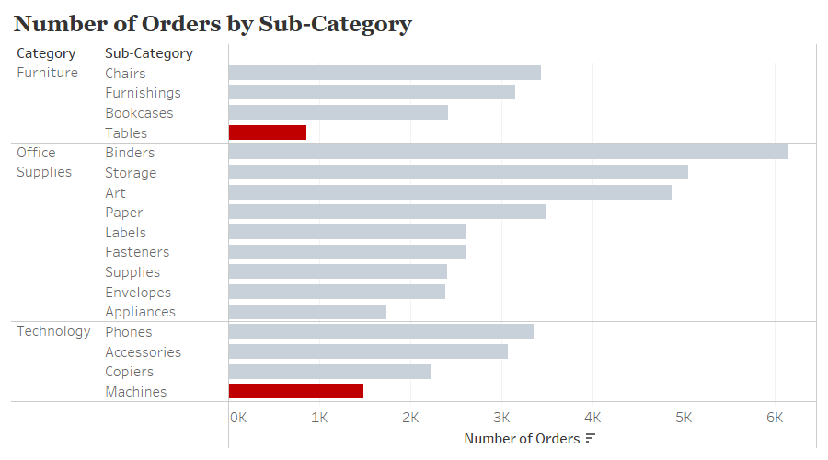
Least Popular Sub-Categories? Tables and Machines

Slide 5
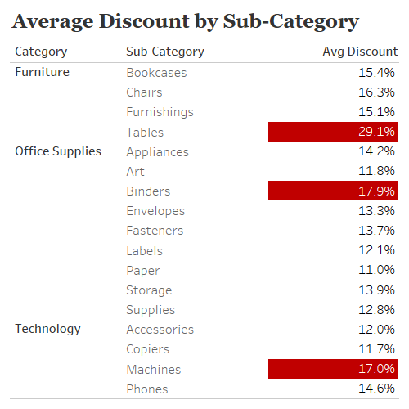
Discount Analysis
Superstore averages a 14.3% discount rate
Three sub-categories stand out negatively with high discount rates
Tables (29.1%)
Binders (17.9%)
Machines (17.0%)

Slide 6
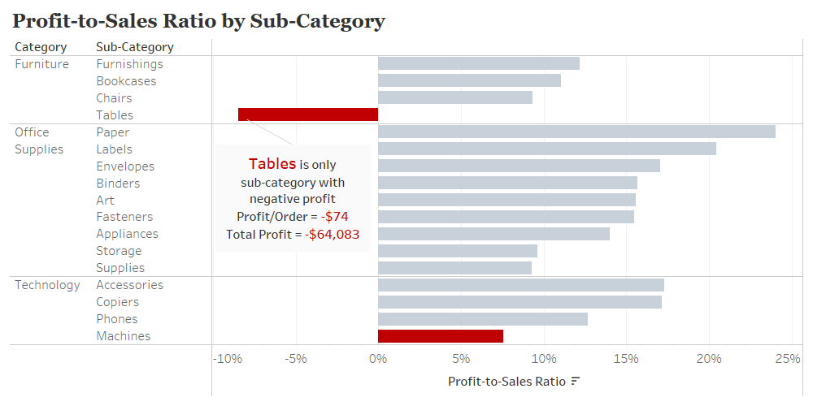
Lowest Profit-to-Sales Sub-Categories? Tables and Machines

Slide 7
Recommendations
Drop Tables
Only unprofitable sub-category in current offerings
Highest discount rate (29.1%)
Lowest number of orders (861)
Drop Machines
Second lowest profit-to-sales ratio (8%)
Above average discount rate (17%)
Second lowest number of orders (1,486)

Slide 8
Appendix

Slide 9
What sub-categories are expensive to ship? Tables and Machines are both in the Top 6
Sub-Category | Number of Orders | Shipping Cost/Order | Total Shipping Cost
Tables | 861 | $93 | $79,863
Copiers | 2,223 | $72 | $159,501
Bookcases | 2,411 | $64 | $155,488
Appliances | 1,742 | $62 | $108,308
Phones | 3,357 | $55 | $184,953
Machines | 1,486 | $53 | $79,150

Slide 10
TABLES: Potential Lost Customers
Top Customers to Contact
Number of Customers*
with 3+ orders | with 10+ units purchased | with $5,000+ purchased
3 | 19 | 3
Customer ID | Table Quantity | Table Sales | Total Sales
JS-1603059 | 17 | $4,552 | $5,489
NP-187001404 | 18 | $4,375 | $5,564
CP-123401406 | 14 | $3,265 | $4,164
Top overall customers have $10,000+ in total sales
*Statistics only for tables

Slide 11
MACHINES: Potential Lost Customers
Top Customers to Contact
Number of Customers*
with 3+ orders | with 10+ units purchased | with $5,000+ purchased
1 | 37 | 4
Customer ID | Table Quantity | Table Sales | Total Sales
SM-203201408 | 10 | $23,459 | $23,669
BM-111401402 | 8 | $8,159 | $10,539
SB-202901402 | 10 | $5,579 | $5,579
Top 10 Customers!
Top overall customers have $10,000+ in total sales
*Statistics only for machines

Slide 12
Would other sub-categories suffer by cutting tables and machines? No
The 19 customers who ordered 10+ tables (232 tables in total) also ordered:
17 chairs
3 bookcases
No other significant sub-category had significant units sold with this group of customers
The 37 customers who ordered 10+ machines (414 machines in total) also ordered:
58 bookcases
45 copiers
No other significant sub-category had significant units sold with this group of customers

