Slide 1
package hellope
import fmt_alias "../../Odin/core/fmt"
main :: proc() {
fmt_alias.println("hellope")
}
Package name, every .odin file in the current directory must share this name
Relative pathing to another package
(Optional) Alias name of the package. If omitted, the package name is the alias
Application Entry Point
Using a procedure from the imported package
Relative pathing to Odin’s core library is not convenient, therefore collection syntax is used. It takes a group of packages and places them in a bucket. See Ch X for Collections in detail.
package hellope
import "core:fmt"
main :: proc() {
fmt.println("hellope")
}
packages can be subdirectories of other packages for taxonomical organization. They are accessed as directories as if the package in the folder above them did not exist. For example, loading the math/linalg library uses a filepath slash:
import la "core:math/linalg"

Slide 2
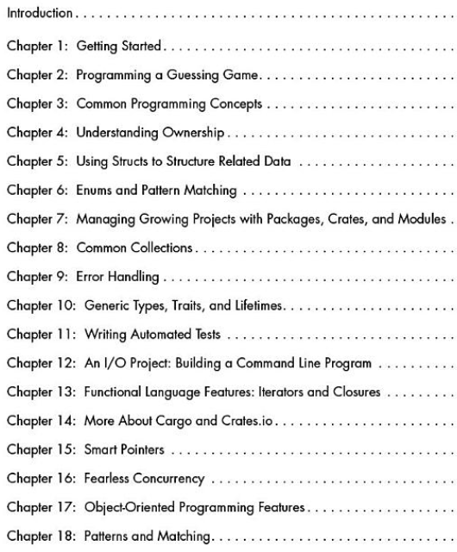
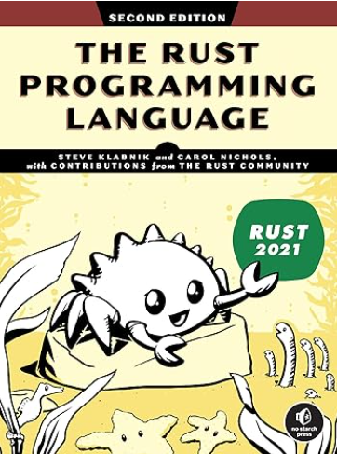
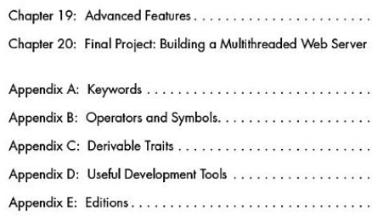
Rust Programming Language

Slide 3
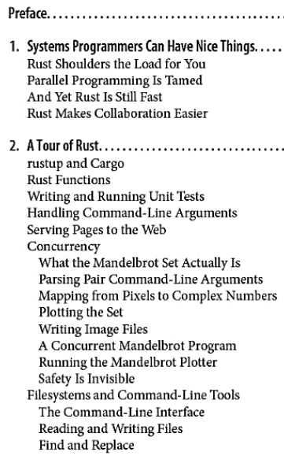
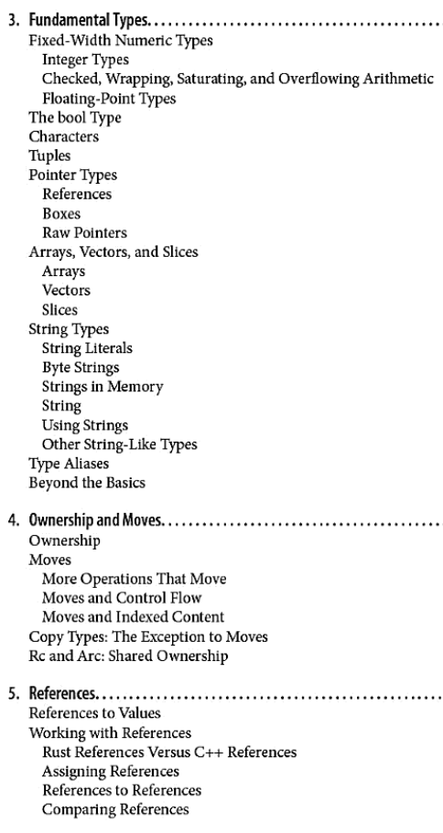
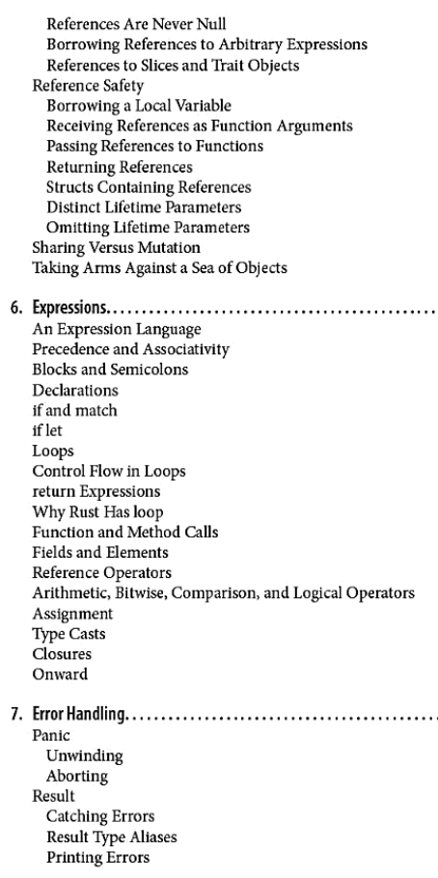
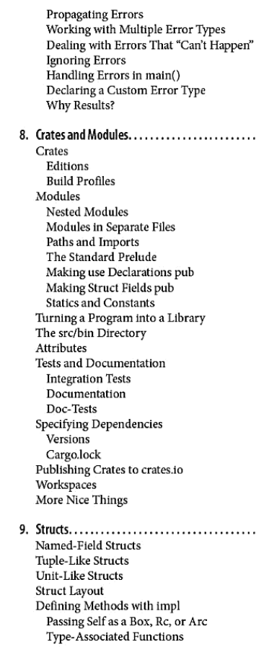
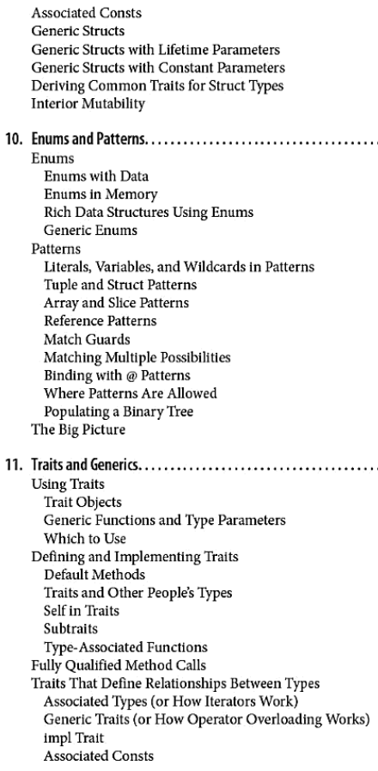

Slide 4
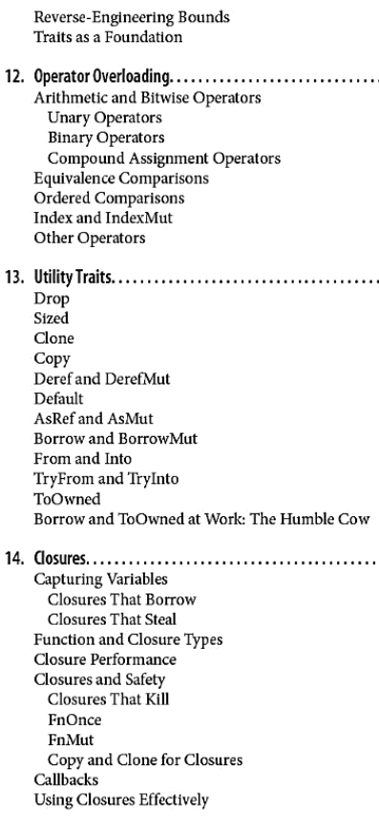
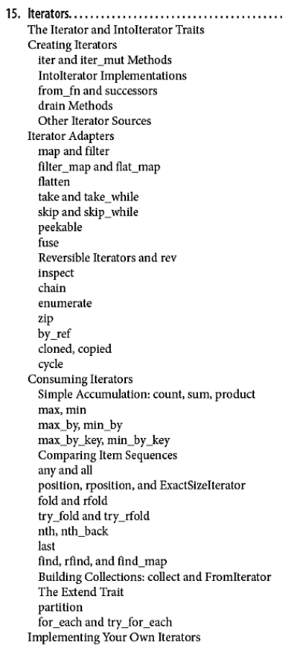
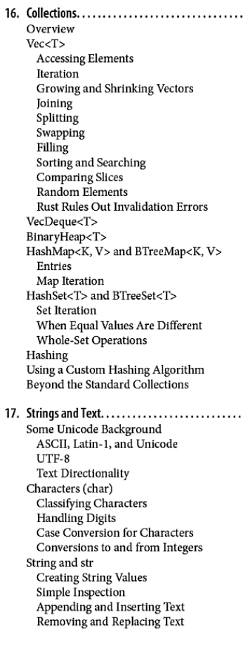
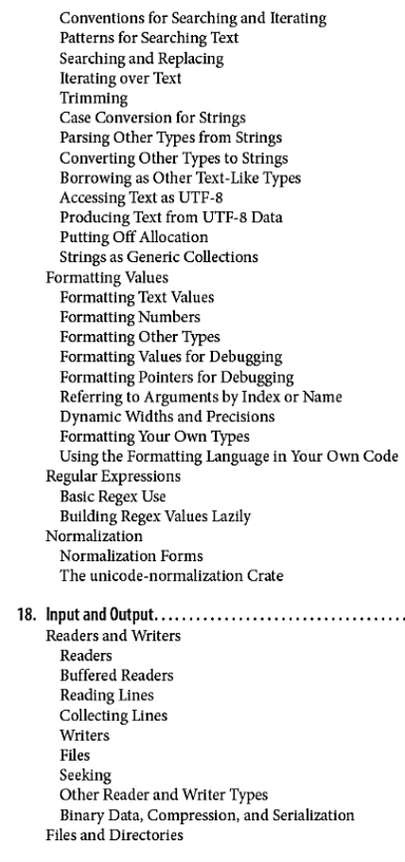

Slide 5
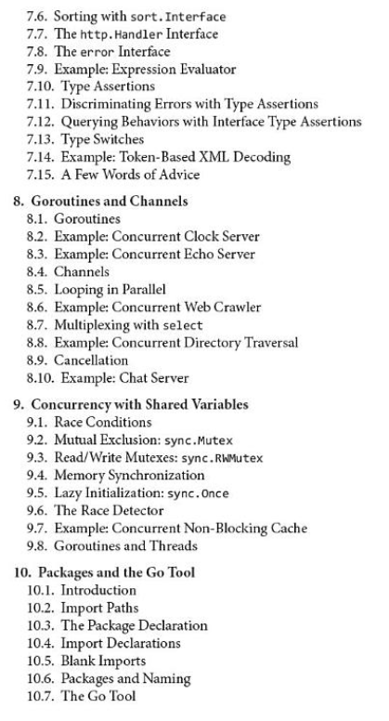
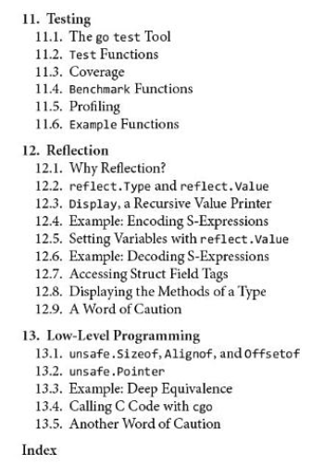
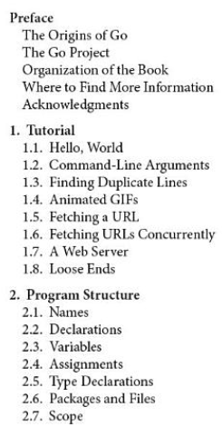
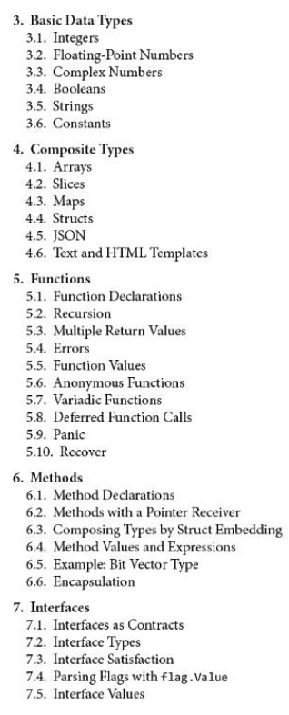
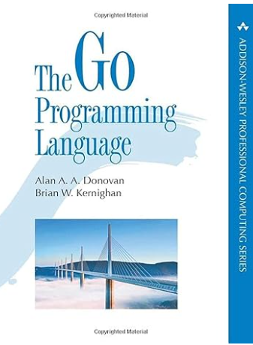
Go Programming Language

Slide 6
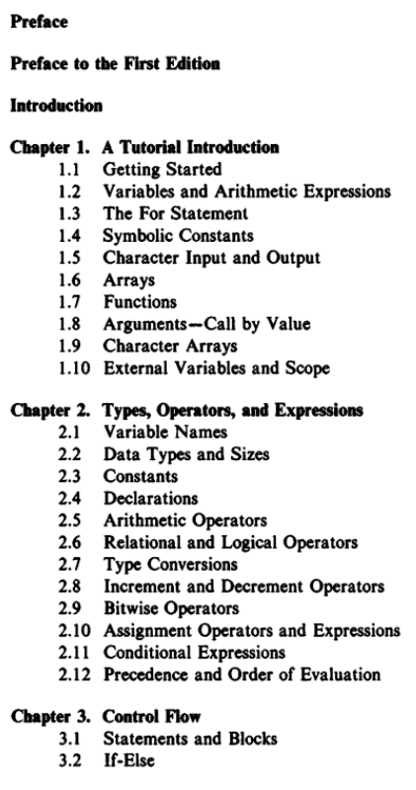
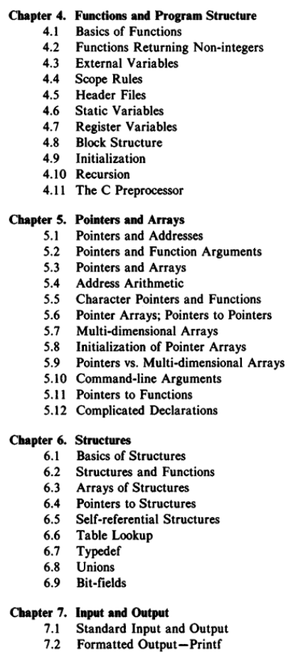
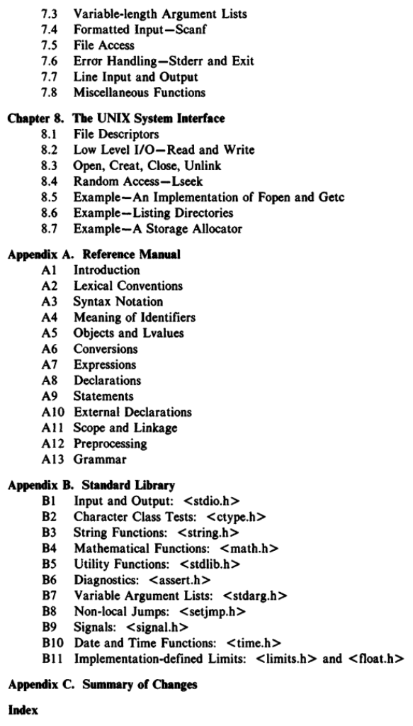
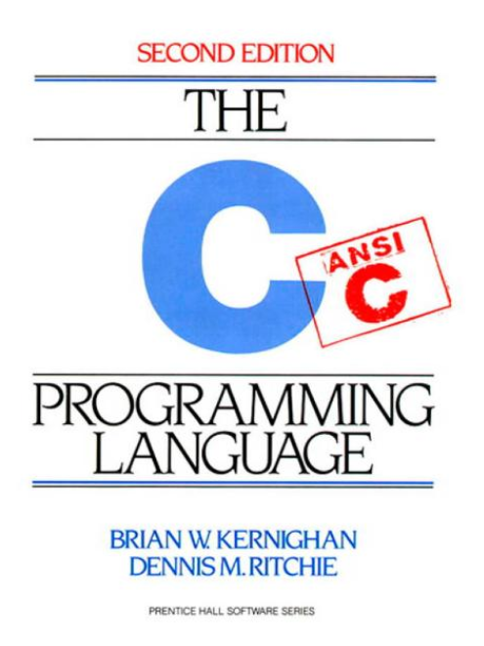
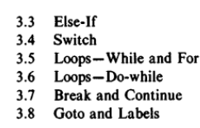
C Programming Language

Slide 7




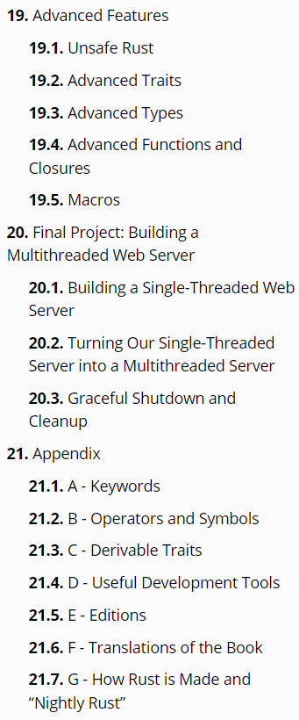
https://doc.rust-lang.org/book/

