Slide 1
RDM_HW Rotation Update
20201125
Jon Mah
Lohmueller Lab

Slide 2
Logistics
Have a nice Thanksgiving!

Slide 3
Project Aim
Detect Recessive Deleterious Mutations (RDM) via departures from Hardy-Weinberg (HW)
Signal is thought to be weak, but we can increase sample size using simulations
Statistical approach or method that aggregates across variants to gain power
Syn vs ns sites; low frequency ns sites; etc.
Determine sufficient sample size for detectable signal
If signal can be detected, determine appropriate test statistic
Use method on simulated data to compute statistical power
If of sufficient power, apply to real data
Notes:
To enrich for signal, we could look at methods to aggregate collections of variants
For example, a collection of variants could be Synonymous or Nonsynonymous sites
Could look at low-frequency nonsynonymous sites.

Slide 4
Game Plan
Start off with completely unrealistic case to isolate effect of RDM on HW.
Simulate aggregates of independent sites.
Simulations of varying sample sizes
Independence was achieved via zero-rate of recombination
Two alleles
Neutral allele
Recessive deleterious allele, dominance factor of 0.0, so purely recessive
Additive deleterious allele, dominance factor of 0.5, so additive
Use known allele frequencies (since it’s simulated)
Compute resulting genotype frequencies
Search for departures from HW.
Notes:
To have site-independence make many small genomes,
Lots of hundred bp fragments
S of -0.1 or -0.01 would be sufficient for lethal or deleterious

Slide 5
Implementation Details
1,000 individuals (hermaphroditic, diploid)
12,000 generation burn in
Random initial seed = {1, 2, 3} (rest can be derived)
Mutation rate = 1e-6
400 chromosomes
25 bp (uniform, recomb = 1e-8)
RDM has dominance of 0 and s of {0, -0.1, -0.01, -0.001}.
ADM has dominance of 0.5 and s of {0, -0.1, -0.01, -0.001}
Test on per-SNP basis
Chi-square test for departure from HW
Fisher’s exact test

Slide 6
Progress
Compute one-sided Fishers-test (<= x homozygotes)
Compute one-sided Fishers-test (>= x homozygotes)
This might help indicate departures from Hardy-Weinberg
Computed two-sided test
Find pr(X=x)
Sum all probabilities <= x, i.e., the more extreme cases.
Check edge cases by hand

Slide 7
Standing questions
Google Fisher’s Method of combined p-values
Generally, look into methods for combining p-values.
Sum of log of p-values should be chi^2 distributed
In the case where HW departure is small, the probability of identifying particular SNP’s is extremely low since method is underpowered.
Instead, given that we are underpowered, is there any evidence that the p-values in aggregate depart from expectation under the null.
Later on we can apply Bonferroni or Benjamini-Hochberg or some other method of controlling FDR, however, due to low power, our current primary concern is low sensitivity.

Slide 8
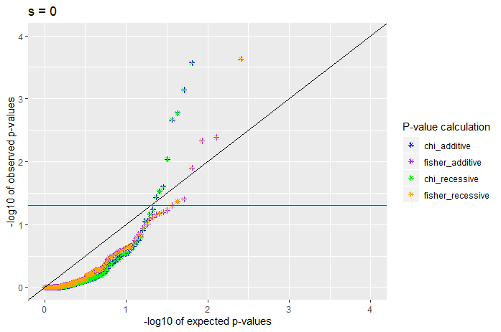
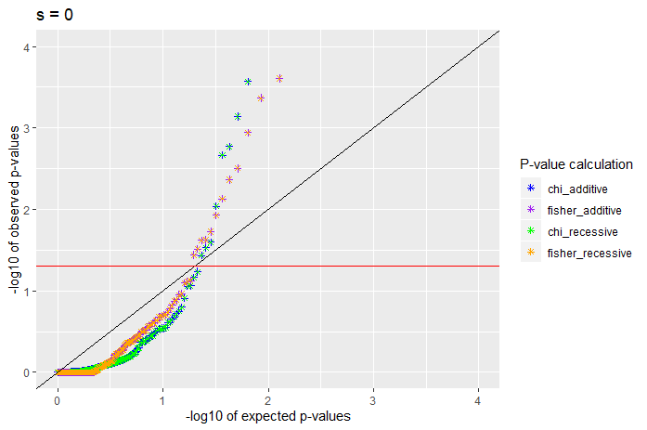
S = 0
One sided test (homozygotes <= X)
One sided test (homozygotes >= X)

Slide 9
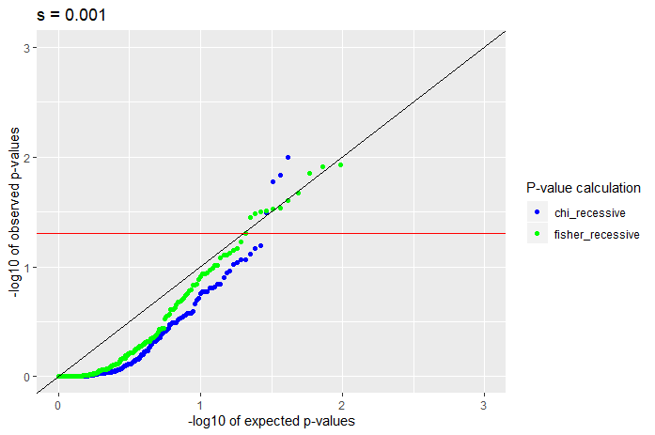
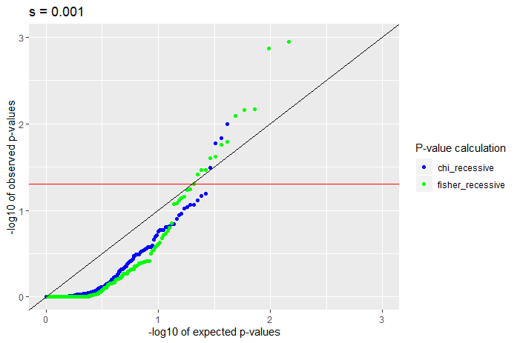
S = -0.001, recessive
One sided test (homozygotes <= X)
One sided test (homozygotes >= X)

Slide 10
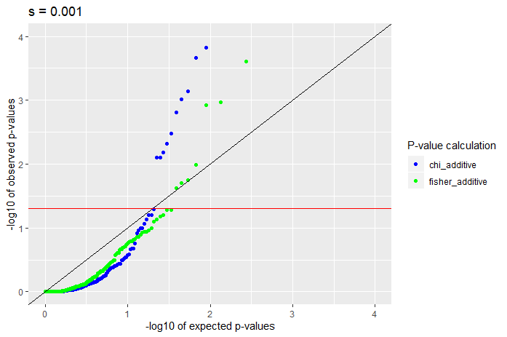
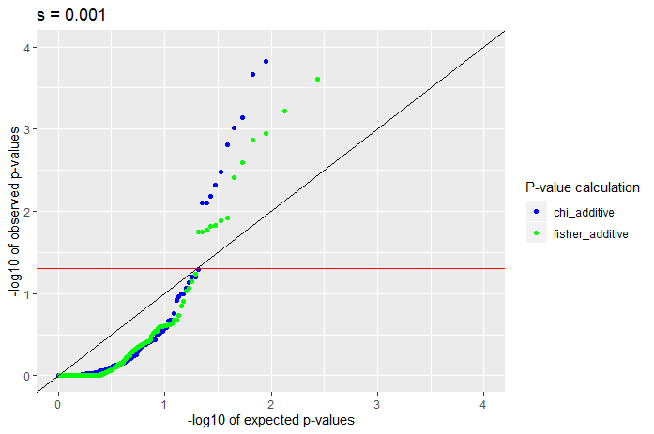
S = -0.001, additive
One sided test (homozygotes <= X)
One sided test (homozygotes >= X)

Slide 11
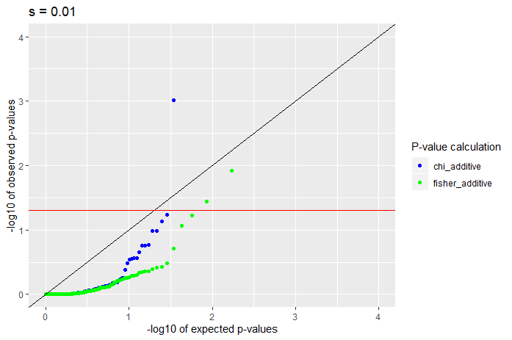
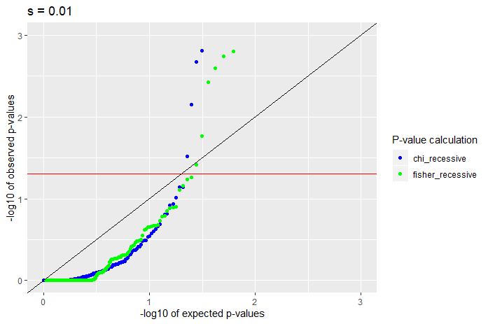
S = -0.01, recessive
One sided test (homozygotes <= X)
One sided test (homozygotes >= X)

Slide 12
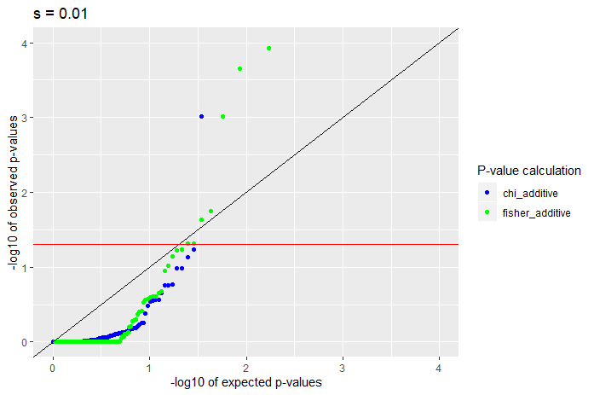
S = -0.01, additive
One sided test (homozygotes <= X)
One sided test (homozygotes >= X)

Slide 13
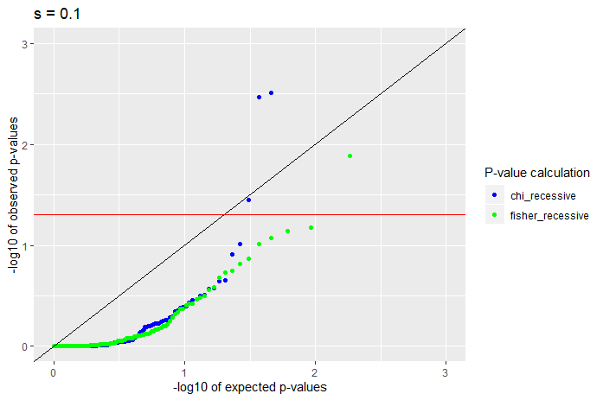
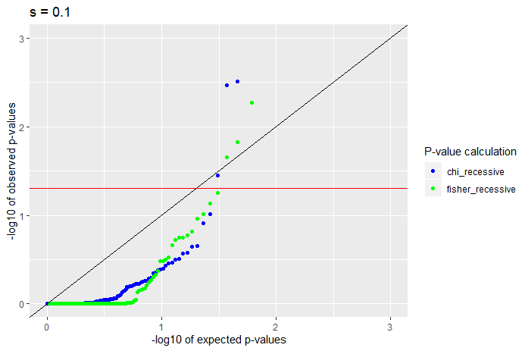
S = -0.1, recessive
One sided test (homozygotes <= X)
One sided test (homozygotes >= X)

Slide 14
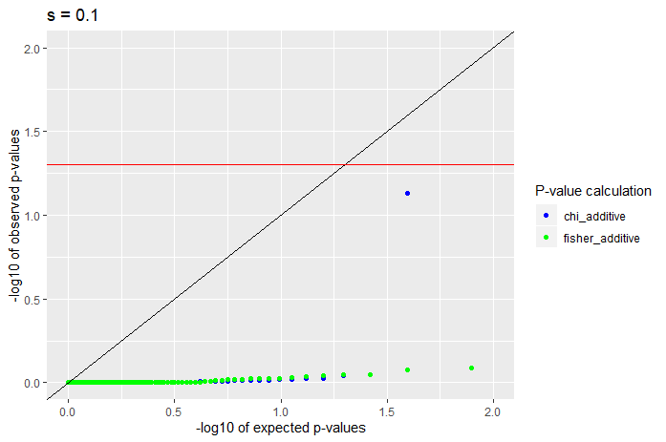
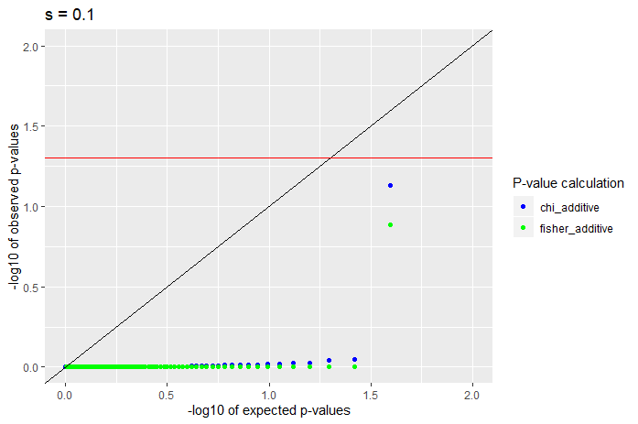
S = -0.1, additive
One sided test (homozygotes <= X)
One sided test (homozygotes >= X)

Slide 15
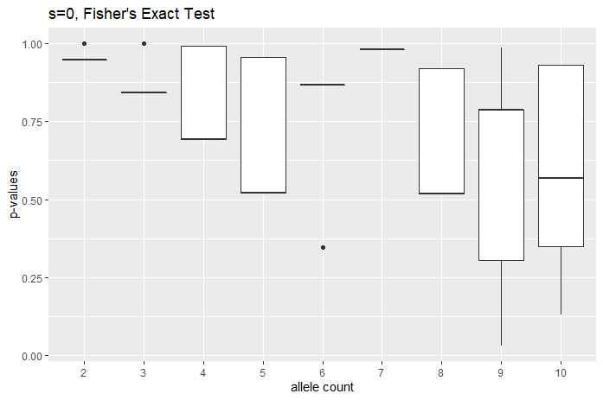
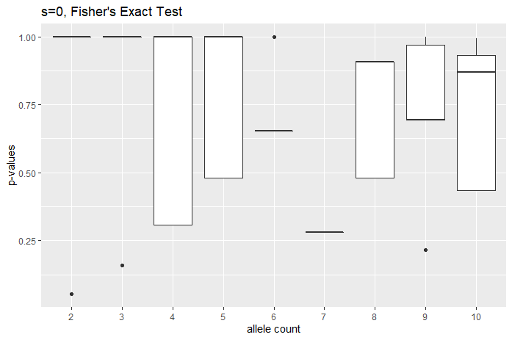
Boxplots (s = 0), Fishers
One sided test (homozygotes <= X)
One sided test (homozygotes >= X)

Slide 16
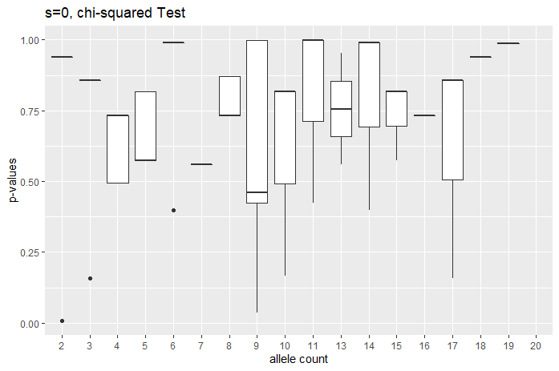
Boxplots (s = 0), chi
400 x 25b

Slide 17
s=0 (homozygotes >= X)
Recessive
Sample size | SNP count | Chi < 0.05 | Chi < 0.5 | Fisher < 0.05 | Fisher < 0.5 | Min chi | Min fisher
10 | 81 (114) | 0.024691 | 0.160494 | 0 | 0.234568 | 0.006738 | 0.052632
50 | 147 (184) | 0.020408 | 0.190476 | 0.027211 | 0.258503 | 2.10E-05 | 0.009892
100 | 174 (211) | 0.034483 | 0.143678 | 0.04023 | 0.201149 | 6.17E-06 | 0.000812
500 | 221 (258) | 0.0181 | 0.144796 | 0.027149 | 0.248869 | 0.002567 | 0.002426
1000 | 256 (292) | 0.042969 | 0.167969 | 0.050781 | 0.230469 | 3.21E-19 | 7.62E-11
Additive (identical to recessive since s = 0)
Sample size | SNP count | Chi < 0.05 | Chi < 0.5 | Fisher < 0.05 | Fisher < 0.5 | Min chi | Min fisher
10 | 81 (114) | 0.024691 | 0.160494 | 0 | 0.234568 | 0.006738 | 0.052632
50 | 147 (184) | 0.020408 | 0.190476 | 0.027211 | 0.258503 | 2.10E-05 | 0.009892
100 | 174 (211) | 0.034483 | 0.143678 | 0.04023 | 0.201149 | 6.17E-06 | 0.000812
500 | 221 (258) | 0.0181 | 0.144796 | 0.027149 | 0.248869 | 0.002567 | 0.002426
1000 | 256 (292) | 0.042969 | 0.167969 | 0.050781 | 0.230469 | 3.21E-19 | 7.62E-11

Slide 18
s=-0.001 (homozygotes >= X)
Recessive
Sample size | SNP count | Chi < 0.05 | Chi < 0.5 | Fisher < 0.05 | Fisher < 0.5 | Min chi | Min fisher
10 | 95 (110) | 0.010526 | 0.136842 | 0.010526 | 0.2 | 0.035186 | 0.04644
50 | 159 (175) | 0.037736 | 0.150943 | 0.031447 | 0.157233 | 2.10E-05 | 0.010704
100 | 196 (213) | 0.015306 | 0.112245 | 0.030612 | 0.163265 | 6.17E-06 | 0.005247
500 | 258 (276) | 0.031008 | 0.158915 | 0.027132 | 0.193798 | 5.25E-06 | 0.002353
1000 | 291 (308) | 0.034364 | 0.216495 | 0.04811 | 0.182131 | 1.67E-05 | 0.000938
Additive
Sample size | SNP count | Chi < 0.05 | Chi < 0.5 | Fisher < 0.05 | Fisher < 0.5 | Min chi | Min fisher
10 | 76 (88) | 0.013158 | 0.078947 | 0 | 0.092105 | 0.035186 | 0.157895
50 | 140 (151) | 0.05 | 0.171429 | 0.028571 | 0.242857 | 2.10E-05 | 0.030303
100 | 177 (188) | 0.016949 | 0.096045 | 0.028249 | 0.186441 | 6.17E-06 | 0.004624
500 | 239 (251) | 0.037657 | 0.16318 | 0.037657 | 0.209205 | 1.68E-12 | 0.002353
1000 | 271 (282) | 0.04428 | 0.177122 | 0.04797 | 0.195572 | 4.10E-11 | 0.000246

Slide 19
s=-0.01 (homozygotes >= X)
Recessive
Sample size | SNP count | Chi < 0.05 | Chi < 0.5 | Fisher < 0.05 | Fisher < 0.5 | Min chi | Min fisher
10 | 54 (54) | 0 | 0.074074 | 0 | 0.074074 | 0.39917 | 0.281734
50 | 119 (119) | 0.033613 | 0.12605 | 0.02521 | 0.176471 | 1.39E-11 | 0.010101
100 | 155 (155) | 0.032258 | 0.141935 | 0.025806 | 0.2 | 6.17E-06 | 0.015256
500 | 218 (218) | 0.027523 | 0.183486 | 0.027523 | 0.206422 | 0.000558 | 0.00634
1000 | 251 (251) | 0.043825 | 0.155378 | 0.035857 | 0.183267 | 4.48E-07 | 3.69E-05
Additive
Sample size | SNP count | Chi < 0.05 | Chi < 0.5 | Fisher < 0.05 | Fisher < 0.5 | Min chi | Min fisher
10 | 15 (15) | 0 | 0.066667 | 0 | 0.066667 | 0.157652 | 0.157895
50 | 53 (53) | 0.09434 | 0.150943 | 0.018868 | 0.150943 | 0.003215 | 0.020951
100 | 86 (86) | 0 | 0.046512 | 0 | 0.069767 | 0.116864 | 0.086149
500 | 145 (145) | 0.041379 | 0.089655 | 0.034483 | 0.137931 | 7.75E-18 | 0.002353
1000 | 173 (173) | 0.028902 | 0.109827 | 0.040462 | 0.138728 | 4.10E-11 | 0.000117

Slide 20
s=-0.1 (homozygotes >= X)
Recessive
Sample size | SNP count | Chi < 0.05 | Chi < 0.5 | Fisher < 0.05 | Fisher < 0.5 | Min chi | Min fisher
10 | 21 (21) | 0.047619 | 0.095238 | 0 | 0.095238 | 0.006738 | 0.052632
50 | 62 (62) | 0 | 0.096774 | 0 | 0.096774 | 0.120775 | 0.12606
100 | 88 (88) | 0.022727 | 0.079545 | 0.011364 | 0.125 | 0.007525 | 0.010293
500 | 153 (153) | 0.026144 | 0.098039 | 0.019608 | 0.137255 | 1.59E-05 | 0.003015
1000 | 185 (185) | 0.032432 | 0.118919 | 0.027027 | 0.118919 | 4.57E-09 | 0.00018
Additive
Sample size | SNP count | Chi < 0.05 | Chi < 0.5 | Fisher < 0.05 | Fisher < 0.5 | Min chi | Min fisher
10 | 1 (1) | 0 | 0 | 0 | 0 | 0.855808 | 1
50 | 5 (5) | 0 | 0 | 0 | 0 | 0.933091 | 1
100 | 13 (13) | 0 | 0 | 0 | 0 | 0.988472 | 1
500 | 54 (54) | 0.018519 | 0.018519 | 0.018519 | 0.018519 | 1.68E-12 | 0.01497
1000 | 79 (79) | 0.012658 | 0.025316 | 0.012658 | 0.025316 | 3.33E-07 | 0.005222

Slide 21
//TODO
Cases where n_ton > num_ind
Reverse the minor allele
Compute average number of homozygotes in data
Compare to expected number of homozygotes
Partition by n_ton count
Simulation with 5000 and 10000 individuals
Plot both one-sided cases
Plot two-sided cases
Bin p-values for boxplot

