Slide 1
RDM_HW Rotation Update
20201209
Jon Mah
Lohmueller Lab

Slide 2
Logistics
Are we meeting next week?

Slide 3
Project Aim
Detect Recessive Deleterious Mutations (RDM) via departures from Hardy-Weinberg (HW)
Signal is thought to be weak, but we can increase sample size using simulations
Statistical approach or method that aggregates across variants to gain power
Syn vs ns sites; low frequency ns sites; etc.
Determine sufficient sample size for detectable signal
If signal can be detected, determine appropriate test statistic
Use method on simulated data to compute statistical power
If of sufficient power, apply to real data
Notes:
To enrich for signal, we could look at methods to aggregate collections of variants
For example, a collection of variants could be Synonymous or Nonsynonymous sites
Could look at low-frequency nonsynonymous sites.

Slide 4
Game Plan
Start off with completely unrealistic case to isolate effect of RDM on HW.
Simulate aggregates of independent sites.
Simulations of varying sample sizes
Independence was achieved via zero-rate of recombination
Two alleles
Neutral allele
Recessive deleterious allele, dominance factor of 0.0, so purely recessive
Additive deleterious allele, dominance factor of 0.5, so additive
Use known allele frequencies (since it’s simulated)
Compute resulting genotype frequencies
Search for departures from HW.
Notes:
To have site-independence make many small genomes,
Lots of hundred bp fragments
S of -0.1 or -0.01 would be sufficient for lethal or deleterious

Slide 5
Implementation Details
10,000 individuals (hermaphroditic, diploid)
100,000 generation burn in
Random initial seed = {1} (rest can be derived)
Mutation rate = 1e-6
400 chromosomes
25 bp (uniform, recomb = 1e-8)
RDM has dominance of 0 and s of {0, -0.1, -0.01, -0.001}.
ADM has dominance of 0.5 and s of {0, -0.1, -0.01, -0.001}
Test on per-SNP basis
Chi-square test for departure from HW
Fisher’s exact test

Slide 6
Progress
Refactor analysis so it runs faster and can account for higher numbers
Some gains in runtime and feasible computation
Still doesn’t quite work for last round of simulations
[WIP] Read through Plink method / literature search
I am bad at C ☹
Plot out expected homozygotes over n-ton for different sample sizes
E.g., sample size of 100, plot expected homozygotes for n-ton = {1, 200}
Look into approximations for large sample sizes
P^2 * sample size vs expected number of homozygotes

Slide 7
It works for large sample sizes!

Slide 8
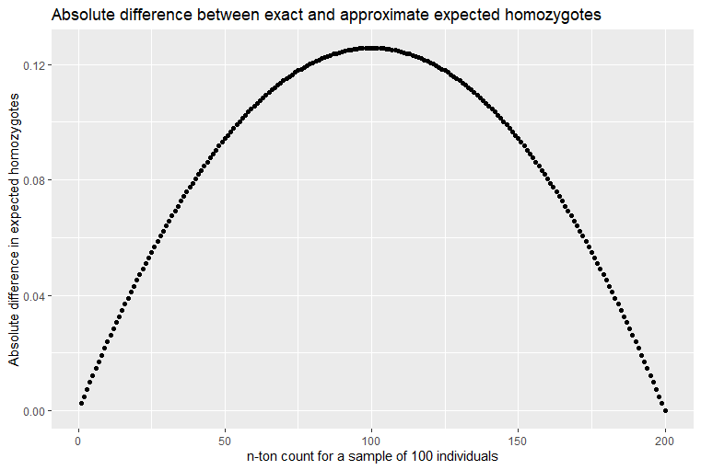
Exact vs. Approximate Expected Homozygotes
Diff is maximum for 101-ton
Max diff is 0.125628

Slide 9
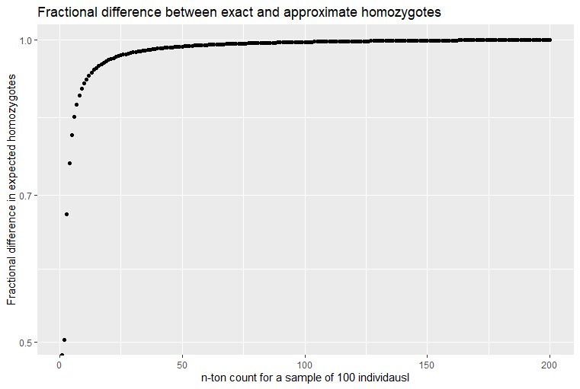
Exact vs. Approximate Expected Homozygotes
This is exact / approximate expected homozygotes
Very quickly converges to 1

Slide 10
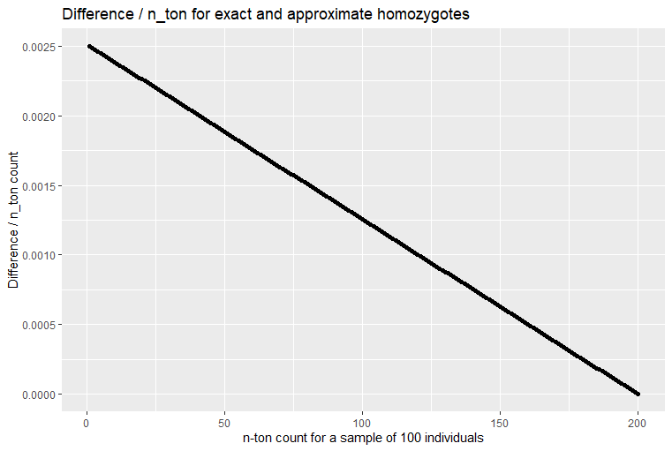
Difference / n-ton count
The percentage effect of the difference rapidly decays as the n-ton count increases.

Slide 11
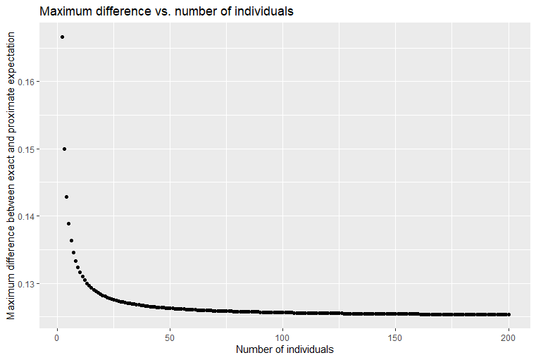
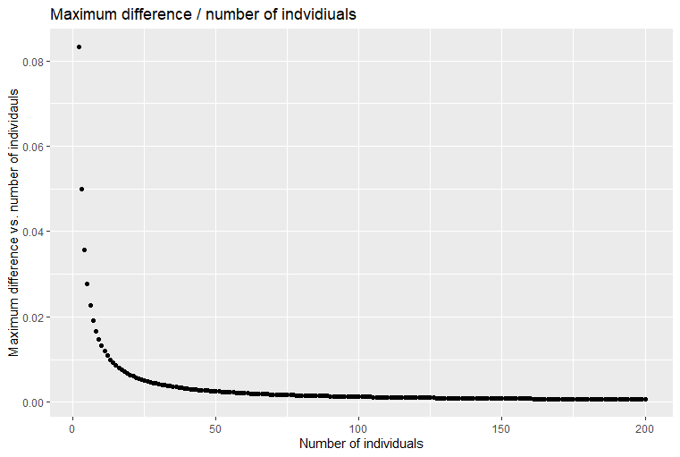
Maximum difference vs. number of individuals
Maximum difference plateaus at about 0.12
Not sure if asymptotic
Maximum difference / number of individuals decays rapidly.

Slide 12
Standing questions
Google Fisher’s Method of combined p-values
Generally, look into methods for combining p-values.
Sum of log of p-values should be chi^2 distributed
In the case where HW departure is small, the probability of identifying particular SNP’s is extremely low since method is underpowered.
Instead, given that we are underpowered, is there any evidence that the p-values in aggregate depart from expectation under the null.
Later on we can apply Bonferroni or Benjamini-Hochberg or some other method of controlling FDR, however, due to low power, our current primary concern is low sensitivity.

Slide 13
//TODO
Recreate slide 8 for sample size of 1000 and 10000
Only up to like 1000-tons (which we know works)
Future game plan is to use exact calculation up to a point
Then use approximation
Statistic: Frequency spectra of expected number of homozygotes by allele frequency
X-axis: n-ton count
Y-axis: observed number of homozygotes and expected number of homozygotes [using exact for small n-tons and approximation for large n-tons]
Compare with SLiM simulations.
Some kind of statistical test on distributions.
Come up with cool name for statistic
Backburner: keep reading through Plink2 / methods for exact test over large samples

