Slide 1
RDM_HW Rotation Update
20201111
Jon Mah
Lohmueller Lab

Slide 2
Logistics
N/A

Slide 3
Project Aim
Detect Recessive Deleterious Mutations (RDM) via departures from Hardy-Weinberg (HW)
Signal is thought to be weak, but we can increase sample size using simulations
Statistical approach or method that aggregates across variants to gain power
Syn vs ns sites; low frequency ns sites; etc.
Determine sufficient sample size for detectable signal
If signal can be detected, determine appropriate test statistic
Use method on simulated data to compute statistical power
If of sufficient power, apply to real data
Notes:
To enrich for signal, we could look at methods to aggregate collections of variants
For example, a collection of variants could be Synonymous or Nonsynonymous sites
Could look at low-frequency nonsynonymous sites.

Slide 4
Game Plan
Start off with completely unrealistic case to isolate effect of RDM on HW.
Simulate aggregates of independent sites.
Simulations of varying sample sizes
Independence was achieved via zero-rate of recombination
Two alleles
Neutral allele
Recessive deleterious allele, dominance factor of 0.0, so purely recessive
Additive deleterious allele, dominance factor of 0.5, so additive
Use known allele frequencies (since it’s simulated)
Compute resulting genotype frequencies
Search for departures from HW.
Notes:
To have site-independence make many small genomes,
Lots of hundred bp fragments
S of -0.1 or -0.01 would be sufficient for lethal or deleterious

Slide 5
Implementation Details
1,000 individuals (hermaphroditic, diploid)
12,000 generation burn in
Random initial seed = {1, 2, 3} (rest can be derived)
Mutation rate = 1e-6
400 chromosomes
25 bp (uniform, recomb = 1e-8)
RDM has dominance of 0 and s of {0, -0.1, -0.01, -0.001}.
ADM has dominance of 0.5 and s of {0, -0.1, -0.01, -0.001}
Test on per-SNP basis
Chi-square test for departure from HW
Fisher’s exact test
Notes:
Given that you have a doubleton, what proportion of the time do you have two heterozygotes or a homozygote
Use Fisher’s Exact Test

Slide 6
Progress
Compute expectation for almost any n-ton for given n
Exception case for when n-ton > number of individuals
Generate plots and tables w and w/o singletons, doubletons, etc.

Slide 7
Standing questions
Conditional on allele count, compute probability of homozygotes – see previous slide
Google Fisher’s Method of combined p-values
Generally, look into methods for combining p-values.
Sum of log of p-values should be chi^2 distributed
In the case where HW departure is small, the probability of identifying particular SNP’s is extremely low since method is underpowered.
Instead, given that we are underpowered, is there any evidence that the p-values in aggregate depart from expectation under the null.
Later on we can apply Bonferroni or Benjamini-Hochberg or some other method of controlling FDR, however, due to low power, our current primary concern is low sensitivity.

Slide 8
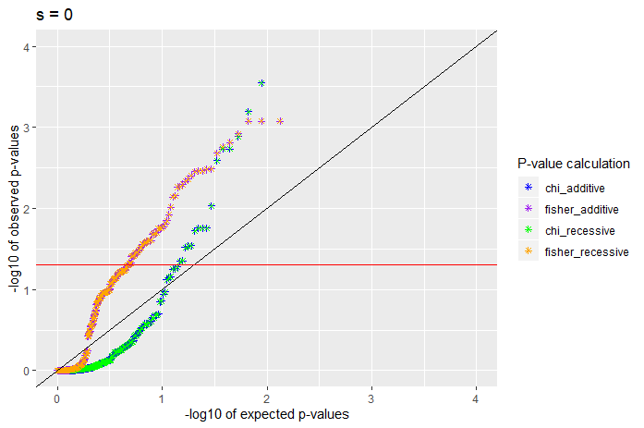
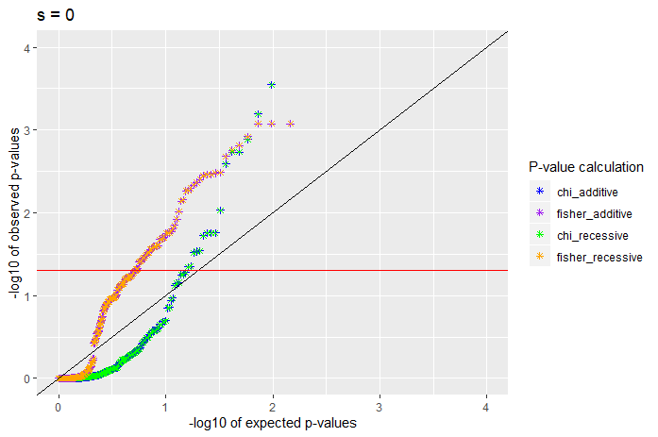
S = 0
Without singletons
With singletons

Slide 9
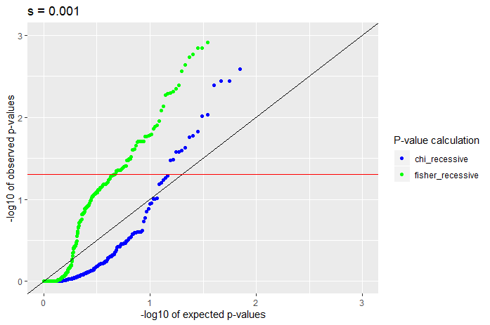
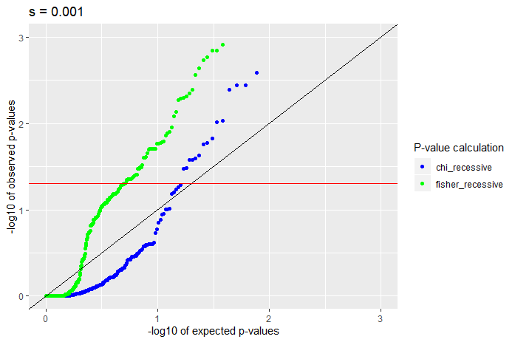
S = -0.001, recessive
Without singletons
With singletons

Slide 10
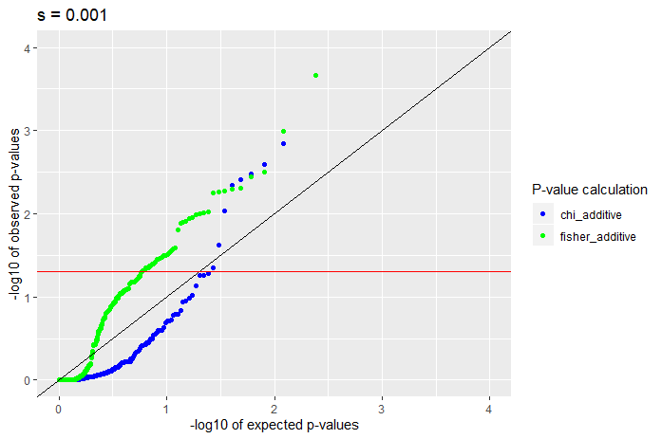
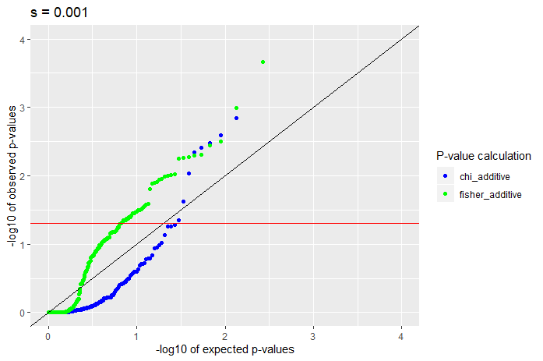
S = -0.001, additive
Without singletons
With singletons

Slide 11
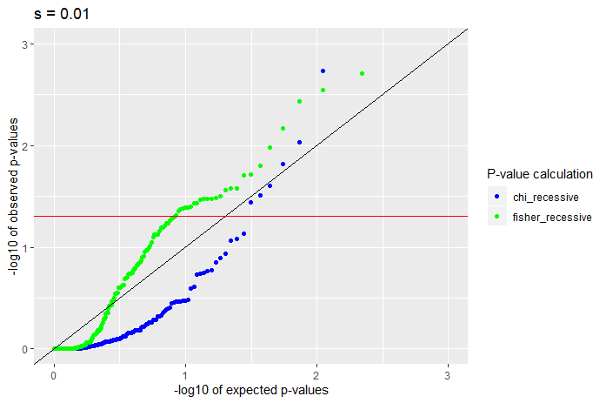
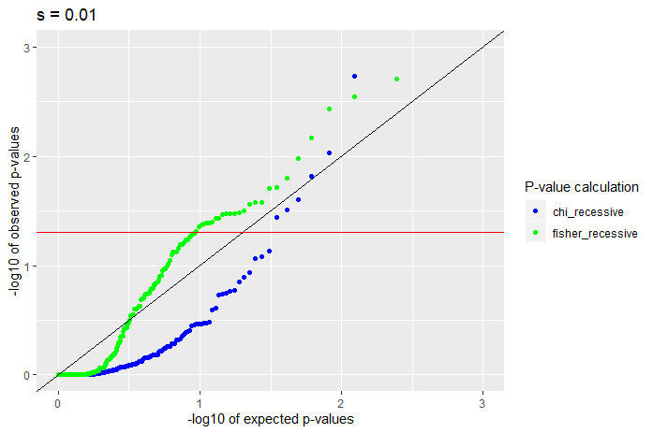
S = -0.01, recessive
Without singletons
With singletons

Slide 12
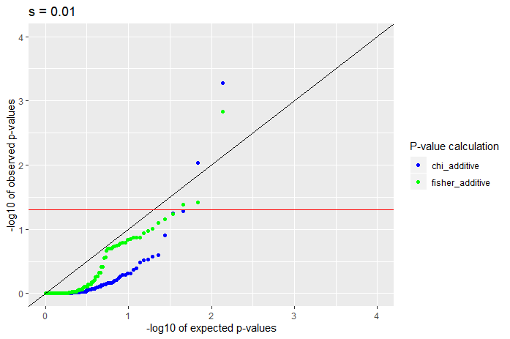
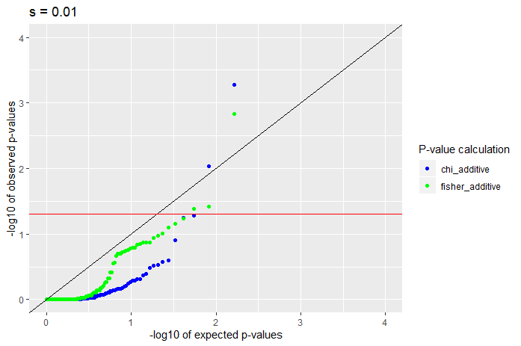
S = -0.01, additive
Without singletons
With singletons

Slide 13
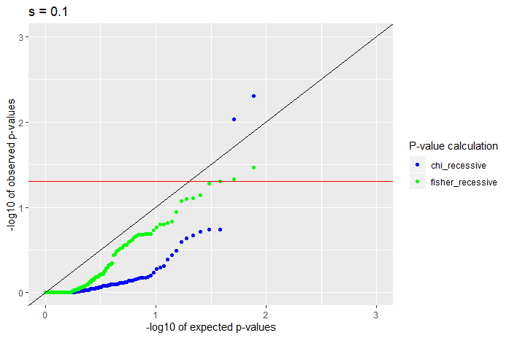
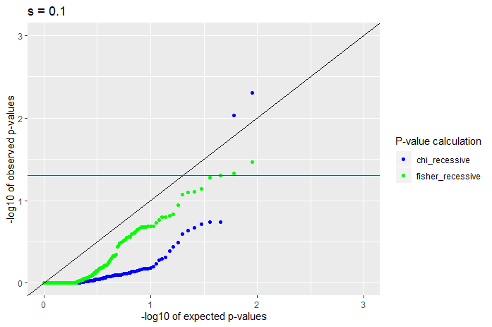
S = -0.1, recessive
Without singletons
With singletons

Slide 14
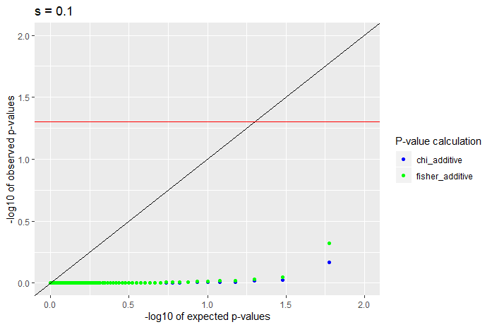
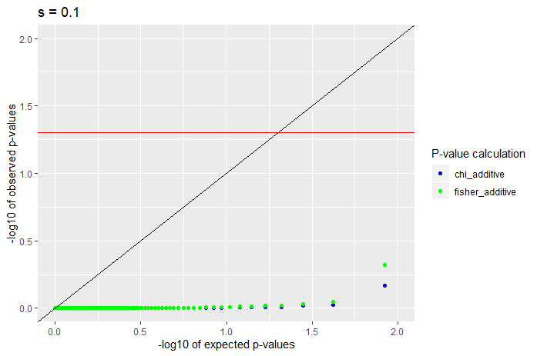
S = -0.1, additive
Without singletons
With singletons

Slide 15
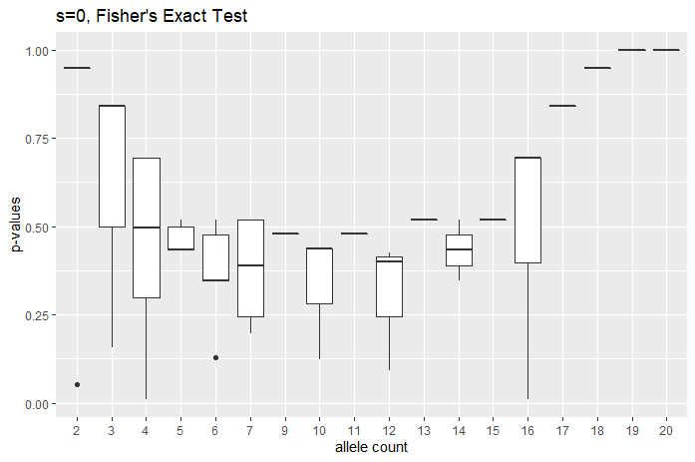
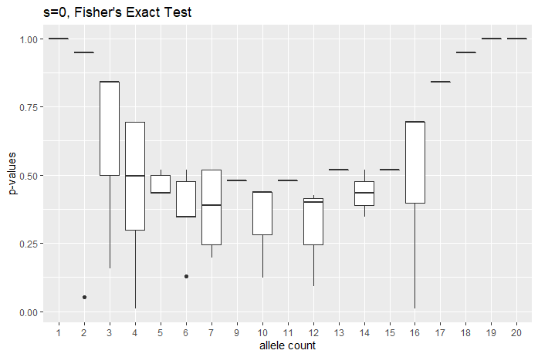
Boxplots (s = 0)
Without singletons
With singletons

Slide 16
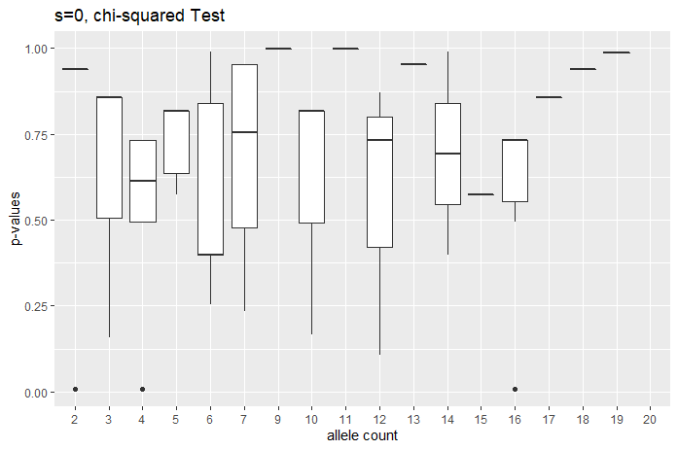
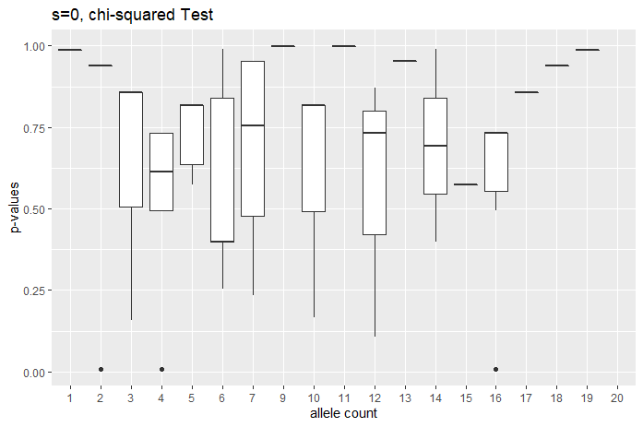
Boxplots (s = 0), chi
Without singletons
With singletons

Slide 17
s=0
Recessive
Sample size | SNP count | Chi < 0.05 | Chi < 0.5 | Fisher < 0.05 | Fisher < 0.5 | Min chi | Min fisher
10 | 85 | 0.047059 | 0.223529 | 0.035294 | 0.388235 | 0.0108368 | 0.009288
50 | 152 | 0.006579 | 0.164474 | 0.013158 | 0.519737 | 0.000698 | 0.010589
100 | 185 | 0.027027 | 0.145946 | 0.059459 | 0.518919 | 1.91E-14 | 0.000383
500 | 254 | 0.03937 | 0.228346 | 0.161417 | 0.492126 | 7.77E-49 | 0.0003
1000 | 266 | 0.067669 | 0.218045 | 0.206767 | 0.515038 | 1.03E-06 | 7.13E-06
Additive (identical to recessive since s = 0)
Sample size | SNP count | Chi < 0.05 | Chi < 0.5 | Fisher < 0.05 | Fisher < 0.5 | Min chi | Min fisher
10 | 85 | 0.047059 | 0.223529 | 0.035294 | 0.388235 | 0.0108368 | 0.009288
50 | 152 | 0.006579 | 0.164474 | 0.013158 | 0.519737 | 0.000698 | 0.010589
100 | 185 | 0.027027 | 0.145946 | 0.059459 | 0.518919 | 1.91E-14 | 0.000383
500 | 254 | 0.03937 | 0.228346 | 0.161417 | 0.492126 | 7.77E-49 | 0.0003
1000 | 266 | 0.067669 | 0.218045 | 0.206767 | 0.515038 | 1.03E-06 | 7.13E-06
Notes:
Chi squared test looks better behaved for expected proportion
For s = 0, look at genotype count of sample size of {500, 1000}
Consider doing 200 50 bp chromosomes, to reduce LD.
Look to see if low p-values are clustered together.

Slide 18
s=-0.001
Recessive
Sample size | SNP count | Chi < 0.05 | Chi < 0.5 | Fisher < 0.05 | Fisher < 0.5 | Min chi | Min fisher
10 | 96 | 0.020833 | 0.229167 | 0.010417 | 0.479167 | 0.006738 | 0.021672
50 | 169 | 0.029586 | 0.147929 | 0.029586 | 0.538462 | 0.003215 | 0.00378
100 | 200 | 0.005 | 0.16 | 0.045 | 0.505 | 0.028012 | 0.008617
500 | 254 | 0.051181 | 0.19685 | 0.129921 | 0.53937 | 4.42E-06 | 0.000245
1000 | 280 | 0.064286 | 0.232143 | 0.210714 | 0.535714 | 2.69E-11 | 3.45E-05
Additive
Sample size | SNP count | Chi < 0.05 | Chi < 0.5 | Fisher < 0.05 | Fisher < 0.5 | Min chi | Min fisher
10 | 60 | 0.016667 | 0.233333 | 0 | 0.383333 | 0.006738 | 0.052632
50 | 135 | 0.02963 | 0.140741 | 0.037037 | 0.466667 | 0.003215 | 0.029177
100 | 163 | 0.018405 | 0.134969 | 0.030675 | 0.435583 | 0.007525 | 0.012903
500 | 217 | 0.050691 | 0.235023 | 0.115207 | 0.497696 | 0.002983 | 0.000675
1000 | 242 | 0.03719 | 0.194215 | 0.169421 | 0.491736 | 3.33E-07 | 0.000215

Slide 19
s=-0.01
Recessive
Sample size | SNP count | Chi < 0.05 | Chi < 0.5 | Fisher < 0.05 | Fisher < 0.5 | Min chi | Min fisher
10 | 42 | 0 | 0.095238 | 0 | 0.119048 | 0.157652 | 0.157895
50 | 102 | 0.009804 | 0.098039 | 0 | 0.284314 | 0.033596 | 0.050961
100 | 133 | 0.015038 | 0.082707 | 0.007519 | 0.338346 | 0.007525 | 0.045154
500 | 193 | 0.036269 | 0.11399 | 0.067358 | 0.398964 | 2.80E-09 | 0.005541
1000 | 221 | 0.031674 | 0.162896 | 0.117647 | 0.40724 | 3.83E-18 | 0.001976
Additive
Sample size | SNP count | Chi < 0.05 | Chi < 0.5 | Fisher < 0.05 | Fisher < 0.5 | Min chi | Min fisher
10 | 8 | 0 | 0.125 | 0 | 0.125 | 0.157652 | 0.157895
50 | 38 | 0.026316 | 0.078947 | 0 | 0.157895 | 0.033596 | 0.097886
100 | 66 | 0 | 0.030303 | 0 | 0.090909 | 0.178732 | 0.162112
500 | 114 | 0.008772 | 0.061404 | 0.008772 | 0.22807 | 0.006152 | 0.041919
1000 | 137 | 0.014599 | 0.10219 | 0.021898 | 0.226277 | 0.000534 | 0.001482

Slide 20
s=-0.1
Recessive
Sample size | SNP count | Chi < 0.05 | Chi < 0.5 | Fisher < 0.05 | Fisher < 0.5 | Min chi | Min fisher
10 | 14 | 0 | 0 | 0 | 0 | 0.573753 | 0.520124
50 | 55 | 0.054545 | 0.072727 | 0 | 0.109091 | 0.003215 | 0.059981
100 | 85 | 0.023529 | 0.047059 | 0.011765 | 0.117647 | 0.001129 | 0.014853
500 | 131 | 0.030534 | 0.10687 | 0.015267 | 0.267176 | 0.008288 | 0.030722
1000 | 153 | 0.019608 | 0.084967 | 0.026144 | 0.267974 | 1.96E-11 | 0.000102
Additive
Sample size | SNP count | Chi < 0.05 | Chi < 0.5 | Fisher < 0.05 | Fisher < 0.5 | Min chi | Min fisher
10 | 0 | 0 | 0 | 0 | 0 | n/a | n/a
50 | 3 | 0 | 0 | 0 | 0 | 0.989642 | 0.989899
100 | 8 | 0 | 0 | 0 | 0 | 0.988472 | 0.984925
500 | 42 | 0 | 0 | 0 | 0 | 0.800118 | 0.658382
1000 | 60 | 0 | 0 | 0 | 0.016667 | 0.680444 | 0.479382

Slide 21
//TODO
Pull out genotype counts
For a given SNP with p at tail-end
Get genotype counts and compute HWE departure by hand
Chi squared test looks better behaved for expected proportion
For s = 0, look at genotype count of sample size of {500, 1000}
Consider doing 200 50 bp chromosomes, to reduce LD.
Or in general investigate looking to decrease effect of LD.
Change recombination to 1e-8.
Look to see if low p-values are clustered together.
Keep tables
Try different seed?

