Slide 1
RDM_HW Rotation Update
20201028
Jon Mah
Lohmueller Lab

Slide 2
Logistics
Let’s not meet next week (Election day)

Slide 3
Progress
Make qq-plot of p-values
Make qq-plot comparing n SNP’s with
Y-axis is vector of –log (p-values) sorted in ascending order of p-value
X-axis is expectation under null. E.g., -log(uniform distribution of p from 0 to 1), except partitions are based on number of SNPs
Histograms (technically boxplots) of p-values
Dependence of p-value on frequency, e.g., doubletons, tripletons, etc.
Compute number of heterozygotes / homozygotes, given allele count

Slide 4
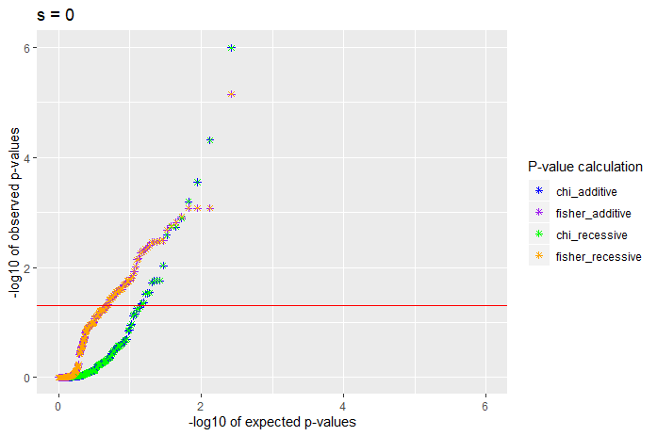
QQ-plots of p-values
Notes:
Add diagonal to qq plot
Add tables with singletons removed
Proportion below 0.05 and 0.5
Histogram of p-values
Qqplots, histograms, tables with/without singletons

Slide 5
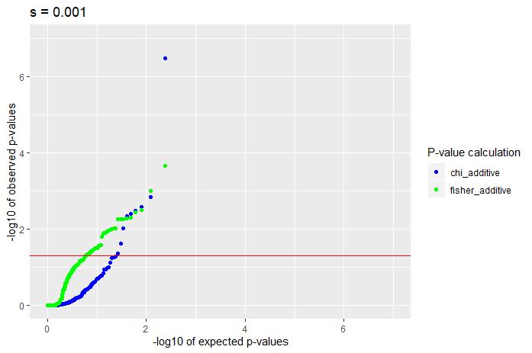
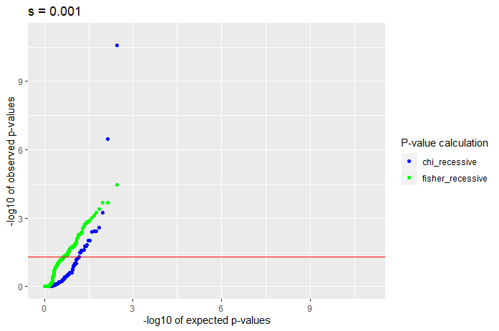
QQ-plots of p-values
Notes:
Re add tables back in

Slide 6
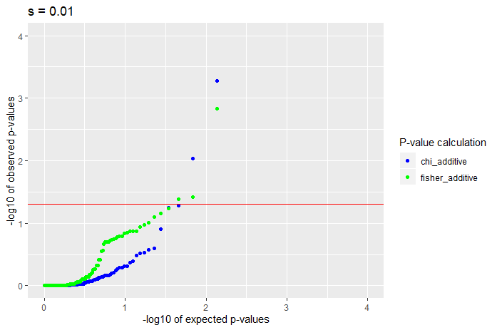
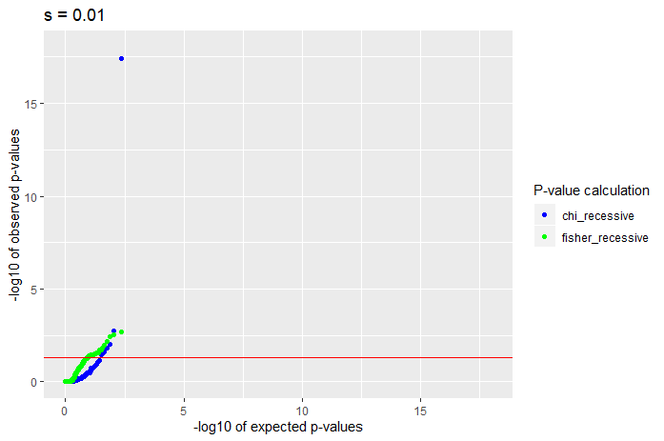
QQ-plots of p-values

Slide 7
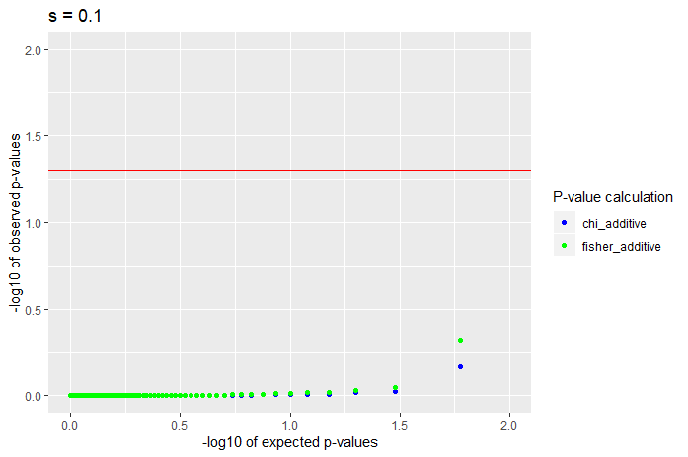
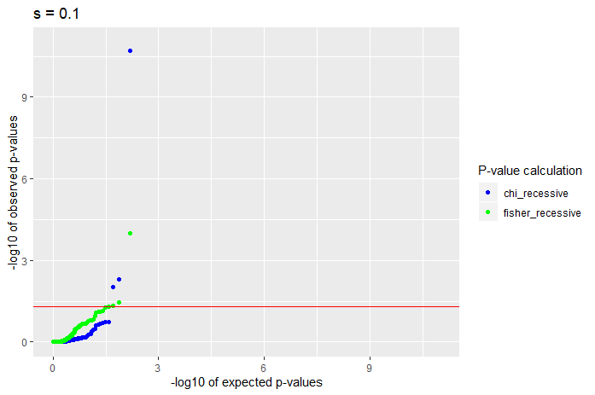
QQ-plots of p-values

Slide 8
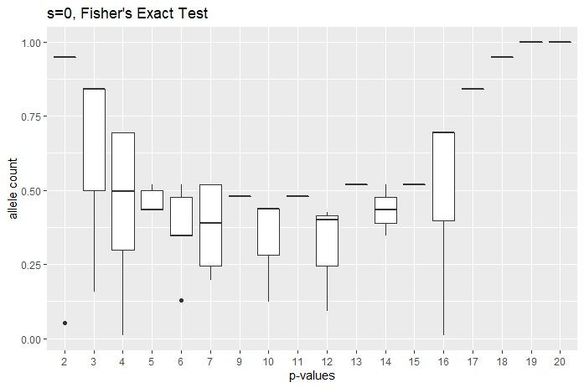
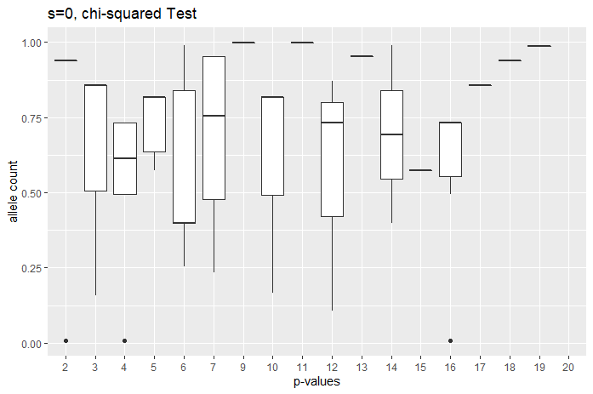
Notes:
Swap axis labels
Consider binning allele counts together, 2-tons through 5 tons, etc.

Slide 9
//TODO
Pull out genotype counts
For a given SNP with p at tail-end
Get genotype counts and compute HWE departure by hand
From exact test, look into computing probability that we see
Find proportion of doubletons that are two heterozygotes vs. one homozygote
Same case for triple tons ({Aa, Aa, Aa} vs {Aa, aa})
Same case for 4-tons ({Aa, Aa, Aa, Aa} vs {aa, aa} vs {Aa, Aa, aa})
Same case for 5-tons (etc.)
Notes:
Start with theory component

Slide 10
Suppose doubleton
n_a = 2, n_A = n - 2
Suppose tripleton
n_a = 3, n_A = n - 3
Suppose four-ton
n_a = 4, n_A = n - 4
Plug in genotype counts, give n
n_AA = n - 2 n_Aa = 2 n_aa = 0
n_AA = n - 1
N_Aa = 0
n_aa = 1
Plug in genotype counts, give n
n_AA = n - 3 n_Aa = 3 n_aa = 0
n_AA = n - 2
N_Aa = 1
n_aa = 1
Plug in genotype counts, give n
n_AA = n - 4 n_Aa = 4 n_aa = 0
n_AA = n - 3
N_Aa = 2
n_aa = 1
N_AA = n - 2
N_Aa = 0
N_aa = 2
Notes:
Etc.

Slide 11
Standing questions
Conditional on allele count, compute probability of homozygotes – see previous slide
Google Fisher’s Method of combined p-values
Generally, look into methods for combining p-values.
Sum of log of p-values should be chi^2 distributed
In the case where HW departure is small, the probability of identifying particular SNP’s is extremely low since method is underpowered.
Instead, given that we are underpowered, is there any evidence that the p-values in aggregate depart from expectation under the null.
Later on we can apply Bonferroni or Benjamini-Hochberg or some other method of controlling FDR, however, due to low power, our current primary concern is low sensitivity.

