Slide 1
RDM_HW Rotation Update
20201109
Jon Mah
Lohmueller Lab Meeting

Slide 2
Logistics
Welcome Dr. Cavassim!

Slide 3
Project Aim
Detect Recessive Deleterious Mutations (RDM) via departures from Hardy-Weinberg (HW)
Signal is thought to be weak, but we can increase sample size using simulations
Statistical approach or method that aggregates across variants to gain power
Syn vs ns sites; low frequency ns sites; etc.
Determine sufficient sample size for detectable signal
If signal can be detected, determine appropriate test statistic
Use method on simulated data to compute statistical power
If of sufficient power, apply to real data
Notes:
To enrich for signal, we could look at methods to aggregate collections of variants
For example, a collection of variants could be Synonymous or Nonsynonymous sites
Could look at low-frequency nonsynonymous sites.

Slide 4
Game Plan
Start off with completely unrealistic case to isolate effect of RDM on HW.
Simulate aggregates of independent sites.
Simulations of varying sample sizes
Independence was achieved via zero-rate of recombination
Two alleles
Neutral allele
Recessive deleterious allele, dominance factor of 0.0, so purely recessive
Additive deleterious allele, dominance factor of 0.5, so additive
Use known allele frequencies (since it’s simulated)
Compute resulting genotype frequencies
Search for departures from HW.
Notes:
To have site-independence make many small genomes,
Lots of hundred bp fragments
S of -0.1 or -0.01 would be sufficient for lethal or deleterious

Slide 5
Implementation Details
1,000 individuals (hermaphroditic, diploid)
12,000 generation burn in
Random initial seed = 1 (rest can be derived)
100 bp (uniform, no recombination)
RDM has dominance of 0 and s of {0, -0.1, -0.01, -0.001}.
ADM has dominance of 0.5 and s of {0, -0.1, -0.01, -0.001}
On per-SNP basis
Chi-square test for departure from HW
Fisher’s exact test
Notes:
Given that you have a doubleton, what proportion of the time do you have two heterozygotes or a homozygote
Use Fisher’s Exact Test

Slide 6
Progress
Compute expectation for doubletons, tripletons, 4-tons, etc. given some n
Generate plots and tables w and w/o singletons, doubletons, etc.
Mink data for covid stuff 😱😱😱

Slide 7
Suppose doubleton
n_a = 2, n_A = 2n - 2
Suppose tripleton
n_a = 3, n_A = 2n - 3
Suppose four-ton
n_a = 4, n_A = 2n - 4
Plug in genotype counts, give n
n_AA = n - 2 n_Aa = 2 n_aa = 0
n_AA = n - 1
N_Aa = 0
n_aa = 1
Plug in genotype counts, give n
n_AA = n - 3 n_Aa = 3 n_aa = 0
n_AA = n - 2
N_Aa = 1
n_aa = 1
Plug in genotype counts, give n
n_AA = n - 4 n_Aa = 4 n_aa = 0
n_AA = n - 3
N_Aa = 2
n_aa = 1
N_AA = n - 2
N_Aa = 0
N_aa = 2
Notes:
Etc.

Slide 8
Suppose fiveton
n_a = 5, n_A = 2n - 5
Suppose sixton
n_a = 6, n_A = 2n - 6
Suppose seventon
n_a = 7, n_A = 2n - 7
Plug in genotype counts, give n
n_AA = n - 7 n_Aa = 7 n_aa = 0
n_AA = n - 6
n_Aa = 5
n_aa = 1
n_AA = n - 5
n_Aa = 3
n_aa = 2
Plug in genotype counts, give n
n_AA = n - 5 n_Aa = 5 n_aa = 0
n_AA = n - 4
N_Aa = 3
n_aa = 1
n_AA = n – 3
n_Aa = 1
n_aa = 2
Plug in genotype counts, give n
n_AA = n - 6 n_Aa = 6 n_aa = 0
n_AA = n - 5
n_Aa = 4
n_aa = 1
n_AA = n - 4
n_Aa = 2
n_aa = 2
n_AA = n - 4 n_Aa = 1 n_aa = 3
n_AA = n - 3 n_Aa = 0 n_aa = 3
Notes:
Etc.

Slide 9
Suppose eightton
n_a = 8, n_A = 2n - 8
Suppose nineton
n_a = 9, n_A = 2n - 9
Suppose tenton
n_a = 10, n_A = 2n - 10
Plug in genotype counts, give n
n_AA = n - 10 n_Aa = 10 n_aa = 0
n_AA = n - 9
n_Aa = 8
n_aa = 1
n_AA = n - 8
n_Aa = 7
n_aa = 2
Plug in genotype counts, give n
n_AA = n - 8 n_Aa = 8 n_aa = 0
n_AA = n - 7
N_Aa = 6
n_aa = 1
n_AA = n – 6
n_Aa = 4
n_aa = 2
n_AA = n - 7 n_Aa = 4 n_aa = 3
n_AA = n - 6 n_Aa = 2 n_aa = 4
n_AA = n - 5 n_Aa = 0 n_aa = 5
n_AA = n - 5 n_Aa = 2 n_aa = 3
n_AA = n - 4
N_Aa = 0
n_aa = 4
Plug in genotype counts, give n
n_AA = n - 9 n_Aa = 9 n_aa = 0
n_AA = n - 8
n_Aa = 7
n_aa = 1
n_AA = n - 7
n_Aa = 5
n_aa = 2
n_AA = n - 6 n_Aa = 3 n_aa = 3
n_AA = n - 5 n_Aa = 1 n_aa = 4
Notes:
Etc.

Slide 10
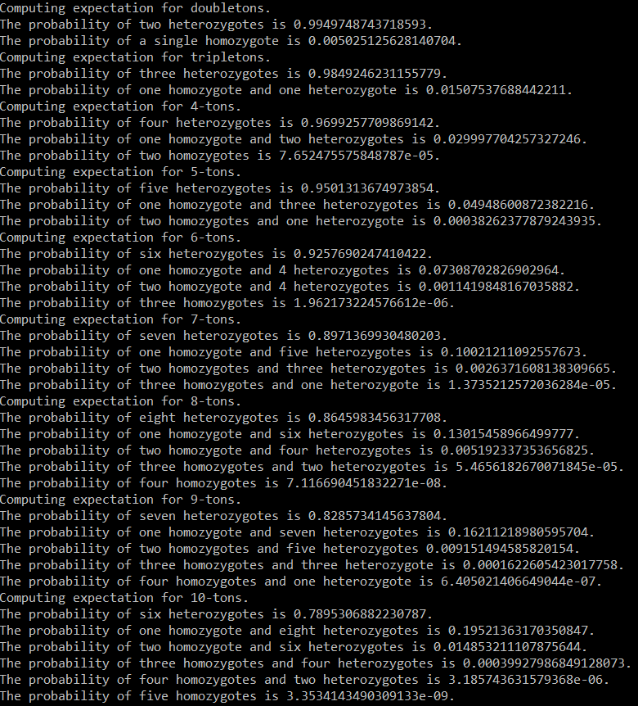
Expectation results (n = 10)
[AA, Aa, aa] | Pr under HW
[n-2, 2, 0] | 0.9949748
[n-1, 0, 1] | 0.005025
[n-3, 3, 0] | 0.984924623
[n-2, 1, 1] | 0.01507537
[n-4, 4, 0] | 0.9699257709
[n-3, 2, 1] | 0.029997704
[n-2, 0, 2] | 7.6524755e-5
[n-5, 5, 0] | 0.9501313
[n-4, 3, 1] | 0.04948600
[n-3, 1, 2] | 0.0003826237
[n-6, 6, 0] | 0.9257690247
[n-5, 4, 1] | 0.0730870
Etc. | Etc.

Slide 11
Standing questions
Conditional on allele count, compute probability of homozygotes – see previous slide
Google Fisher’s Method of combined p-values
Generally, look into methods for combining p-values.
Sum of log of p-values should be chi^2 distributed
In the case where HW departure is small, the probability of identifying particular SNP’s is extremely low since method is underpowered.
Instead, given that we are underpowered, is there any evidence that the p-values in aggregate depart from expectation under the null.
Later on we can apply Bonferroni or Benjamini-Hochberg or some other method of controlling FDR, however, due to low power, our current primary concern is low sensitivity.

Slide 12
//TODO
Pull out genotype counts
For a given SNP with p at tail-end
Get genotype counts and compute HWE departure by hand
Expectation given n and allele frequency class
Notes:
Start with theory component

