Slide 1
RDM_HW Rotation Update
20201118
Jon Mah
Lohmueller Lab

Slide 2
Logistics
N/A

Slide 3
Project Aim
Detect Recessive Deleterious Mutations (RDM) via departures from Hardy-Weinberg (HW)
Signal is thought to be weak, but we can increase sample size using simulations
Statistical approach or method that aggregates across variants to gain power
Syn vs ns sites; low frequency ns sites; etc.
Determine sufficient sample size for detectable signal
If signal can be detected, determine appropriate test statistic
Use method on simulated data to compute statistical power
If of sufficient power, apply to real data
Notes:
To enrich for signal, we could look at methods to aggregate collections of variants
For example, a collection of variants could be Synonymous or Nonsynonymous sites
Could look at low-frequency nonsynonymous sites.

Slide 4
Game Plan
Start off with completely unrealistic case to isolate effect of RDM on HW.
Simulate aggregates of independent sites.
Simulations of varying sample sizes
Independence was achieved via zero-rate of recombination
Two alleles
Neutral allele
Recessive deleterious allele, dominance factor of 0.0, so purely recessive
Additive deleterious allele, dominance factor of 0.5, so additive
Use known allele frequencies (since it’s simulated)
Compute resulting genotype frequencies
Search for departures from HW.
Notes:
To have site-independence make many small genomes,
Lots of hundred bp fragments
S of -0.1 or -0.01 would be sufficient for lethal or deleterious

Slide 5
Implementation Details
1,000 individuals (hermaphroditic, diploid)
12,000 generation burn in
Random initial seed = {1, 2, 3} (rest can be derived)
Mutation rate = 1e-6
400 chromosomes
25 bp (uniform, recomb = 1e-8)
RDM has dominance of 0 and s of {0, -0.1, -0.01, -0.001}.
ADM has dominance of 0.5 and s of {0, -0.1, -0.01, -0.001}
Test on per-SNP basis
Chi-square test for departure from HW
Fisher’s exact test
Notes:
Given that you have a doubleton, what proportion of the time do you have two heterozygotes or a homozygote
Use Fisher’s Exact Test

Slide 6
Progress
Check if p-values are “clustered” {s=0, sample=1000}
Sort of …
Check low p-value calc by hand
Reduce potential effect of LD.
Increase chromosome count
Non-zero recombination rate
Redid simulations

Slide 7
low (fisher) p-value calcs by hand (old data)
Min p-value = 7.130864453311901e-06 for {s=0, n=1000, chrom=72}
868 0|0 homozygotes
115 heterozygotes
54 1|0 heterozygotes
61 0|1 heterozygotes
17 1|1 homozygotes
1000 individuals total,
149-ton
The probability of [868, 115, 17] is: 7.130864453311901e-06
Notes:
Sum up p-values for more extreme cases, i.e., fewer homozygotes
One-sided (fewer homozygotes)
One-sided (more homozygotes)
Two-sided (every more extreme case, i.e., lower p-value)

Slide 8
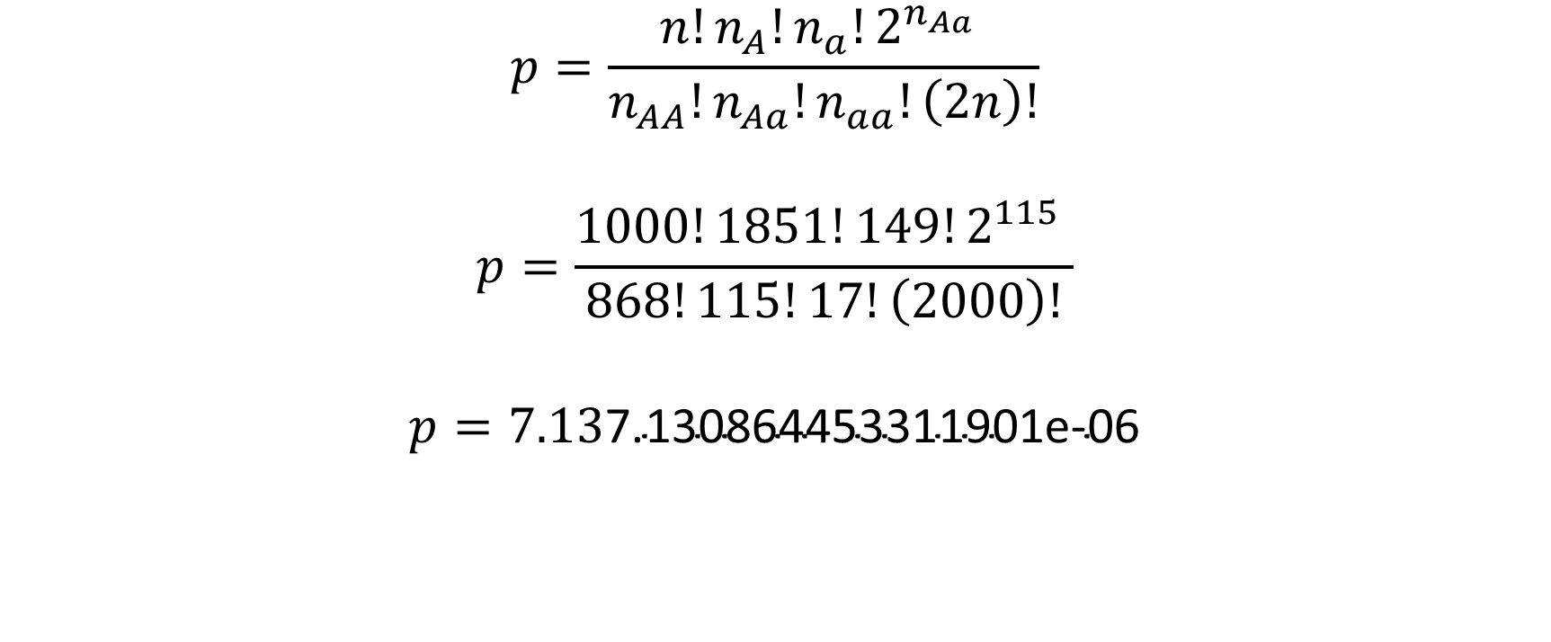
low (fisher) p-value calcs by hand
$$p=\frac{n!n_{A}!n_{a}!2^{n_{Aa}} }{n_{AA}!n_{Aa}!n_{aa}!\left(2n\right)!}$$
$$p=\frac{1000!1851!149!2^{115} }{868!115!17!\left(2000\right)!}$$
$$p=7.13\text{7.1308644533119}\text{01}\text{e}\text{−06}$$

Slide 9
Standing questions
Google Fisher’s Method of combined p-values
Generally, look into methods for combining p-values.
Sum of log of p-values should be chi^2 distributed
In the case where HW departure is small, the probability of identifying particular SNP’s is extremely low since method is underpowered.
Instead, given that we are underpowered, is there any evidence that the p-values in aggregate depart from expectation under the null.
Later on we can apply Bonferroni or Benjamini-Hochberg or some other method of controlling FDR, however, due to low power, our current primary concern is low sensitivity.

Slide 10
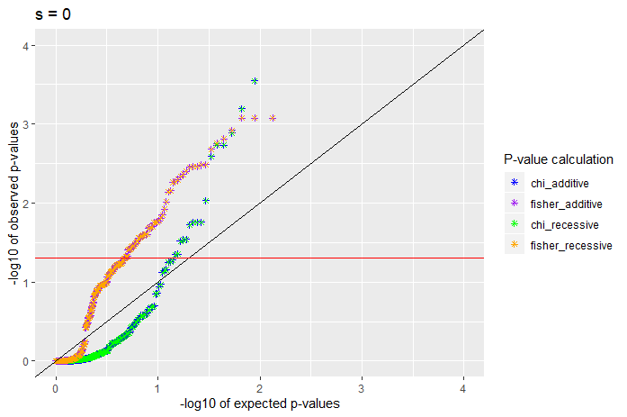
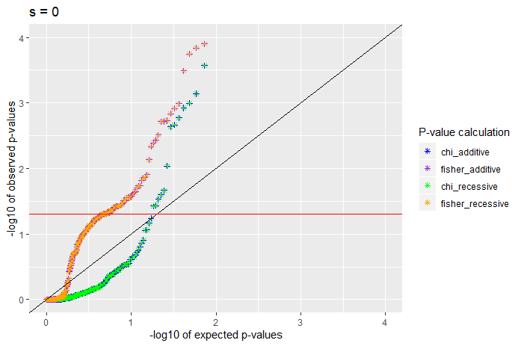
S = 0
100 x 100b
400 x 25b

Slide 11
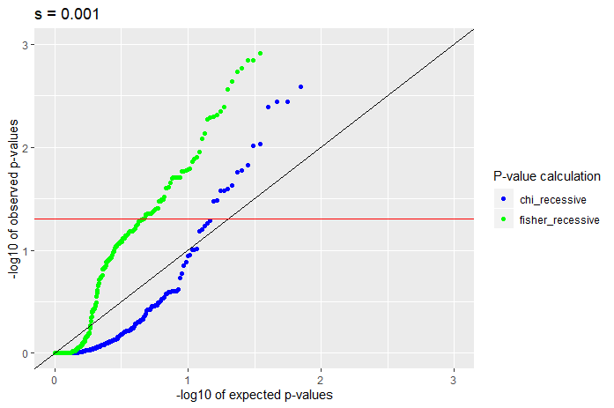
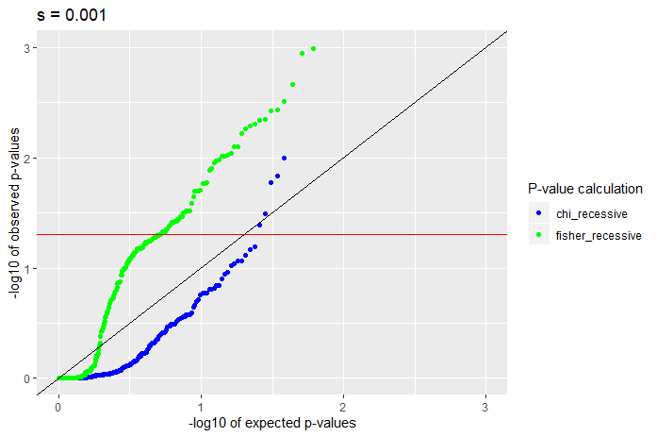
S = -0.001, recessive
100 x 100b
400 x 25b

Slide 12
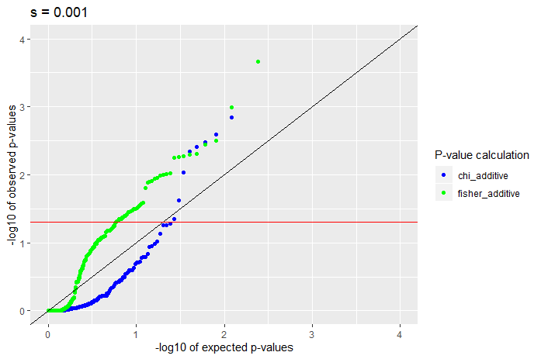
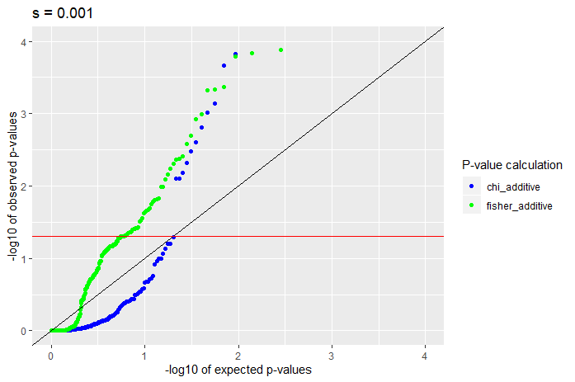
S = -0.001, additive
100 x 100b
400 x 25b

Slide 13
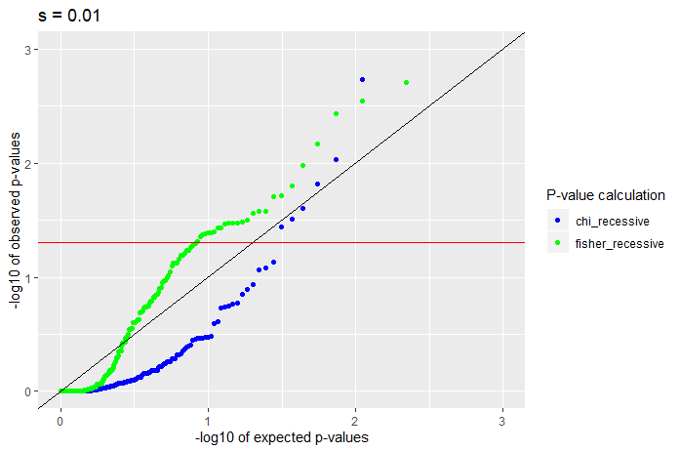
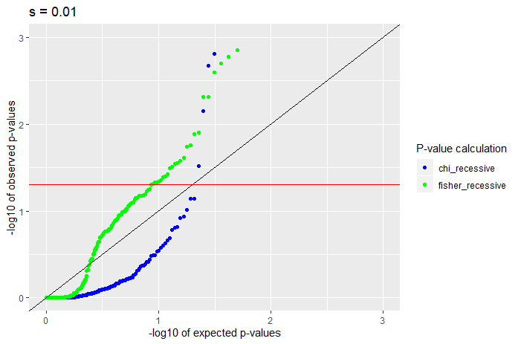
S = -0.01, recessive
100 x 100b
400 x 25b

Slide 14
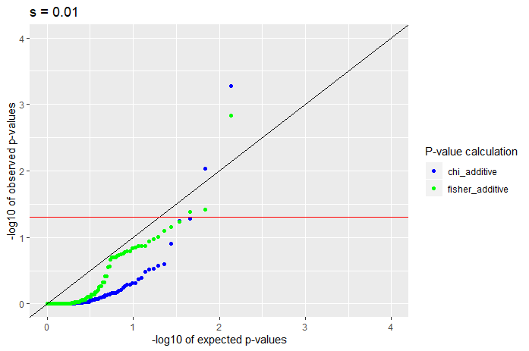
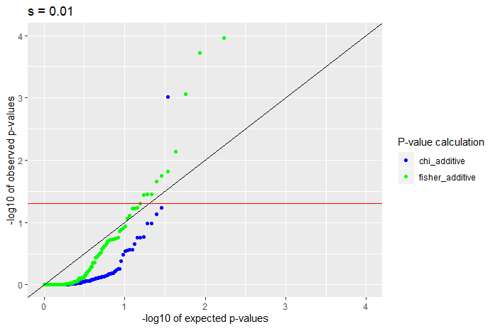
S = -0.01, additive
100 x 100b
400 x 25b

Slide 15
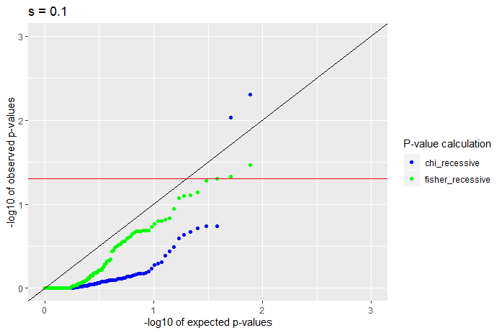
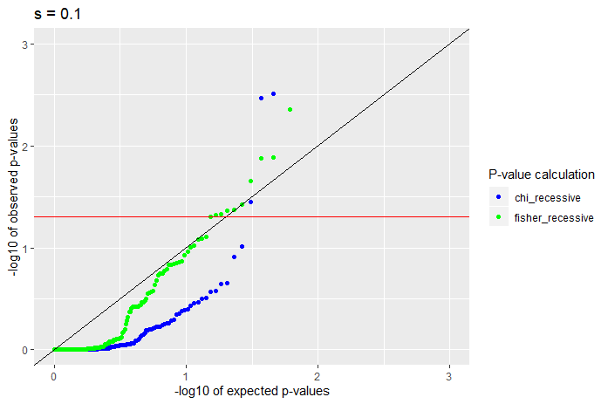
S = -0.1, recessive
100 x 100b
400 x 25b

Slide 16
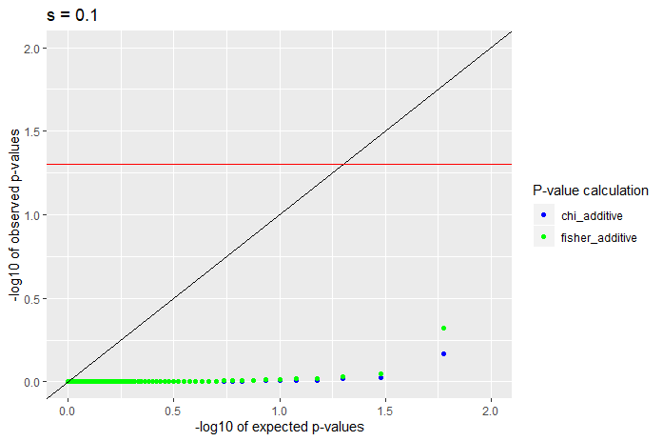
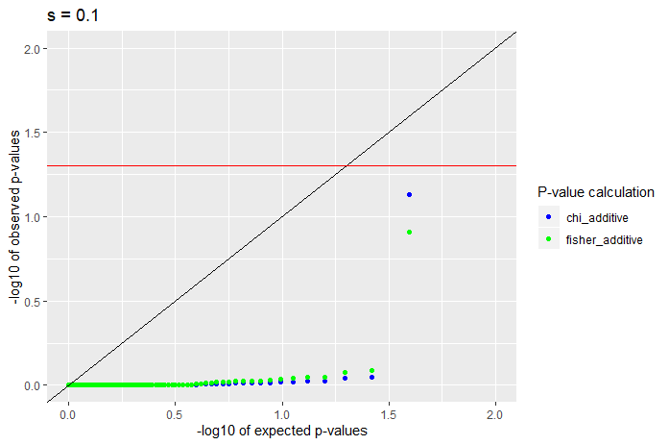
S = -0.1, additive
100 x 100b
400 x 25b

Slide 17
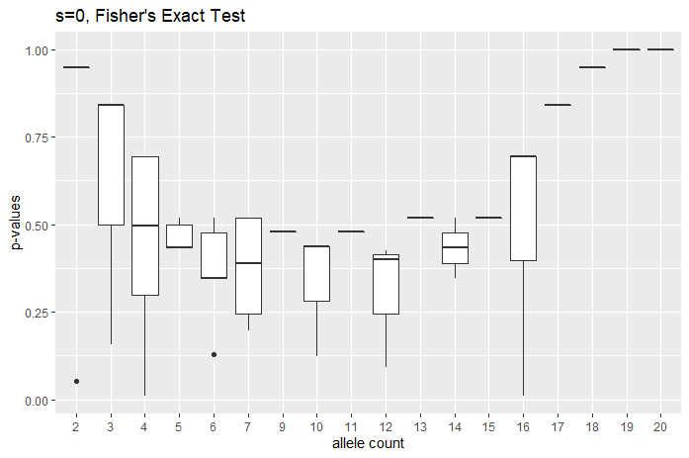
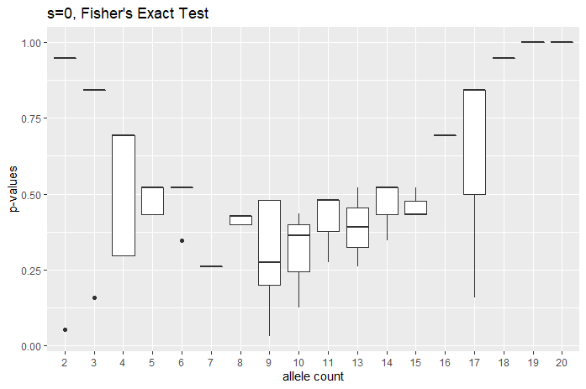
Boxplots (s = 0), Fishers
100 x 100b
400 x 25b

Slide 18
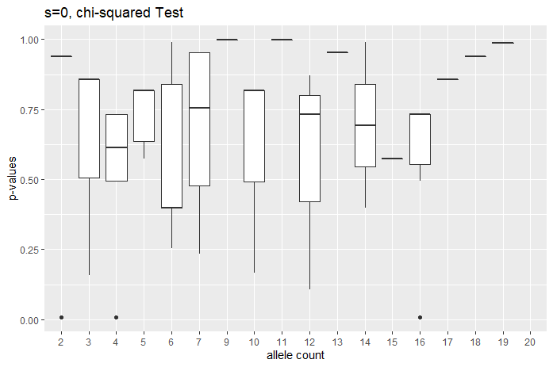
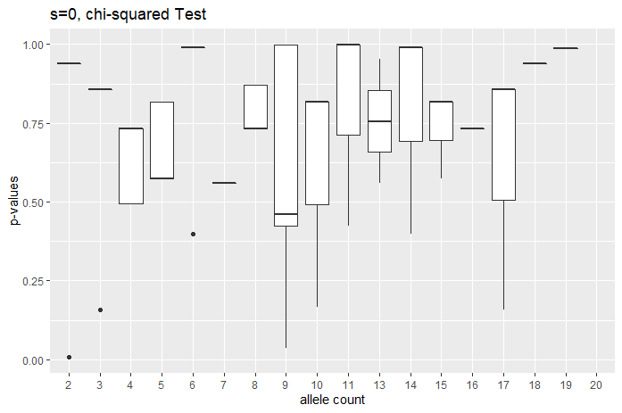
Boxplots (s = 0), chi
100 x 100b
400 x 25b

Slide 19
s=0
Recessive
Sample size | SNP count | Chi < 0.05 | Chi < 0.5 | Fisher < 0.05 | Fisher < 0.5 | Min chi | Min fisher
10 | 114 | 0.017544 | 0.140351 | 0.008772 | 0.342105 | 0.006738 | 0.030483
50 | 184 | 0.016304 | 0.206522 | 0.048913 | 0.527174 | 2.10E-05 | 0.008151
100 | 211 | 0.028436 | 0.14218 | 0.061611 | 0.563981 | 6.17E-06 | 0.000787
500 | 258 | 0.023256 | 0.170543 | 0.143411 | 0.596899 | 0.002567 | 0.000298
1000 | 292 | 0.054795 | 0.191781 | 0.215753 | 0.547945 | 3.21E-19 | 7.10E-11
Additive (identical to recessive since s = 0)
Sample size | SNP count | Chi < 0.05 | Chi < 0.5 | Fisher < 0.05 | Fisher < 0.5 | Min chi | Min fisher
10 | 114 | 0.017544 | 0.140351 | 0.008772 | 0.342105 | 0.006738 | 0.030483
50 | 184 | 0.016304 | 0.206522 | 0.048913 | 0.527174 | 2.10E-05 | 0.008151
100 | 211 | 0.028436 | 0.14218 | 0.061611 | 0.563981 | 6.17E-06 | 0.000787
500 | 258 | 0.023256 | 0.170543 | 0.143411 | 0.596899 | 0.002567 | 0.000298
1000 | 292 | 0.054795 | 0.191781 | 0.215753 | 0.547945 | 3.21E-19 | 7.10E-11
Notes:
Chi squared test looks better behaved for expected proportion
For s = 0, look at genotype count of sample size of {500, 1000}
Consider doing 200 50 bp chromosomes, to reduce LD.
Look to see if low p-values are clustered together.

Slide 20
s=-0.001
Recessive
Sample size | SNP count | Chi < 0.05 | Chi < 0.5 | Fisher < 0.05 | Fisher < 0.5 | Min chi | Min fisher
10 | 110 | 0.009091 | 0.163636 | 0.018182 | 0.363636 | 0.035186 | 0.030483
50 | 175 | 0.034286 | 0.165714 | 0.04 | 0.565714 | 2.10E-05 | 0.00421
100 | 213 | 0.014085 | 0.117371 | 0.075117 | 0.511737 | 6.17E-06 | 0.005192
500 | 276 | 0.032609 | 0.177536 | 0.144928 | 0.518116 | 5.25E-06 | 5.88E-06
1000 | 308 | 0.038961 | 0.224026 | 0.194805 | 0.512987 | 1.66E-05 | 8.44E-07
Additive
Sample size | SNP count | Chi < 0.05 | Chi < 0.5 | Fisher < 0.05 | Fisher < 0.5 | Min chi | Min fisher
10 | 88 | 0.011364 | 0.068182 | 0.011364 | 0.193182 | 0.035186 | 0.030483
50 | 151 | 0.046358 | 0.15894 | 0.02649 | 0.523179 | 2.10E-05 | 0.027867
100 | 188 | 0.015957 | 0.101064 | 0.031915 | 0.452128 | 6.17E-06 | 0.003994
500 | 251 | 0.035857 | 0.163347 | 0.115538 | 0.486056 | 1.68E-12 | 0.001624
1000 | 282 | 0.046099 | 0.187943 | 0.177305 | 0.48227 | 4.10E-11 | 0.000131

Slide 21
s=-0.01
Recessive
Sample size | SNP count | Chi < 0.05 | Chi < 0.5 | Fisher < 0.05 | Fisher < 0.5 | Min chi | Min fisher
10 | 54 | 0 | 0.074074 | 0 | 0.111111 | 0.39917 | 0.260062
50 | 119 | 0.033613 | 0.12605 | 0.02521 | 0.361345 | 1.39E-11 | 0.010101
100 | 155 | 0.032258 | 0.141935 | 0.025806 | 0.406452 | 6.17E-06 | 0.014853
500 | 218 | 0.027523 | 0.183486 | 0.077982 | 0.422018 | 0.000558 | 0.004714
1000 | 251 | 0.043825 | 0.155378 | 0.115538 | 0.434263 | 4.48E-07 | 2.62E-05
Additive
Sample size | SNP count | Chi < 0.05 | Chi < 0.5 | Fisher < 0.05 | Fisher < 0.5 | Min chi | Min fisher
10 | 15 | 0 | 0.066667 | 0 | 0.066667 | 0.157652 | 0.157895
50 | 53 | 0.09434 | 0.150943 | 0.018868 | 0.207547 | 0.003215 | 0.020494
100 | 86 | 0 | 0.046512 | 0.011628 | 0.093023 | 0.116864 | 0.041908
500 | 145 | 0.041379 | 0.089655 | 0.041379 | 0.227586 | 7.75E-18 | 0.00225
1000 | 173 | 0.028902 | 0.109827 | 0.063584 | 0.248555 | 4.10E-11 | 0.00011

Slide 22
s=-0.1
Recessive
Sample size | SNP count | Chi < 0.05 | Chi < 0.5 | Fisher < 0.05 | Fisher < 0.5 | Min chi | Min fisher
10 | 21 | 0.047619 | 0.095238 | 0 | 0.095238 | 0.006738 | 0.052632
50 | 62 | 0 | 0.096774 | 0 | 0.145161 | 0.120775 | 0.105131
100 | 88 | 0.022727 | 0.079545 | 0.011364 | 0.159091 | 0.007525 | 0.009375
500 | 153 | 0.026144 | 0.098039 | 0.019608 | 0.248366 | 1.59E-05 | 0.002867
1000 | 185 | 0.032432 | 0.118919 | 0.064865 | 0.275676 | 4.57E-09 | 0.000168
Additive
Sample size | SNP count | Chi < 0.05 | Chi < 0.5 | Fisher < 0.05 | Fisher < 0.5 | Min chi | Min fisher
10 | 1 | 0 | 0 | 0 | 0 | 0.855808 | 0.842105
50 | 5 | 0 | 0 | 0 | 0 | 0.933091 | 0.900552
100 | 13 | 0 | 0 | 0 | 0 | 0.988472 | 0.984925
500 | 54 | 0.018519 | 0.018519 | 0.018519 | 0.018519 | 1.68E-12 | 0.014925
1000 | 79 | 0.012658 | 0.025316 | 0.012658 | 0.025316 | 3.33E-07 | 0.005088

Slide 23
//TODO
Try different seed
Compute one-sided t-test (<= x homozygotes)
Compute one-sided t-test (>= x homozygotes)
Computed two-sided test
Find pr(X=x)
Sum all probabilities <= x, i.e., the more extreme cases.
Bin p-values for boxplot

