Slide 1
A
B
C
One-epoch
Two-epoch
Three-epoch
Constant effective
population size
One instantaneous size change
Two instantaneous size changes
Time
Effective Population Size
A
B
C
One-epoch
Two-epoch
Three-epoch
Time
Constant effective
population size
One instantaneous size change
Two instantaneous size changes
Notes:
Now that we have evidence that North American gut microbiomes have depleted genetic diversity relative to African gut microbiomes, likely due to differences in diet, environment, and a host of other factors which can broadly be grouped together as “urbanization”, we proceeded with inferring the demographic models, which allow us to infer parameters such as the time since the last major demographic event and the magnitude of any change in population size. Here, we used four different demographic models, with cartoons (explain cartoons).

Slide 2
Two-epoch
Three-epoch
Ancestral
Time
Current
Ancestral
Time
Current
One instantaneous size change
Two instantaneous size changes

Slide 3
T₂
T₂
T₃
T₃
T₄
T₄
T₅
T₅
T₆
T₇

Slide 4
Three-epoch
Two-epoch
Ancestral
T₂
Time
T₃
Current
T₄
T₅
Ancestral
T₂
Time
T₃
Current
T₄
T₅
Two size
changes
One size
change
T₆
T₇
Ancient contraction,
Recent expansion
Ancient contraction vs. Recent expansion
Two-epoch inference

Slide 5
Three-epoch
Two-epoch
Ancestral
T₂
Time
T₃
Current
T₄
Ancestral
T₂
Time
T₃
Current
T₄
T₅
Two size
changes
One size
change
T₆
T₇
Ancient contraction,
Recent expansion
Ancient contraction vs. Recent expansion
Two-epoch inference

Slide 6
One-epoch
Two-epoch
Three-epoch
Time
Constant effective
population size
One instantaneous size change
Two instantaneous size changes

Slide 7
Ground Truth
Ancestral
Three-epoch
10 Diploids
Time
20 Diploids
Current
…
800 Diploids
Simple Two-epoch Inference

Slide 8
(a)
(b)
(c)
Ground Truth
Computed SFS
Simple Two-epoch Inference
Ancestral
Three-epoch
10 Diploids
Ancestral
Time
20 Diploids
Time
Bottleneck
…
Current
800 Diploids
Current

Slide 9
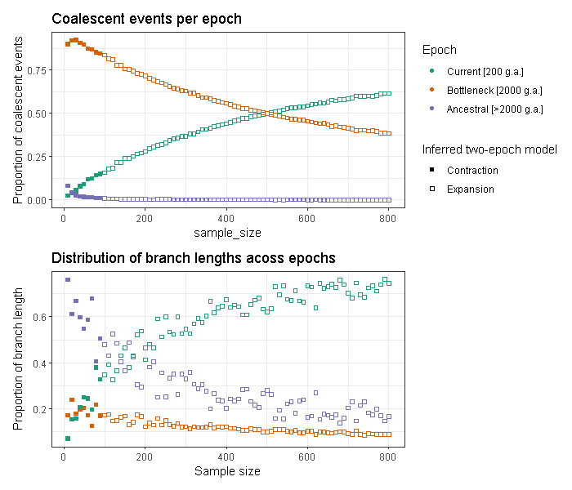
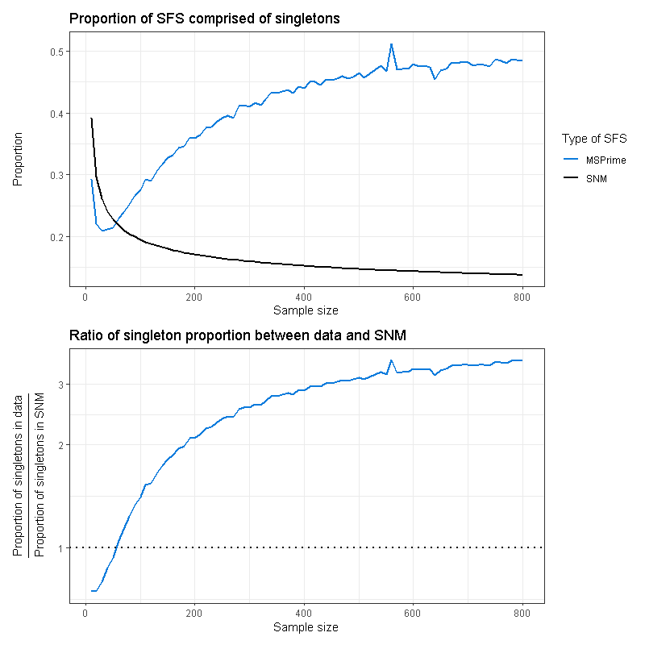
(a)
(b)
(a)
(b)

Slide 10
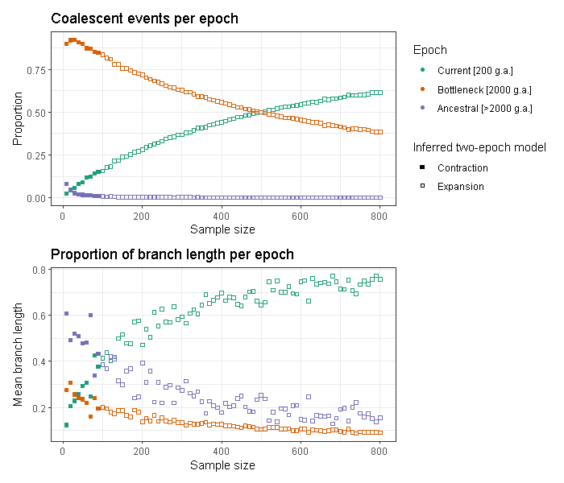
(a)
(b)

Slide 11
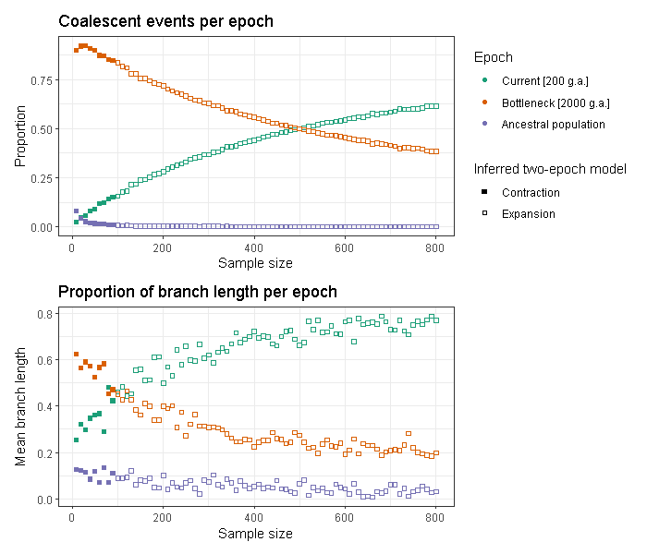
(a)
(b)
(a)
(b)

Slide 12
(a)
(d)
(b)
(e)
(c)
(a)
(d)
(b)
(e)
(c)

Slide 13
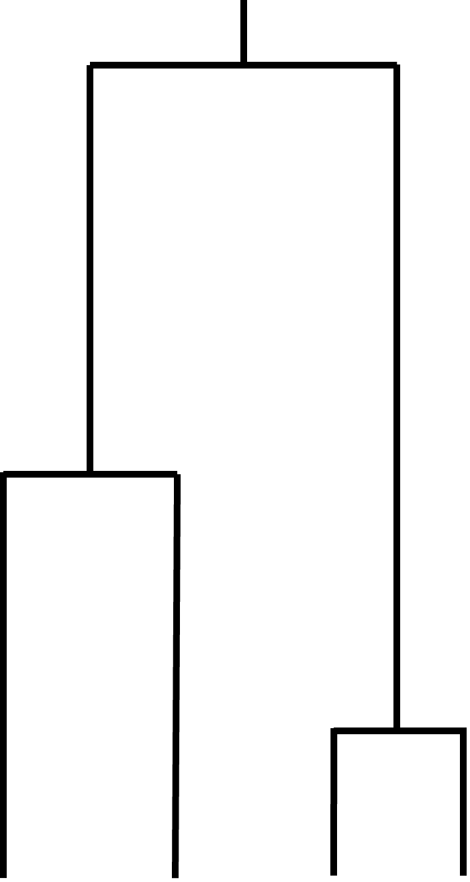
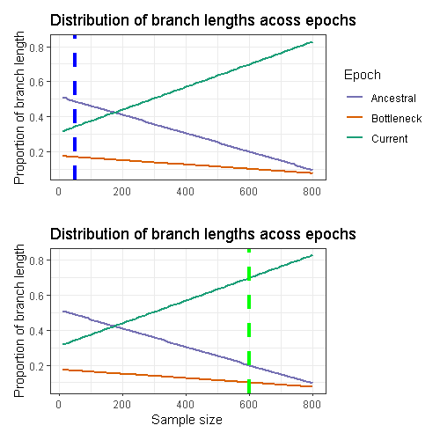
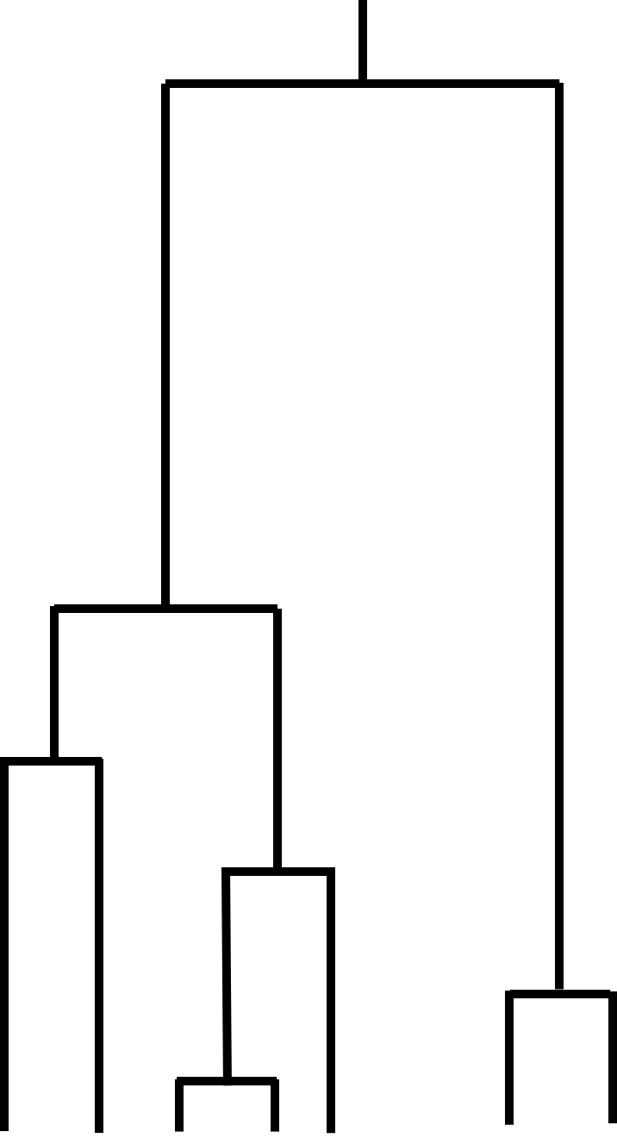
Smaller sample
Complex three-epoch
demographic scenario
Sample-size dependent distribution
of coalescent branch lengths
Simple two-epoch
inference
(a)
Ancestral
Bottleneck
Current
(b)
Larger sample
Ancestral
Bottleneck
Current

Slide 14
(a)
(d)
(b)
(e)
(c)

Slide 15
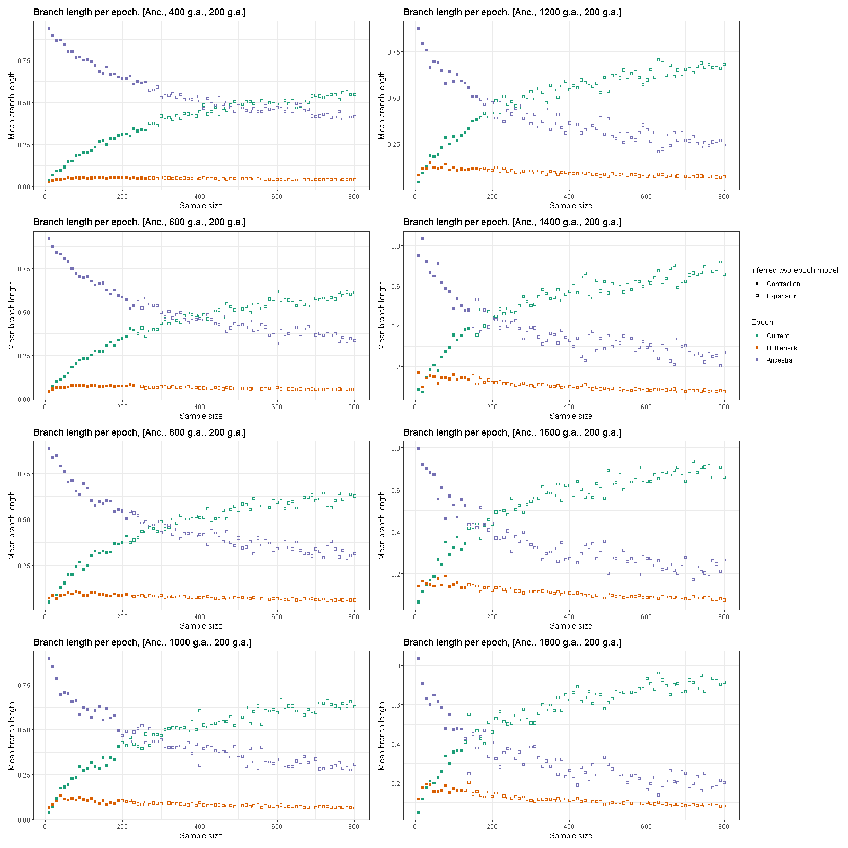
(a)
(e)
(b)
(f)
(c)
(g)
(d)
(h)

Slide 16
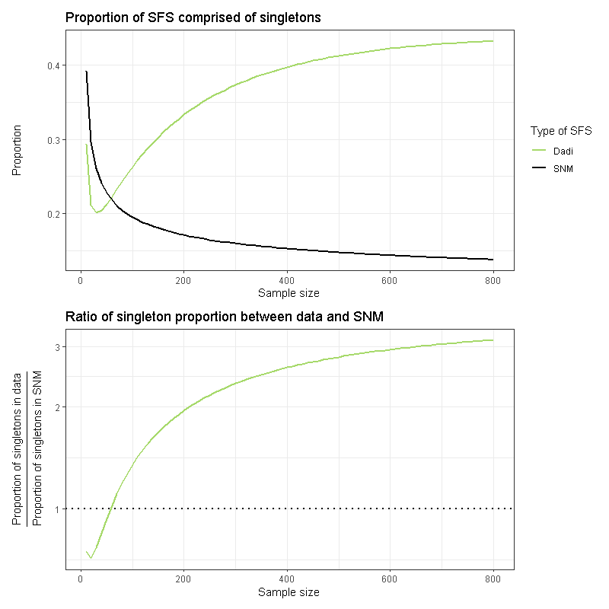
(a)
(b)

