Slide 1
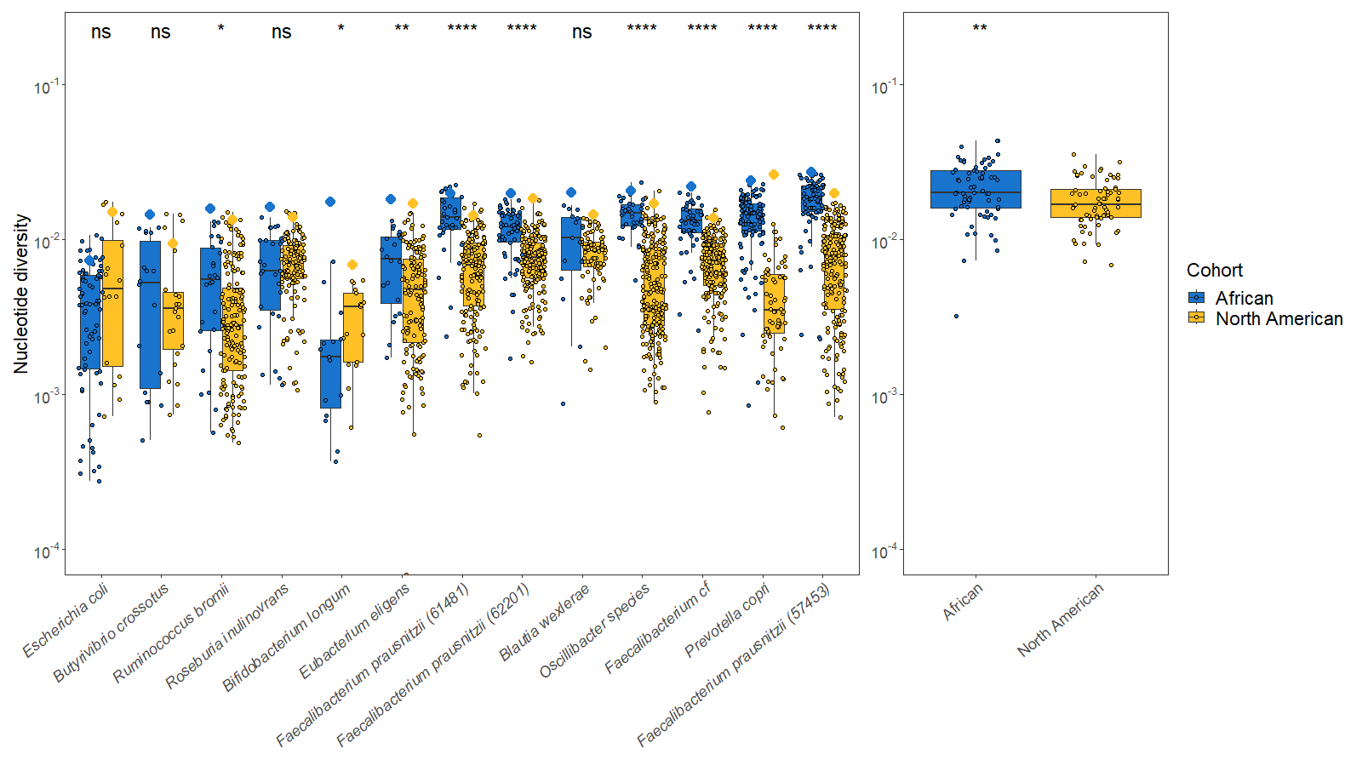
A
B

Slide 2


Slide 3
One-epoch
Two-epoch
Three-epoch
or
or
or
Demographic
Equilibrium
Contraction
Expansion
Constant effective
population size
One instantaneous size change
Two instantaneous size changes
One-epoch
Two-epoch
Three-epoch
Time
Constant effective
population size
One instantaneous size change
Two instantaneous size changes
A
B
C
One-epoch
Two-epoch
Three-epoch
Constant effective
population size
One instantaneous size change
Two instantaneous size changes
Time
Effective Population Size
Notes:
Now that we have evidence that North American gut microbiomes have depleted genetic diversity relative to African gut microbiomes, likely due to differences in diet, environment, and a host of other factors which can broadly be grouped together as “urbanization”, we proceeded with inferring the demographic models, which allow us to infer parameters such as the time since the last major demographic event and the magnitude of any change in population size. Here, we used four different demographic models, with cartoons (explain cartoons).

Slide 4
A
B
C
One-epoch
Two-epoch
Three-epoch
Constant effective
population size
One instantaneous size change
Two instantaneous size changes
Time
Effective Population Size
A
B
C
One-epoch
Two-epoch
Three-epoch
Time
Constant effective
population size
One instantaneous size change
Two instantaneous size changes
Notes:
Now that we have evidence that North American gut microbiomes have depleted genetic diversity relative to African gut microbiomes, likely due to differences in diet, environment, and a host of other factors which can broadly be grouped together as “urbanization”, we proceeded with inferring the demographic models, which allow us to infer parameters such as the time since the last major demographic event and the magnitude of any change in population size. Here, we used four different demographic models, with cartoons (explain cartoons).

Slide 5
One-epoch
Two-epoch
Three-epoch
Ancestral
Time
Current
Constant effective
population size
One instantaneous size change
Two instantaneous size changes

Slide 6
One-epoch
Two-epoch
Three-epoch
Time
Present
Constant effective
population size
One instantaneous size change
Two instantaneous size changes

Slide 7
One-epoch
Two-epoch
Three-epoch
Time
Present
Constant effective
population size
One instantaneous size change
Two instantaneous size changes

Slide 8
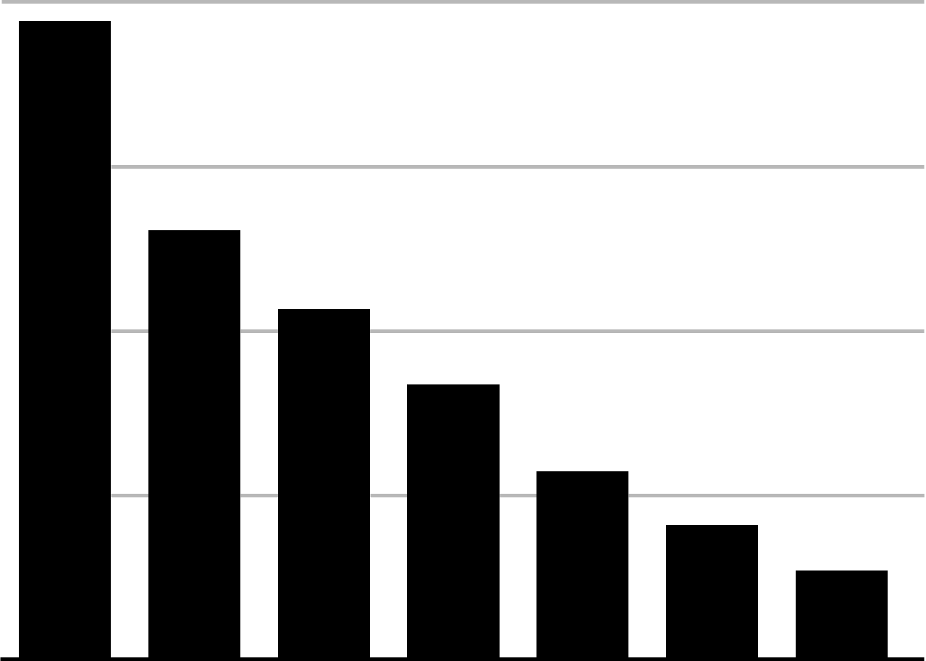

A
One-epoch
Two-epoch
Three-epoch
Time
Present
Constant effective
population size
One instantaneous size change
Two instantaneous size changes
B
Proportion of variants
Mutational Frequency

Slide 9
A
Proportion of variants
B
Mutational Frequency
One-epoch
Two-epoch
Three-epoch
Time
Present
Constant effective
population size
One instantaneous size change
Two instantaneous size changes

Slide 10
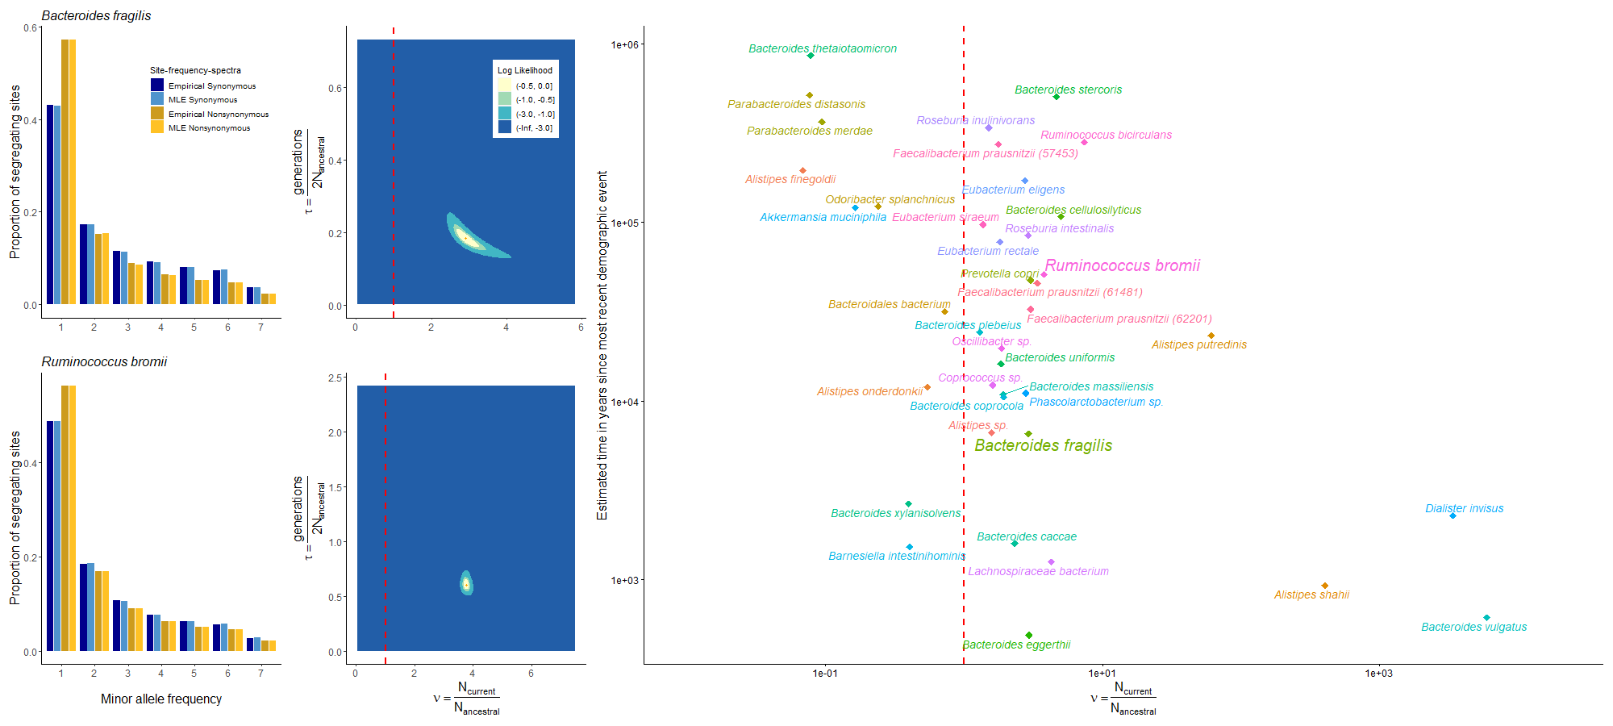
A
C
E
B
D

Slide 11
A
C
E
G
~6.6kya
B
D
F
~51.9kya

Slide 12
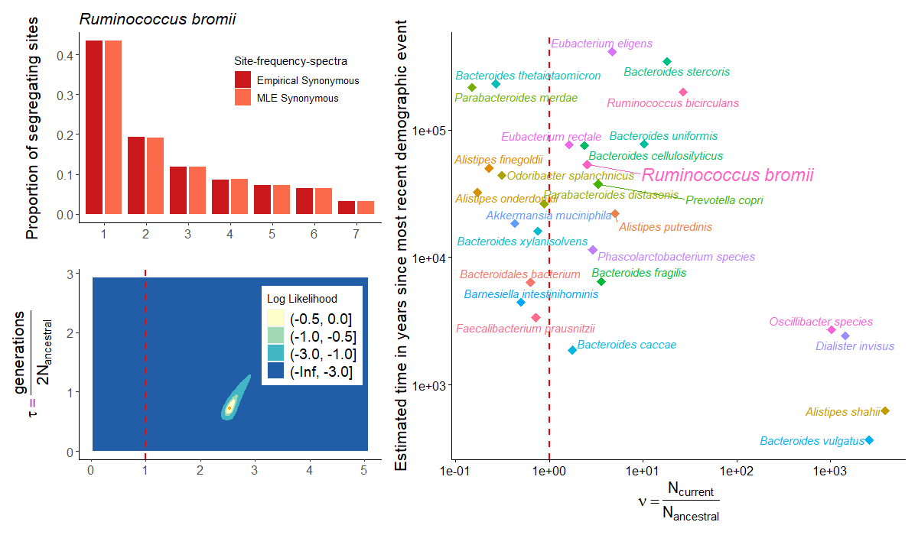

Slide 13
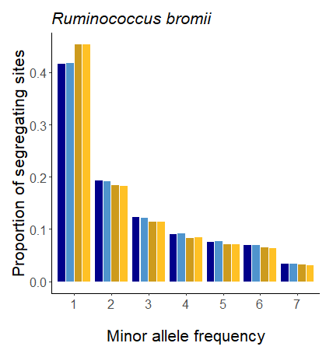

Slide 14
Expansion
Contraction
Site Frequency Spectra
Site Frequency Spectra
30.00%
30.00%
22.50%
22.50%
Proportional Frequency
Proportional Frequency
15.00%
15.00%
7.50%
7.50%
0.00%
1 2 3 4
5
6
7
8
0.00%
1 2 3 4
5
6
7
8
Mutation class (Singletons, doubletons, tripletons, etc.)
Mutation class (Singletons, doubletons, tripletons, etc.)

Slide 15
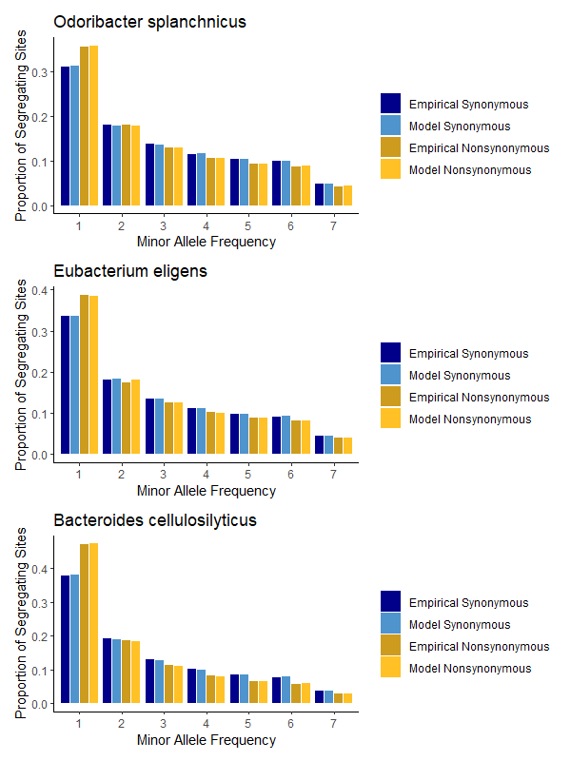

Slide 16
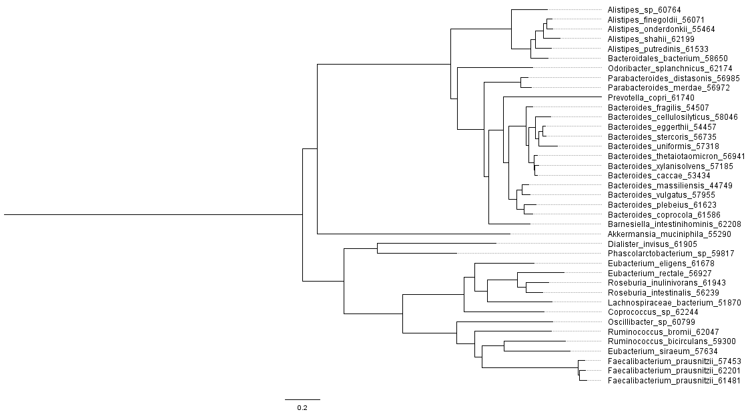
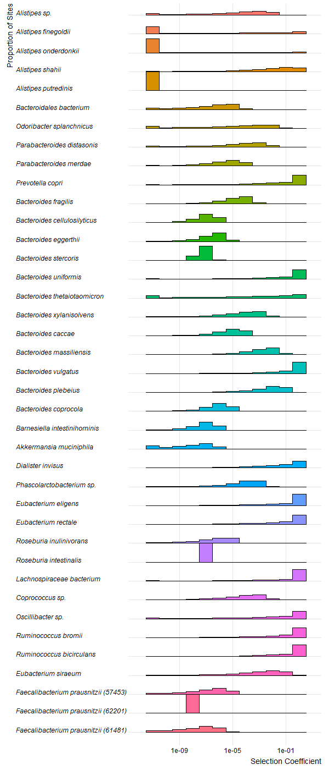
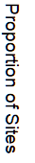
Notes:
Gamma_high

Slide 17
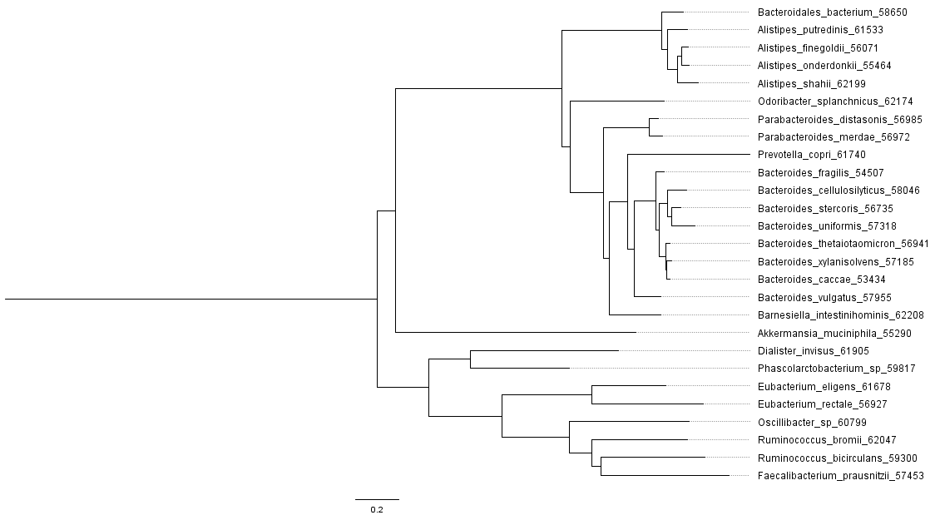
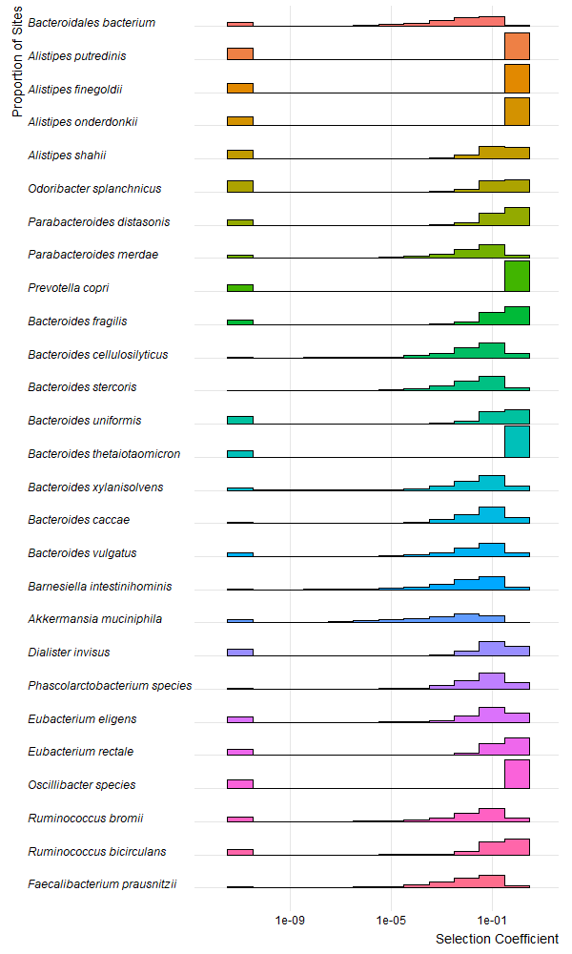
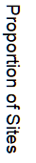
Notes:
Supplemental Figure 3

Slide 18
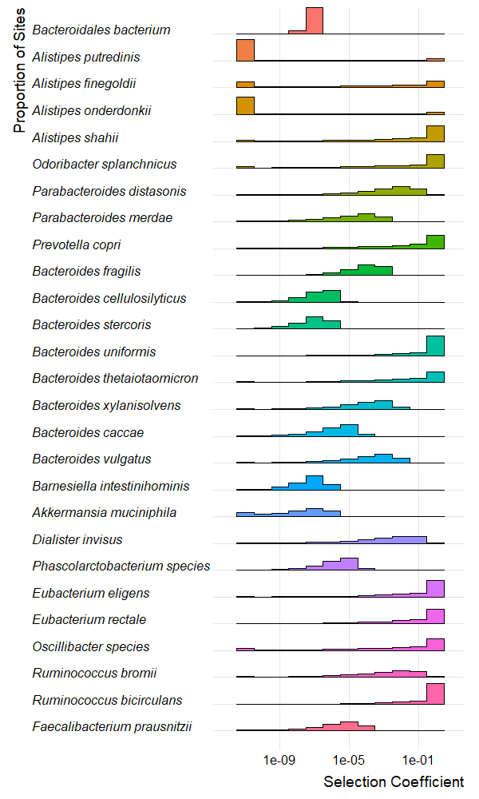

Slide 19
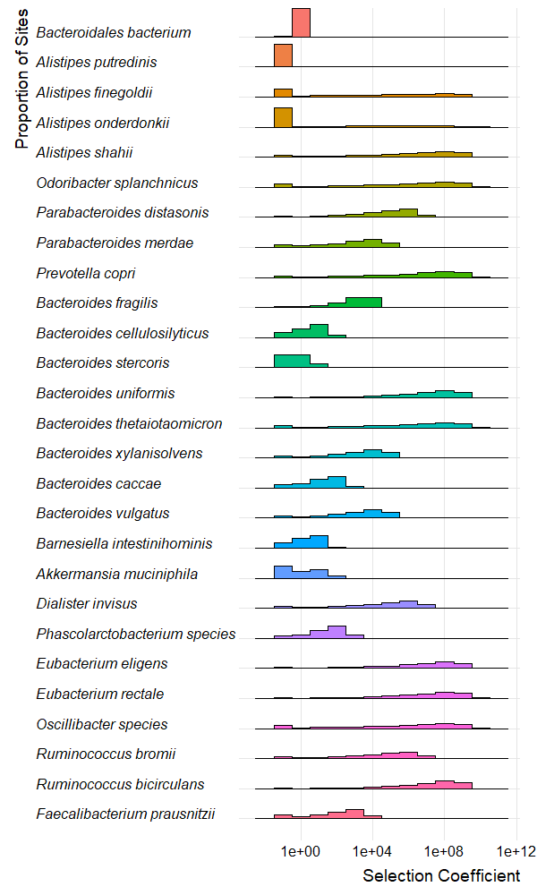
Notes:
Gamma_dadi_dfe

Slide 20
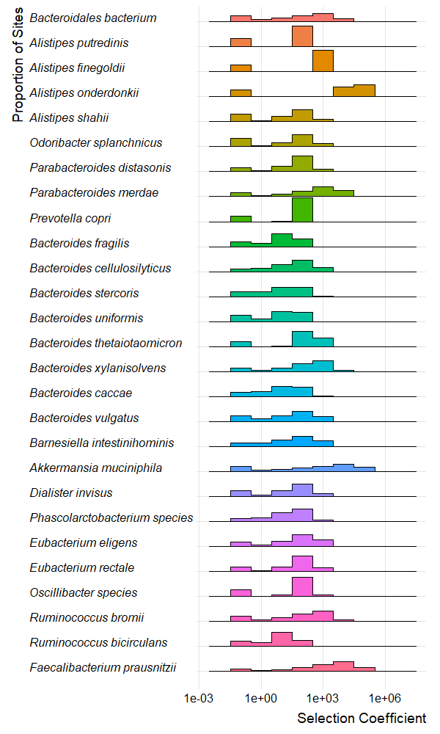
Notes:
Neugamma_dadi_dfe

Slide 21
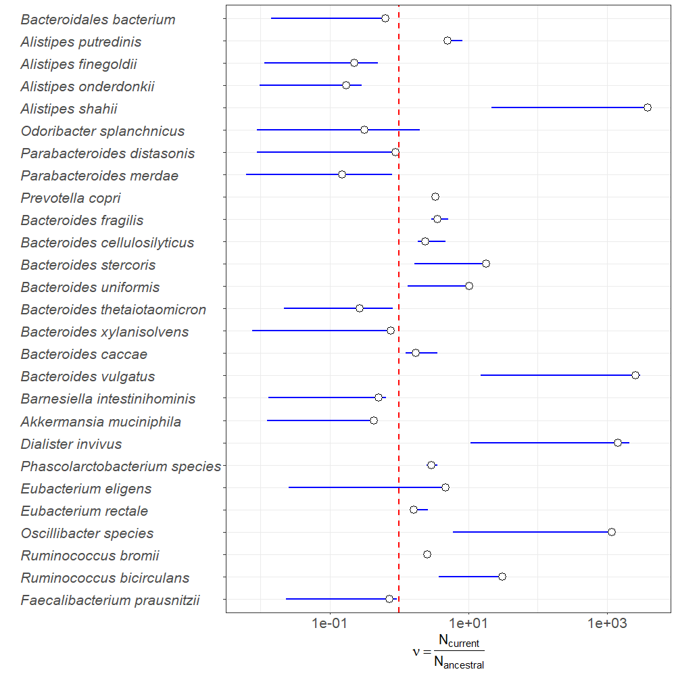

Slide 22
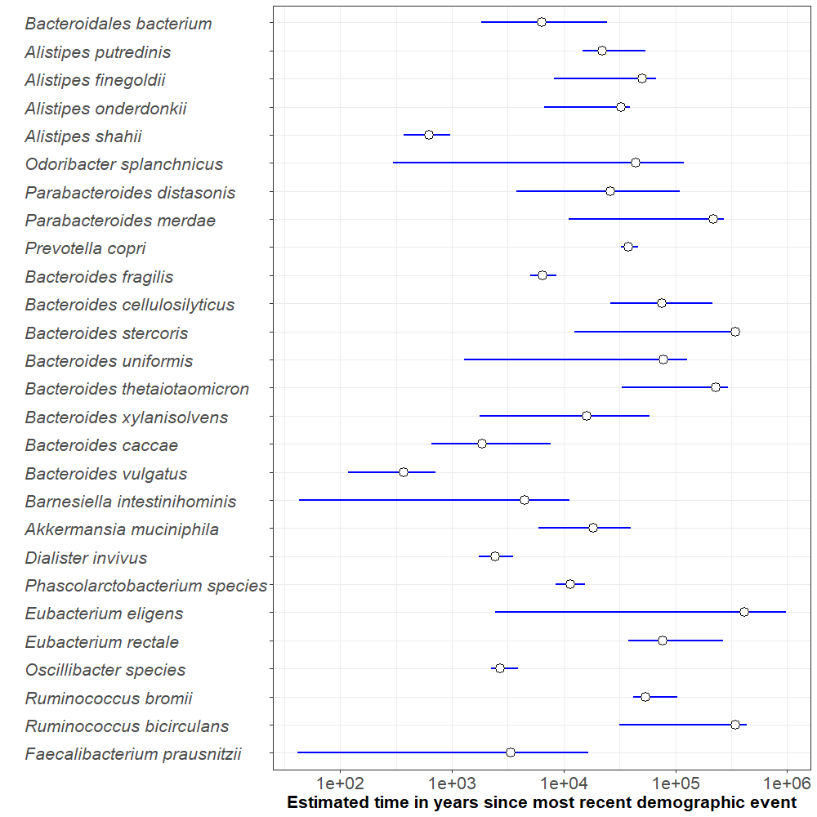

Slide 23
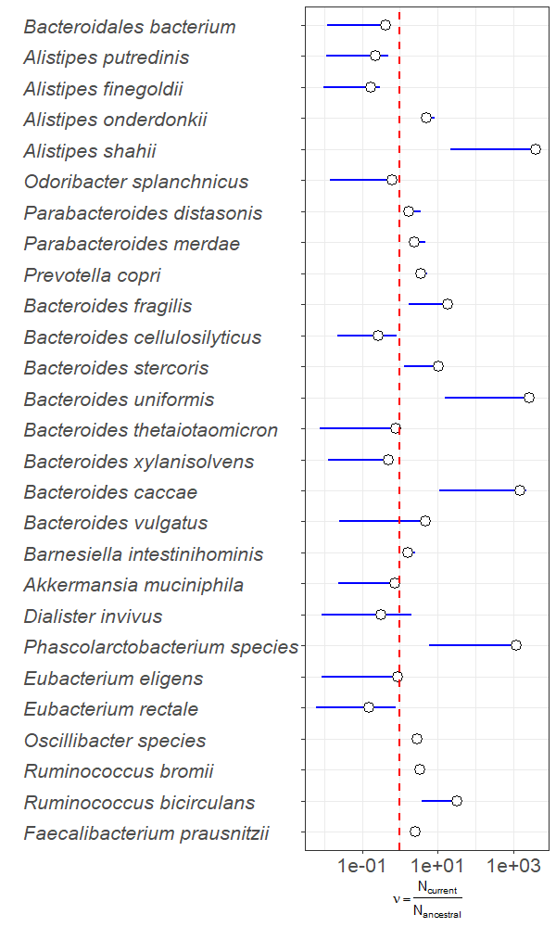
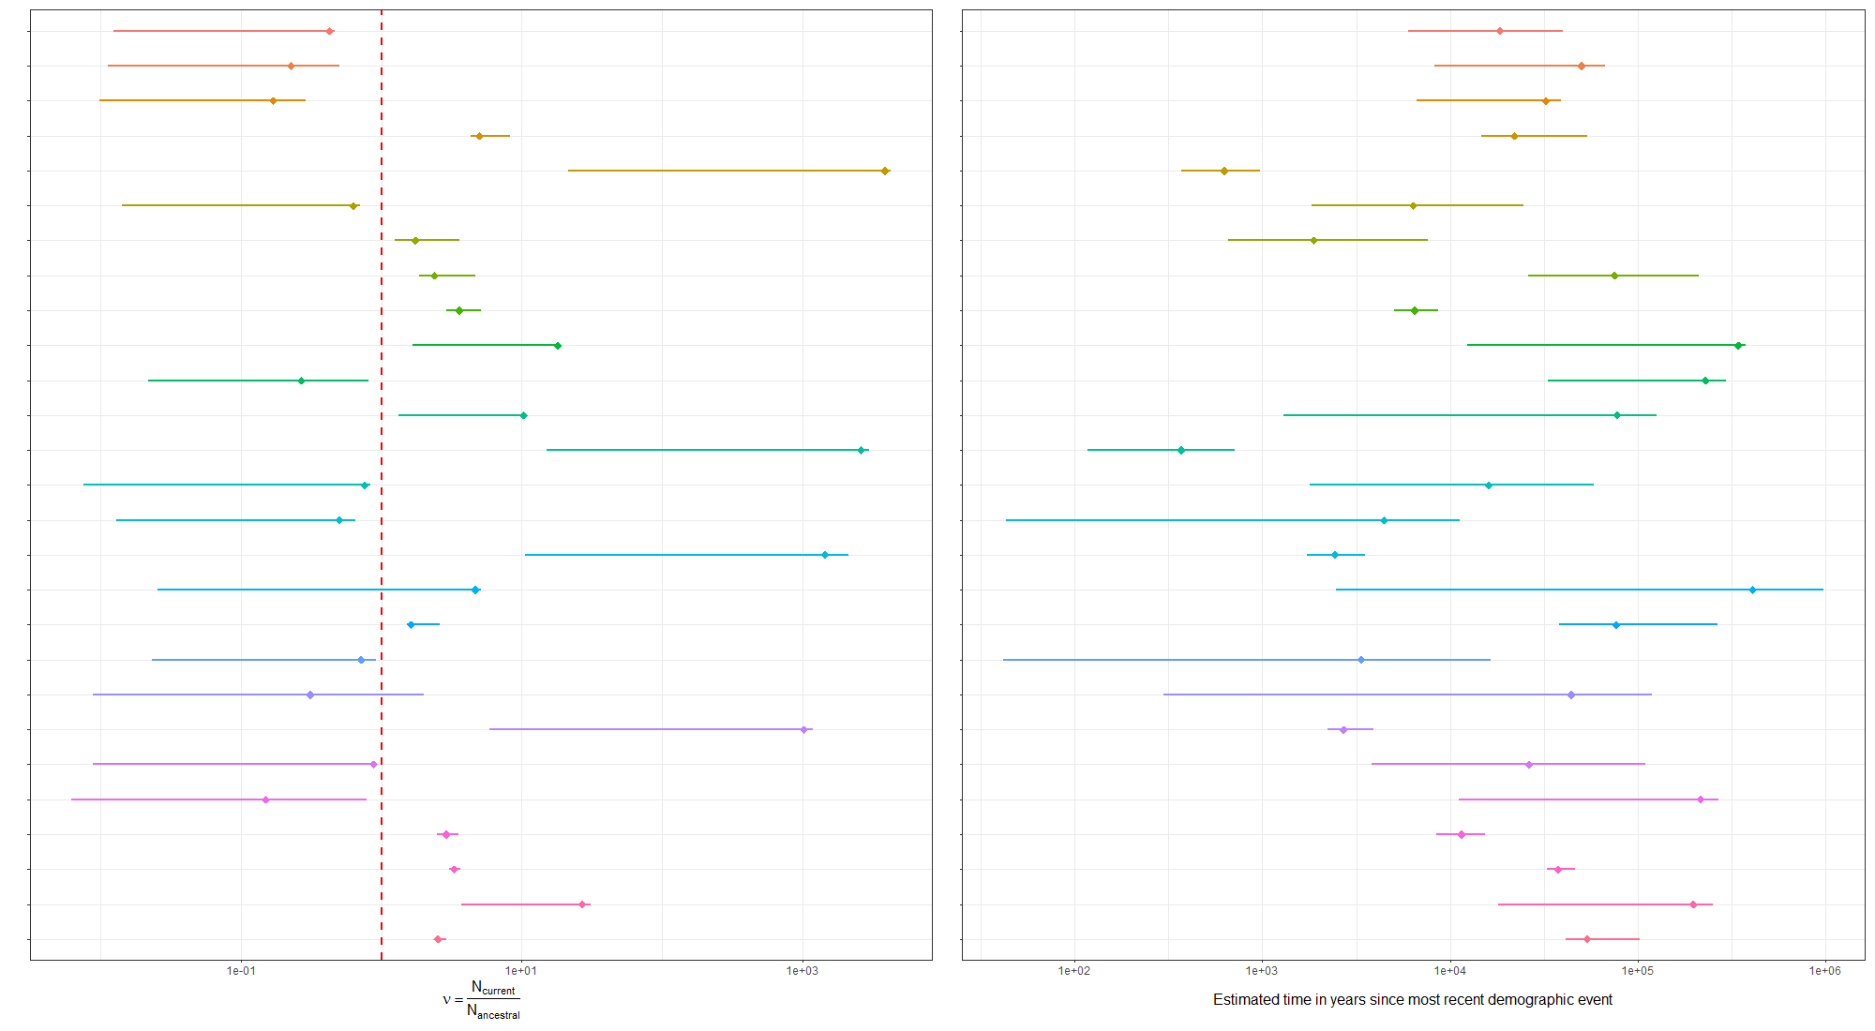

Slide 24
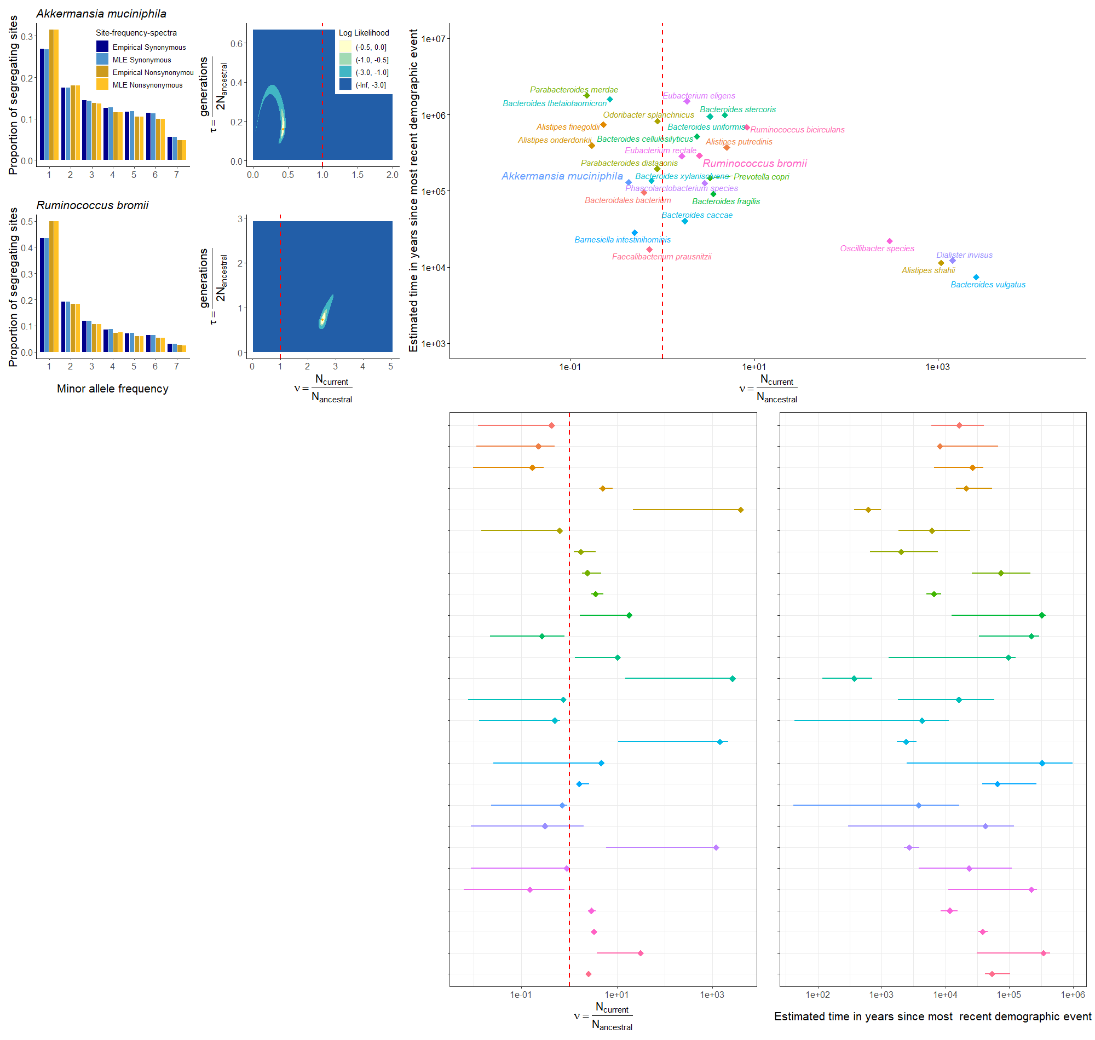
A
C
E
B
D
F
G
H

Slide 25
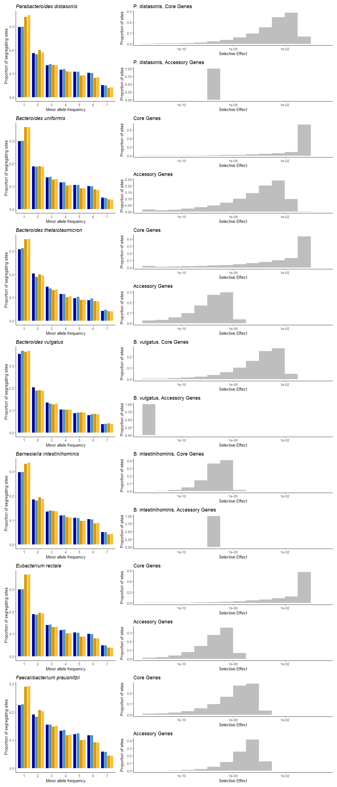
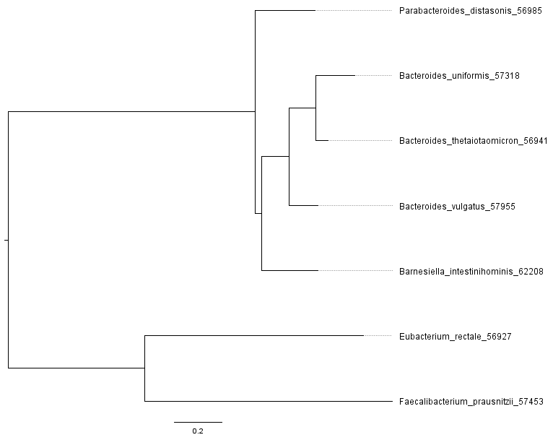
A
B
Notes:
Figure 5

Slide 26
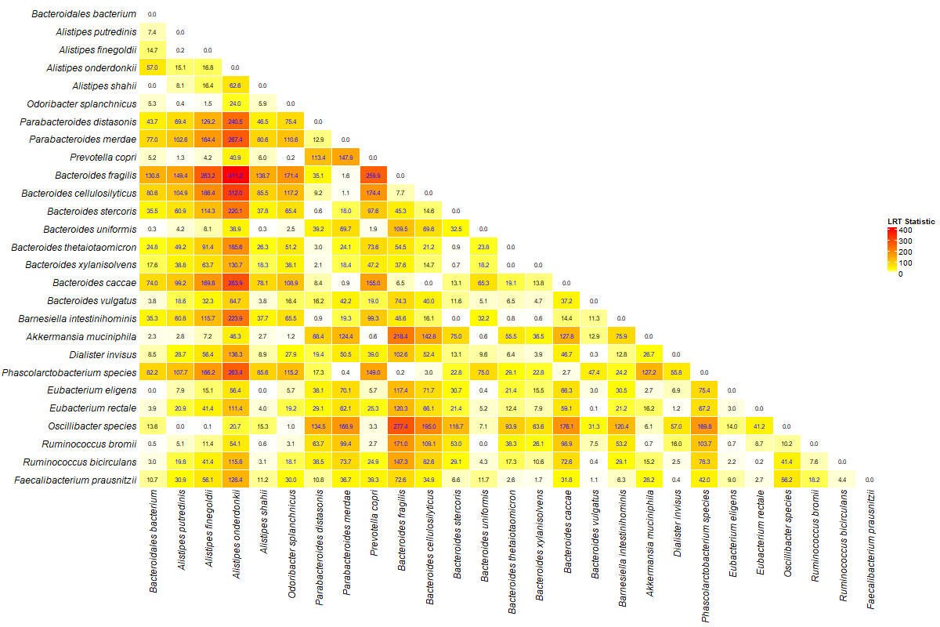

Slide 27
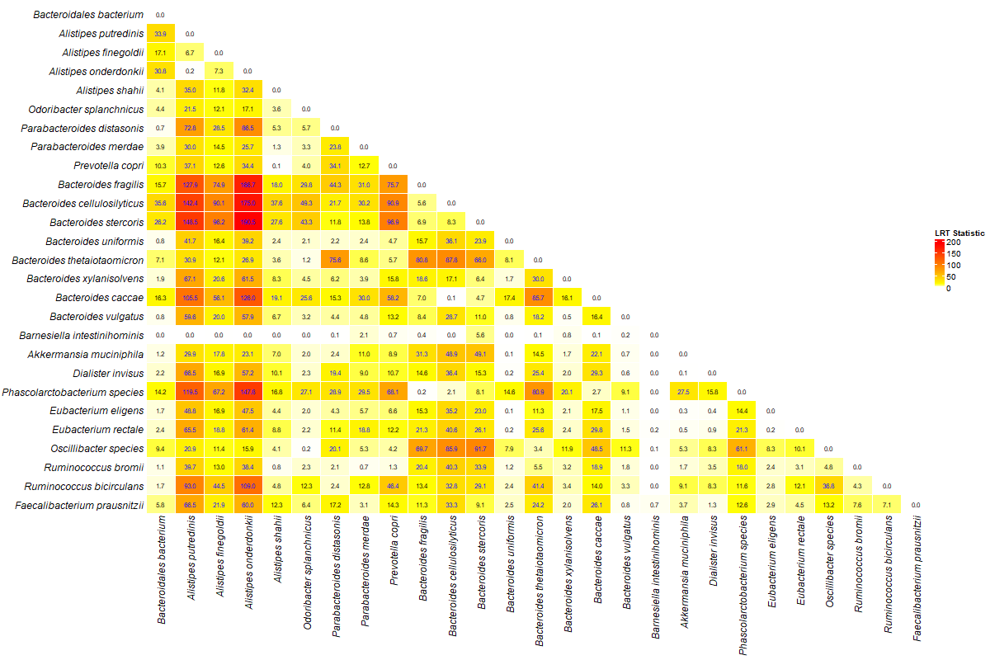

Slide 28
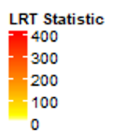
A
B

Slide 29
A
B

Slide 30
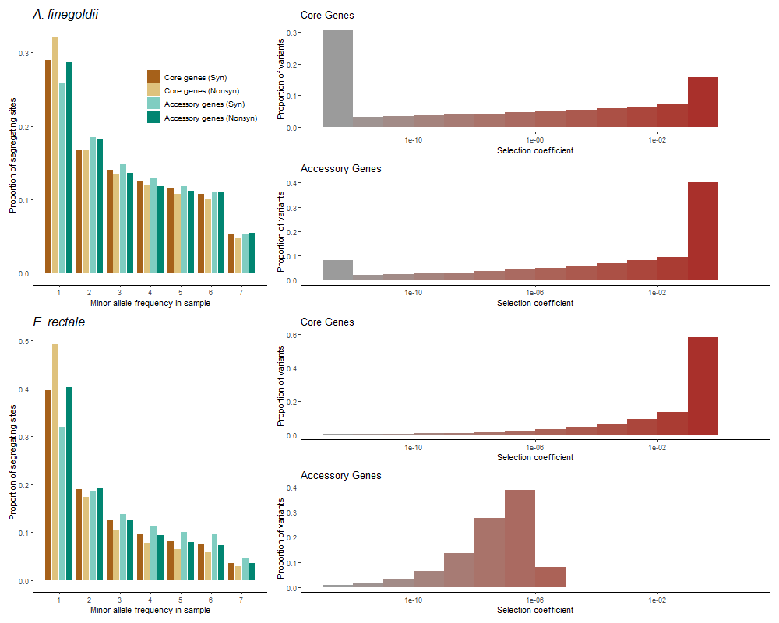
A
C
B
D

Slide 31
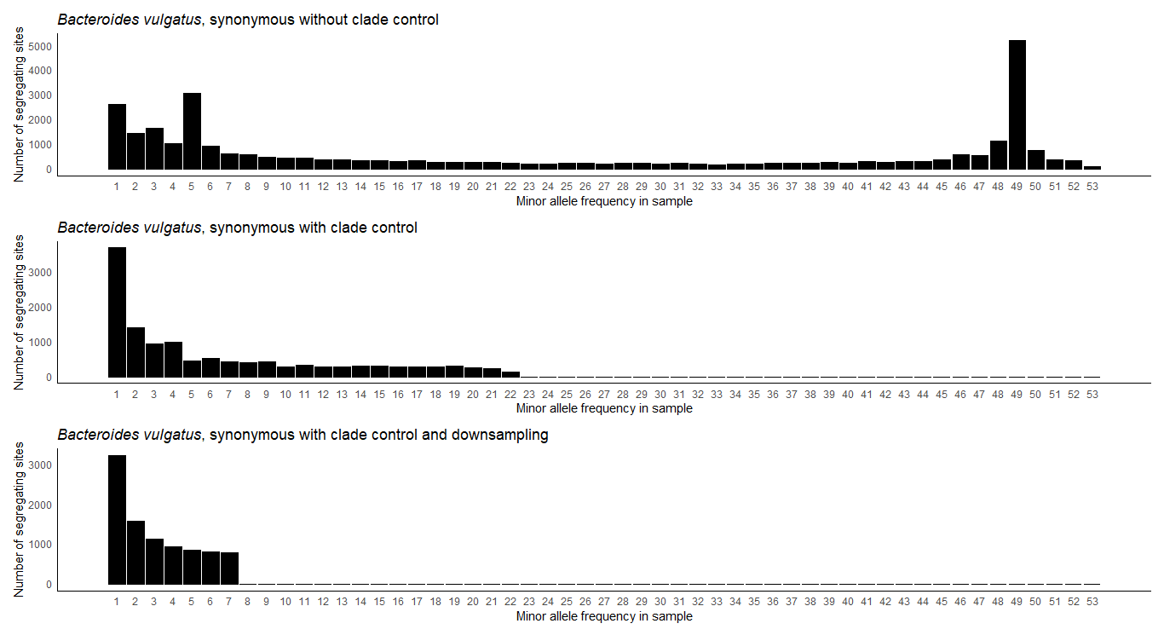

Slide 32
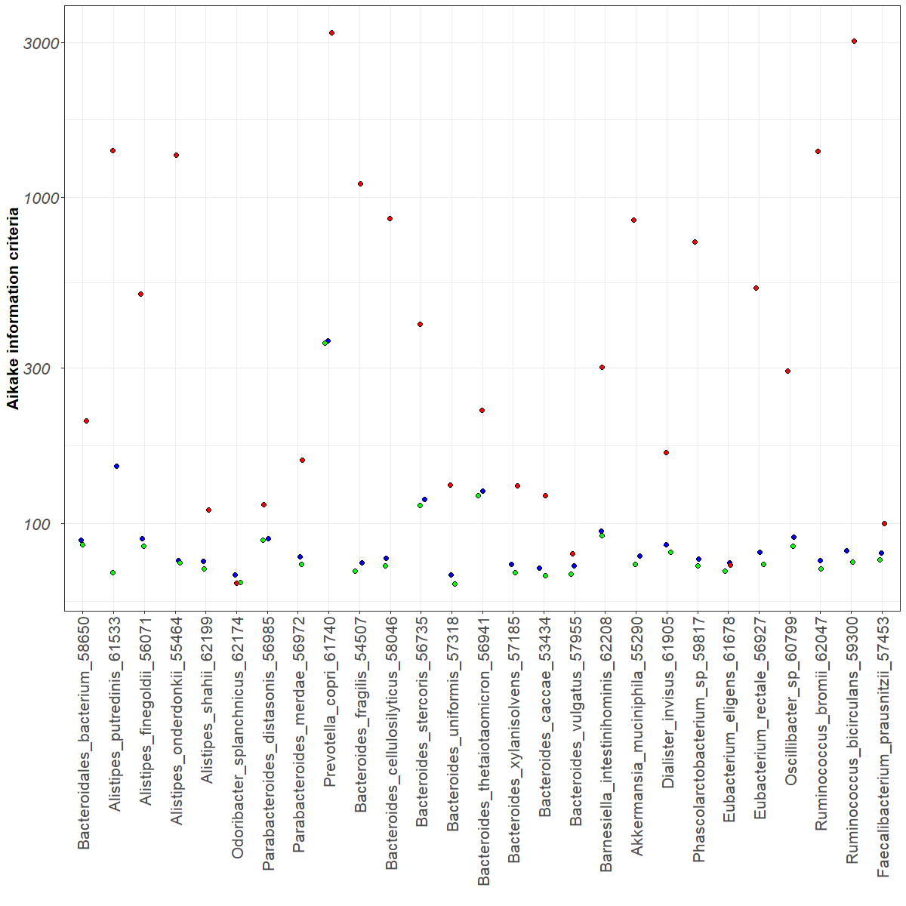

Slide 33
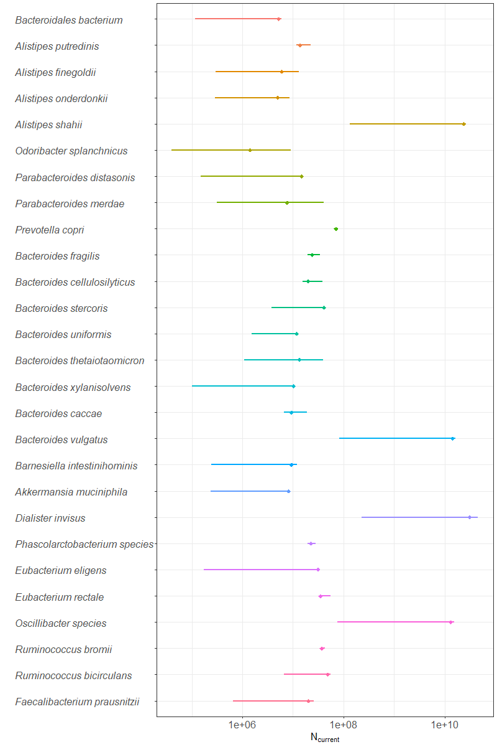

Slide 34
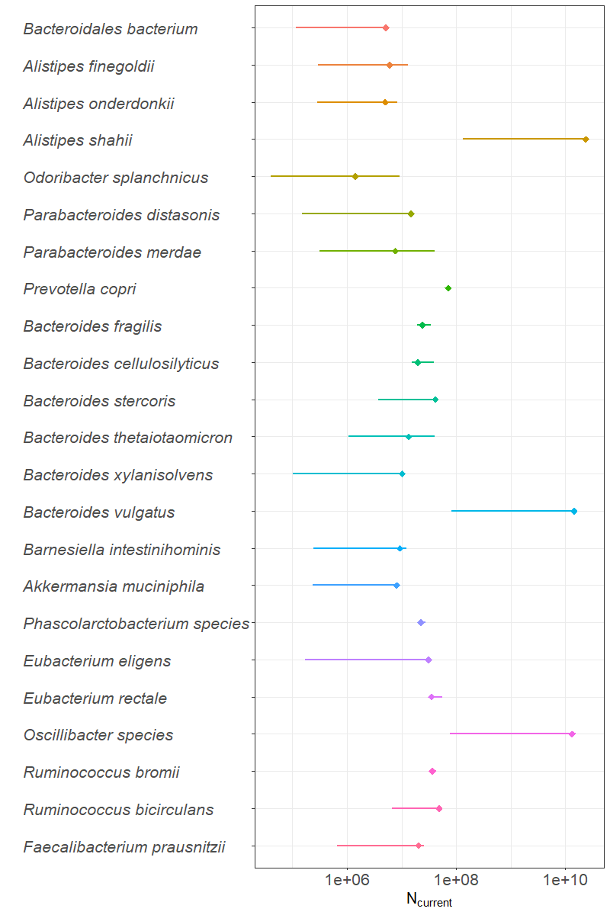

Slide 35
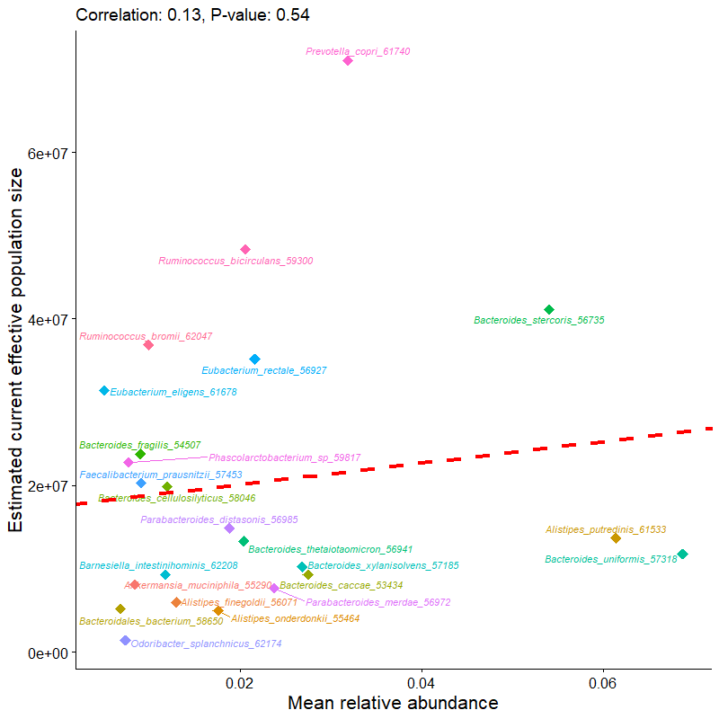
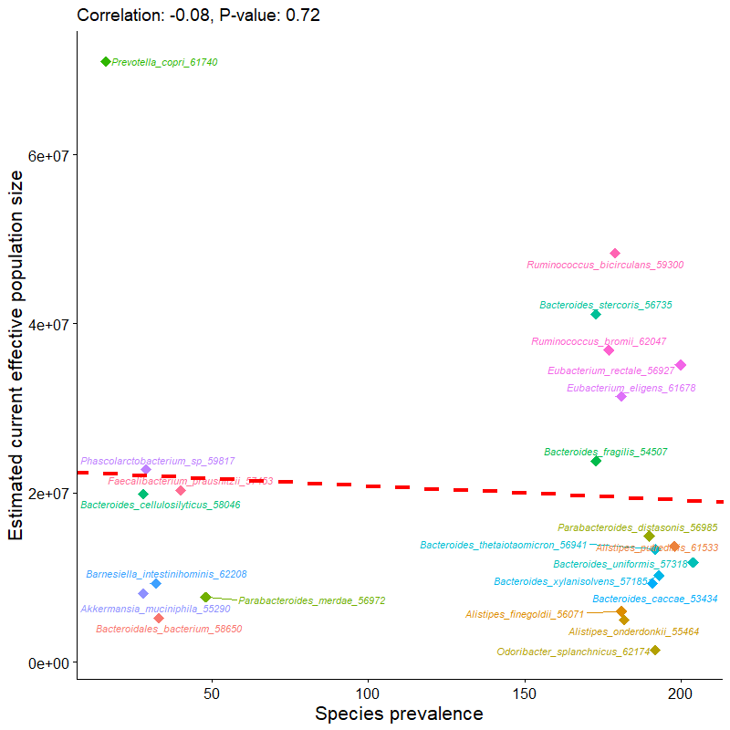
A
B

Slide 36
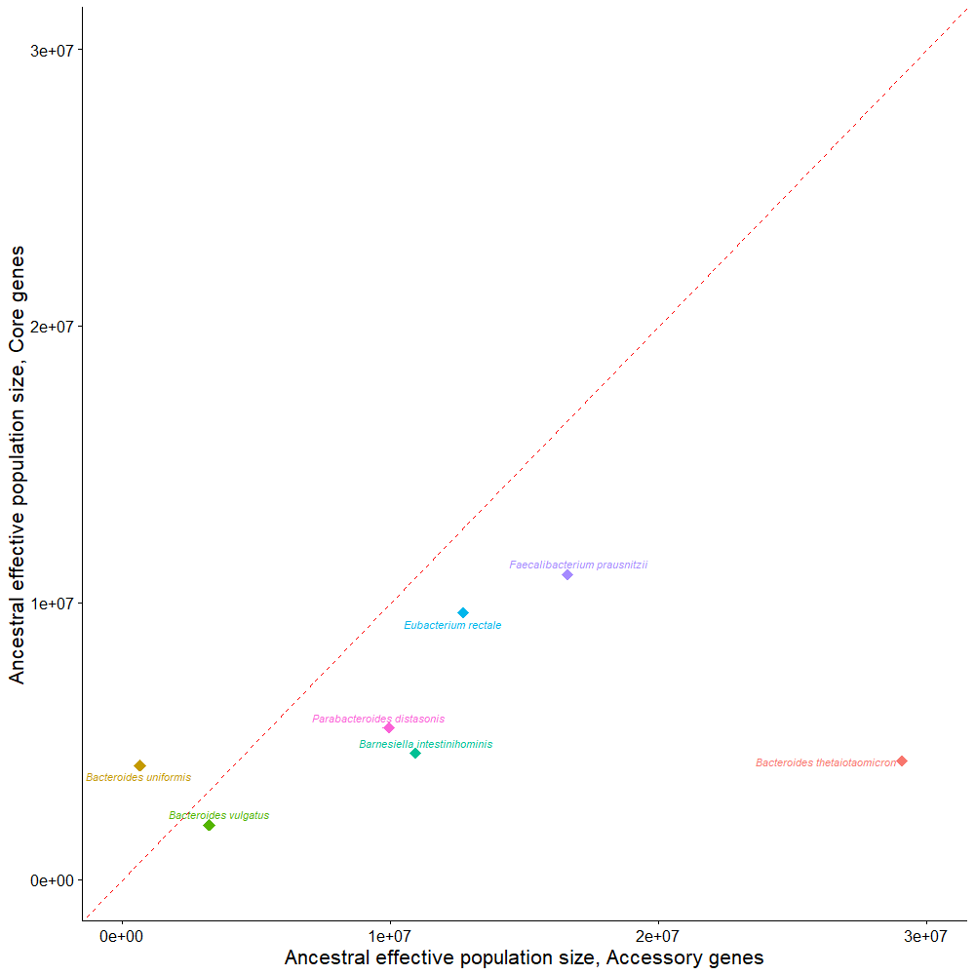

Slide 37
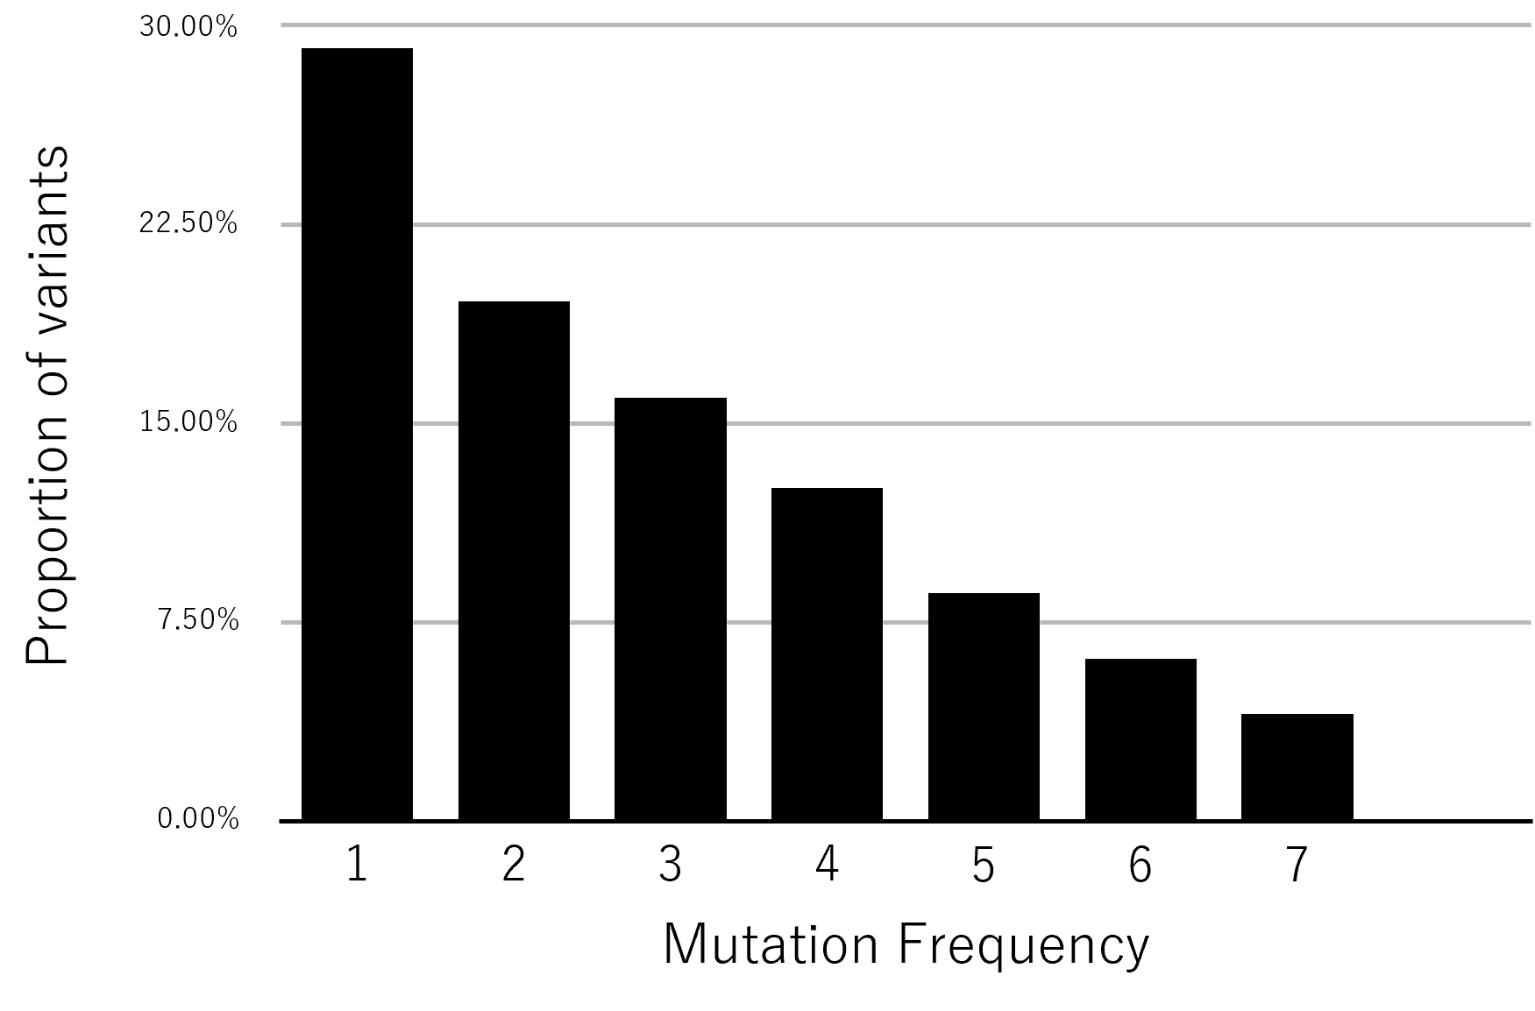

Slide 38
Proportion of variants
1 2 3 4
5
6
7
Mutation class (Singletons, doubletons, tripletons, etc.)

Slide 39
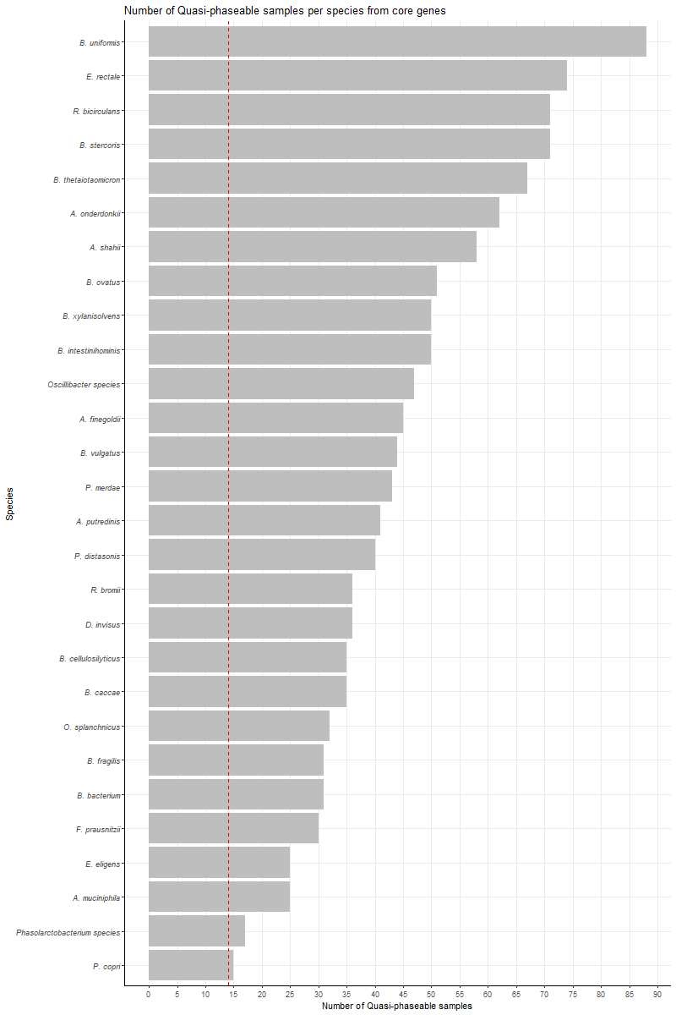

Slide 40
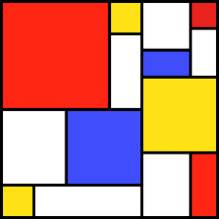


A
B
Proportion of variants
Mutational Frequency
C
One-epoch
Two-epoch
Three-epoch
Time
Present
Constant effective
population size
One instantaneous size change
Two instantaneous size changes

Slide 41



A
Time
Present
B
C
Two-epoch
Three-epoch
One-epoch
Time
Present
Constant effective
population size
One instantaneous
size change
Two instantaneous size changes

Slide 42
A
Time
Present
B
C
n=8
n=7
n=6
n=5
One-epoch
Two-epoch
Three-epoch
Time
Present
Constant effective
population size
One instantaneous
size change
Two instantaneous size changes

Slide 43



A
Time
Vs.
Present
B
N=10
C
Two-epoch
Time
Present
One instantaneous
size change

Slide 44


A
Time
Vs.
Present
B
N=10
C
Two-epoch
Time
Present
One instantaneous
size change

Slide 45
A
Time
Vs.
Present
B
N=10
C
Two-epoch
Time
Present
One instantaneous
size change

Slide 46
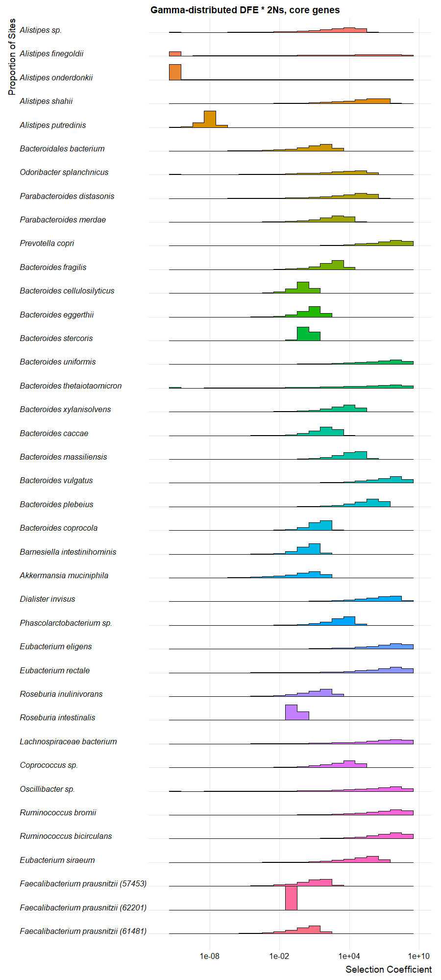
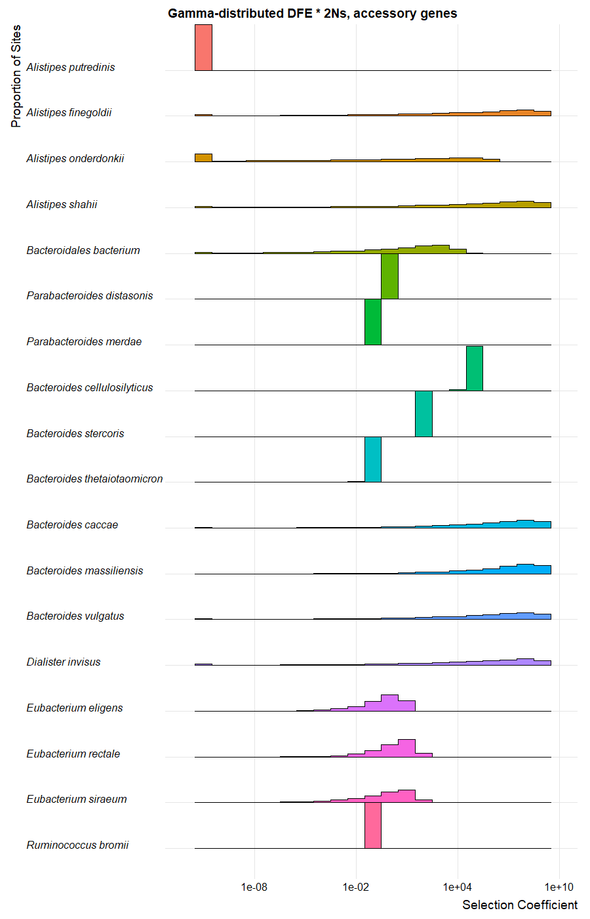

Slide 47
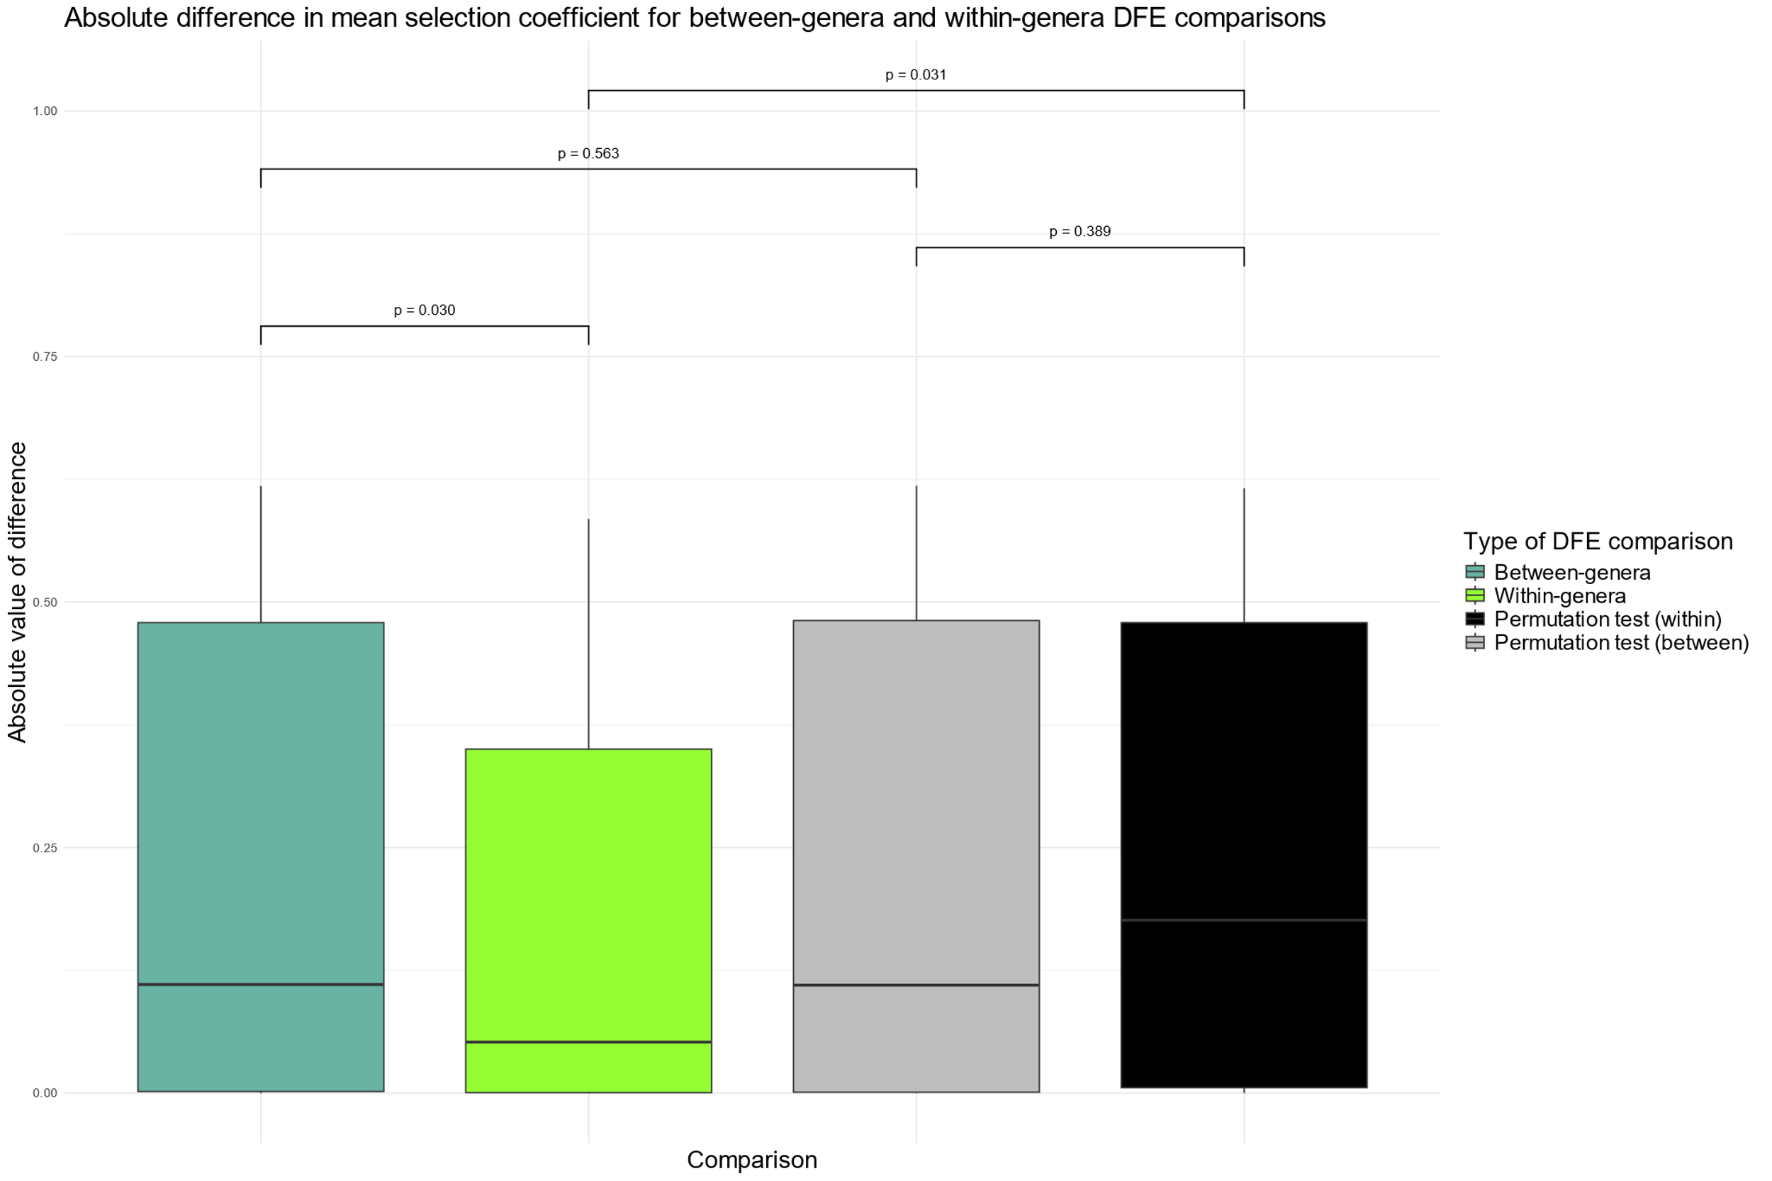

Slide 48
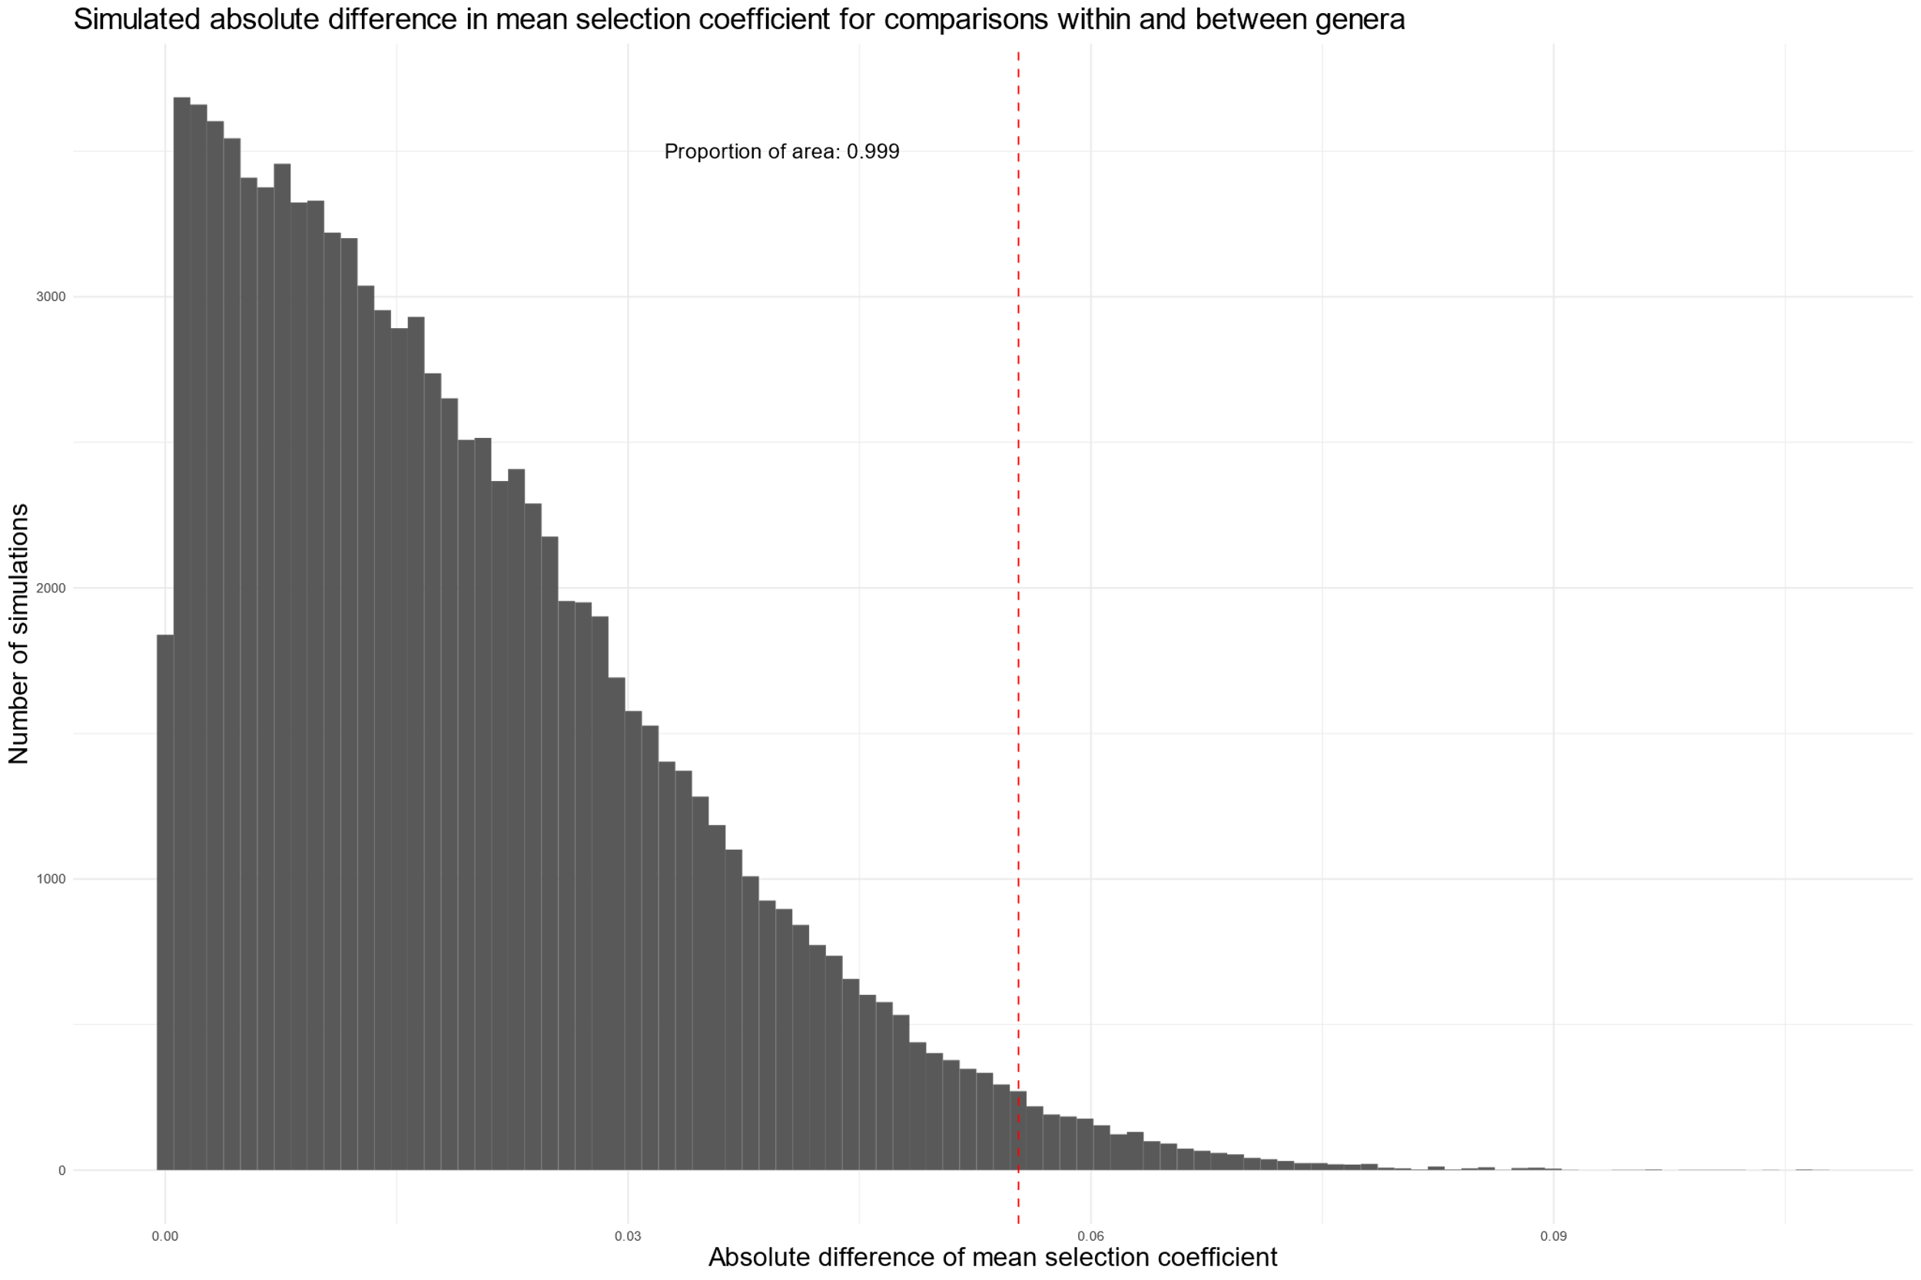

Slide 49
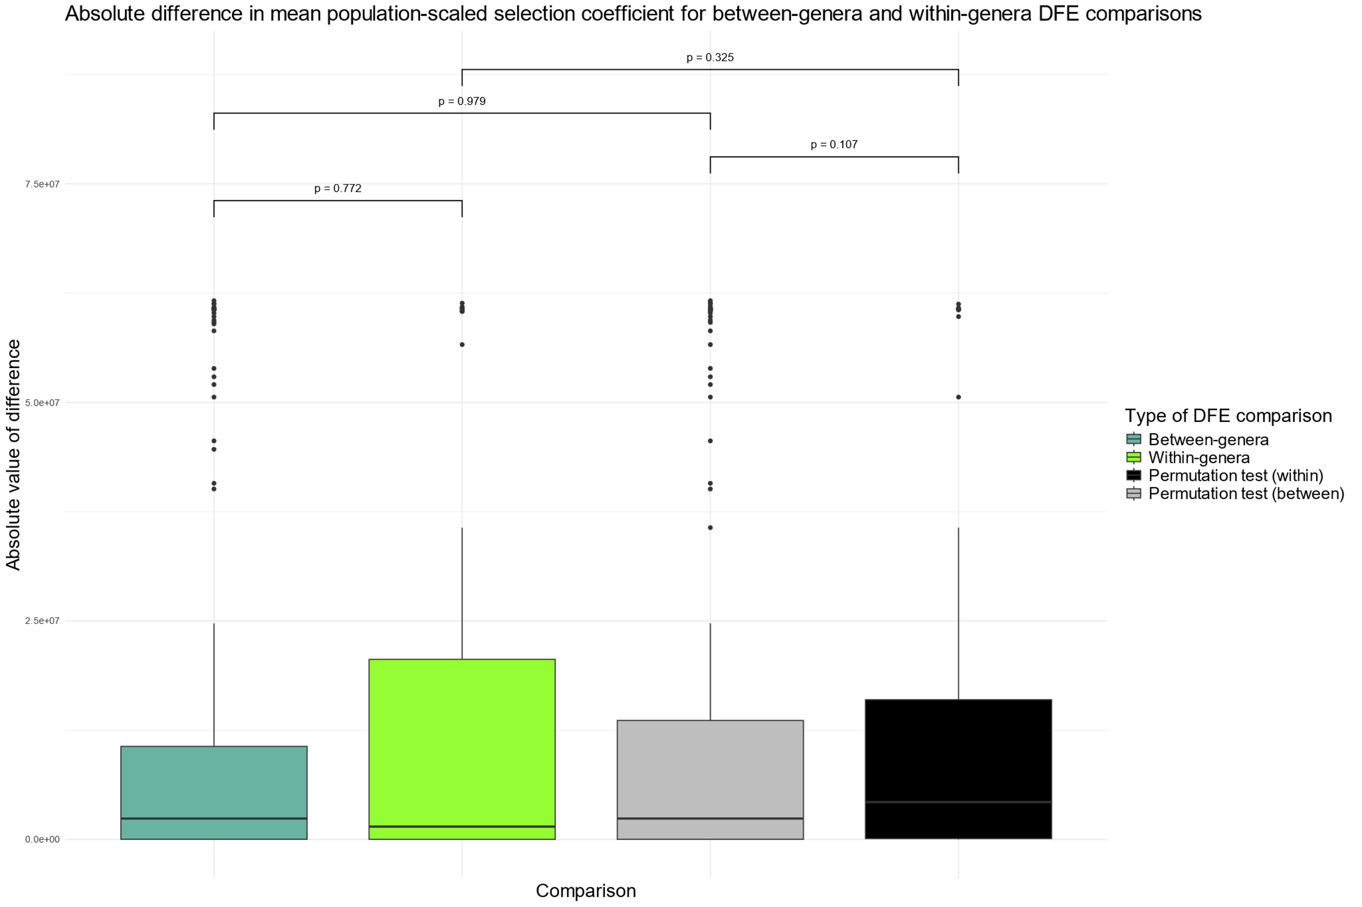

Slide 50
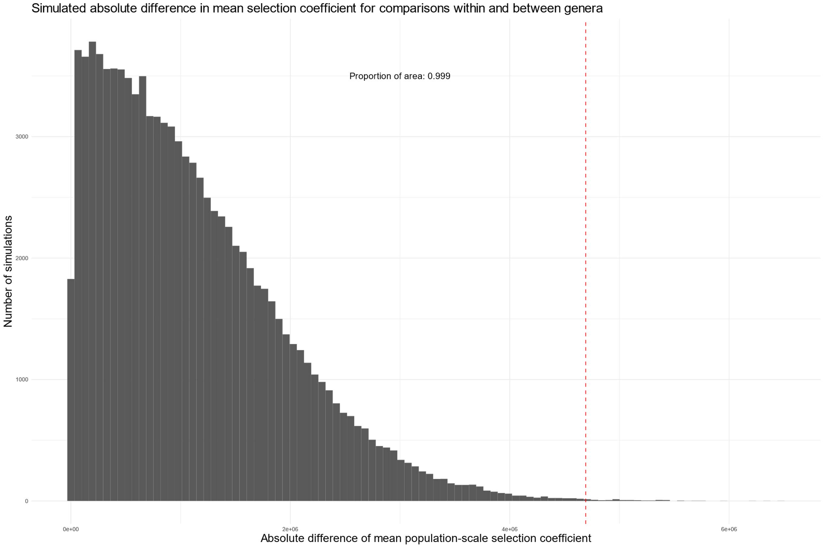

Slide 51
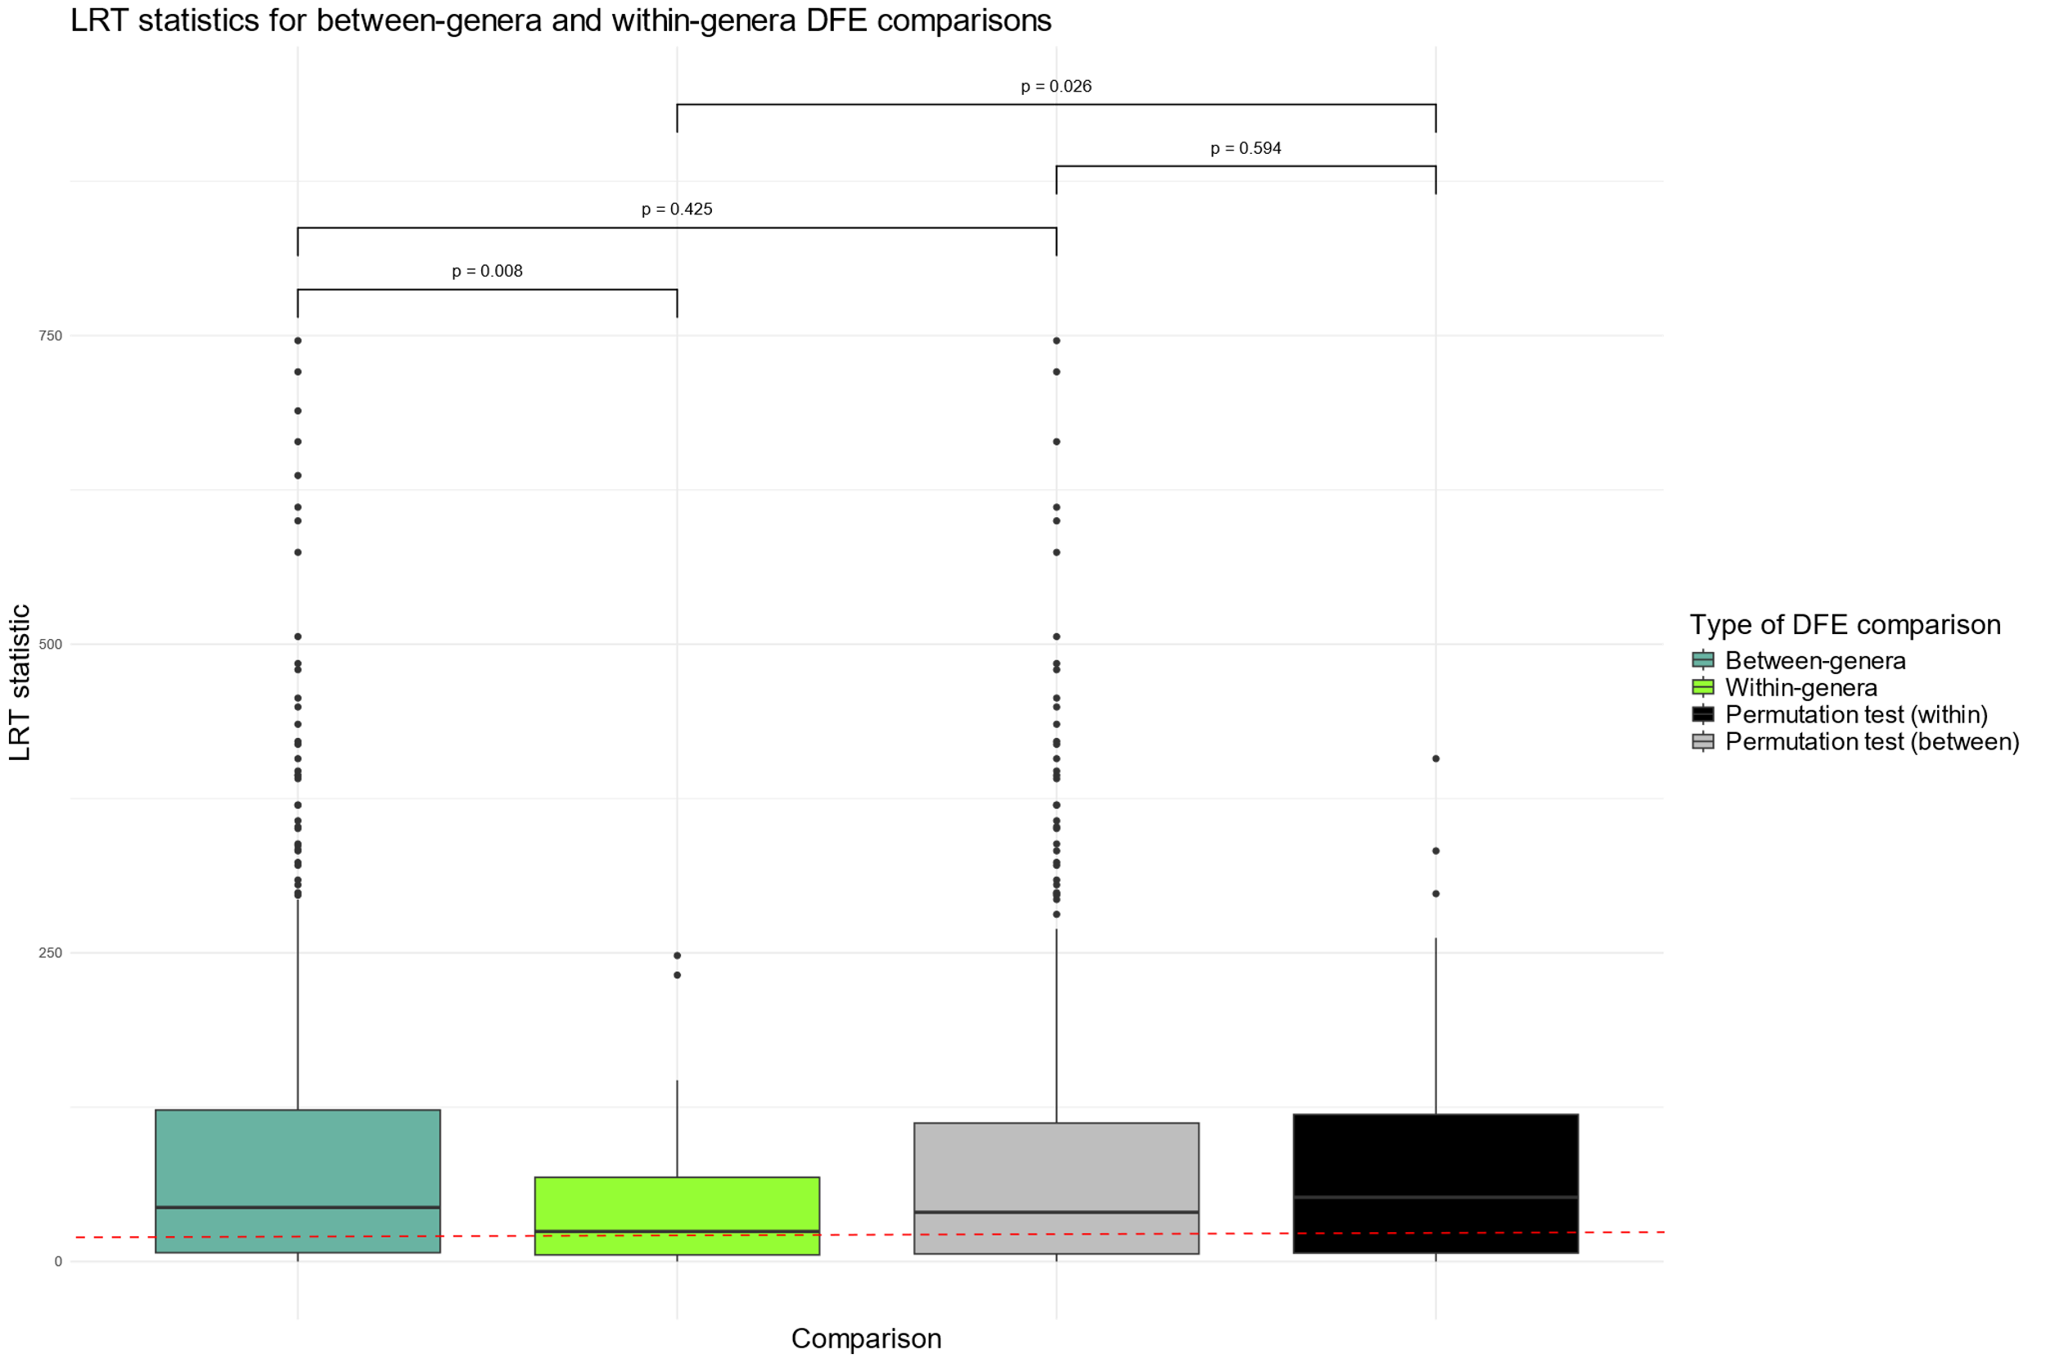

Slide 52
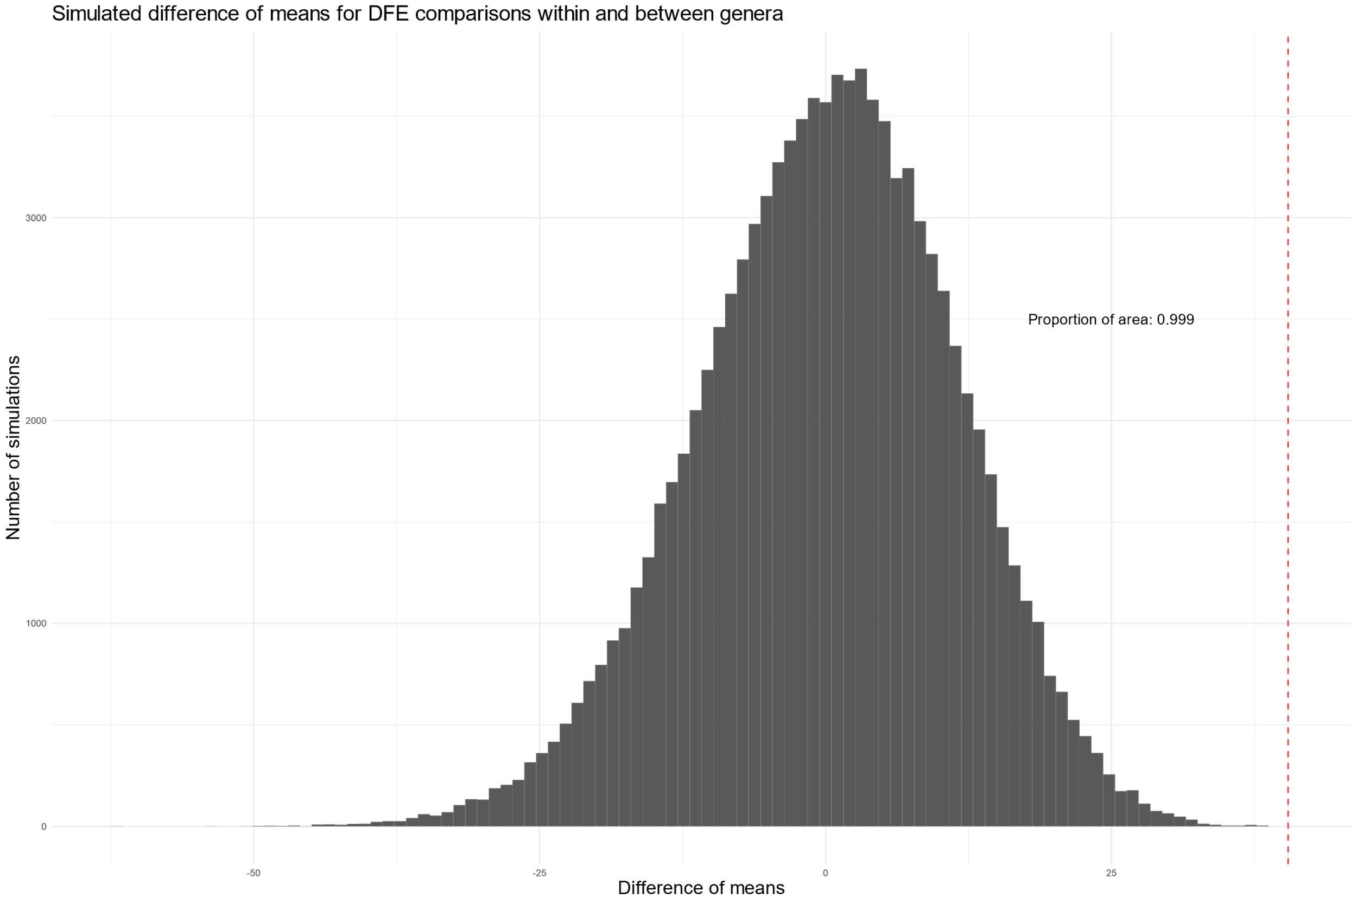

Slide 53
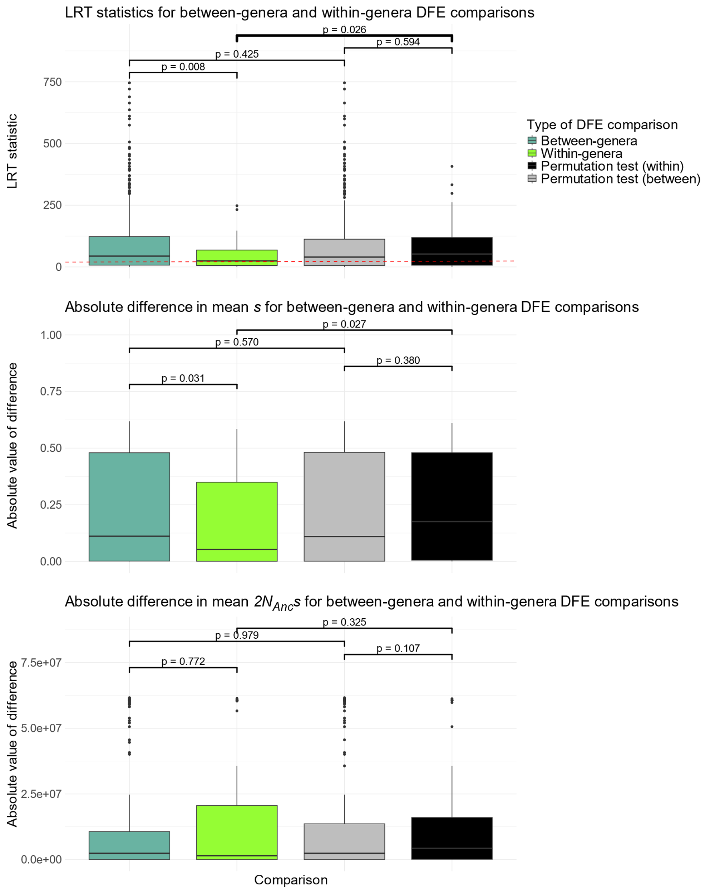
A
B
C
Notes:
Supplemental Figure SA

Slide 54
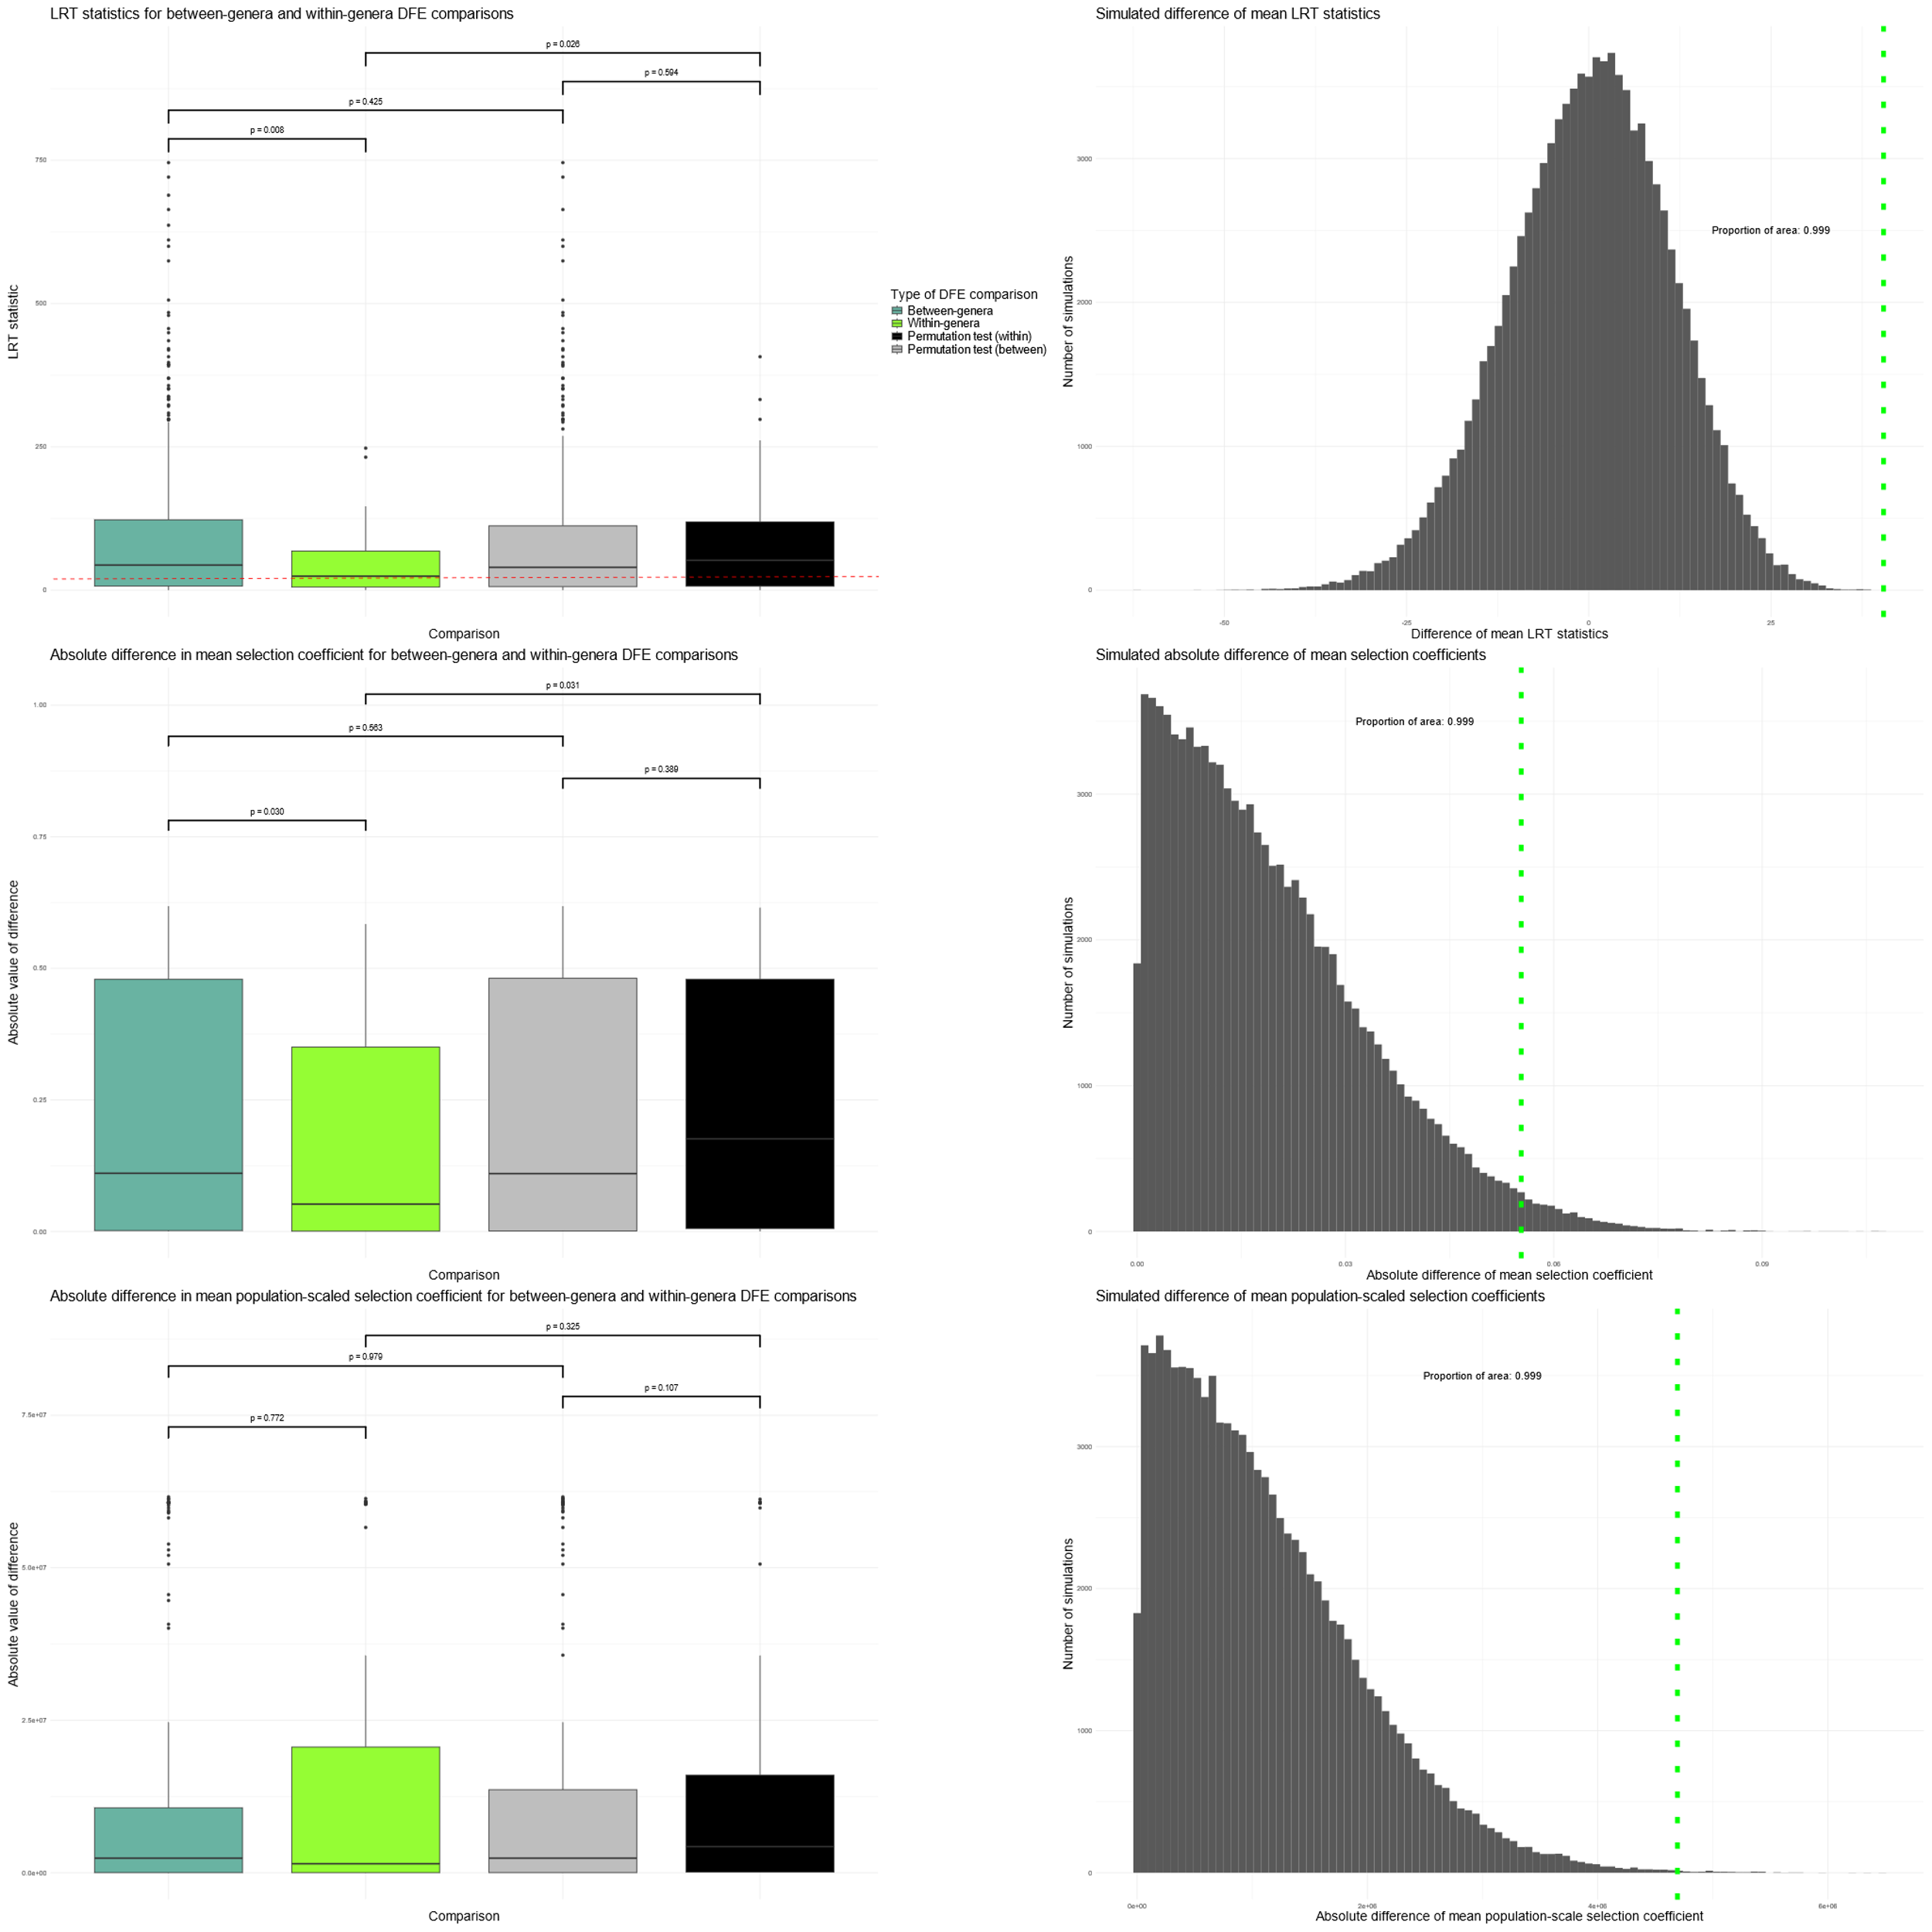
A
D
B
E
C
F

Slide 55
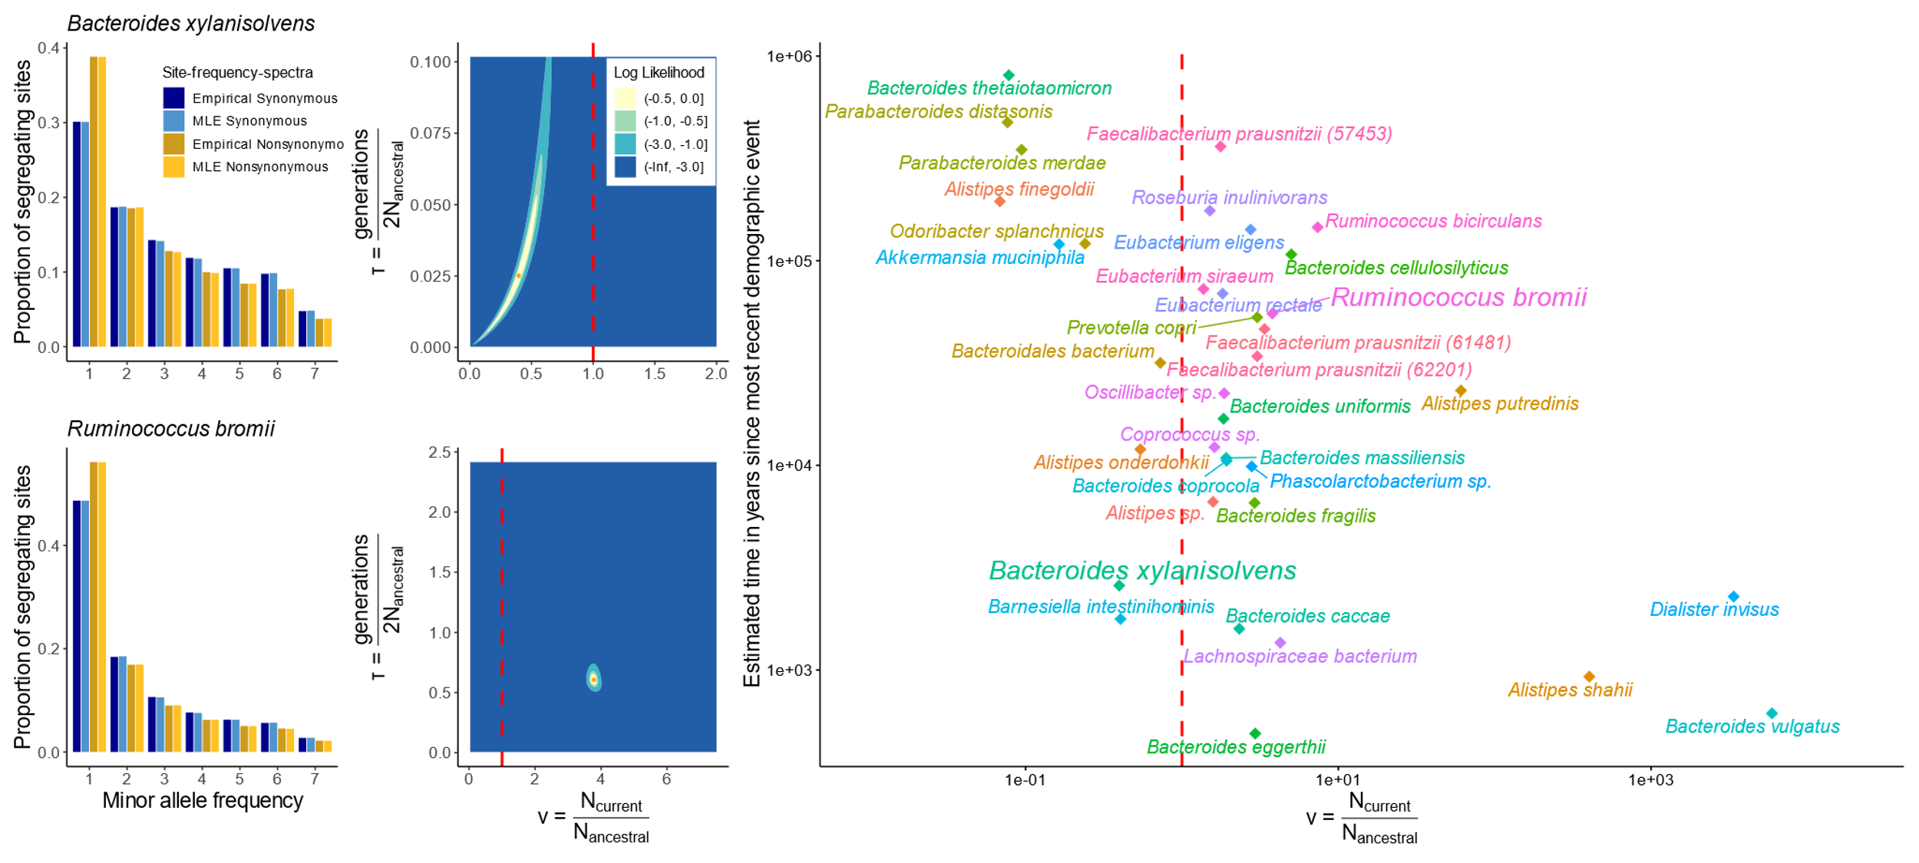
A
C
E
G
~2.2kya
B
D
F
~51.9kya
Notes:
Main text Figure 2

Slide 56
A
Singleton
Doubleton
Tripleton
Host 1
Host 2
Proportion of SNPs
Host 3
…
5
7
Host 14
1
2
3
4
6
Minor allele prevalence
B
One-epoch
Two-epoch
Three-epoch
Time
Present
Constant effective
population size
One instantaneous size change
Two instantaneous size changes

Slide 57
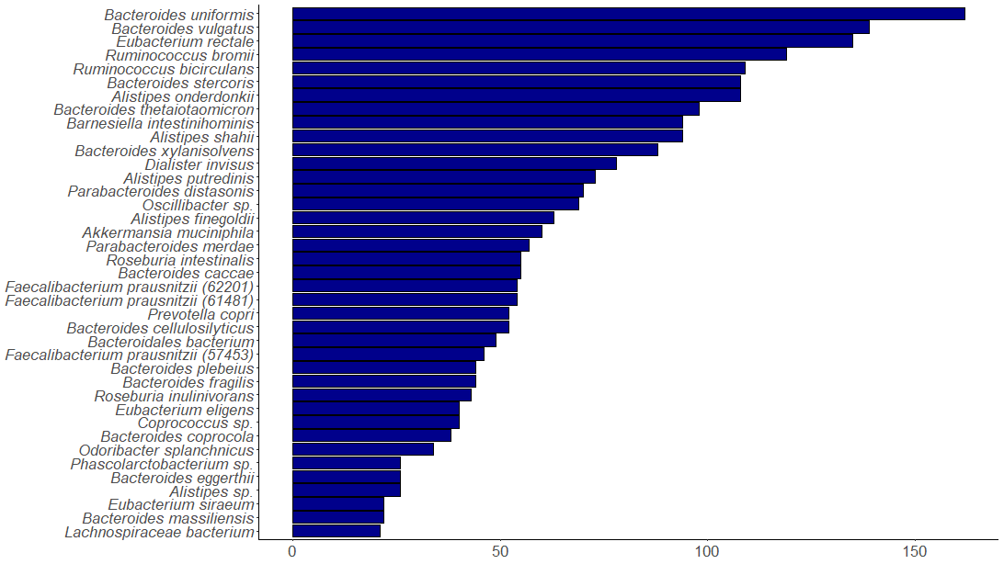
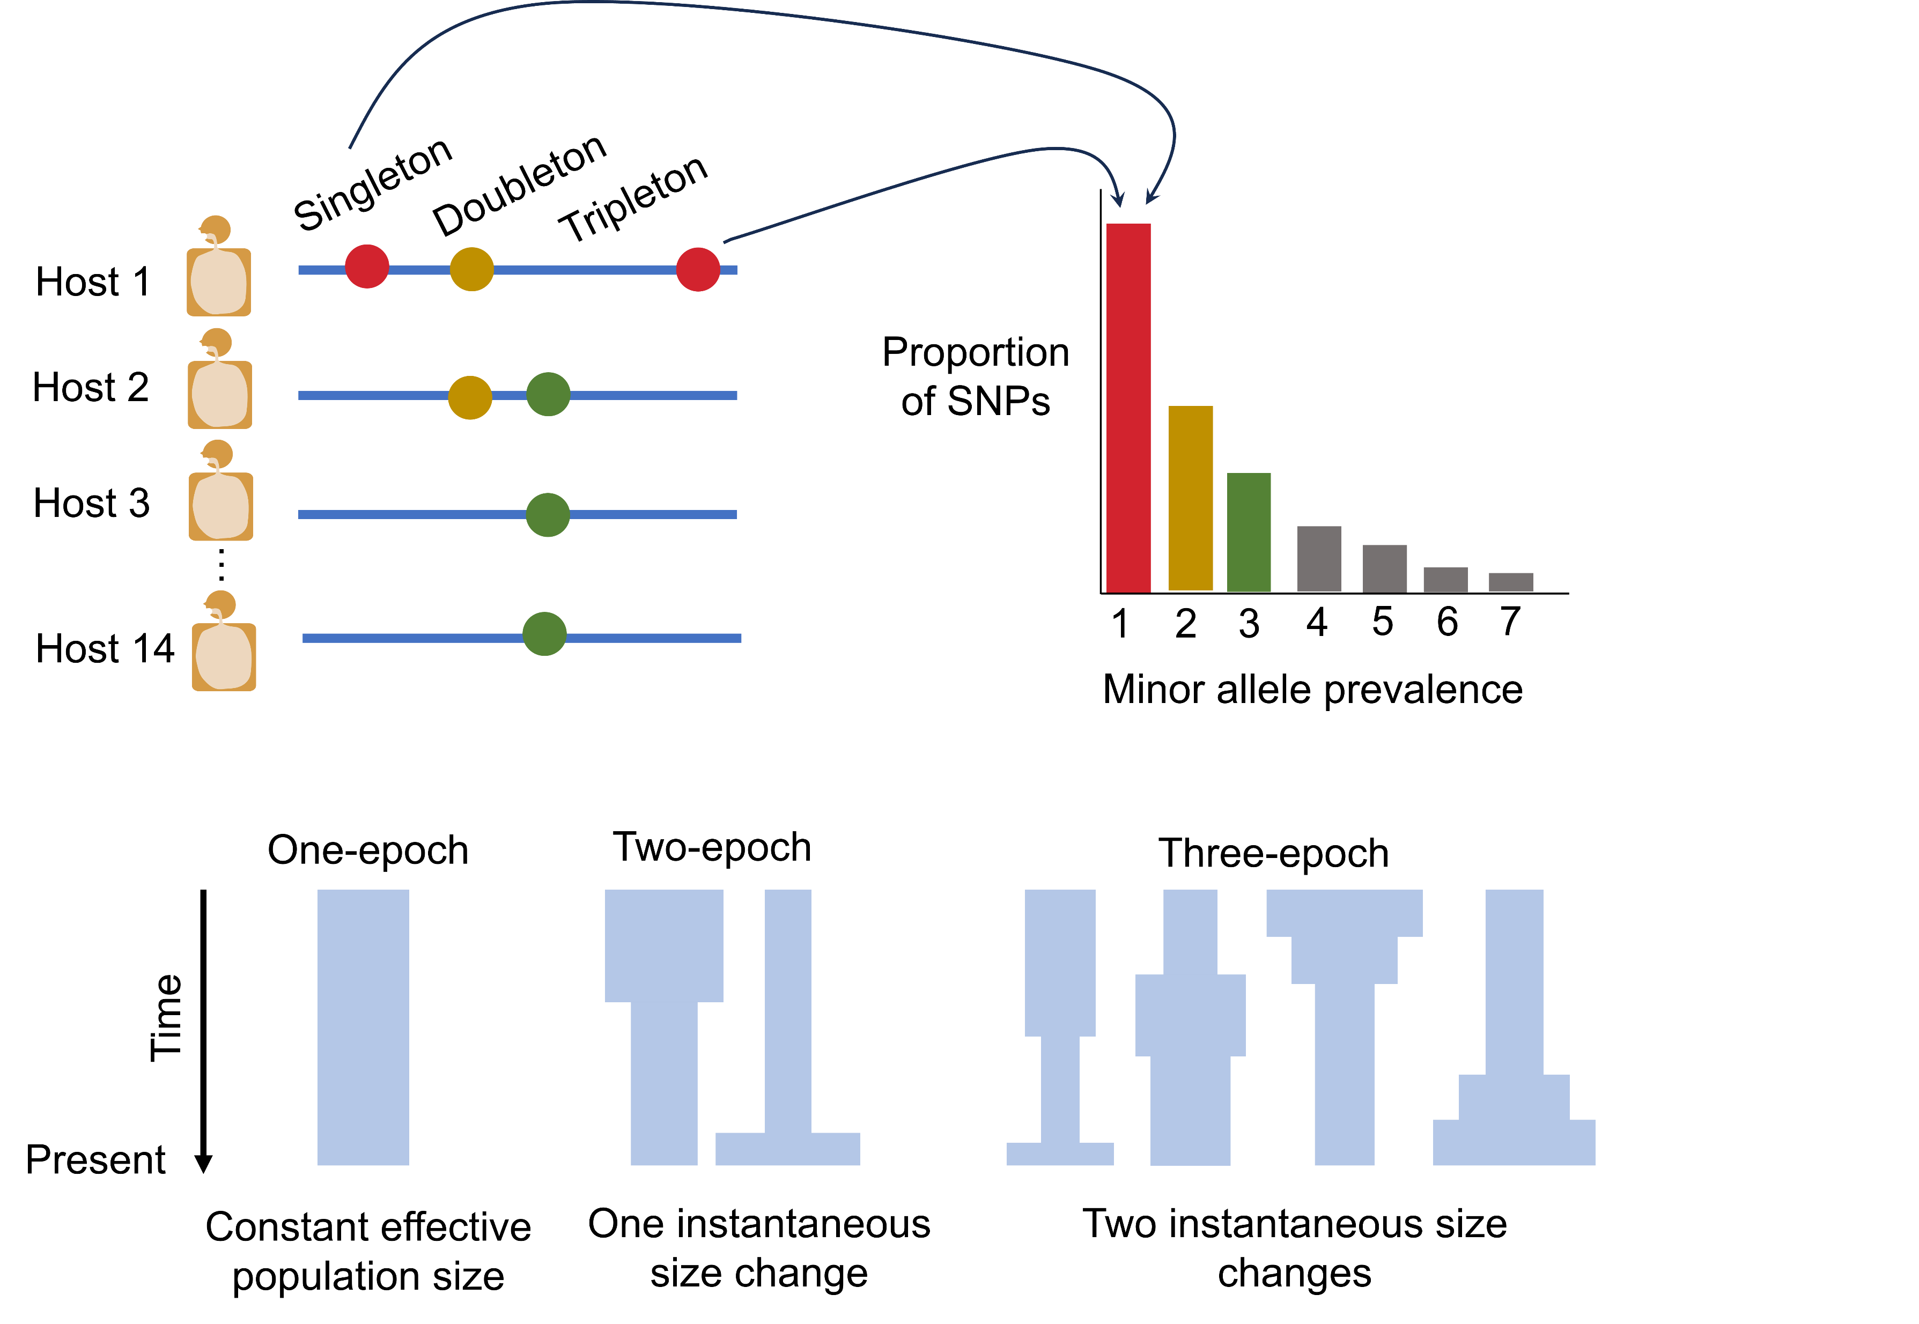
A
Species
Number of QP samples
B
C
Notes:
Main text figure 1

Slide 58
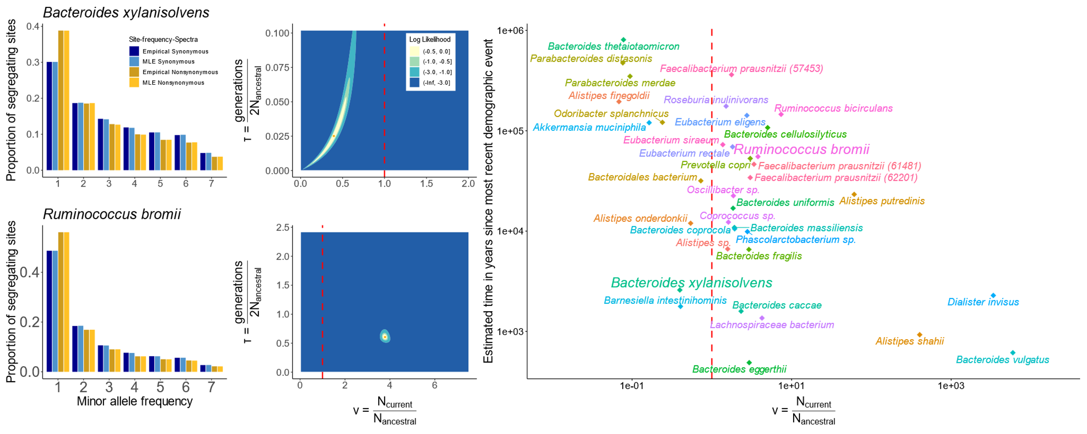
A
C
E
~2.2kya
B
D
F
~51.9kya
G
Notes:
Main text Figure 2

Slide 59


Notes:
Main text Figure 3

Slide 60


A
B
C
D
E
F
Notes:
Main text figure 4

Slide 61

A
C
B
D
Notes:
Main Text Figure 5

Slide 62

Notes:
Figure S1

Slide 63

Notes:
Figure S2

Slide 64

Notes:
Figure S4

Slide 65
Notes:
Figure S5

Slide 66


A
B
Notes:
Supplemental Figure 6

Slide 67
Notes:
Figure S11

Slide 68

Notes:
Figure S11

Slide 69

A
B
C
D
E
F
Notes:
Figure SA

