Slide 1
Optimizing inference on ARGs: coordinate search → CMA-ES
20261002
Jon Mah, PhD
Research Associate @ Chiang Lab
Notes:
Hi all, I’m Jon, a relatively recent hire in Charleston’s group. Today I’ll be talking about some ongoing work concerning inference on ancestral recombination graphs using gLike, a software package output by Caoqi, a prior trainee from Charleston’s group.

Slide 2
Summary
Ancestral Recombination Graphs (ARG)
Notes:
The goal of this project is to estimate demographic parameters from likelihoods defined on ancestral recombination graphs, or ARGs. In summary, given an ARG and a model of population demographic history, we ask: what parameters best explain the observed ancestry? Whatever model parameters fit best to the data are then assumed to represent the underlying biology.

Slide 3
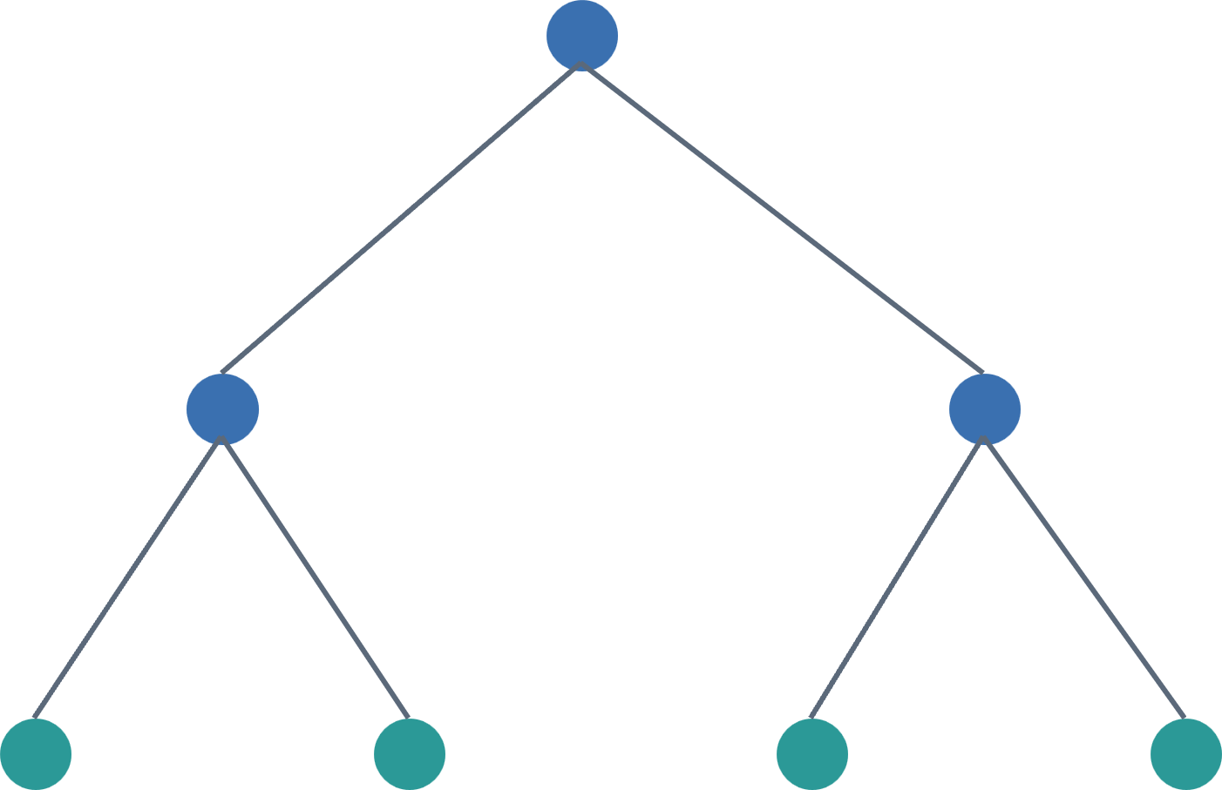
Summary
Ancestral Recombination Graphs (ARG)
Notes:
Here on the left I how a schematic representation of an ARG or ancestral recombination graph, which represents a sampling of ancestry across the genome. Unlike a single phylogenetic tree, genealogies can change as we parse along the genome due to recombination. This makes ARGs particularly useful for demographic inference because their structure contains information about population size changes, migration, admixture, recombination, etc.

Slide 4
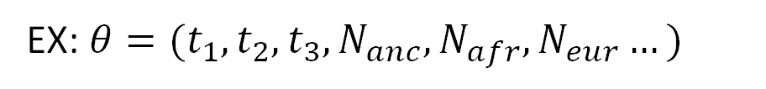
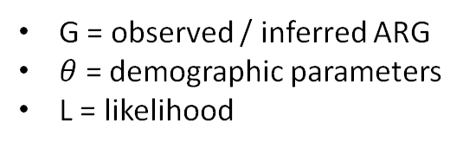
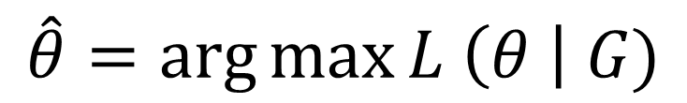
Summary
$$\hat{θ}=\arg{\max{L \left(θ \right| G)}}$$
Ancestral Recombination Graphs (ARG)
G = observed / inferred ARG
$θ$ = demographic parameters
L = likelihood
EX: $θ=(t_{1}, t_{2}, t_{3}, N_{anc}, N_{afr}, N_{eur}…)$
Notes:
Once we have an ARG, the problem becomes about likelihood optimization. Suppose we have some demographic parameter vector, theta, shown here on the right. We want to find the parameterization that maximizes the likelihood of the observed ancestry. The important computational point is that a major challenge to this class of problem is that evaluating this likelihood function can be expensive, and parameter space can be highly coupled. Today, I’ll be focusing specifically on optimization strategy, and some recent work on implementing an alternative model fitting approach known as CMA-ES or a Covariance matrix adaptation evolution strategy.

Slide 5
gLIke Coordinate Search
Param 1
Param 1
Param 2
Param 2
The original gLike Coordinate Search approach relies a set of three candidate parameterizations, jittering each parameter iteratively with an adaptive step size
Notes:
I’d like to first identify the problems that occur for the currently implemented gLike search. The basic strategy is to independently maintain a learning rate for each parameter, and then iteratively jitter each parameter “up” or “down” a step size and evaluating the likelihood while holding all other parameters constant. Successful likelihood improvements in one direction will encourage the search to move 50% faster in that direction, while unsuccessful likelihood improvements will encourage the search to move 50% slower in that direction.

Slide 6
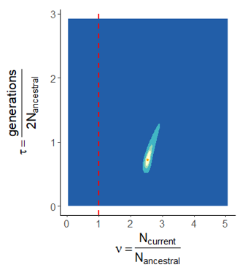
Problem: parameter coupling
Mah, Lohmueller, and Garud MBE 2024
Notes:
One prevalent issue with the currently implemented search in gLike is that parameters are often coupled, such as population size change and time parameters. On the left, I show a simple two-dimensional likelihood surface of a much simpler demographic model in which we find that the likelihood surface has a “ridge”-like affect.

Slide 7
Problem: parameter coupling
Param 1
Param 1
Param 1
Param 2
Param 2
Param 2
Param 1
Param 1
Mah, Lohmueller, and Garud MBE 2024
Param 2
Param 2
Notes:
In practice, this can cause issues with gLike’s currently implemented search method, in which we can iteratively “zig-zag”. Here on the right I show five such iterations where, starting at the black dot, we iterate small changes over parameter 1 and parameter 2 until finally landing at a better parameterization shown as a larger green dot. Note that this is only being demonstrated with a simple two-dimensional likelihood surface – actual models are much more complex and may have even more complex likelihood topology. The underlying assumption of a coordinate search approach is that likelihood progression can be made by exploring one coordinate at a time, when that might not necessarily be the case.

Slide 8
CMA-ES (Covariance matrix adaptation evolution strategy)
Coordinate Search
CMA-ES
Param 1
Param 1
Param 2
Param 2
Iterate each param
Check down() and up()
Save faster() or slower()
Evaluate span of solutions
Compute covariance matrix
Tighten solution space
Notes:
CMA-ES takes a fundamentally different approach. Instead of asking which direction we should move our search at what step size for each individual coordinate, we instead begin by sampling a population of candidate solutions from a multivariate distribution determined by some span of solution space.

Slide 9

CMA-ES (Covariance matrix adaptation evolution strategy)
Coordinate Search
CMA-ES
Param 1
Param 1
Param 2
Param 2
Iterate each param
Check down() and up()
Save faster() or slower()
Evaluate span of solutions
Compute covariance matrix
Tighten solution space
Notes:
The key feature is covariance adaptation. From the sampling of about 30 different candidate solutions in our span of solution space, we calculate a covariance matrix of the local likelihood topology.

Slide 10
CMA-ES (Covariance matrix adaptation evolution strategy)
Coordinate Search
CMA-ES
Param 1
Param 1
Param 1
Param 2
Param 2
Param 2
Iterate each param
Check down() and up()
Save faster() or slower()
Evaluate span of solutions
Compute covariance matrix
Tighten solution space
Notes:
The optimizer is then able to learn correlations between parameters, and choose to rotate or stretch the next search distribution.

Slide 11
CMA-ES Implementation
Original parameters → encode_parameters() → normalized parameters → CMA-ES
Denormalize → decode_parameters() → check parameter validity → calculate likelihood
Notes:
This is the basic workflow of CMA-ES as is currently impelemnted. There are three important modifications to a standard CMA-ES impelentation, being parameter encoding and transformation, parameter scaling, and constrained evaluation.

Slide 12
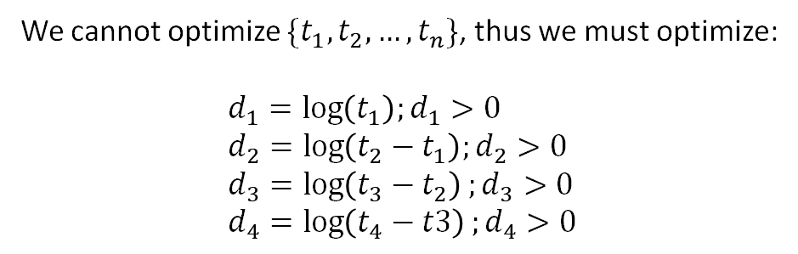

CMA-ES Implementation
Original parameters → encode_parameters() → normalized parameters → CMA-ES
Denormalize → decode_parameters() → check parameter validity → calculate likelihood
We cannot optimize $\{t_{1},t_{2},…, t_{n}\}$, thus we must optimize:
$$d_{1}=\log\left(t_{1}\right);d_{1}>0 \\ d_{2}=\log\left(t_{2}−t_{1}\right);d_{2}>0 \\ d_{3}=\log\left(t_{3}−t_{2}\right);d_{3}>0 \\ d_{4}=\log\left(t_{4}−t3\right);d_{4}>0$$
$$t_{1}=e^{d_{1}};t_{1}>0 \\ t_{2}=e^{d_{1}}+e^{d_{2}};t_{2}>t_{1} \\ t_{3}=e^{d_{2}}+e^{d_{3}};t_{3}>t_{2} \\ t_{4}=e^{d_{3}}+e^{d_{4}};t_{4}>t_{3}$$
Notes:
In ARGs, time parameters are interpreted backwards in time such that t_1 must be less than t_2, and so on and so forth. Importantly, relationships between parameters must be learned from the covariance matrix, thus, we cannot natively optimize time parameters. To address this, we implemented a parameter transformation, encoding, and decoding step.

Slide 13
CMA-ES Implementation
Original parameters → encode_parameters() → normalized parameters → CMA-ES
Denormalize → decode_parameters() → check parameter validity → calculate likelihood
Solution span treats all parameters equally
Param 1
Param 2
Notes:
The second important modification is to normalize the parameters. CMA-ES does not consider parameters differently, and as a result, the span of the solution space essentially treats population size the same as growth rate, which is bad.

Slide 14
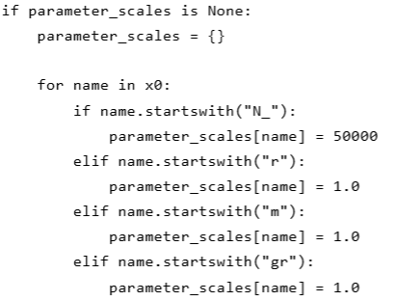
CMA-ES Implementation
Original parameters → encode_parameters() → normalized parameters → CMA-ES
Denormalize → decode_parameters() → check parameter validity → calculate likelihood
Solution span treats all parameters equally
Param 1
Param 2
Notes:
To address this, we allow for users to internally provide a set of parameter rescaling factors such that the normalized parameters are between 0 and 1. If no specific set of factors is provided we scan the names of the parameters and approximate a scale which should normalize the parameter.

Slide 15
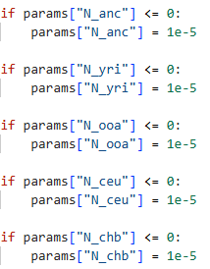
CMA-ES Implementation
Original parameters → encode_parameters() → normalized parameters → CMA-ES
Denormalize → decode_parameters() → check parameter validity → calculate likelihood
Notes:
Lastly, an important consideration is that CMA-ES doesn’t have a lot of support for boundary conditions, because ideally the objective function and the covariance matrix should inform the optimizer of where to go. However, it’s entirely possibly that the span of solution space may capture non-viable parts of the likelihood surface. In this case, we set up a set of parameter validity checks wherein if a parameter escapes the boundaries, then we set it to a soft value close to the boundary.

Slide 16
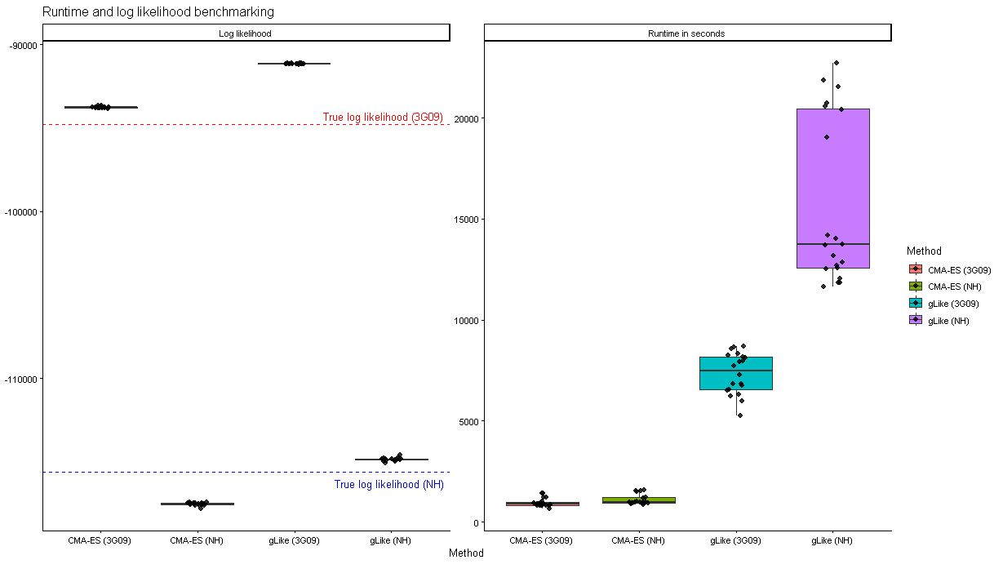
Preliminary results

Slide 17
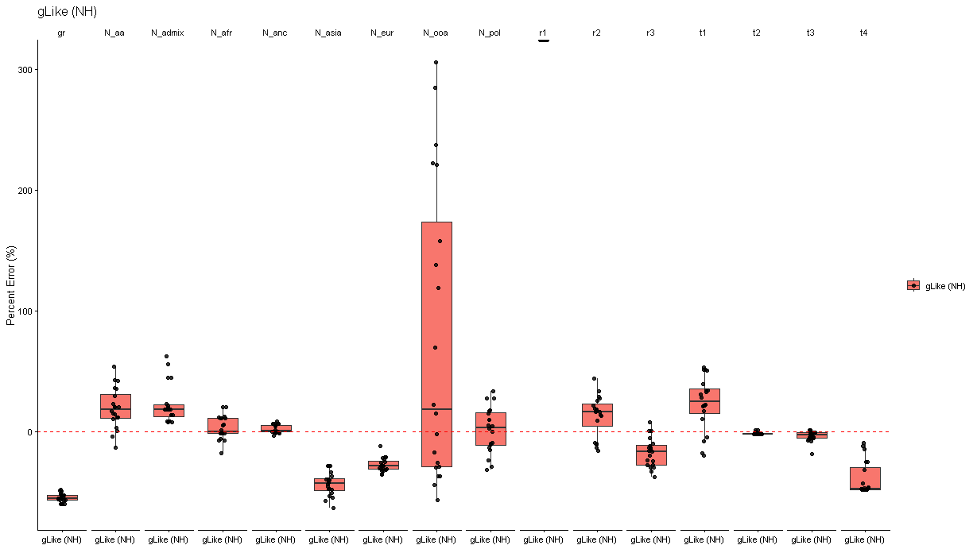
Preliminary results

Slide 18
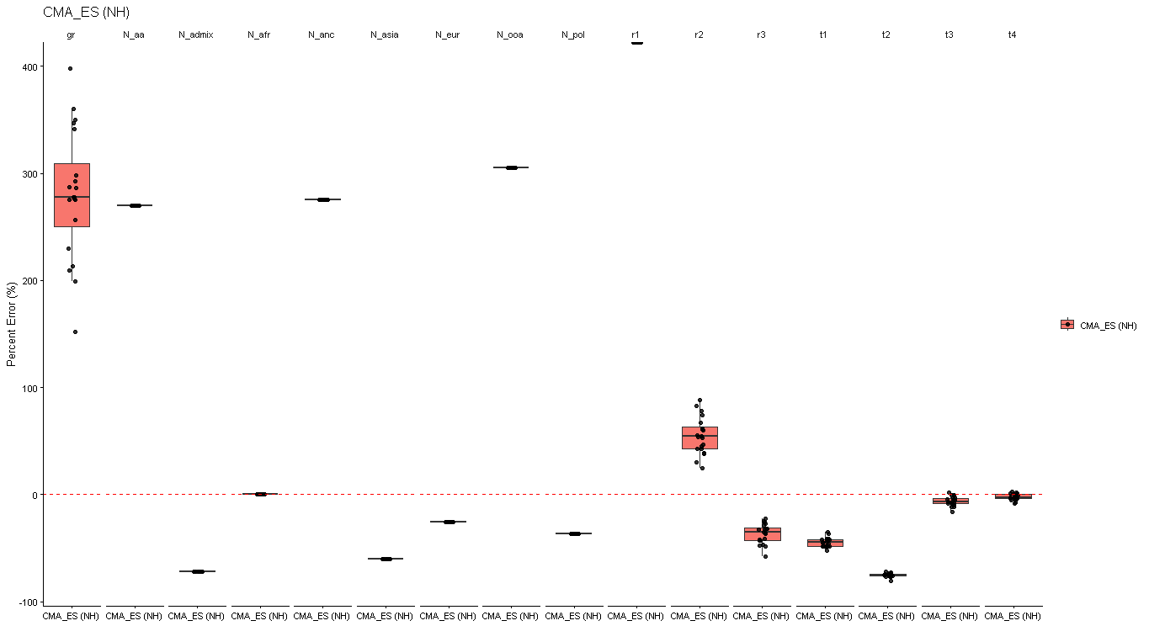
Preliminary results

Slide 19
TODO
Investigate Kappa (solutions considered)
Investigate epoch / generations across methods
Investigate finite trees
Demographic model implementation / robustness

